Slide 1


Slide 2
Agenda
Introduction
Lambda Expressions & Functional Interfaces
Stream API
Collections API Improvements
Concurrency API Improvements
Java IO Improvements

Slide 3
Introduction
“Java Platform, Standard Edition 8 (Java SE 8)” is released on 18th March 2014.
Earlier Java Versions used to have a names like JDK 1.2 (Playground), JDK 1.3( Kestrel), JDK 1.4 (Kerlin), JDK 5 (Tiger), JDK 6( Mustang), JDK 7 (Dolphin).
But from Java 8 release, the code name is discontinued and so no official code name for Java 8.

Slide 4
Lambda Expressions Introduction
Lambda Expressions, a new language feature, has been introduced in Java 8.
Java is a strong object oriented language. Apart from primitive types, everything in java are objects. We need object references to invoke method calls.
Now, think about Java script, we can define functions any where you want, you can assign functions to any variables, and you can pass functions as an input parameters to a method. It is called functional programming language.
As of now, Java don’t support functional programming. But Lambda expressions introducing functional programming to Java.

Slide 5
Lambda Expressions
A lambda expression is an anonymous function.
A function that doesn’t have a name and doesn’t belong to any class
Lambda Expression was first introduced in LISP programming.

Slide 6
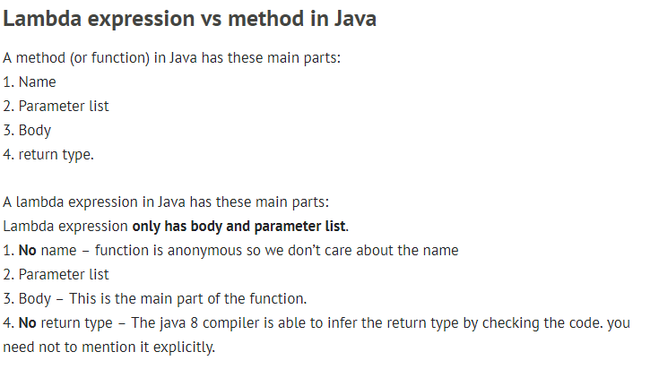

Slide 7
Where to use the Lambdas in Java
To use lambda expression, you need to either create your own functional interface or use the pre defined functional interface provided by Java. An interface with only single abstract method is called functional interface(or Single Abstract method interface),
For example: Runnable, callable, ActionListener etc.
To use function interface: Pre Java 8: We create anonymous inner classes. Post Java 8: You can use lambda expression instead of anonymous inner classes.

Slide 8
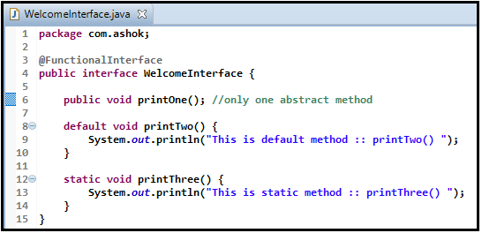
What is Functional Interface ?
An interface with exactly one abstract method is called Functional Interface. @FunctionalInterface annotation is added so that we can mark an interface as functional interface.

Slide 9
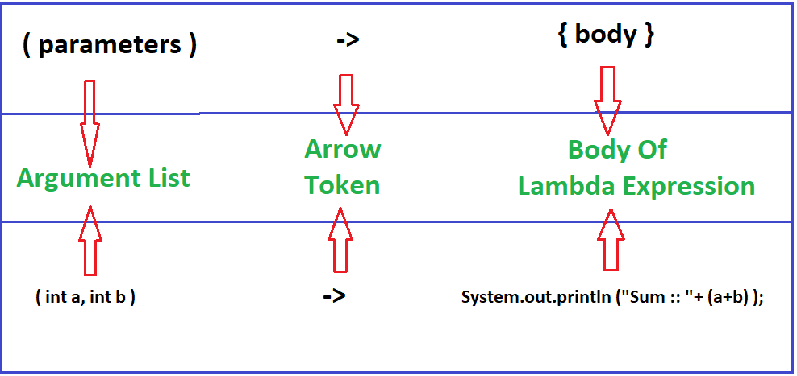
Lambda Expression Syntax

Slide 10
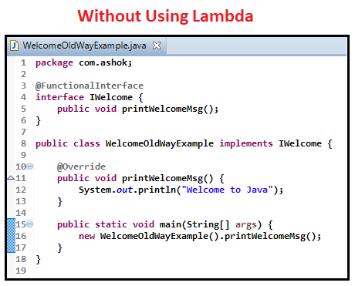
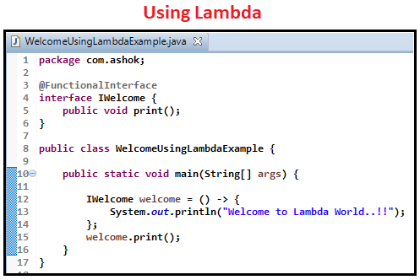
Comparison-1

Slide 11
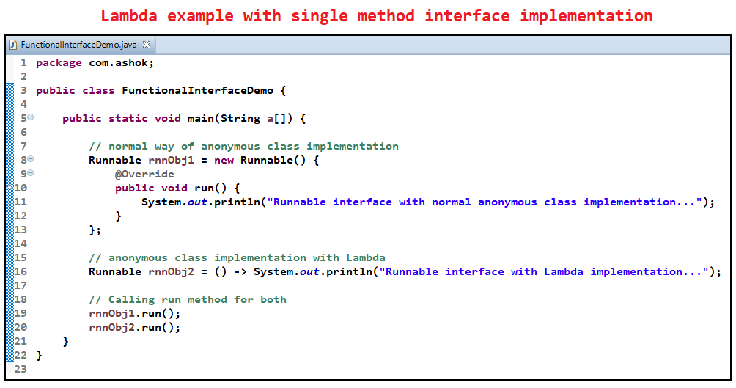

Slide 12
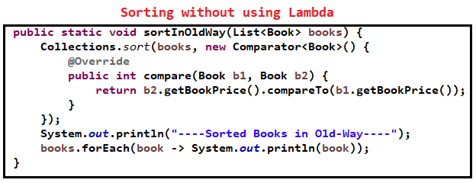
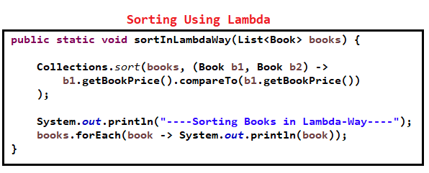
Comparator Example using Lambda

Slide 13
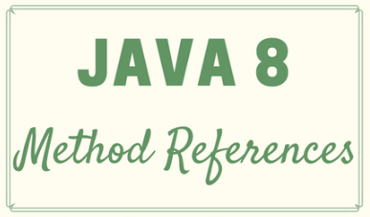

Slide 14
Introduction
Java provides a new feature called method reference in Java 8.
Method reference is used to refer method of functional interface.
It is compact and easy form of lambda expression.
Each time when you are using lambda expression to just referring a method, you can replace your lambda expression with method reference.

Slide 15
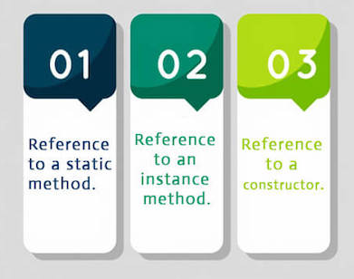
Types of Method References

Slide 16
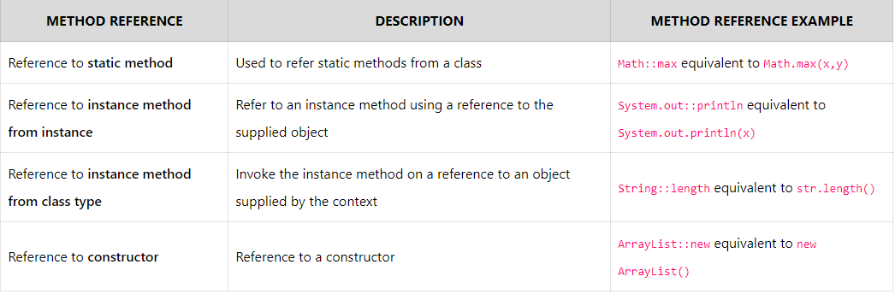

Slide 17
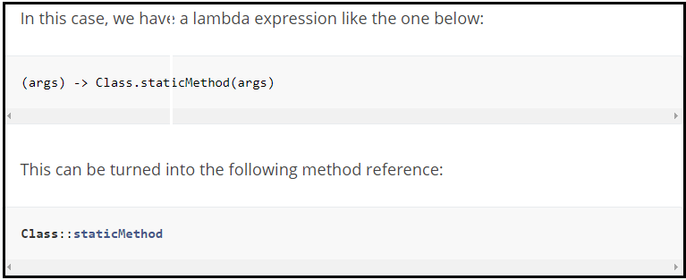
Method reference to static method
We can refer static method using class name
Syntax : ClassName::staticMethodName

Slide 18
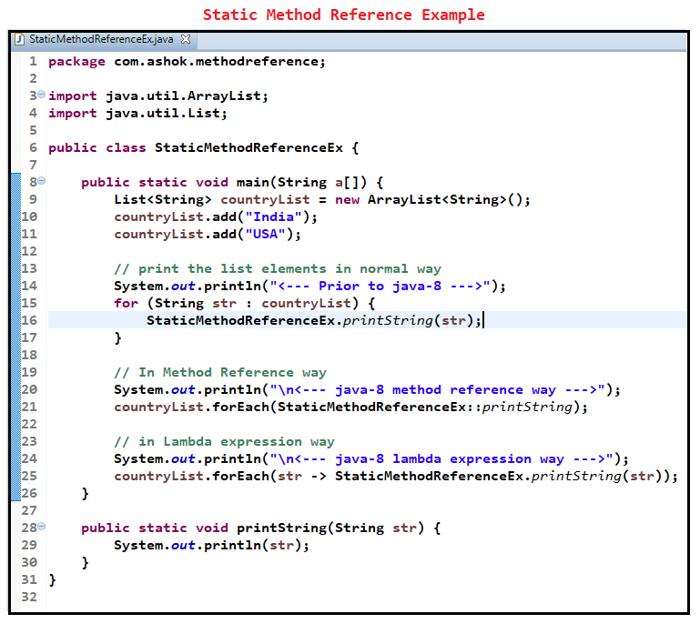

Slide 19
Method Reference to a instance method
We can reference instance methods using instance
Syntax : ClassInstance::instanceMethodName

Slide 20
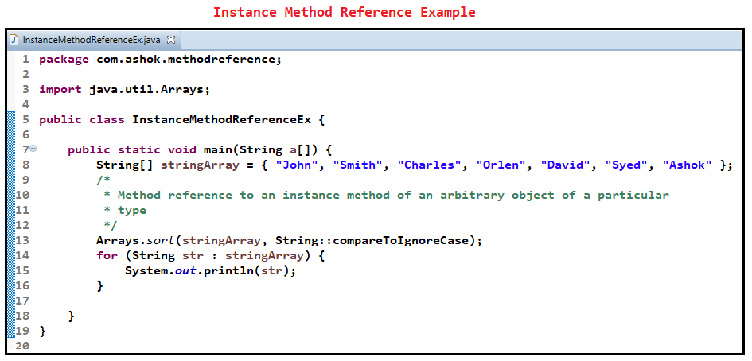

Slide 21
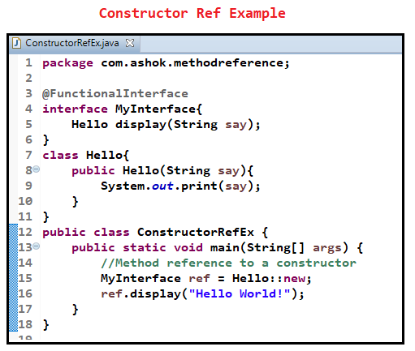

Slide 22
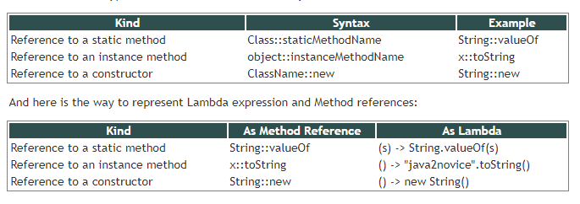

Slide 23
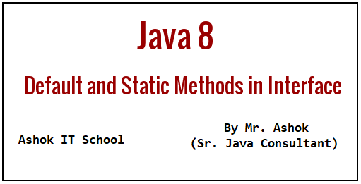

Slide 24
Introduction
Prior to java 8, interface in java can only have abstract methods. All the methods of interfaces are public & abstract by default.
Java 8 allows the interfaces to have default and static methods.
The reason we have default methods in interfaces is to allow the developers to add new methods to the interfaces without affecting the classes that implements these interfaces.

Slide 25
Why default method?
For example, if several classes such as A, B, C and D implements an interface XYZInterface then if we add a new method to the XYZInterface, we have to change the code in all the classes(A, B, C and D) that implements this interface.
In this example we have only four classes that implements the interface which we want to change but imagine if there are hundreds of classes implementing an interface then it would be almost impossible to change the code in all those classes.
This is why in java 8, we have a new concept “default methods”. These methods can be added to any existing interface and we do not need to implement these methods in the implementation classes mandatorily, thus we can add these default methods to existing interfaces without breaking the code.

Slide 26
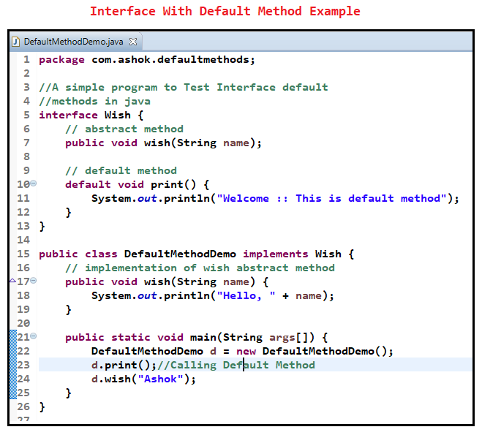

Slide 27
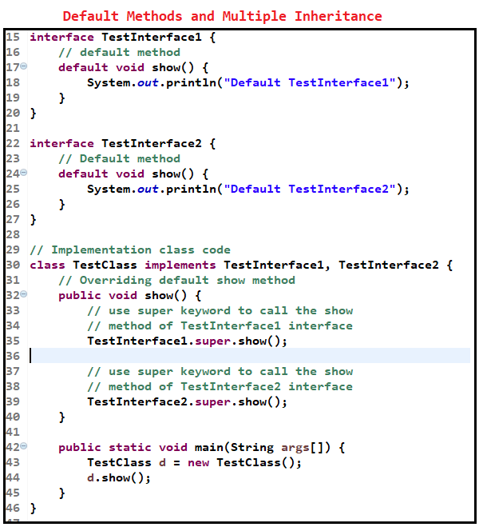

Slide 28
Why Default Methods are Needed ?
The default methods were introduced to provide backward compatibility so that existing intefaces can use the lambda expressions without implementing the methods in the implementation class. Default methods are also known as defender methods or virtual extension methods.

Slide 29
Java 8 – Abstract classes vs interfaces
With the introduction of default methods in interfaces, it seems that the abstract classes are same as interface in java 8. However this is not entirely true, even though we can now have concrete methods(methods with body) in interfaces just like abstract class, this doesn’t mean that they are same. There are still few differences between them, one of them is that abstract class can have constructor while in interfaces we can’t have constructors.
The purpose of interface is to provide full abstraction, while the purpose of abstract class is to provide partial abstraction. This still holds true. The interface is like a blueprint for your class, with the introduction of default methods you can simply say that we can add additional features in the interfaces without affecting the end user classes.

