Slide 1


Slide 2

Introduction
In web applications end users will fill details in form and will submit those forms to server using HTTP Post request.
After form got submitted successfully user can refresh the same form using F5 or he can click on Submit button again.
As a result web forms may end up getting submitted twice to server. This is called as Duplicate Form Submission or Double Posting Problem.

Slide 3
Double posting problem
Pressing refresh button or Clicking on Submit button second time sends one more request to server which gives below side effects.
Duplicate records will be inserted.
Deducting amount from credit/debit card one more time and etc.

Slide 4
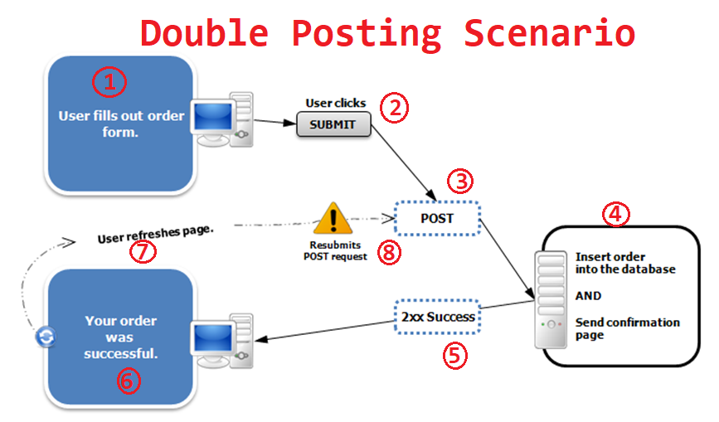

Slide 5
Post-Redirect-Get Pattern
Post/Redirect/Get (PRG) is a web development design pattern that prevents duplicate form submission.
In simple terms, this pattern asks us to follow simple steps mentioned below and get our problem solved.
Submit the form via POST.
Submit the changes in database.
Redirect the user to another page or the same page with optionally displaying the success.

Slide 6
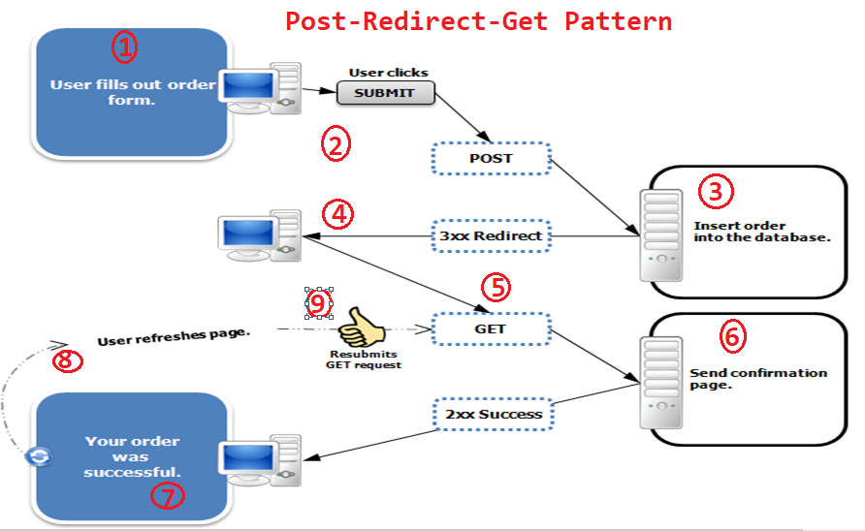

Slide 7
Thankyou..!!
Facebook Group Name : Ashok IT School
Email Id : ashokitschool@gmail.com

