Slide 1
Sentiment Analysis of Reviews on Yelp Dataset
By - Prashant Chhabra, Nathan Mots, Melina Victoria Sparks
Notes:
Say something about yelp(what yelp is?)
Problem - Just say that we are trying to predict sentiment of reviews on yelp on the basis of text of review

Slide 2
Why?
None of us did NLP Before.
Curious to know how efficient NLP is.
Academic dataset challenge is going on.

Slide 3
Dataset Description
Dataset available as dump of json files.
Relevant fields of relevant Json files
Business.json {
'type': 'business',
'business_id': (encrypted business id),
'attributes': {
(attribute_name): (attribute_value),
...
}
Review.json
{
'business_id': (encrypted business id),
'stars': (star rating, rounded to half-stars),
'text': (review text),
}
Notes:
Just say a little about the attributes of json file. ‘attributes’ attribute specified the type of business like restaurants, nightclub, etc.
Example of reviews.json tuple[ This is one Tuple only]
{"votes": {"funny": 0, "useful": 2, "cool": 1}, "user_id": "Xqd0DzHaiyRqVH3WRG7hzg", "review_id": "15SdjuK7DmYqUAj6rjGowg", "stars": 5, "date": "2007-05-17", "text": "dr. goldberg offers everything i look for in a general practitioner. he's nice and easy to talk to without being patronizing; he's always on time in seeing his patients; he's affiliated with a top-notch hospital (nyu) which my parents have explained to me is very important in case something happens and you need surgery; and you can get referrals to see specialists without having to see him first. really, what more do you need? i'm sitting here trying to think of any complaints i have about him, but i'm really drawing a blank.", "type": "review", "business_id": "vcNAWiLM4dR7D2nwwJ7nCA"}
Example of business.json tuple[ This is one Tuple only]
{"business_id": "vcNAWiLM4dR7D2nwwJ7nCA", "full_address": "4840 E Indian School Rd\nSte 101\nPhoenix, AZ 85018", "hours": {"Tuesday": {"close": "17:00", "open": "08:00"}, "Friday": {"close": "17:00", "open": "08:00"}, "Monday": {"close": "17:00", "open": "08:00"}, "Wednesday": {"close": "17:00", "open": "08:00"}, "Thursday": {"close": "17:00", "open": "08:00"}}, "open": true, "categories": ["Doctors", "Health & Medical"], "city": "Phoenix", "review_count": 9, "name": "Eric Goldberg, MD", "neighborhoods": [], "longitude": -111.98375799999999, "state": "AZ", "stars": 3.5, "latitude": 33.499313000000001, "attributes": {"By Appointment Only": true}, "type": "business"}

Slide 4




Data Preprocessing
Notes:
Data collection was trivial as it was available as json dump on yelp website
Sql queries were used to remove unnecessary columns, extract 1 star and 5 star reviews of only restaurants, do some data cleaning like replacing , “ \n \r with just spaces. This preprocessing was done with MySQL because dataset was huge which made it difficult to do processing on json directly. Also because of our familiarity with sql. We selected reviews of only restaurants so that we have similar tuples. We selected same number of 1 start and 5 star reviews to avoid any bias.

Slide 5
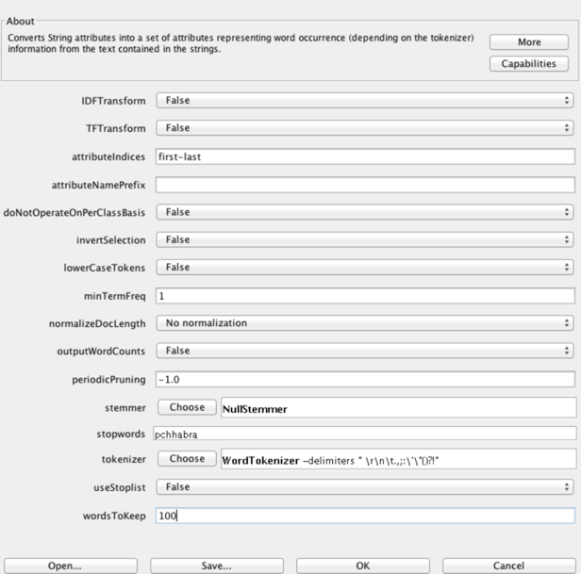
Data Preprocessing contd.(Weka)
String to word vector(Converts String to attributes representing word occurrence). Tried with default settings.

Slide 6
Classification
Try Algorithms with 5 fold cross Validation.
Naive Bayes - 72.32%
2. Multinomial Naive Bayes - 80.52%
3. K Nearest Neighbor(5) - 73.16%
4. J48 (Decision Tree) - 76.86%
5. Random Forest - 82.89%
6. Support Vector Machine - 83.79%
Notes:
Say that Naive Bayes and Multinomial Naive Bayes was very fast.
Random forest and SMO were slow
Random forest tried with 20 features and 100 trees
Multinomial Naive Bayes gave best balance of speed and accuracy

Slide 7
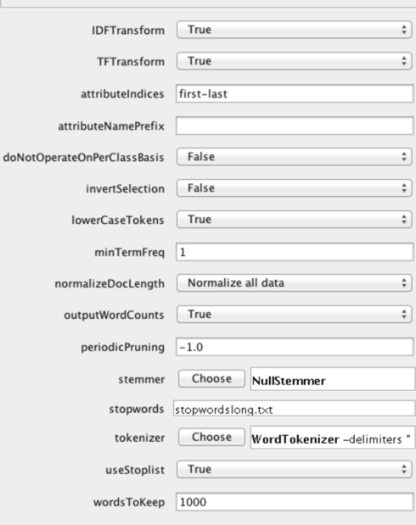
Play around with String to word Vector
94.64% Accuracy
Notes:
Talk about some interesting observation -
Some stemming algorithms decreased accuracy. I noticed that words which are incorrect according to dictionary were used. Example - anyon, anyth
n-gram tokenizer and alphabetic tokenizer also decreased accuracy

Slide 8
LingPipe Java Library

Slide 9
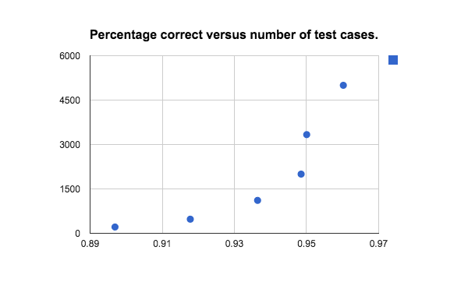
Notes:
2-5000-5000-0.9602
3-6666-3334-0.9500450045
5-8000-2000-0.9485
9-8888-1112-0.9364311431
21-9523-477-0.9177780111
47-9787-213-0.8969040564

Slide 10
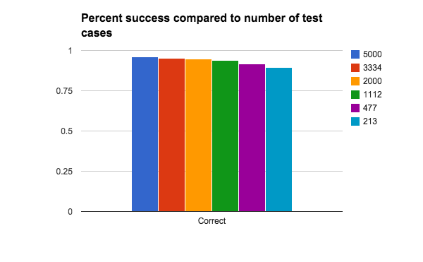
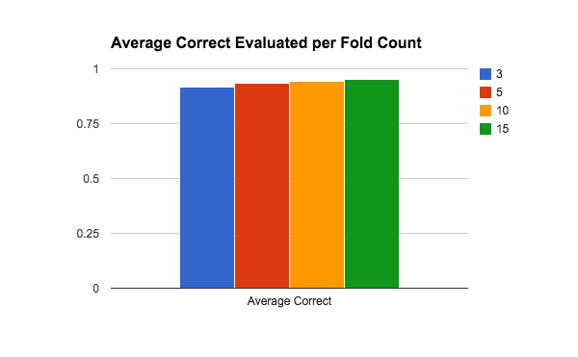
Notes:
3 0.9171
5 0.9352
10 0.943
15 0.9498

Slide 11
Questions?

