Slide 1


Autonomous Remediation Pipeline
Automated systems for efficient problem resolution
Notes:
AI-generated content may be incorrect. ---

Slide 2
Autonomous Remediation Pipeline
Notes:
End-to-End Flow Overview, Detection with Prometheus, Orchestration and RCA via Concert and Instana, Change Management Through GitOps, Continuous Delivery with Argo CD, Environment Stabilization with Kubernetes, Visual Architecture Flow

Slide 3
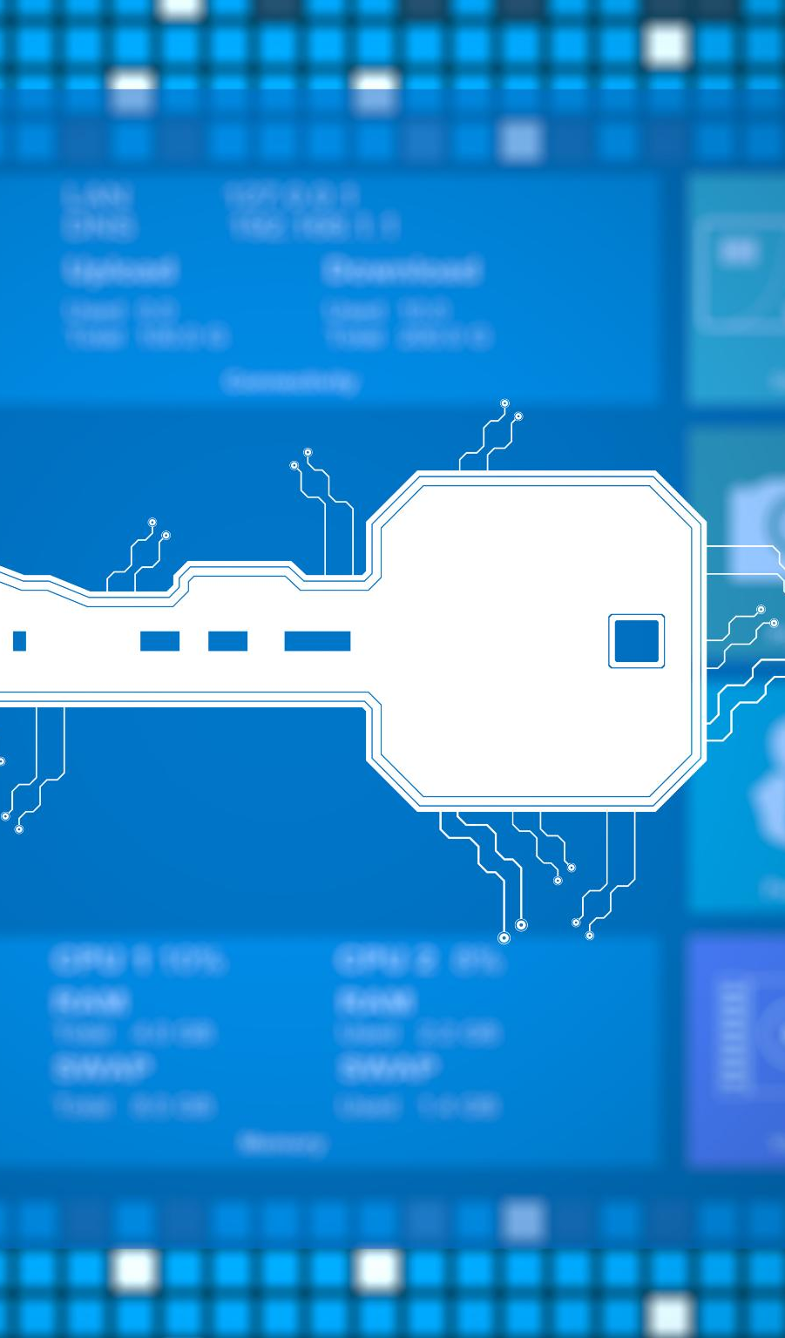
Problem Statement
Modern AIOps solutions promise autonomous operations and faster incident resolution.
However, many implementations introduce black-box automation, limited transparency, and reduced operational sovereignty.
Infrastructure changes triggered directly by AI systems can bypass established engineering workflows, making them hard to validate, difficult to audit, and risky in regulated environments.
Organizations therefore face a dilemma:
They want the benefits of AI-driven operations, but must still ensure governance, compliance, vendor independence, and deterministic platform behavior.
A new operating model is required — one that combines AI-driven intelligence with controlled, auditable execution.
Notes:
This slide provides a comprehensive overview of an autonomous remediation pipeline designed to identify, analyze, and resolve system issues without manual intervention. The flow begins with Prometheus, an industry-standard monitoring system that continuously evaluates service health using metrics-based alerting rules. When a threshold is breached—such as elevated latency, increased error rates, or resource saturation—Prometheus generates an alert enriched with contextual labels. This alert is then handed off to Concert, which orchestrates the first level of response by selecting and executing appropriate remediation workflows. Instana enhances this process by analyzing real-time traces, metrics, and distributed service dependencies to surface intelligent root-cause suggestions. These insights guide remediation decisions and reduce mean time to resolution. Once the remediation workflow determines the required fix, the change is formalized through a GitOps workflow, where patches are created, peer-reviewed, validated, and merged. Git becomes the authoritative source of truth, ensuring traceability and governance. Argo CD continuously monitors the Git repository, detects desired state changes, and deploys them automatically to the Kubernetes environment. Kubernetes then concludes the pipeline by stabilizing the environment through reconciliation loops and its self‑healing capabilities. This end‑to‑end process ensures safe, automated, and auditable remediation of operational issues across cloud‑native systems.

Slide 4
High-Level Operating Model
GitOps as the Execution Backbone
GitOps is an operating model where all platform and infrastructure changes are defined, reviewed, and versioned in Git before they are applied to runtime environments.
Instead of manual interventions or direct automation, a reconciliation engine continuously ensures that the actual system state matches the desired state stored in Git.
This creates a deterministic and fully auditable change process, enabling safe automation, rollback capability, and clear ownership of operational decisions.
By positioning GitOps as the execution backbone, AI-driven insights can be translated into controlled change proposals rather than uncontrolled system actions, ensuring transparency, governance, and operational sovereignty.
Notes:
This slide provides a comprehensive overview of an autonomous remediation pipeline designed to identify, analyze, and resolve system issues without manual intervention. The flow begins with Prometheus, an industry-standard monitoring system that continuously evaluates service health using metrics-based alerting rules. When a threshold is breached—such as elevated latency, increased error rates, or resource saturation—Prometheus generates an alert enriched with contextual labels. This alert is then handed off to Concert, which orchestrates the first level of response by selecting and executing appropriate remediation workflows. Instana enhances this process by analyzing real-time traces, metrics, and distributed service dependencies to surface intelligent root-cause suggestions. These insights guide remediation decisions and reduce mean time to resolution. Once the remediation workflow determines the required fix, the change is formalized through a GitOps workflow, where patches are created, peer-reviewed, validated, and merged. Git becomes the authoritative source of truth, ensuring traceability and governance. Argo CD continuously monitors the Git repository, detects desired state changes, and deploys them automatically to the Kubernetes environment. Kubernetes then concludes the pipeline by stabilizing the environment through reconciliation loops and its self‑healing capabilities. This end‑to‑end process ensures safe, automated, and auditable remediation of operational issues across cloud‑native systems.

Slide 5
End-to-End Flow Overview
Monitoring and Alerting
AI-driven observability platforms such as IBM Instana continuously analyze runtime signals and identify service degradation, risk patterns, and optimization opportunities.
Instana can leverage existing Prometheus-based monitoring landscapes, ingesting and contextualizing already available metrics without requiring a disruptive replacement of the current observability stack.
Root Cause Analysis
Based on this contextual insight, IBM Concert acts as the decision layer, evaluating compliant remediation actions and generating structured change intents instead of directly modifying infrastructure.
Automated Response Orchestration
These proposed changes are translated into version-controlled configuration updates in Git, where they pass existing engineering workflows such as policy validation, peer review, and automated testing.
Finally, the GitOps controller (e.g., Argo CD) deterministically reconciles the approved desired state into the runtime environment, ensuring controlled automation, full auditability, and operational sovereignty.
Notes:
This slide provides a comprehensive overview of an autonomous remediation pipeline designed to identify, analyze, and resolve system issues without manual intervention. The flow begins with Prometheus, an industry-standard monitoring system that continuously evaluates service health using metrics-based alerting rules. When a threshold is breached—such as elevated latency, increased error rates, or resource saturation—Prometheus generates an alert enriched with contextual labels. This alert is then handed off to Concert, which orchestrates the first level of response by selecting and executing appropriate remediation workflows. Instana enhances this process by analyzing real-time traces, metrics, and distributed service dependencies to surface intelligent root-cause suggestions. These insights guide remediation decisions and reduce mean time to resolution. Once the remediation workflow determines the required fix, the change is formalized through a GitOps workflow, where patches are created, peer-reviewed, validated, and merged. Git becomes the authoritative source of truth, ensuring traceability and governance. Argo CD continuously monitors the Git repository, detects desired state changes, and deploys them automatically to the Kubernetes environment. Kubernetes then concludes the pipeline by stabilizing the environment through reconciliation loops and its self‑healing capabilities. This end‑to‑end process ensures safe, automated, and auditable remediation of operational issues across cloud‑native systems.

Slide 6
Detection with Prometheus
Continuous Metrics Evaluation
Prometheus continuously monitors application and infrastructure metrics using custom alerting rules.
Threshold-Based Alerting
Alerts are triggered when metrics exceed defined thresholds, ensuring timely anomaly detection.
Contextual Alert Forwarding
Alerts include detailed labels and annotations to aid automated downstream processing and remediation.
Notes:
Prometheus initiates the remediation pipeline by serving as the primary detection system. It continuously evaluates application and infrastructure metrics through user‑defined alerting rules. These may measure service-level indicators such as request throughput, error ratios, CPU saturation, or latency percentiles. When a condition meets or exceeds a defined threshold, Prometheus fires an alert and forwards it to the configured Alertmanager routes. These alerts include labels and annotations that provide key context—such as affected services, failure types, and severity levels—which downstream tools rely on for automated processing. This mechanism ensures prompt detection of anomalies and forms the backbone of the autonomous remediation workflow.

Slide 7
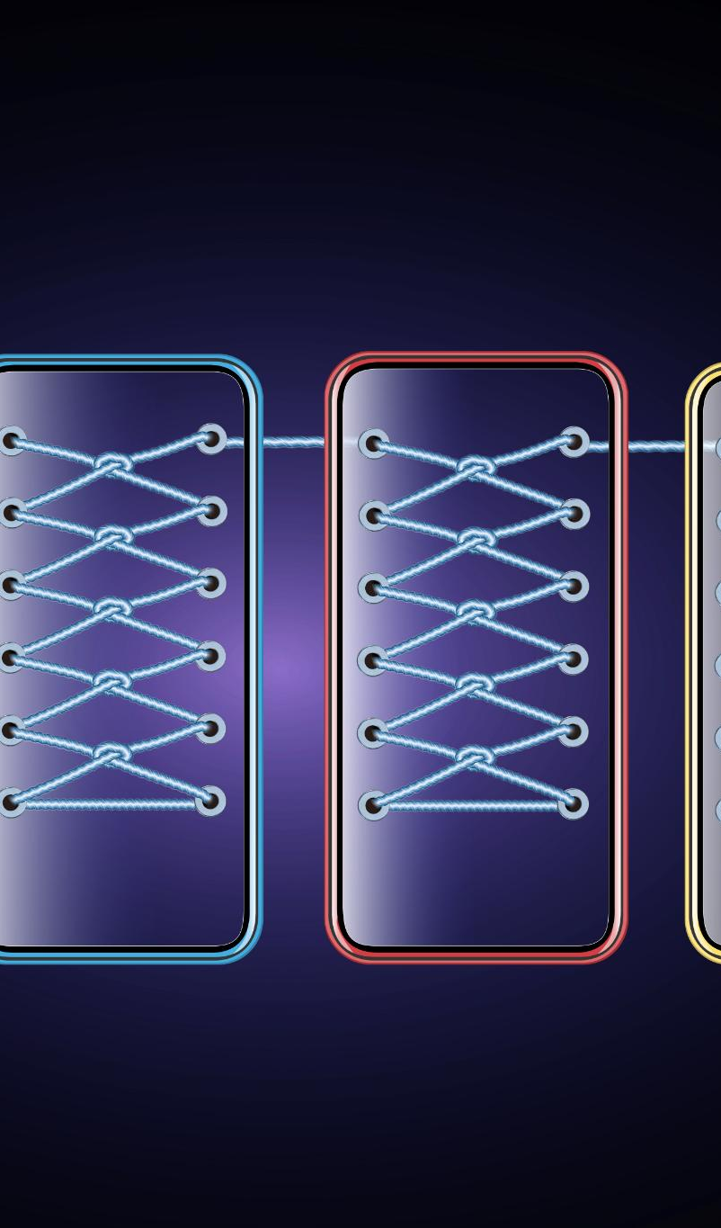
Orchestration and RCA via Concert and Instana
Orchestration Engine Role
Concert acts as the orchestration engine that triggers remediation workflows after receiving alerts from monitoring systems.
Remediation Workflows
Workflows include diagnostics, safety checks, and corrective actions following predefined runbooks to ensure safety and consistency.
Root Cause Analysis Insights
Instana provides intelligent root-cause analysis by correlating traces, telemetry, and topology to pinpoint failure sources.
Enhanced Incident Response
Combined, Concert and Instana accelerate incident response and reduce operational overhead with real-time analytics and automation.
Notes:
Concert serves as the orchestration engine that receives alerts from Prometheus and triggers appropriate remediation workflows. These workflows may include diagnostic commands, safety checks, or targeted corrective actions. Concert ensures that each remediation step follows predefined runbooks to maintain consistency and safety across environments. Instana complements this stage by providing deep insights through intelligent root-cause analysis. It correlates distributed traces, telemetry data, and service topology to identify the most probable sources of failure. Its real‑time analytics reduce noise and highlight actionable insights, allowing Concert to drive more precise and effective automated remediation. Together, Concert and Instana significantly accelerate incident response and reduce operational overhead.

Slide 8
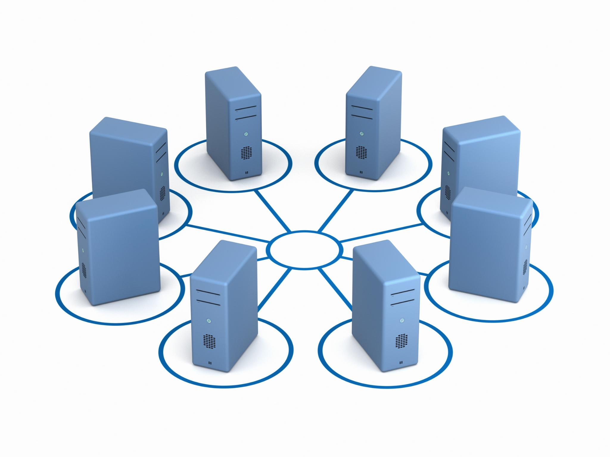
Change Management Through GitOps
Structured Change Management
GitOps applies structured and auditable change management by using version control for infrastructure and application changes.
Automated Validation and Testing
Changes undergo CI workflows, policy checks, automated testing, and peer review before approval to ensure quality and compliance.
Traceability and Rollback
Centralizing changes in Git provides full historical visibility and enables quick rollback to previous stable states when needed.
Notes:
GitOps introduces structured, auditable change management into the remediation process. After identifying the required fix, the system generates a patch or pull request against infrastructure‑as‑code or application manifests stored in version control. This ensures that all modifications are reviewed through established CI workflows, policy checks, automated testing, and peer validation. Once approved, the merge commit becomes the canonical desired state for the environment. This approach guarantees traceability, security, and compliance while providing a consistent mechanism for automated remediation. By centralizing all changes in Git, teams gain full historical visibility and the ability to roll back quickly when necessary.

Slide 9
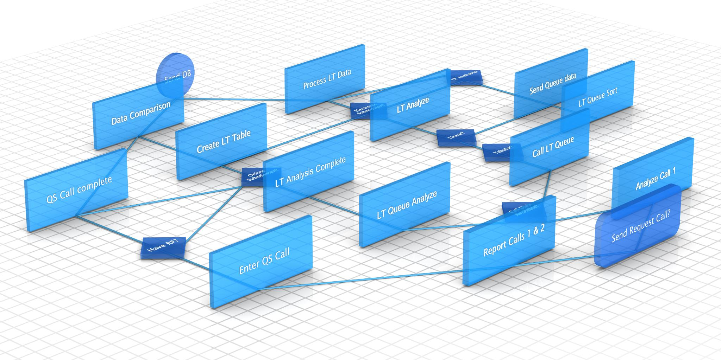
Continuous Delivery with Argo CD
Git and Runtime Bridge
Argo CD automates continuous delivery by linking Git repositories with live Kubernetes environments.
State Monitoring and Sync
It monitors desired state changes and syncs the cluster to ensure configuration accuracy.
Health Verification and Rollback
Argo CD checks application health after deployment and can automatically roll back if needed.
Notes:
Argo CD plays a central role in bridging Git and the runtime environment through continuous delivery automation. It continuously monitors the Git repository for changes to the declared state and compares them to the live cluster configuration. When it detects a drift—or identifies new changes introduced by a merged patch—it initiates a synchronization process to apply the desired state to the Kubernetes cluster. Argo CD verifies application health post‑deployment, enforces sync policies, and can roll back changes automatically if service-level objectives are violated. This ensures safe, predictable, and repeatable delivery of remediation‑driven updates.

Slide 10

Environment Stabilization with Kubernetes
Autonomous Remediation Loop
Kubernetes continuously enforces the declared state to maintain operational stability and close the remediation loop.
Self-Healing Mechanism
It restarts failed containers and reschedules workloads on healthy nodes to ensure service reliability.
Dynamic Resource Scaling
Kubernetes adjusts resources via horizontal and cluster autoscaling to minimize downtime and optimize performance.
Continuous Reconciliation
Controllers reconcile actual resource states against desired configurations defined in Git repositories.
Notes:
Kubernetes closes the autonomous remediation loop by enforcing the declared state and ensuring operational stability. Its controllers continuously reconcile actual resource states—such as deployments, pods, and services—against the desired configuration defined in Git. Kubernetes provides built‑in self‑healing by restarting failed containers, rescheduling workloads on healthy nodes, and automatically adjusting resources through horizontal or cluster autoscaling. These mechanisms help maintain service reliability and minimize downtime after automated fixes are deployed. Through reconciliation and healing loops, Kubernetes ensures that the environment remains stable, resilient, and aligned with the intended operational state.

Slide 11

Visual Architecture Flow
Detection and Alert Generation
Prometheus initiates the process by detecting issues and generating alerts to trigger remediation workflows.
Workflow Orchestration
Concert orchestrates the remediation workflows, coordinating tasks to handle alerts efficiently and effectively.
Root Cause Intelligence
Instana provides insights and root-cause analysis to improve decision-making in the remediation process.
Automated Deployment and Stabilization
GitOps and Argo CD automate patching, validation, deployment, and Kubernetes ensures system stability and self-healing.
Notes:
The visual architecture slide depicts the entire automated remediation process as a sequential flow. It begins with Prometheus at the top, representing detection and alert generation. A connector arrow leads to Concert, symbolizing workflow orchestration. Instana follows, providing root‑cause intelligence that enhances the remediation workflow's decision‑making capability. The next stage in the diagram illustrates GitOps, where patches are created, reviewed, validated, and merged into the repository. Another arrow directs to Argo CD, highlighting its role in detecting changes and deploying updates automatically. The final component in the diagram is Kubernetes, which stabilizes the environment through reconciliation and self‑healing. Together, the diagram effectively conveys how each component integrates to support a fully automated detection‑to‑remediation pipeline.

