Slide 1
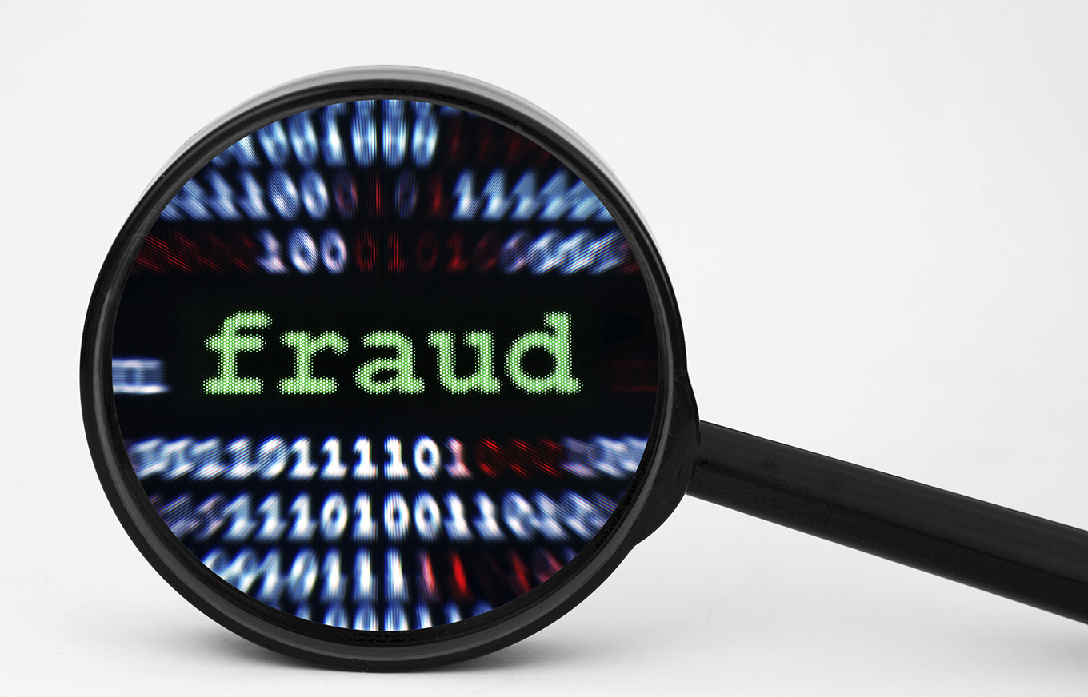
Credit Card Fraud Detection

Slide 2
Overview
Why Credit Card Fraud Matters :-
Medium of 70% of transactions
FTC estimated victims - 10 million
$50 billion loss
Project Overview :-
SSDI concepts, Developed Model
Kaggle dataset, Python (tenserflow, numpy, pandas, sklearn), QDA & LDA to analyze algorithmic performance
5 modules

Slide 3
Programming Language & Data Description
Python-
Large collection of libraries (Tensorflow, Pandas, numpy)
Popular and professional
Dataset-
Contains the transaction made in two days
Contains numerical input variables which are result of a PCA transformation
Two features are important- Amount and Class

Slide 4
Approach
Agile Methodology
Bi weekly Meetings
Remote teams
Code first

Slide 5
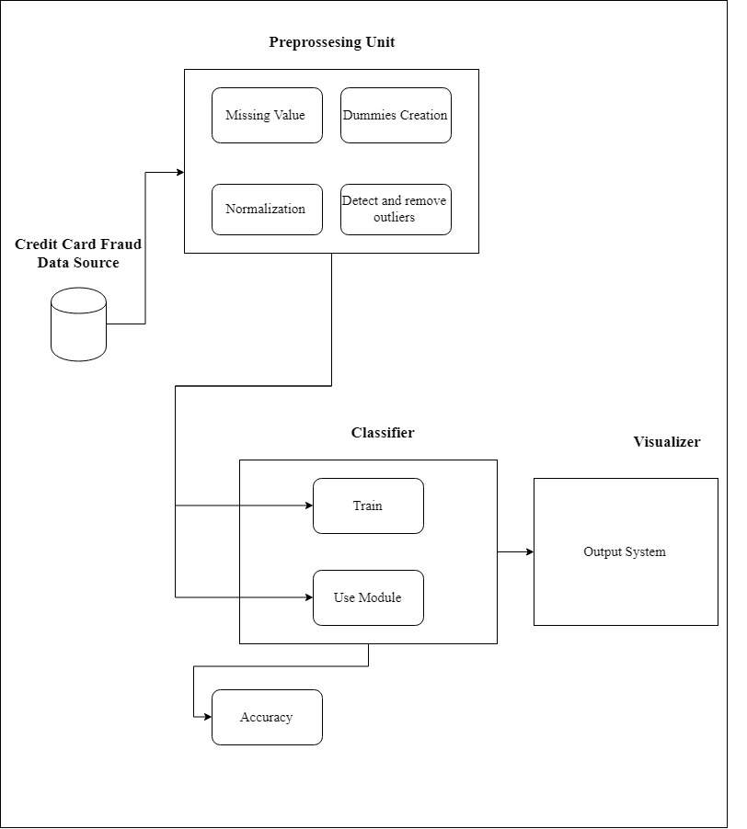
UML Diagrams
Architecture diagram

Slide 6
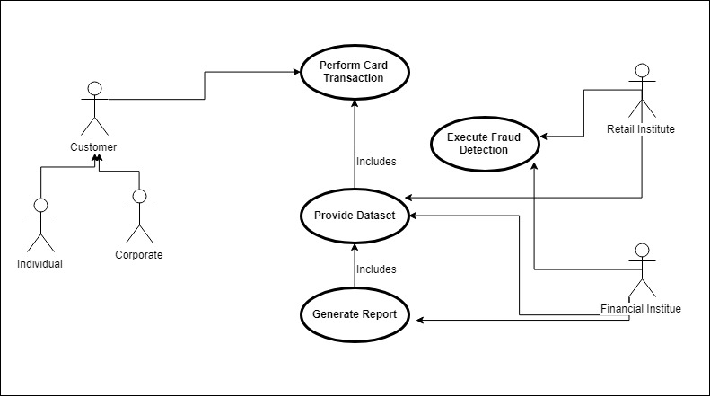
Use case diagram

Slide 7
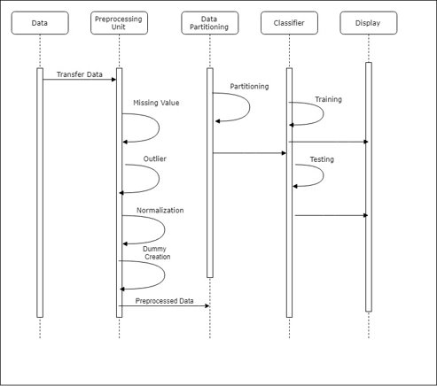
Sequence diagram

Slide 8
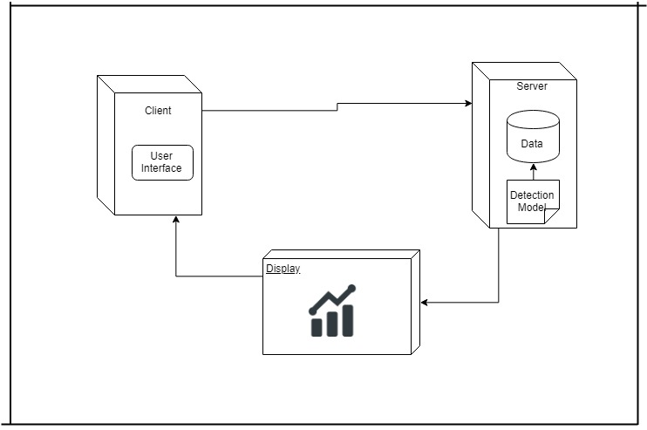
Deployment diagram

Slide 9
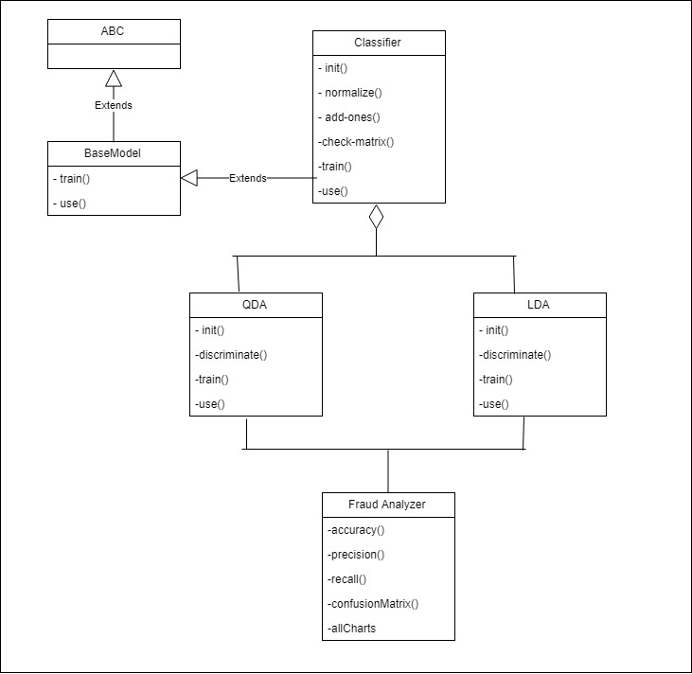
Class diagram

Slide 10
Implementation
QDA
LDA
Confusion Matrix
Accuracy

Slide 11
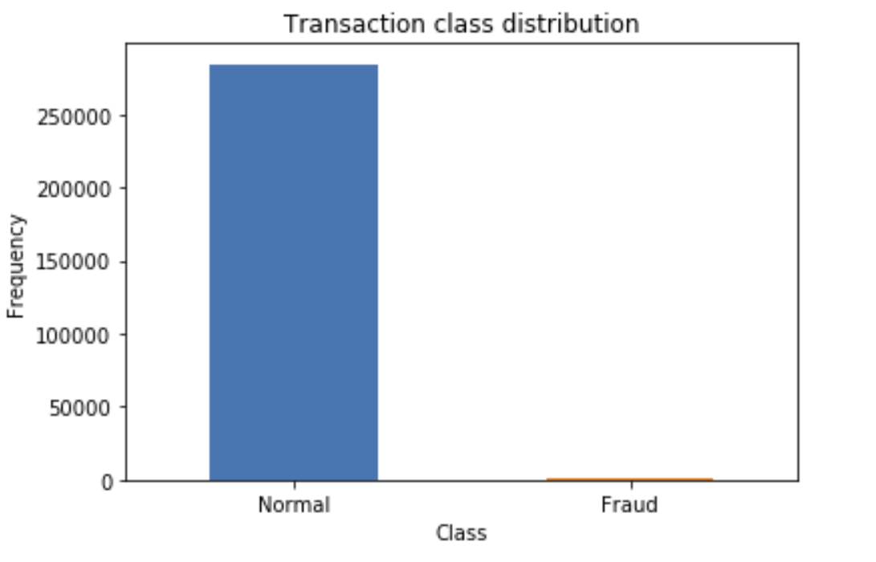
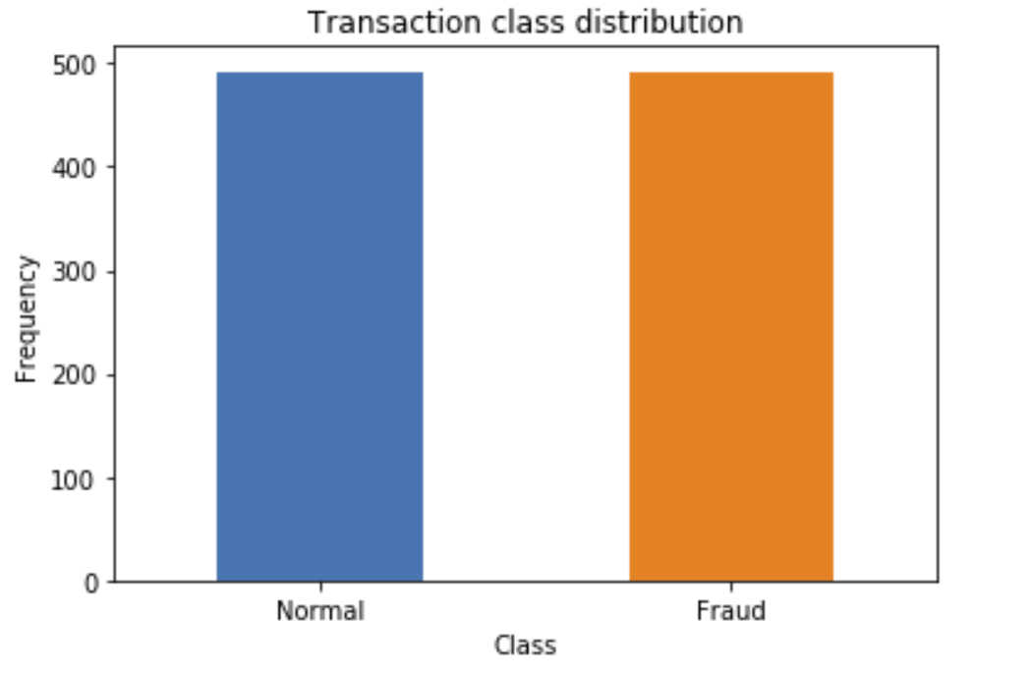
Observation

Slide 12
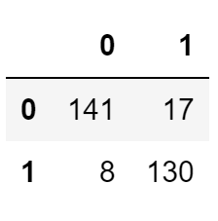
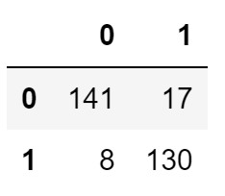
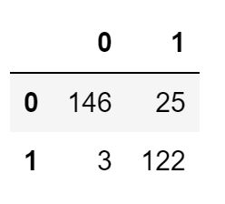
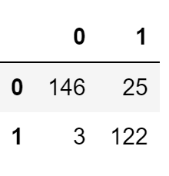
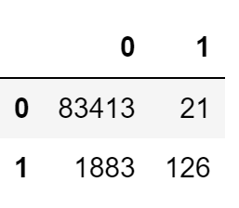
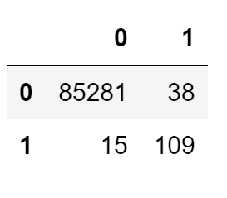
Output / Analysis
QDA | QDA (Library) | LDA | LDA(Library)
Under-Sampled Data
Original Data

Slide 13
Conclusion
A productive instrument for credit card fraud detection is an extreme necessity.
The precision of the model prepared on the biased dataset is less accurate with uniformly circulated information.
The fraud rate detection can be enhanced by feeding the model under sampled data.
The model training speed can be altogether improved by improvising the training algorithm.

Slide 14
Future Enhancements
A web-interface can be made to give a front end to load data files and display the results.
The model accuracy ought to be close to 100% or 1 bringing about the detection of all the fraud transaction.
The model can be extemporized utilizing reinforced learning which empowers the model to distinguish fraud and train itself in the meantime.

Slide 15
References
Dataset - https://www.kaggle.com
https://medium.com/@curiousily/credit-card-fraud-detection-using-autoencoders-in-keras-tensorflow-for-hackers-part-vii-20e0c85301bd
Draw.io to draw diagrams- www.draw.io

Slide 16
Thank You

