Slide 1
PlanTree 🌴
😔😟😕🙁☹️ ➡️ 🙂🙃🥳🤩😎
🏡
🏡
🛣
Generate Data | Reliable | Trusted | Verified

Slide 2
DATA 🙏 DATA 🙏 DATA 🙏 DATA
A. I
Machine Learning
DATA
Augmented Reality
NLP
Vision

Slide 3
The Data
Helps in machine learning
Helps visualize data and understand multiple dimension
Helps make decisions
Builds economy
Leads to healthy and wealthy lifestyle

Slide 4
Ever thought where the data is coming from?
We rely highly on some csv data without boosting its actual value
Crime witnessed vs Crime reported
University review VS student opinions
Grant news and reports vs Reality

Slide 5
Moto
Immediate Data generation
Robust upvoting system building up common concern amongst people
Helping in immediate decision making
Prioritize important concerns
Location based notification system further boosting data originality

Slide 6
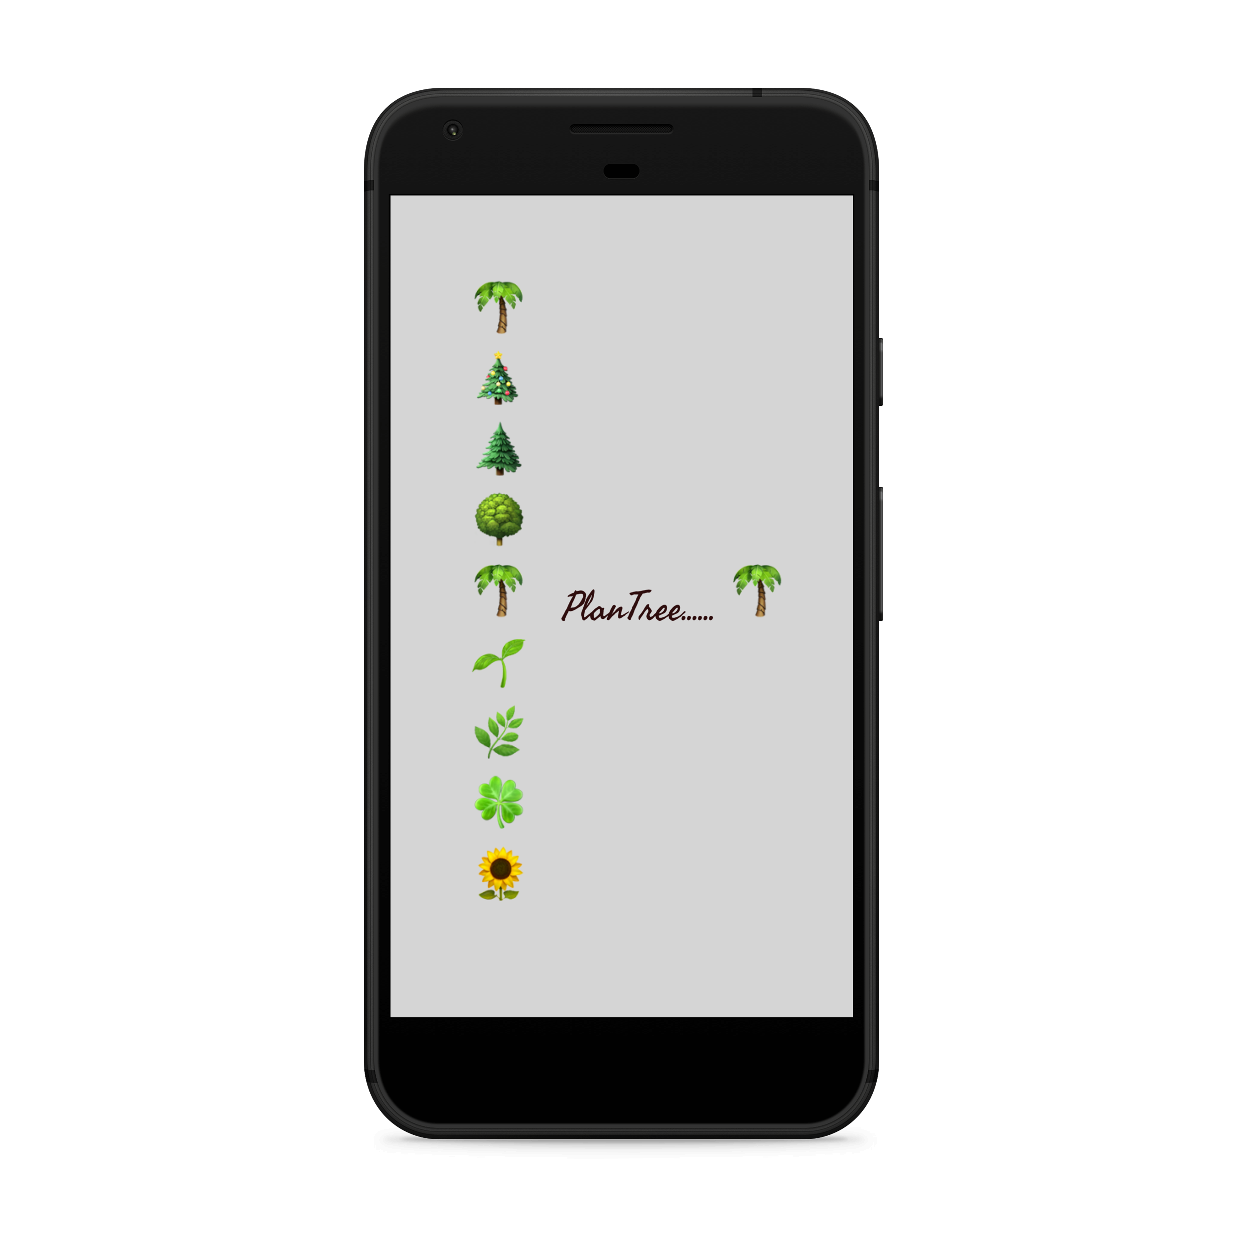
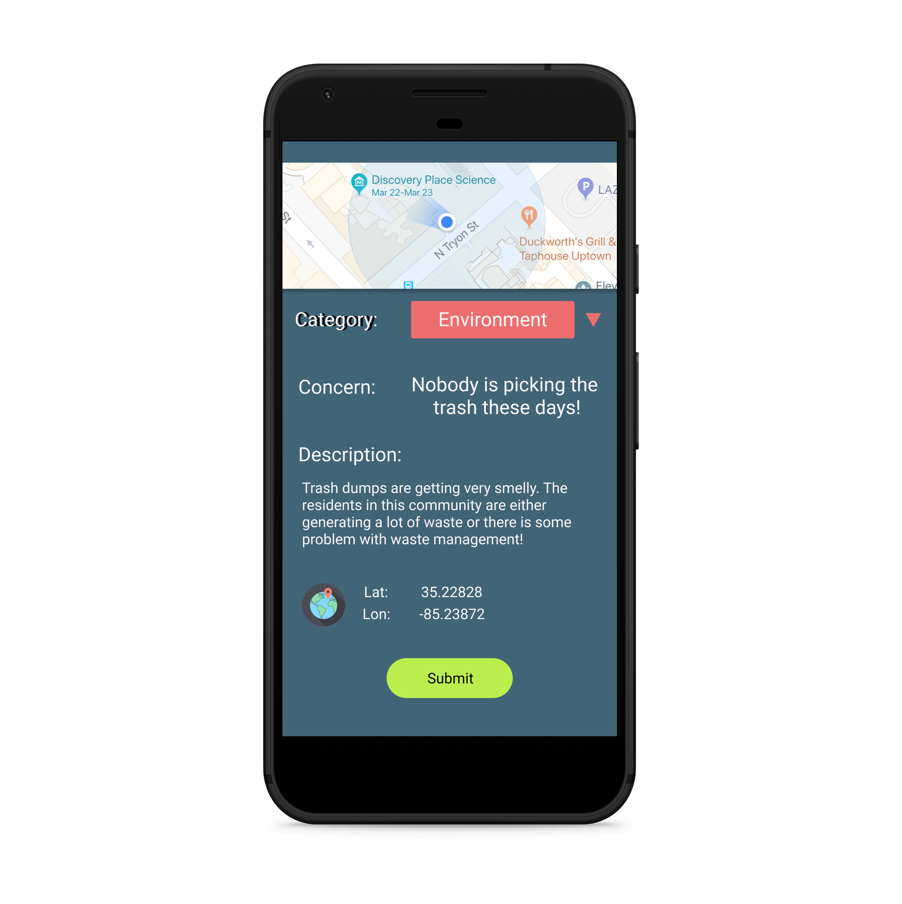
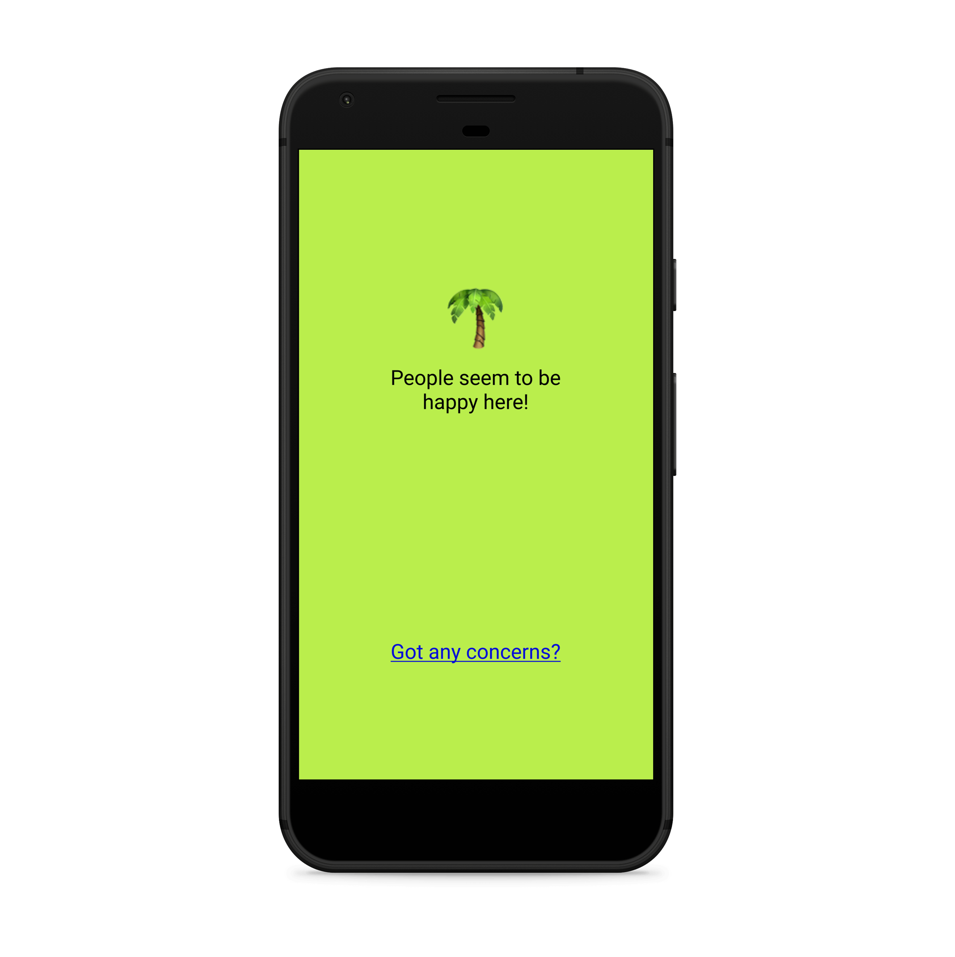
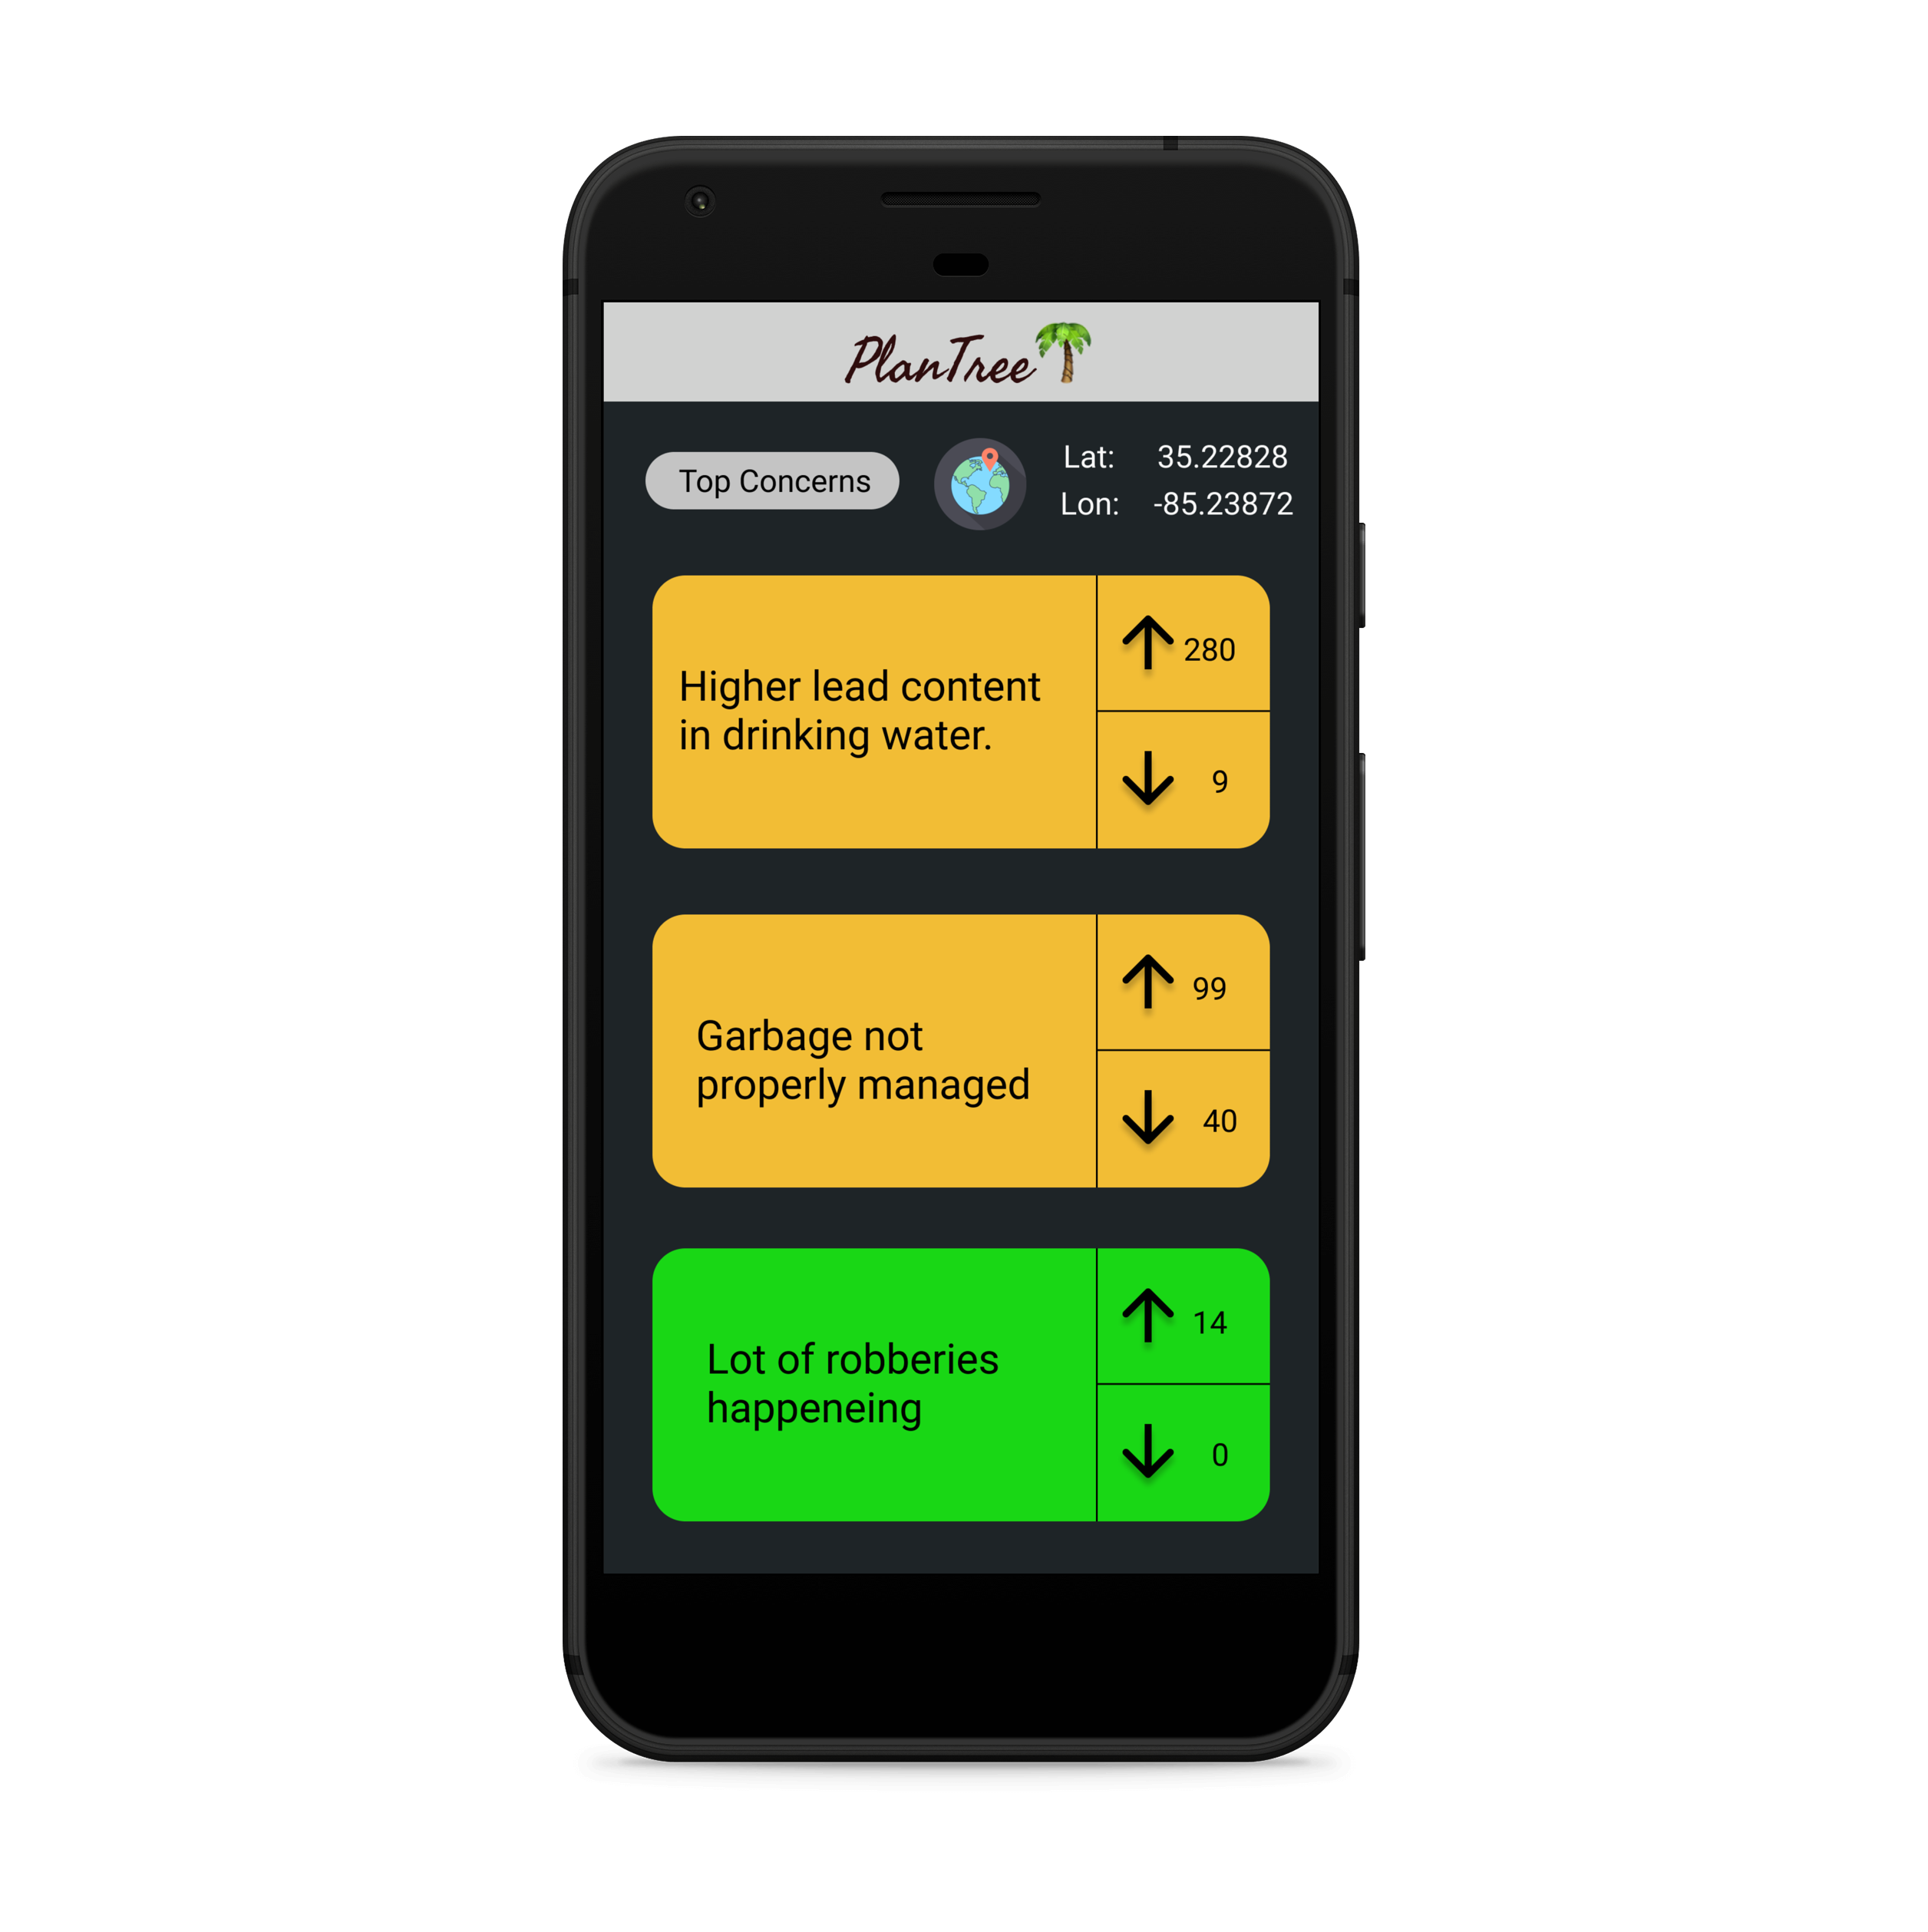
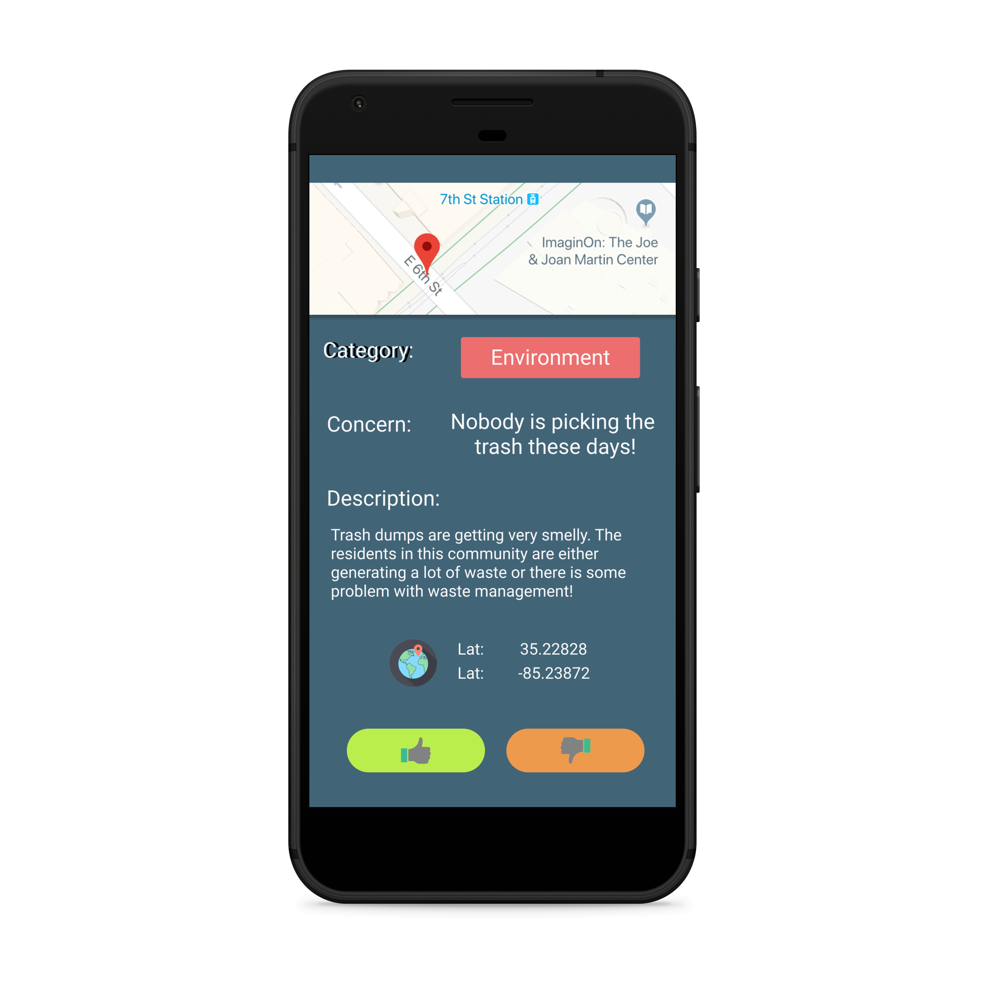
Application Design

Slide 7
Application specific features
Single sign up system
Google sign in integration
On the go Scalable database from firebase
Realtime data availability
Location based push notification

Slide 8
Technology
Front End : Android Device, iOS (for next iteration)
Backend and Database : Firebase
Location based user selection and push notification : Cloud lambda functions Firebase

Slide 9
Thank you
Lets build data more reliable while we are relying on data

