Slide 1
Witcher Potion Guided by Mr. V. G. K

Slide 2
Group Members
1.Gunjan P. Rajgure. 17UCS12012XX
2.Prashant B. Jadhav. 17UCS12015XX 3.Yogesh R. Chillal. 17UCS12004XX
4.Pratik G. Durukkar. 17UCS12010XX

Slide 3
Index
1 | Introduction
2 | Problem Statement
3 | Problem description
4 | Input
5 | Output
6 | Sample Input
7 | Sample Output
8 | Requirement analysis
9 | Algorithm
10 | Snapshot
11 | Conclusion
12 | References

Slide 4
Introduction
The aim of the project is to find the maximum number of monster,Geralt (fighter) can kill provided particular number of potion bottles (energy drink).

Slide 5
Problem Statement
In fighting contest , a fighter Geralt fights monsters using potion
bottles. We need to find maximum no of monsters Geralt can
defeat .

Slide 6
Problem Description
In a mythical world, there is a fighting contest where each fighter fights a monster and needs to defeat monsters as many as possible. Among fighter tribes, a Witcher tribe has advantage over others since they can take energy-boosting potions. These potions instantly increase his or energy and as long as a Witcher does not run out of energy, he will not be knocked out. Unfortunately, these potions contain toxicity and he can drink at most one potion bottle once he defeats each monster.
Geralt, a legendary Witcher, enters this tournament with N potion bottles. Each bottle has its own strength and toxicity level.

Slide 7
Problem Description
If he drinks a potion with strength E, his energy increases by E units, but it will not exceed 100. Potion with toxicity level P increases toxicity level in his blood by P units. If the toxicity level in blood reaches 100, Geralt will be knocked out. In T minutes, his blood toxicity level reduces by T units too. This allows Geralt to safely drink another potion bottle.
Task is to analyze potion and monster data. Then, tell Geralt the maximum number of monsters he can defeat before he will be knocked out. Assume that all monsters are the same (need the same amount of energy and time to be defeated). Furthermore, if the needed energy is K units and Geralt has K or less energy units, Geralt will not be able to defeat a monster.

Slide 8
Input
The first line contains a positive integer C ≤ 20, representing the number of test cases. For each test case, the input is as follows:
Line 1- contains positive integers K and M where K and M are the amount of energy and time that Geralt needs to spend for each monster. Also, 10 ≤ K ≤ 80 and M ≤ 100.
Line 2- contains N, the number of potions Geralt has where 1 ≤ N ≤ 8.
Line 3-contains positive integers E1, E2, E3, . . . , EN , the potion strength of bottles 1 to N.
Line 4- contains positive integers P1, P2, P3, . . . , PN , the potion toxicity level of bottles 1 to N. (1 ≤ Ei , Pi ≤ 100)

Slide 9
Output
For each test case, your program will print the maximum number of monsters that Geralt can defeat, one line for one case.

Slide 10
Sample input
4 - No of test cases
Test case 1:
30 20 - energy and time to kill one monster.
6 - no of potion bottles
30 30 50 100 40 50 - energies in each bottle
10 30 80 90 50 60 - toxicities in each bottle
Test case 2:
20 30 - energy and time to kill one monster.
6 - no of potion bottles
10 30 80 90 50 60 - energies in each bottle
30 30 50 100 40 50 - toxicities in each bottle

Slide 11
Sample input
Test case 3:
50 30- energy and time to kill one monster.
8 - no of potion bottles
10 60 70 20 70 50 60 40- energies in each bottle
15 40 50 30 60 70 40 75- toxicities in each bottle
Test case 4:
30 50- energy and time to kill one monster.
8- no of potion bottles
15 40 50 30 60 70 40 75- energies in each bottle
10 60 70 20 70 50 60 40- toxicities in each bottle

Slide 12
Sample Output
Test case 1: 10 - maximum no of monsters killed
Test case 2: 16 - maximum no of monsters killed
Test case 3: 7 - maximum no of monsters killed
Test case 4: 15 - maximum no of monsters killed

Slide 13
Requirement Specifications
Input notations :-
C – no of test cases (C<=20)
K- Energy required to kill one monster.(10<=K<=80)
M- Time required to kill one monster. (M<100)
N- No. of bottles of potion.(1<=N<=8)
E- Energies in potion bottles.
P- Toxicity level in potion bottles.(1<=E_{i} , P_{i}<=10 Output notation :-
NoM :- no of monsters Geralt can defeat according to given inputs.

Slide 14
Requirement Analysis
The number of test cases should be no more than 20 i.e. user can enter at maximum 20 cases to test.
Energy required by Geralt to kill one monster should be between 10 to 80 energy units i.e. user can enter maximum 80 energy units and minimum 10 energy units to kill one monster.
Time required by Geralt to kill one monster should be not more than 100 time units i.e. User can enter maximum 100 time units to kill one monster.
Number of potion bottles that Geralt uses to gain energy should be between 1 to 8 i.e. user can enter maximum 8 potion bottles and minimum 1 bottle for Geralt to use in case if Geralt is out of energy.

Slide 15
Requirement Analysis
Energy in one potion bottle should be between 1 to 100 i.e. user can enter maximum 100 energy unit in one bottle and minimum 1 energy units so that Geralt can take that energy can continue killing monsters.
Toxicity level in one potion bottle should be between 1 to 100 i.e. user can enter maximum 100 toxicity level in one bottle and minimum 1 toxicity.

Slide 16
Algorithm
Start
Get no. of test cases.
Check if test cases are less than or equal to 20.
Yes: continue to program
If No : Enter correct no. of test cases.
while test cases not equal to 0.
Get amount of energy required to kill one monster(K) and time to kill one monster(M).
Check 10 <= k <= 80.
if yes , ask time.
-if no , ask to enter correct value between 10 to 80

Slide 17
9. Check is M <100
-if yes next step.
-if no , ask to enter correct value less than 100.
10.Get the number of potion bottles(N)
-check N should be between 1 to 8.
11.Get energy (E) and toxicity level (P) in each bottle.
12.Set the initial energy to 100 and toxicity level to 0.
13.Arrange the entered potion bottle in ascending order according to their energy levels.
14.While no . Of potion bottles not equal to 0.
15.While (Geralt energy > required energy )
increment the number of monsters killed.
Geralt energy = Geralt energy –required energy.
Geralt toxicity= Geralt toxicity- Time Required.
go back to step 15.

Slide 18
16.Check if geralt toxicity +toxicity level of last potion bottle is >=100
17.Yes- a) Check if balance energy != 0
b) Yes – i)Geralt Energy = Geralt Energy + balance Energy.
ii)Set balance energy to 0.
iii) check if Geralt energy greater than required energy.
iv) Yes- go back to step 15.
c) Decrement no of potion bottles.
18.Use potion bottle i.e. increment geralt energy by energy provided by potion bottle.
19.Check if Geralt energy greater than 100
20.Yes : a) Balance energy = geralt energy – 100
b)Geralt energy = geralt energy – balance energy
21.Geralt toxicity = Geralt toxicity + toxicity level of potion used
22.Decrement no. of potion bottles.
23.Go back to step 14.
24.Print max no. of monsters killed.
25.Decrement no. of test cases.
26.Go back to step 6.
27.End.

Slide 19
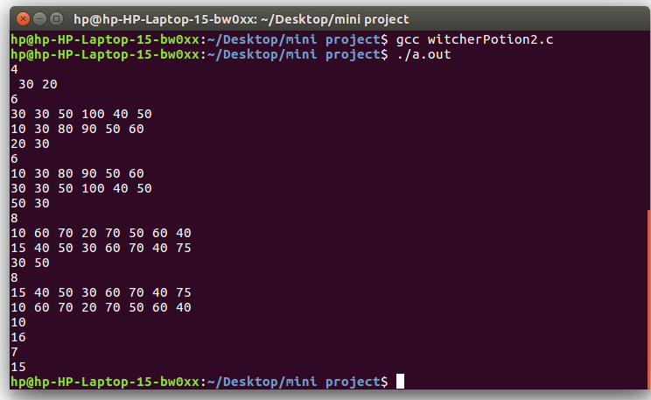
Snapshot

Slide 20
Conclusion
Given the required energy and time to kill one monster we found out maximum no. of monsters Geralt can defeat, also provided that Geralt can use the potion bottles which contains particular amount of toxicity and energy.

Slide 21
Any Questions?

Slide 22
Thank you

