Slide 1



SMART INDIA HACKATHON 2024
1
Problem Statement ID :
1648
2
Problem Statement Title:
Online Chatbot based ticketing system
3
Theme:
Travel & Tourism
4
PS Category :
Software
5
Team ID
6
Team Name (Registered on portal)

Slide 2

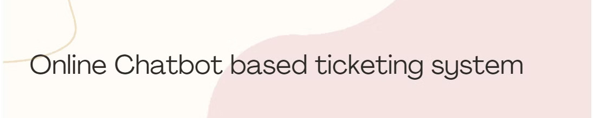
Proposed Solution
To address the problem statement of creating an online chatbot-based ticketing system for the travel and tourism industry, our proposed solution involves a comprehensive approach.
First, we will define the detailed requirements for the chatbot system, including the desired user flow, user interface design, and backend architecture. We will carefully select the appropriate languages to support based on the target market and user needs.
In the development phase, we will build the chatbot interface and integrate it seamlessly with the client's website or mobile application. We will set up the necessary backend infrastructure and implement robust multilingual support to cater to a diverse user base.
The key innovation and uniqueness of our project lies in the rigorous testing and optimization of the chatbot responses. We will conduct extensive user testing to ensure an exceptional user experience, continuously refining the chatbot's capabilities to provide accurate and helpful information to users.

Slide 3

Technical Approach
Frontend Technologies
React.js, Bootstrap CSS for building responsive web interfaces.
Backend Technologies
Django, for server-side development.
Cloud & Deployment
AWS, for hosting, scaling, and cloud services.
Sqllite3, MySQL, for database management and API integration.
Google Analytics, , Power BI for data analytics and reporting.
Chatbot platforms Rasa for natural language processing.

Slide 4
Feasibility
The proposed solution is highly feasible as it leverages well-established technologies and industry best practices in the travel and tourism domain.
Viability
The use of a chatbot-based system allows for scalable and cost-effective implementation, with the potential for seamless integration with the client's existing infrastructure.
Analysis of the feasibility of the idea
The proposed solution is highly feasible as it leverages well-established technologies and industry best practices in the travel and tourism domain. The use of a chatbot-based system allows for scalable and cost-effective implementation, with the potential for seamless integration with the client's existing infrastructure.
Potential challenges and risks
Some key challenges may include ensuring accurate and contextual responses from the chatbot, catering to diverse user preferences and language requirements, and maintaining data security and privacy. Integration with legacy systems could also pose technical complexities.
Strategies for overcoming these challenges
To address these challenges, we will implement robust natural language processing and machine learning algorithms to enhance the chatbot's conversational abilities. Multilingual support and personalization features will cater to user diversity. Rigorous testing and security audits will ensure data protection and compliance. Close collaboration with the client's IT team will help navigate integration challenges effectively.

Slide 5


Impact and Benefits
1
Improved Customer Service
Instant responses, automated ticketing, and reduced staff burden.
2
Efficient Handling of High Volumes
Automated systems manage large numbers of bookings without delays or crashes.
3
Cost-Effective Solution
Reduces the need for manual ticket counters and staff, lowering operational costs.
4
Data-Driven Decision Making
Collect and analyze visitor data to optimize marketing, pricing, and resource allocation.

Slide 6


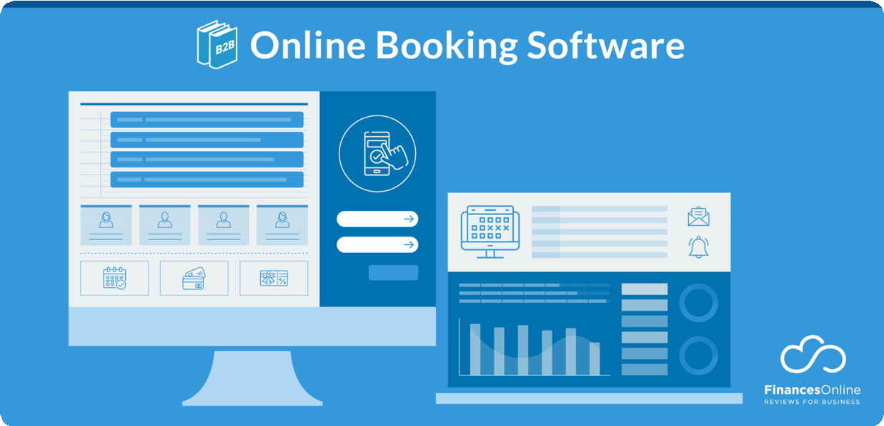
Research and References
Chatbot Platforms
Dialogflow,, Rasa
Backend Frameworks
Django
Database Solutions
Ssqlite3, MySQL
Cloud Providers
AWS,
Analytics Tools
Google Analytics, Power BI

