Slide 1
Home Automation using Raspberry pi
Project guide: team members: Prof. Hari ram vishwakarma N Nagamani 12bit0258
T Prashanth reddy 12bit0077
Roop sai Krishna 12bit0156

Slide 2
Motivation and objective
The proposed system we want to bring in the concept of internet of thing in home automation. This will allow all the devices to control from remote place i.e. user might control devices in his home or even in his car from his offices.
This provides a very important factor called mobility which is very important. This sole concept is responsible for slimmer phones, smaller devices, light weight laptop etc. this remote access will allow us to monitor user’s general usage patterns of various devices remotely.
This project forwards the design of home automation using Raspberry pi, a credit card sized computer.

Slide 3
Related works
N. Sriskanthan and Tan Karand. “Bluetooth Based Home Automation System”. Journal of Microprocessors and Microsystems, Vol. 26, pp.281-289, 2002.
Muhammad Izhar Ramli, Mohd Helmy Abd Wahab, Nabihah, “TOWARDS SMART HOME: CONTROL ELECTRICAL DEVICES ONLINE” , Nornabihah Ahmad International Conference on Science and Technology: Application in Industry and Education (2006)
E. Yavuz, B. Hasan, I. Serkan and K. Duygu. “Safe and Secure PIC Based Remote Control Application for Intelligent Home”. International Journal of Computer Science and Network Security, Vol. 7, No. 5, May 2007

Slide 4
Overview
Raspberry pi provides the features of a mini computer, additional with its GPIO pins where other components and devices can be connected.
GPIO registers of raspberry pi are used for the output purposes. We have design a power strip that can be easily connected to GPIO Pins of the Raspberry pi.
The home appliances are connected to the input/output ports of Raspberry pi along with the power strip and their status is passed to the raspberry pi.
The android running OS in any phone connected to a network can access the status of the home appliances via an application. It presents the design and implementation of automation system that can monitor and control home appliances via android phone or tablet.

Slide 5
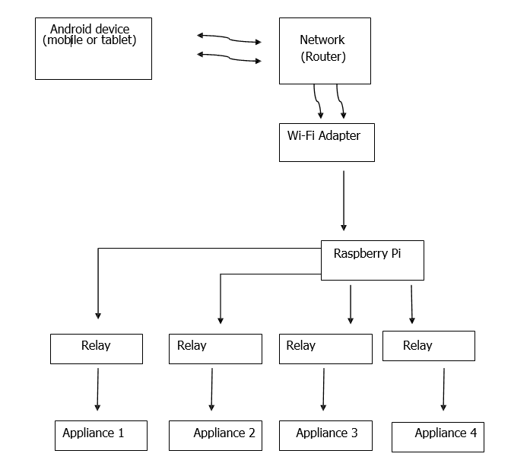
Block diagram
Notes:
The architecture shown above is the basic idea of how system would communicate. The interaction between the raspberry pi and the android app is done via network. The raspberry pi is further connected to relays. Then relays are connected to home appliances which ever devices we want to control remotely.

Slide 6
System Implementation

Slide 7
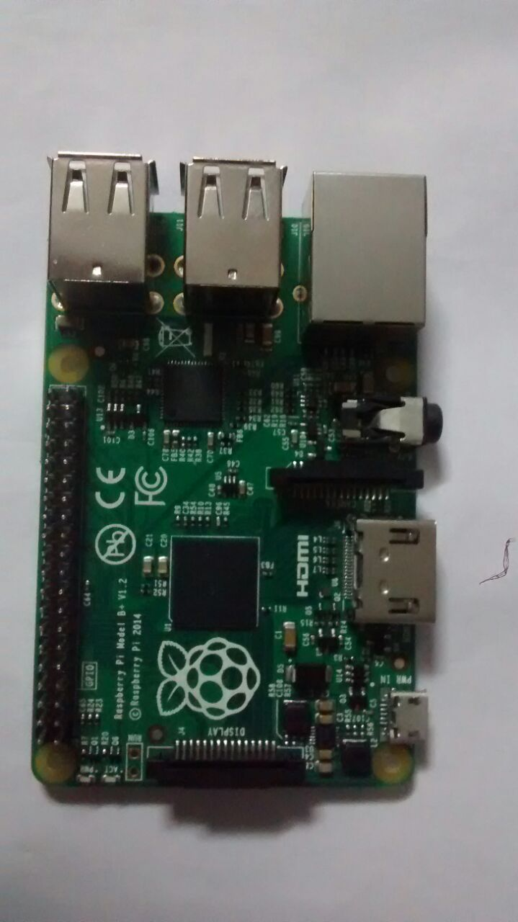
Raspberry pi

Slide 8
Raspberry pi
The Raspberry Pi is a credit card–sized single-board computer.
It features a Broadcom system on a chip (SOC) which include an ARM compatible CPU and an on chip graphics processing unit GPU (a VideoCore IV).
CPU speed range from 700 MHz to 1.2 GHz for the Pi 3 and on board memory range from 256MB to 1GB RAM. Secure Digital SD cards are used to store the operating system and program memory in either the SDHC or MicroSDHC sizes.
Most boards have between 1 and 4 USB slots, HDMI and composite video output, and a 3.5mm phono jack for audio. Lower level output is provided by a number of GPIO pins which support common protocols like I2C.

Slide 9
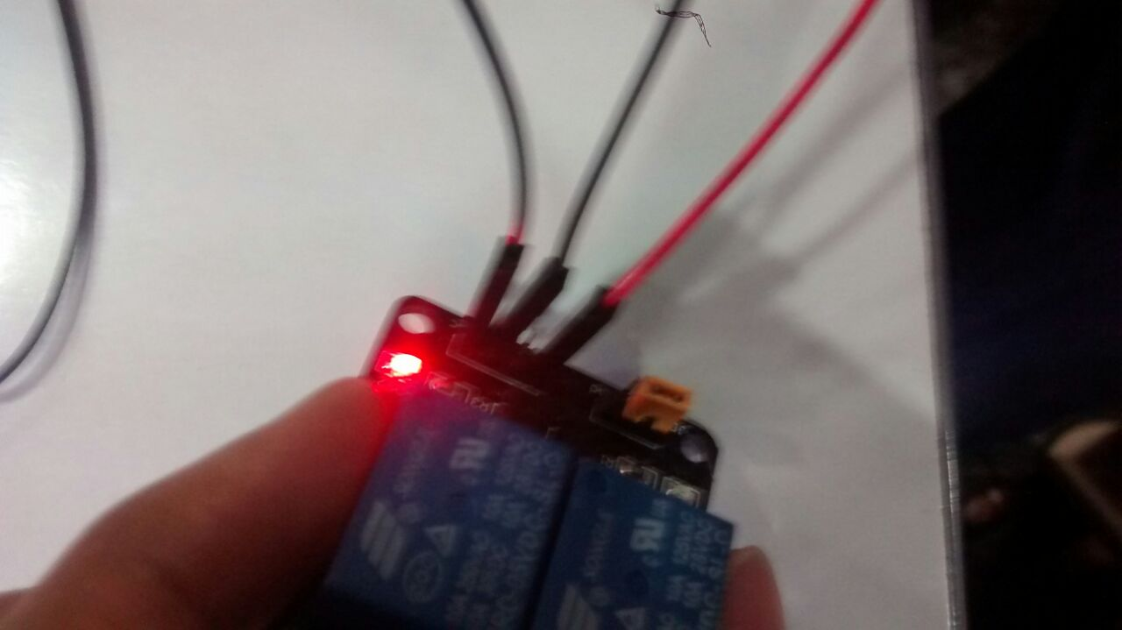
Relay switch

Slide 10
Relay switch
Control all devices by switching on and off.
A relay is an electromagnetic switch operated by a relatively small electric current that can turn on or off a much larger electric current.
The heart of a relay is an electromagnet (a coil of wire that becomes a temporary magnet when electricity flows through it). You can think of a relay as a kind of electric lever: switch it on with a tiny current and it switches on ("leverages") another appliance using a much bigger current.

Slide 11
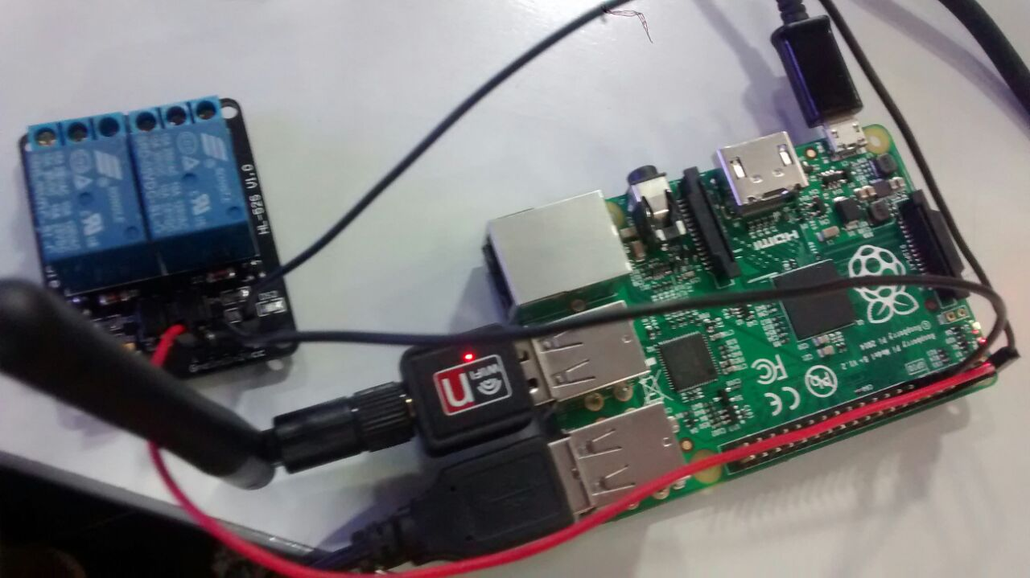
Wi-Fi Modem
Notes:
Wi-Fi modem is connected in order to access the internet

Slide 12
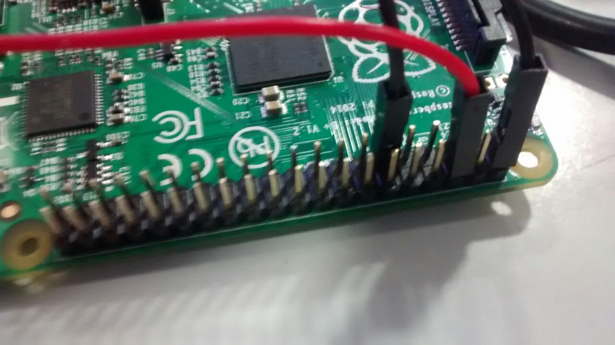
GPIO
Notes:
General Purpose Input/Output (GPIO) is a generic pin on a chip whose behaviour (including whether it is an input or output pin) can be controlled (programmed) through software.

Slide 13
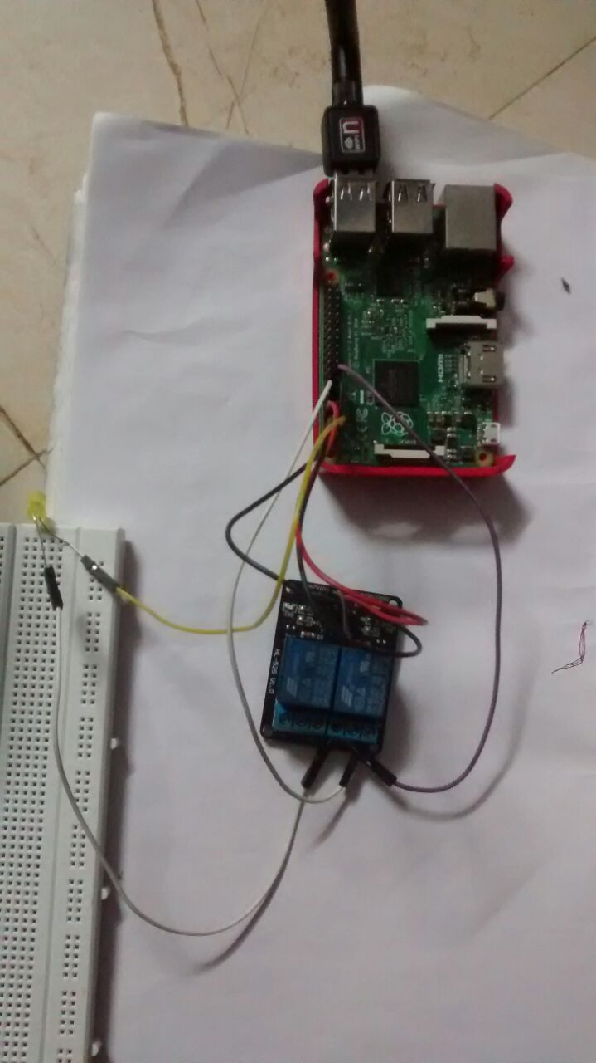
LED setup
Notes:
The pi collects the data analyses it and further activates GPIO pins as necessary. The GPIO pins of raspberry pi are connected to the relay. Relay switch are used to connect the home appliances. In this setup a led is connected to relay. Based on input to relay it switch it on or switch it off the led.

Slide 14
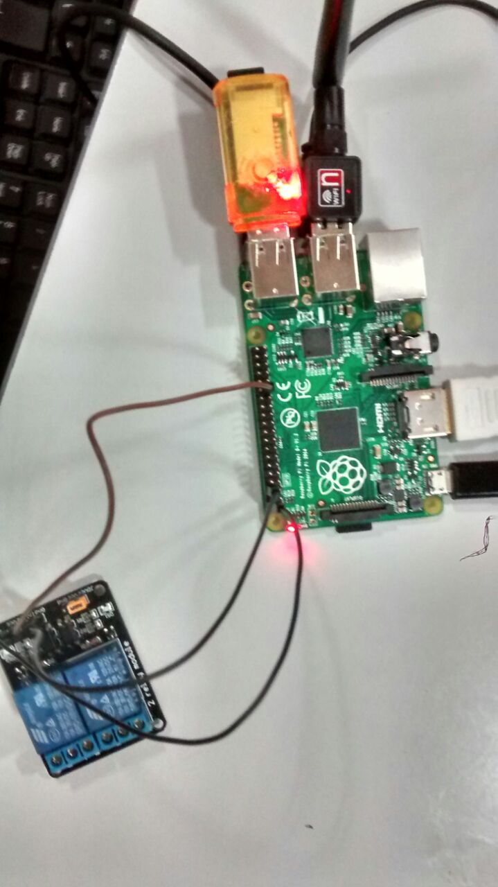
External memory
Notes:
Secure Digital SD cards are used to store the operating system and program memory in either the SDHC or MicroSDHC sizes.

Slide 15
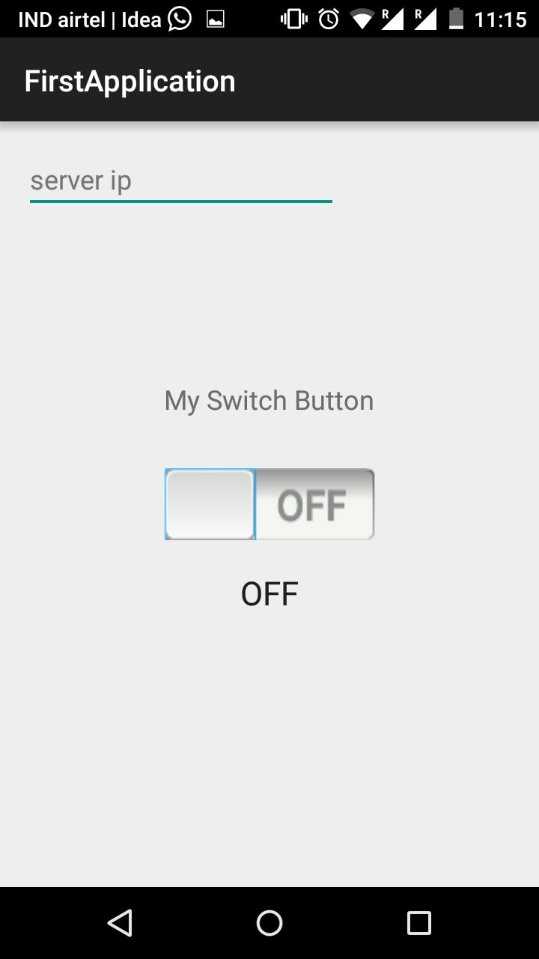
APP
Notes:
Android app to control and monitor all devices remotely and controlling them with it.

Slide 16
Working Model (LED)

Slide 17
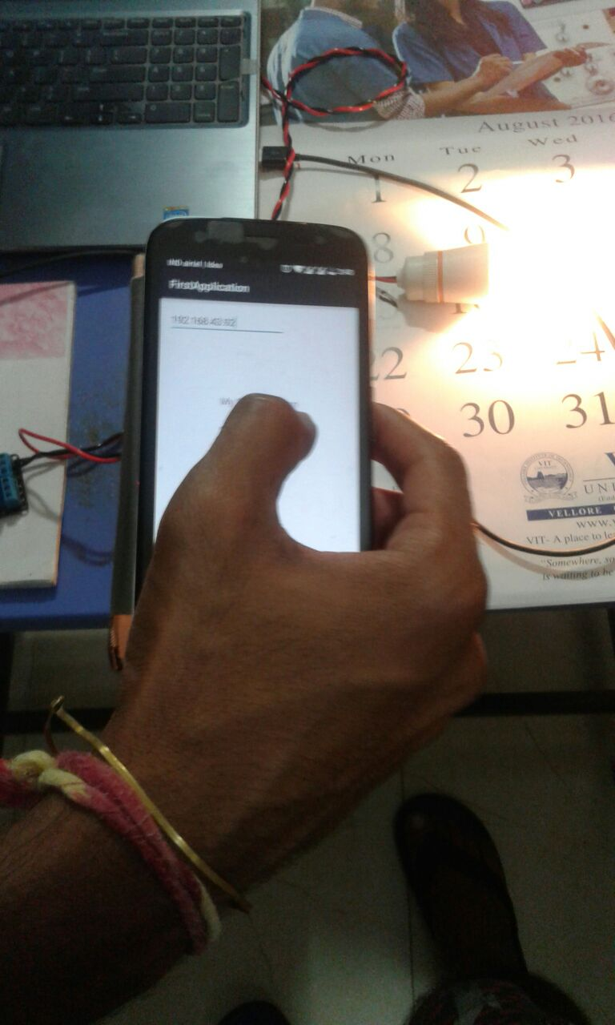
Working Model (Electric bulb)

Slide 18
Conclusion
This system is designed to assist and provide support in order to fulfill the needs of elderly and disabled in home. Household appliances can be easily controlled via a Mobile/Tablet. Status of light, fan and other electrical appliances can be known.
This system can be used in home, small offices to the big malls.
The system incorporates the use of technology and making smart home automation. By the use of day to day gadgets we can utilize them for different prospective.

Slide 19
References
http://www.ijettjournal.org/archive/ijett-v4i9p168
http://eprints.uthm.edu.my/194/1/muhammad_izhar_ramli.pdf
http://paper.ijcsns.org/07_book/200705/20070526.pdf

