Slide 1
Contrastive Learning using Twitter Data
Technical Progress Report
Prashanth Umapathy

Slide 2
Outline
Introduction
Project Objective
Proposed Methodology
Results
Future Work

Slide 3
Introduction
The goal of contrastive learning is to learn such embedding space in which similar samples are close to each other while dissimilar ones are far apart. It assumes a set of the paired sentences that are related semantically to each other.
It can be applied to both supervised and unsupervised settings.
Contrastive learning in computer vision is just generating the augmentation of images. It is more challenging to construct text augmentation than image augmentation because we need to keep the meaning of the sentence.

Slide 4
Introduction
Cutoff:
In 2009, Shen et al, at Microsoft and the University of Illinois researchers proposed a method that uses cutoff to perform text augmentation. They propose 3 different strategies for cutoff augmentation. We will be discussing these strategies one by one, but let’s consider the sentences are represented as the embedding of L*d where L is the number of features, d is the length of sentence
Feature Cutoff: Removes some selected features.
Token Cutoff: Removes the information of few selected tokens.
Span Cutoff: Removes a continuous chunk of text.

Slide 5
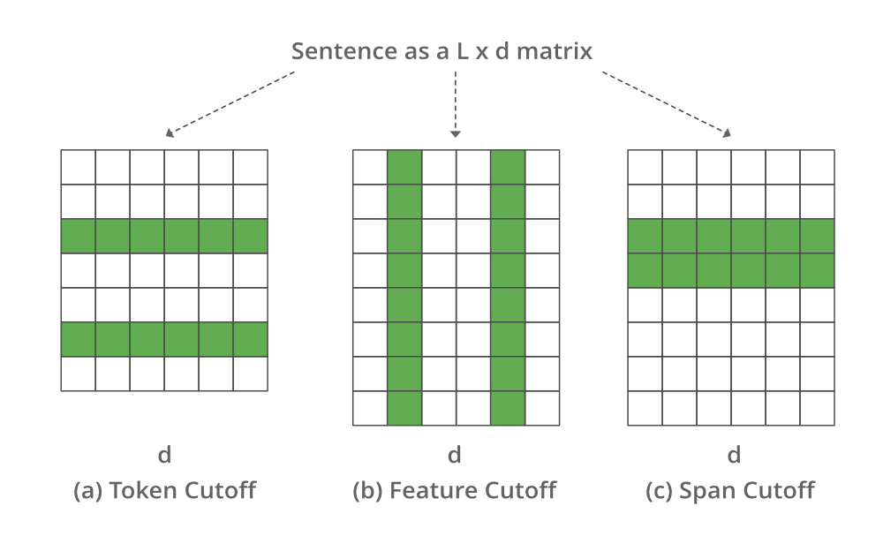
Introduction
Cutoff and DropOut:
Cutoff:

Slide 6
Introduction
Dropout:
In 2021, the researchers from the Stanford NLP group propose SimCSE. In the unsupervised scenario, it learns to predict the sentence itself using the DropOut noise In other words, they treat dropout as data augmentation for text sequences.
In the above approach, we take a collection of sentences and treat positive pair as itself. During training of Transformers, there is a dropout mask and attention probabilities applied on fully-connected layers. It simply feed the same input to the encoder twice by applying different dropout masks
In supervised setting, we try to leverage the Natural Language Inference dataset (NLI) to predict whether there is entailment (positive pairs) or contradiction (negative pairs) between a given pair of sentences.

Slide 7
Introduction

Slide 8
Project Objective
Scrape tweets from Twitter or crawl the web to find related tweets or news items
Train a classifier to separate opinions that either support or are against this decision.
AI Model to use: (1) contrastive learning for NLP; (2) locate entities/evidences to help explain the results.

Slide 9
Proposed Methodology
Develop a Scraping Bot
Search relevant topics related the data required
Data Cleaning
Filtering Relevant Factors from the cleaned data
Develop NLP model
Train the NLP model with our Data
Get inferences from Results
Optimize model based on results

Slide 10
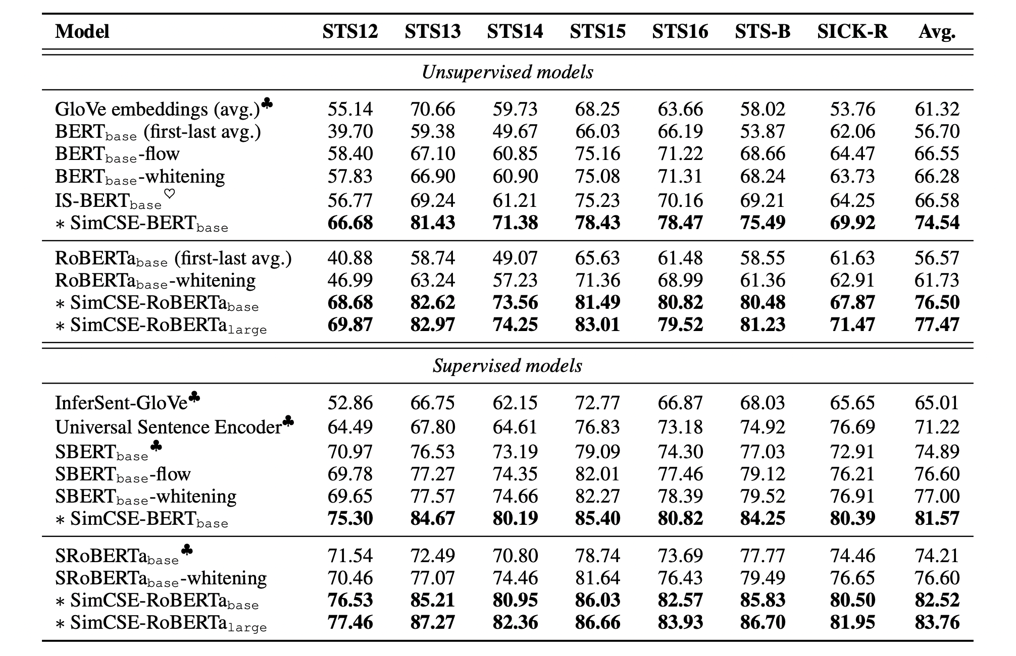
Results
Actual benchmarks of SIMCSE Model on Unsupervised and Supervised Learning

Slide 11
Results
Running our custom trained NLP model, these are our cosine distance evaluation on a few tweets

Slide 12
Results

Slide 13
Future Work
The scraping bot could be bash scripted to run on a schedule to add new tweets as they show up online
The data cleaning pipeline could dynamically alter the factors required in training our model
The NLP model could be optimized to train larger datasets faster. Try multithreading workers in training phase to speedup
The results generated on the validation tweets could be stored for each model to get key inferences

Slide 14
Thank you

