Slide 1
Credit Card Fraud Detection
Technology
Machine Learning in Artificial Neural Networks

Slide 2
Overview of Topics
Introduction
Types of fraud get solved
Implementation
Neural Networks
BackPropagation
Gradient Descent
Dataset Information
Output

Slide 3
Introduction
Online banking and e-commerce organizations have been experiencing the increase in credit card transaction and other modes of on-line transaction.
Due to this credit card fraud becomes a very popular issue for credit card industry, it causes many financial losses for customer and also for the organization.
In this project, Back Propagation algorithm is used to train the Neural Networks for Credit Card fraud detection in real-time scenario.
This project is likely beneficial for the organizations and for individual users in terms of cost and time efficiency.

Slide 4
Types of Fraud Get Solved
Bankruptcy Fraud
Application Fraud
Behavioral Fraud
Theft Fraud

Slide 5
Implementation

Slide 6
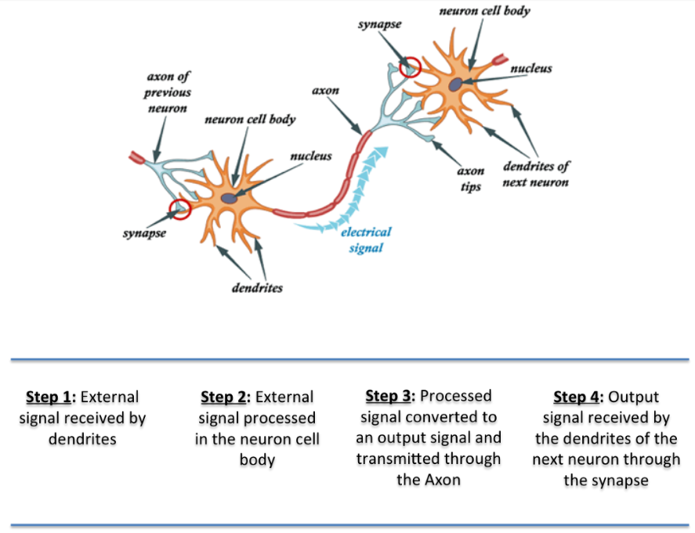
Neural Network

Slide 7
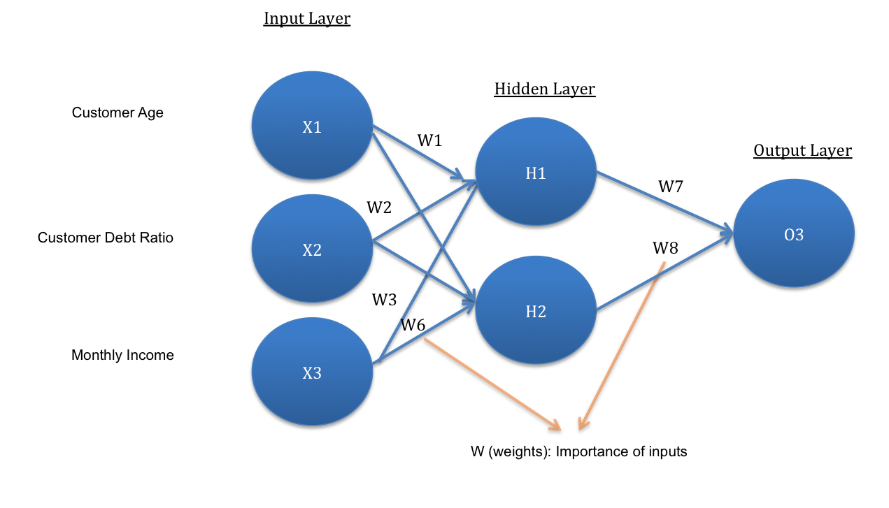
Neural Network
A Simple ANN Architecture
The network architecture has an input layer, hidden layer and the output layer.
The hidden layer finds some of the important patterns from the inputs and passes it onto the next layer .
Hidden Layer makes network faster and efficient .
Finally, output layer gives the final prediction.
Network architecture is called “feed-forward network”, as you can see that input signals are flowing in only one direction.
A good model with high accuracy gives predictions that are very close to the actual values.

Slide 8
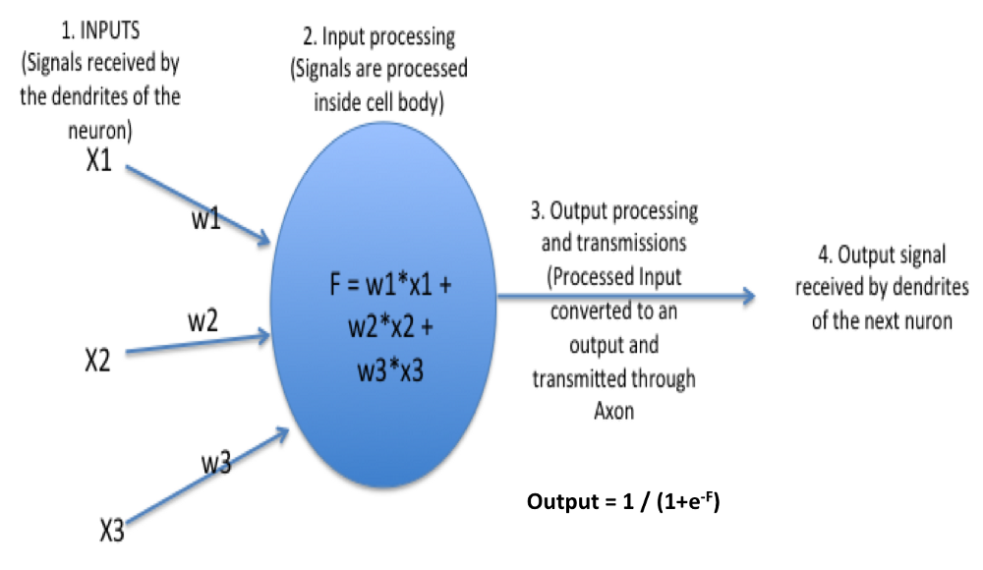
Neural Network
What happens in each percepton?
The activation function serves two notable purposes:
- It captures non-linear relationship between the inputs
It helps convert the input into a more useful output
The activation function used is sigmoid:
O1 = 1 / (1+exp(-F))
Where F = W1*X1 + W2*X2 + W3*X3
. Sigmoid activation function creates an output with values between 0 and 1.
Similar calculations are happened in between hidden and output layer.

Slide 9
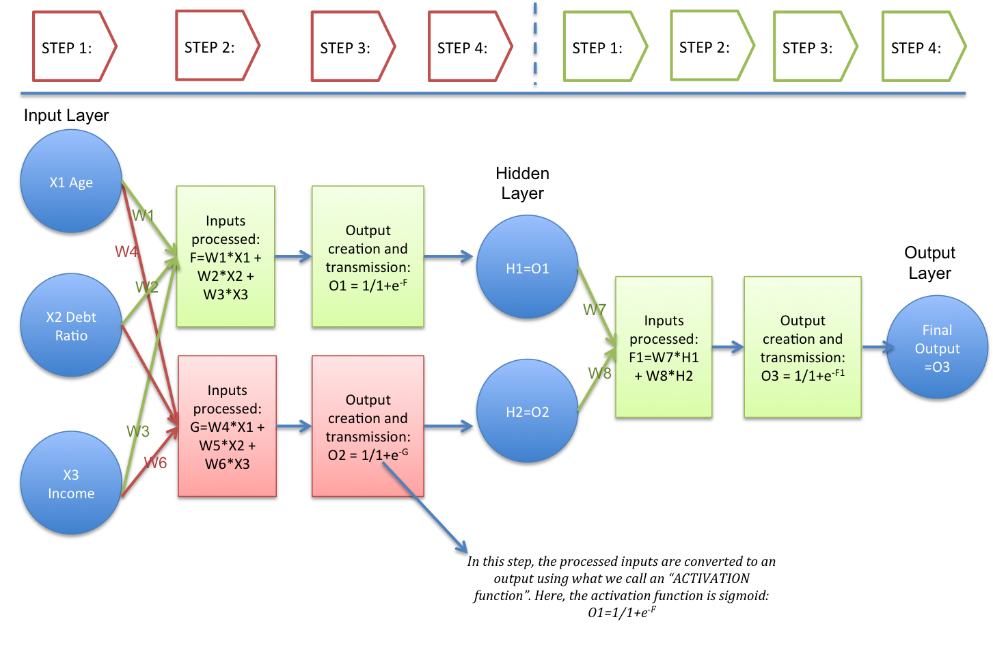
Neural Network
Internal ANN Architecture

Slide 10
BackPropagation
Backpropagation is a method used in artificial neural networks.
It is used to calculate the error contribution of each neuron after a batch of data is processed.
This is used by an enveloping optimization algorithm to adjust the weight of each neuron, completing the learning process.
It calculates Error function.
Error Function=(Predicted Output)-(Excepted Output)
It is commonly used in the gradient descent optimization algorithm.
It is also called backward propagation of errors, because the error is calculated at the output and distributed back through the network layers.
It is considered as supervised learning method.

Slide 11
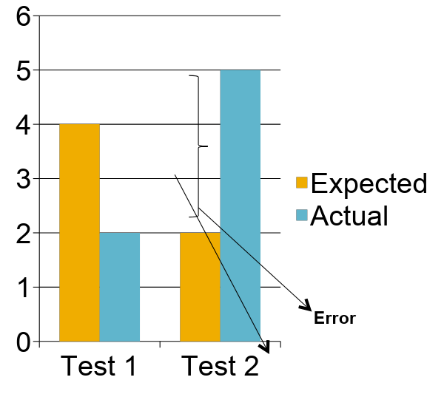
BackPropagation
Calculate Average Cost Function(J)
J=1/2∑(e1^2+e2^2)
J is Minimized by using the Gradient Descent Optimization Algorithm.
Once Cost function minimized weights are set in the network such that predictions match the excepted output.

Slide 12
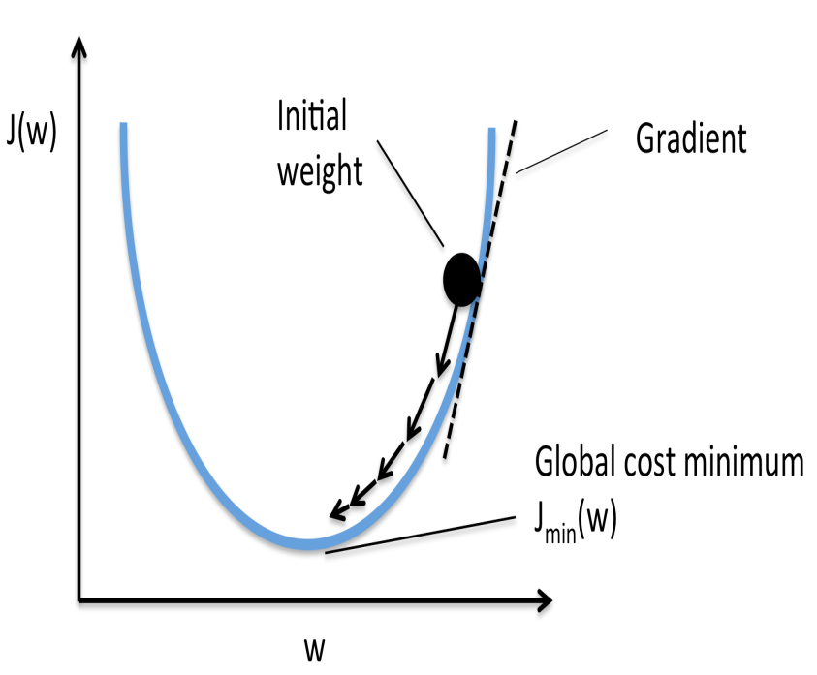
Gradient Descent
Optimization
Gradient descent is a iterative optimization algorithm for finding the minimum of a cost function.
To find a local minimum of a function using gradient descent, one takes steps proportional to the negative of the gradient of the function at the current point.
If instead one takes steps proportional to the positive of the gradient, one approaches a local maximum of that function.
Cost minimum can be achieved by derivative of cost function using the chain rule.

Slide 13
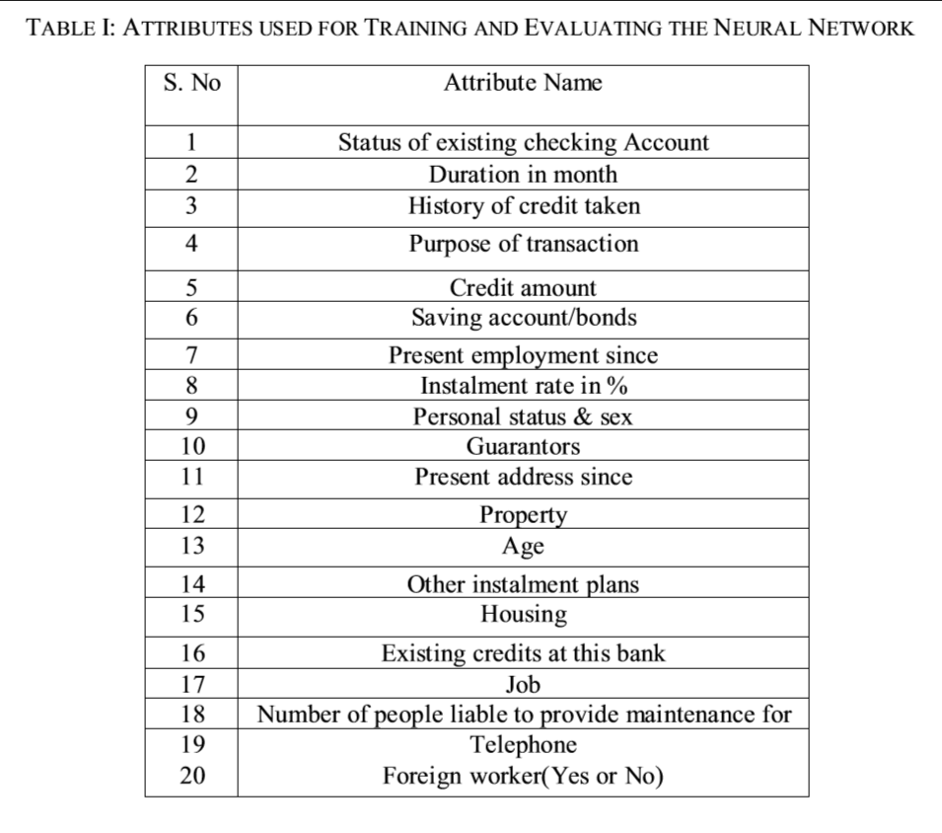
Dataset Information
Dataset : German Credit Card consist
of 1000 instance.
We have divided the dataset into two parts:
75% data is taken from dataset for the training purpose.
25% data is taken for the evaluation of trained neural network.

Slide 14
Output
Observed | Total | Correct | Percentage correct
Total Case | 250 | 162 | 65%
Fraud Case | 173 | 97 | 57%
Non-Fraud Case | 77 | 65 | 84%

Slide 15
Output
Synthetic Dataset
Total Instance:20
Training Instance:15
Test Instance:5
Observed | Total | Correct | Percentage correct
Total Case | 5 | 5 | 100%
Fraud Case | 4 | 4 | 100%
Non-Fraud Case | 1 | 1 | 100%

