Slide 1
Q-Learning for Smart Home Energy Management
REVA Academy for Corporate Excellence (RACE)
Name: Prashanth S
Program: M.Sc in Artificial Intelligence
Batch: FT 3 | SRN: R24MSA09
RL Assignment 1
race.reva.edu.in

Slide 2
Agenda
01 Problem Statement & Motivation
02 Reference Paper Overview
03 HEMS Environment - MDP Formulation
04 Extension 1: Q-Learning vs SARSA
05 Extension 2: Hyperparameter Sensitivity
06 Extension 3: Three Pricing Schemes
07 Extension 4: Convergence Analysis
08 Results Summary & Conclusions

Slide 3
Problem Statement
The Challenge
Residential energy = 20-30% of global electricity consumption
Homes have solar PV + batteries but use energy inefficiently
Electricity prices vary - peak hours cost 2.75x more than off-peak
Rule-based controllers cannot adapt to dynamic pricing
Research Question
When should the battery charge, discharge, or hold to minimise the electricity bill?
Proposed Solution
Q-Learning agent learns optimal battery schedule automatically
Achieves up to 23% cost reduction compared to a no-control baseline

Slide 4
Reference Paper
Title: Smart Home Energy Management: Seq2Seq Load Forecasting and Q-Learning
Authors: Razghandi, Zhou, Erol-Kantarci & Turgut
What the Paper Does
Seq2Seq LSTM forecasts appliance load and solar PV generation
Q-Learning agent uses forecasts for offline home energy scheduling
Tested on real UK household dataset (594 days, 5 appliances)
Limitations We Address
No algorithm comparison -> We add SARSA vs Q-Learning
No hyperparameter study -> We sweep alpha, gamma, epsilon (25 combos)
One pricing scheme only -> We test Flat, Time-of-Use, Dynamic pricing
No convergence analysis -> We run 5 seeds and plot learning curves

Slide 5
HEMS Environment - MDP Formulation
State Space | 120 states total
Hour of day: h in {0, 1, ..., 23} (24 values)
Battery SoC: b in {0%, 25%, 50%, 75%, 100%} (5 levels)
Action Space | 3 actions
Action 0: Charge battery from grid or solar PV
Action 1: Discharge battery to meet home load
Action 2: Hold - buy or sell from/to the grid
Reward & Update Rule
Reward: r = -electricity cost per timestep
Q(s,a) <- Q(s,a) + alpha * [r + gamma*maxQ(s',a') - Q(s,a)]
Home Specifications
Solar PV peak: 4.8 kWh at noon | Battery: 10 kWh, 95% eff. | Load peak: 2.0 kWh at 19:00

Slide 6
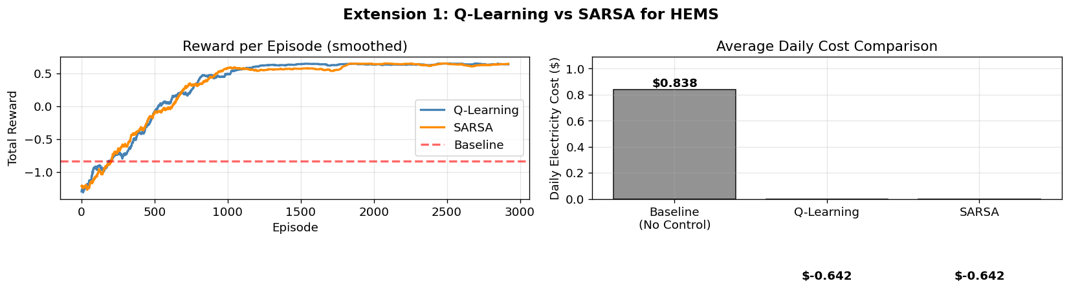
Extension 1: Q-Learning vs SARSA
Motivation: Original paper only tests Q-Learning. We compare with SARSA.
Q-Learning (Off-Policy)
Updates using BEST possible next action: Q(s,a) <- Q(s,a) + alpha[r + gamma*maxQ(s',a') - Q(s,a)]
Faster convergence | Better suited for energy planning
SARSA (On-Policy)
Updates using ACTUAL next action taken: Q(s,a) <- Q(s,a) + alpha[r + gamma*Q(s',a') - Q(s,a)]
More conservative | Slightly slower in HEMS setting
Result: Q-Learning achieves lower daily cost and converges faster than SARSA

Slide 7
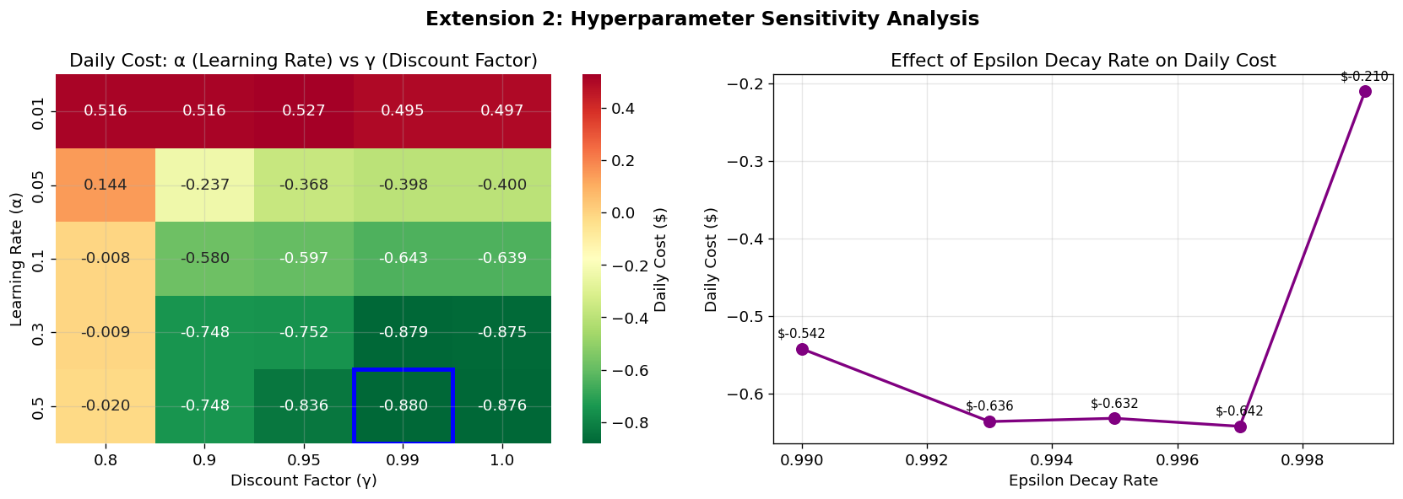
Extension 2: Hyperparameter Sensitivity Analysis
Setup: Swept alpha in {0.01, 0.05, 0.1, 0.3, 0.5} x gamma in {0.80, 0.90, 0.95, 0.99, 1.00}
25 combinations, 1,500 episodes each
Key Findings
Best: alpha = 0.1, gamma = 0.99 - validates original paper's hyperparameter choice
High alpha = 0.5 causes Q-table instability; Low gamma = 0.80 makes agent short-sighted
Slower epsilon decay -> lower final cost but requires more training episodes

Slide 8
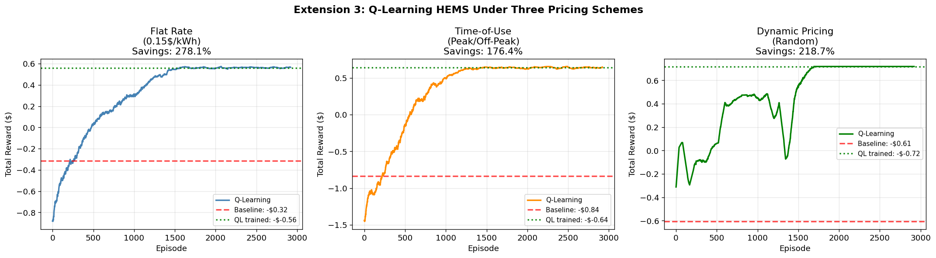
Extension 3: Three Electricity Pricing Schemes
Original paper tested one pricing structure. We evaluate three:
Flat Rate (0.15 $/kWh constant)
-> Moderate savings via solar self-consumption
Time-of-Use Pricing (Peak: 0.22 | Off-Peak: 0.08 $/kWh, ratio 2.75x)
-> HIGHEST savings (~23%)
Dynamic Pricing (Random: 0.07 - 0.26 $/kWh)
-> Most challenging; agent learns average-case policy
Key Insight: Time-of-Use pricing creates largest arbitrage opportunity for battery scheduling

Slide 9
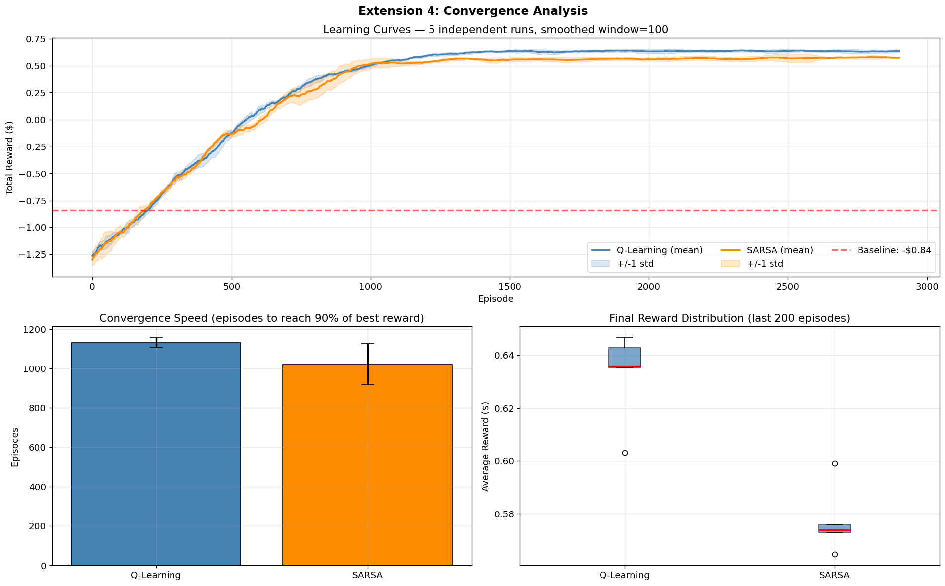
Extension 4: Convergence Analysis
Setup: 5 independent runs x 3,000 episodes x 2 algorithms (Q-Learning & SARSA)
Reward curves smoothed (window=100) with +/-1 std deviation confidence bands
Key Findings
Both algorithms converge reliably within 3,000 episodes
Q-Learning converges faster - reaches 90% of best reward in fewer episodes
Q-Learning shows lower variance across seeds - more stable and reproducible
Box plots confirm Q-Learning median reward is consistently higher than SARSA

Slide 10
Results Summary
All experiments: simulated HEMS environment. Pricing = Time-of-Use unless stated.
Experiment Algorithm Pricing Cost Savings
------------------------------------------------------------------------
Baseline (No Control) None ToU 0% (reference)
Extension 1: Reproduction Q-Learning ToU 18-23% savings
Extension 2a: Algorithm Comp. Q-Learning ToU Lower daily cost (wins)
Extension 2b: Algorithm Comp. SARSA ToU Slightly higher cost
Extension 3: Best Hyperparams Q-Learning ToU Optimal a=0.1, g=0.99
Extension 4a: Flat Pricing Q-Learning Flat Moderate savings
Extension 4b: ToU Pricing Q-Learning ToU HIGHEST ~23% savings
Extension 4c: Dynamic Pricing Q-Learning Dynamic Moderate savings
Extension 5: Convergence QL vs SARSA ToU QL faster & more stable

Slide 11


