Slide 1



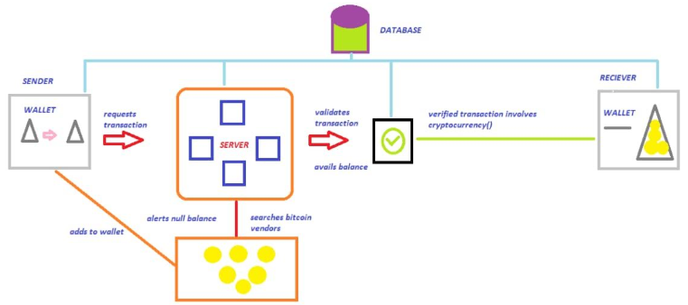
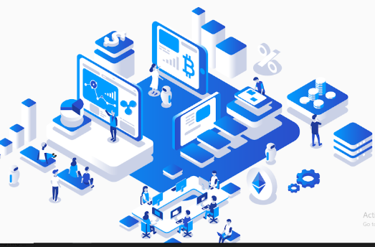
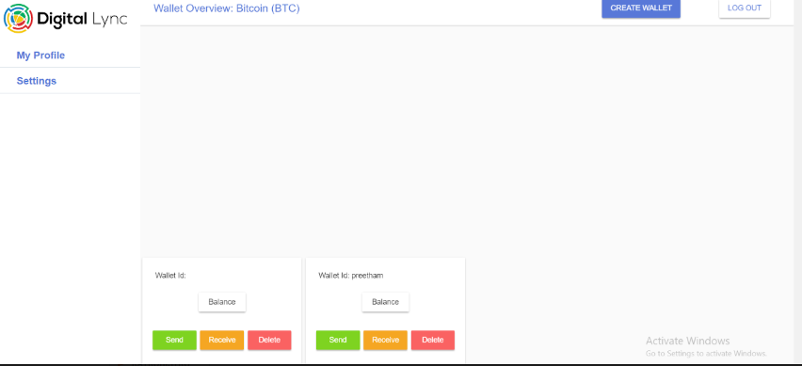
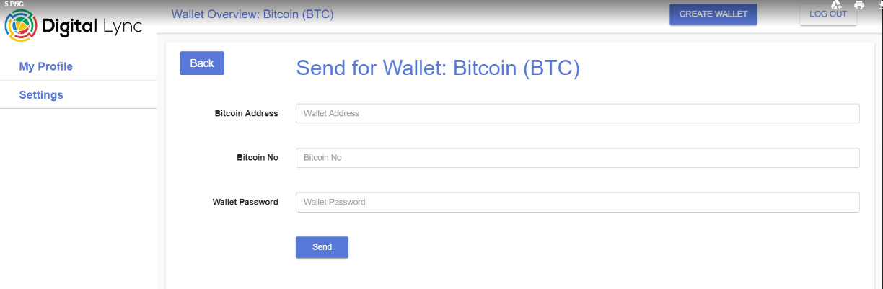
DIGITAL CURRENCY TRANSFER
Y.PRIYANKA (15PQ1A05A1)
P.SHASHI PREETHAM (15PQ1A0577)
T.ROHIT SINGH (15PQ1A0594)
Department of Computer Science Engineering
Under the guidance of Ms.P.Niharika
Tionnt
3
MODULES:
USER: Here individuals can trace personal profile.
WALLET: Send and Receive information’s are maintained.
Tionnt
3
ABSTRACT:
ARCHITECTURE:
INTRODUCTION:
Digital currency transfer is mainly opted to transfer money in secured way.
These transfers are assured security by using the block chain technology.
These transfers takes place by using bit coins.
This mode of transaction is mainly used for forwarding amounts in large figures.
.
FUTURE ENHANCEMENT:
Present project is dynamic web application which can modified or updated.
If there exists any more security project can be updated or modified.
3. Any graphical modification or updation to interface is accepted to the project.
EXISTING SYSTEM:
SCREEN SHOTS:
At the initial age bit coin is physical form of curreny.
2. Bit coin is digital currency created in 2009 by a mysterious figure Satoshi Sakamoto.
3. Even though later on it was devitalised there were some loop holes like loosing of wallets, no security etc...
REFERENCES:
SCOPE OF THE PROJECT:
The purpose of this application is
mainly to provide security and
also to avoid 3rd party’s like banks.
PROPOSED SYSTEM:
1.The main feature of the present system is the security of the transfer which is the prior customer aspect.
2.This system mainly poses the aspects of secure crypto currency which is formerly renown to most of the merchants.
3.The block chain technology mainly involved is used to minimize the task of rotation.
REFERENCES:
Websites::
www.wikipedia.com
www.getbootstrap.com
Books:
Block chain by Melanie Swan
the Bit coin standard by Wiley.
Notes:
LL

