Slide 1
CYBERBULLYING DETECTION ON SOCIAL NETWORKS USING HYBRID RNN-LSTM MODELS

Slide 2
INTRODUCTION
Cyberbullying refers to the act of using digital communication tools, such as social media, text messages, or emails, to harass, threaten, or intimidate individuals. It often involves sending hurtful or offensive messages, spreading rumors, sharing private information, or posting derogatory comments or images online. Cyberbullying can have severe emotional and psychological effects on the victims.
In our project we’ll identify whether the comment or tweet is cyberbullying or non cyberbullying.

Slide 3
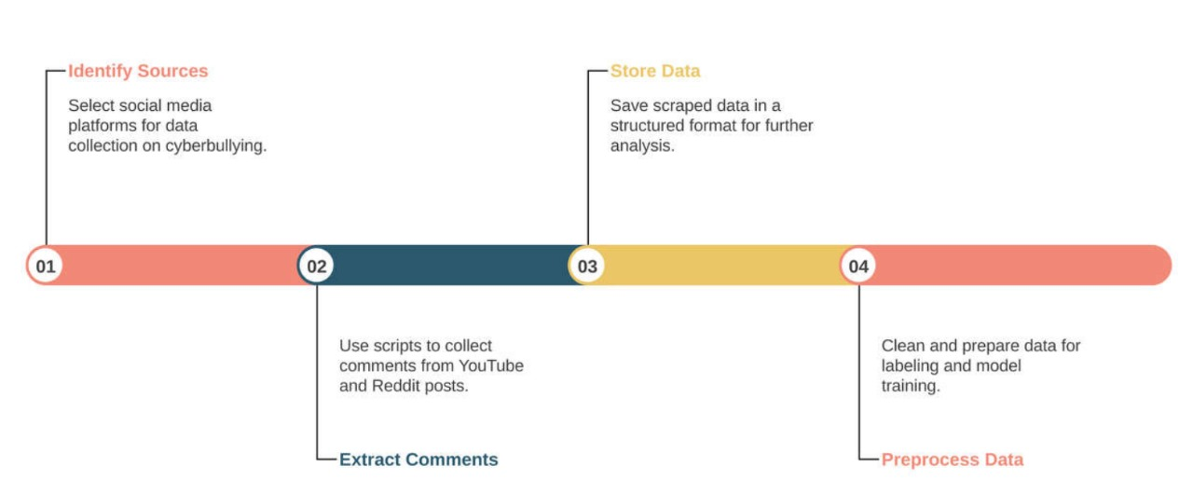
WEB SCRAPING
Web scraping is a technique used to extract large amounts of data from websites in an automated fashion, and it is particularly useful for collecting user-generated content such as comments from platforms like Reddit and YouTube.
. Using Python libraries such as PRAW (Python Reddit API Wrapper) and Google’s YouTube Data API, we can efficiently gather comments from specific posts or videos.

Slide 4




DATA LABELLING
Data labeling is an essential process where data points are tagged with labels to train models for specific tasks.
We manually reviewed each comment and assigned a binary label: 1 for comments that exhibited signs of cyberbullying, such as harassment, insults, or aggressive language, and 0 for comments that were neutral or non-harmful.

Slide 5
MILESTONE
MILESTONE 3
Training and evaluation of various models(RNN,LSTM) - Choose the best performing model.
MILESTONE 4
Development of user interface (GUI) using Flask - Textbox for comments and output indicating cyberbullying or not.
MILESTONE 1
Web scraping and data labeling
MILESTONE 2
Exploring baseline models- Logistic Regression, Random Forests

Slide 6
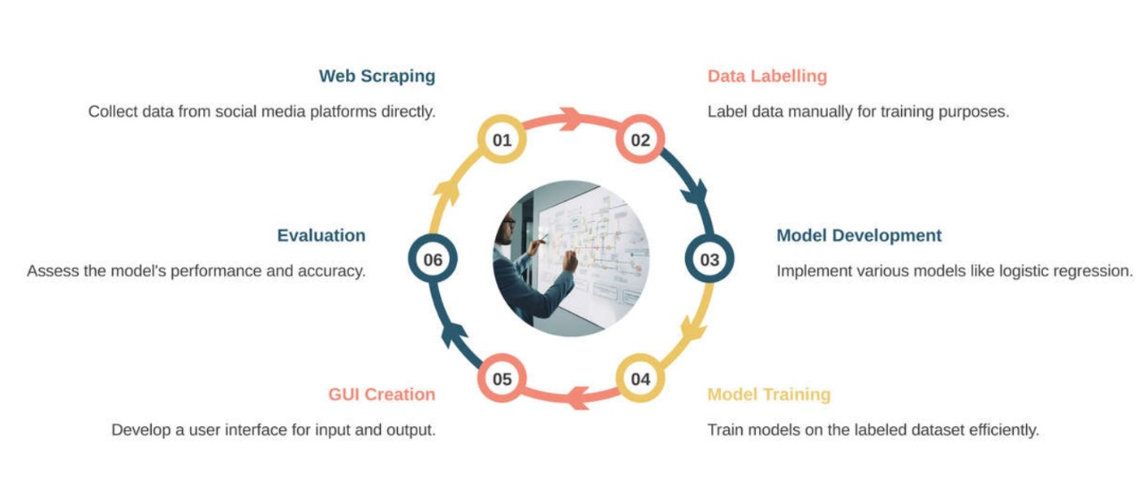
FLOWCHART

Slide 7
BASELINE MODELS USED
LOGISTIC REGRESSION:
Logistic Regression is a simple and widely used algorithm for binary classification tasks like detecting cyberbullying vs. non-cyberbullying comments.
ADVANTAGES:
Simplicity and Efficiency
Interpretable
Works Well with Linear Decision Boundaries
RANDOM FORESTS:
Random forests are an ensemble method using multiple decision trees to make predictions. The final prediction is based on majority vote from all trees.
ADVANTAGES:
Robustness
Feature Importance
Versatile

Slide 8
Cont’d
NAÏVE BAYES:
Naïve Bayes classifier apply Bayes’ theorem with an assumption of independence between features. For text data, Multinomial Naïve Bayes is used.
ADVANTAGES:
Simple and Fast
Good for high-dimensional data
Baseline Performance
SUPPORT VECTOR MACHINE(SVM):
SVM works by finding a hyperplane that best separates the classes.
ADVANTAGES:
Effective
Robust
Good for Binary Classification

Slide 9
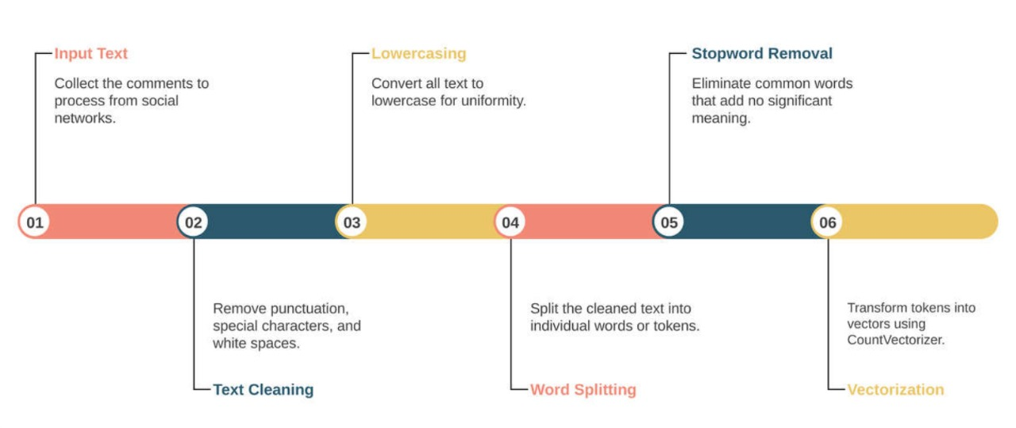
TOKENIZATION

Slide 10
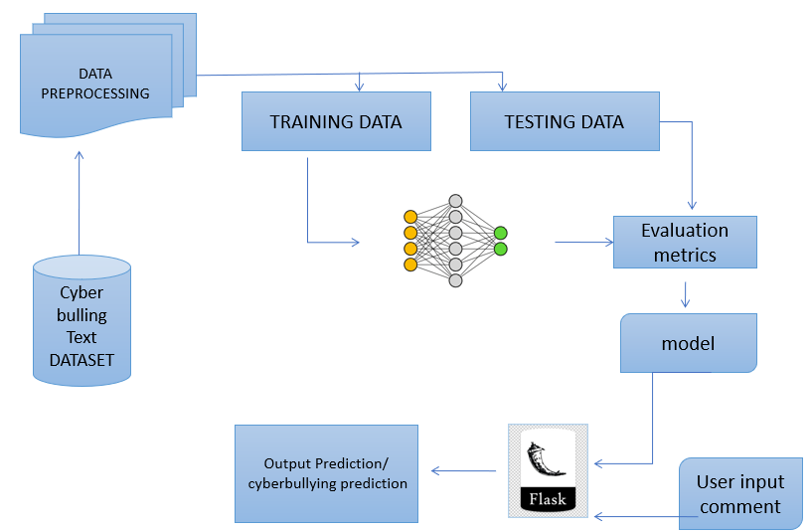
AFTER TOKENIZATION

Slide 11
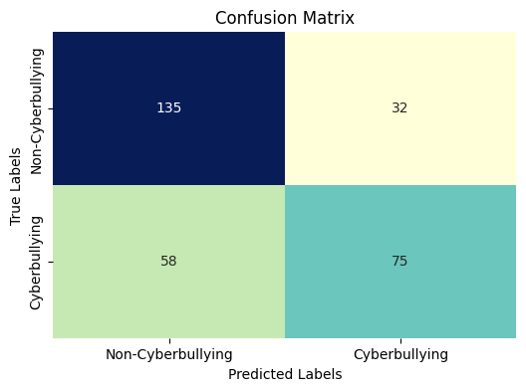
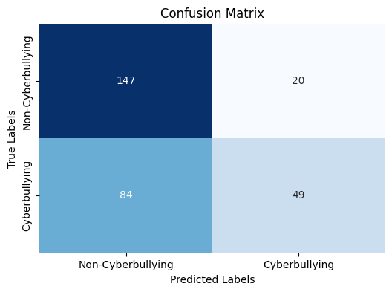
CONFUSION MATRIX
Confusion matrix for Logistic Regression Confusion matrix for Random forest

Slide 12
ANALYSIS
Accuracy of different models at various test sizes
Test size Model | 20% | 25% | 30% | 35%
Logistic Regression | 65 | 68 | 70 | 69
Random Forest | 60 | 63 | 65 | 67
Naïve Bayes | 59 | 60 | 64 | 63
SVM | 64 | 66 | 67 | 69
Test size Model | 20% | 25% | 30% | 35%
Logistic Regression | 74 | 70 | 71 | 72
Random Forest | 67 | 66 | 67 | 68
Naïve Bayes | 71 | 68 | 69 | 69
SVM | 75 | 71 | 69 | 70
For 1000 comments For 2031 comments

Slide 13
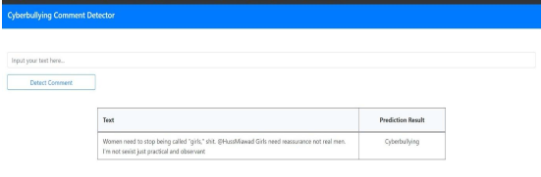
CONCLUSION
Project's achievements until Milestone 2:
Web scraping and data labeling for cyberbullying detection.
Exploration of baseline models (Logistic Regression, Random Forests).
FUTURE WORK:
Training and testing the Hybrid RNN-LSTM model.
Development of the user interface using Flask.
END RESULT:

Slide 14
TEAM MEMBERS
D. HARICHANDANA D. SUDHEER
K. RAGHUNADHA RAO
T. PRASHANTH

