Slide 1

BLOCKCHAIN
Prof. Sunitha R
Department of Computer Science and Engineering

Slide 2

BLOCKCHAIN
Bitcoin Blockchain Network
Prof. Sunitha R
Department of Computer Science and Engineering

Slide 3
BLOCKCHAIN
Learning Content
Learn about one open network public blockchain i.e. bitcoin, coin creation and spending in blockchain network.

Slide 4
BLOCKCHAIN
Bitcoin – The Beginning
“A decentralized digital currency enables instant payments to anyone, anywhere in the world”.
– en.bitcoin.it
No central authority, uses peer-to-peer technology.
Two broad operations
Transaction Management – transfer of bitcoins from one user to another.
Money Issuance – regulate the monetary base.

Slide 5
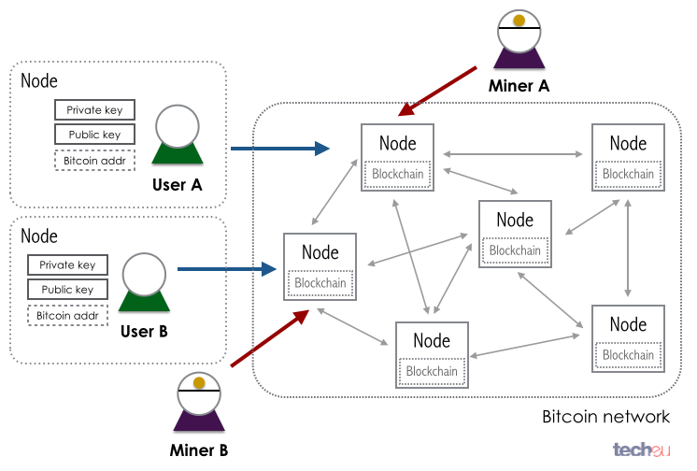
BLOCKCHAIN
Bitcoin Overview

Slide 6
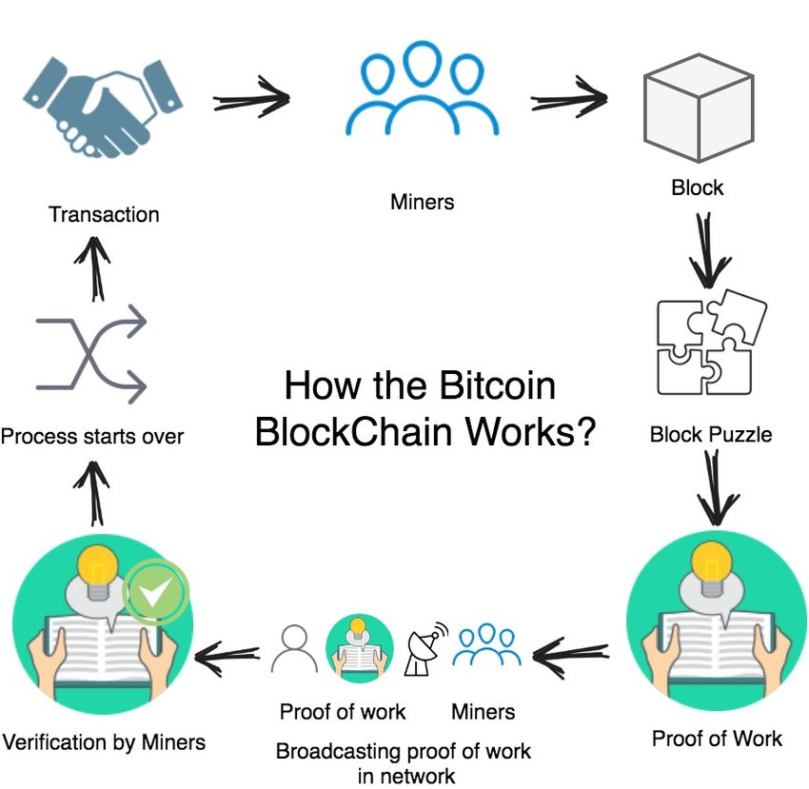
BLOCKCHAIN
Bitcoin Overview

Slide 7
BLOCKCHAIN
Bitcoin Basics – Creation of Coins
The number of bitcoins generated per block is set to decrease geometrically, with a 50% reduction for every 210,000 blocks, or approximately 4 years.
This reduces, with time, the amount of bitcoins generated per block
Theoretical limit for total bitcoins: Slightly less than 21 million
Miners will get less reward as time progresses
How to pay the mining fee – increase the transaction fee

Slide 8
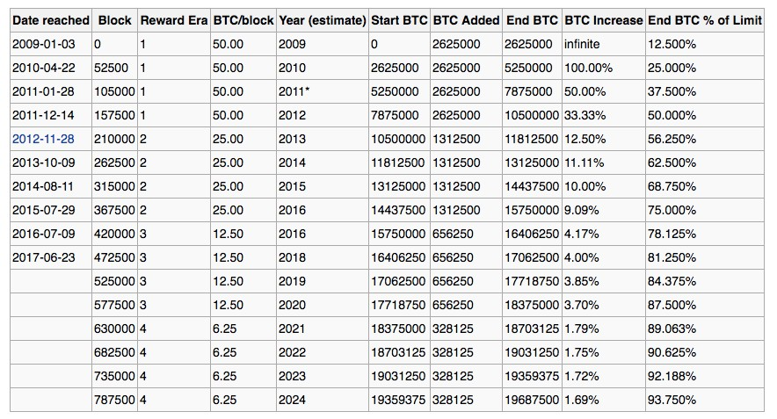
BLOCKCHAIN
Projected Bitcoin

Slide 9
BLOCKCHAIN
Bitcoin Basics – Sending Payments
Need to ensure that Eve cannot spend Alice’s bitcoins by creating transactions in her name.
Bitcoin uses public key cryptography to make and verify digital signatures.
Each person has one or more addresses each with an associated pair of public and private keys (may hold in the bitcoin wallet)

Slide 10


BLOCKCHAIN
Bitcoin Basics – Sending Payments
Alice wish to transfer some bitcoin to Bob.
Alice can sign a transaction with her private key
Anyone can validate the transaction with Alice’s public key
^{T}(A->B)^{, S}A^{(T}(A->B)⁾

Slide 11
BLOCKCHAIN
Bitcoin Basics – Sending Payments
Alice wants to send bitcoin to Bob
Bob sends his address to Alice.
Alice adds Bob’s address and the amount of bitcoins to transfer in a “transaction” message.
Alice signs the transaction with her private key, and announces her public key for signature verification.
Alice broadcasts the transaction on the Bitcoin network for all to see.

Slide 12





BLOCKCHAIN
Double Spending
Same bitcoin is used for more than one transactions
In a centralized system, the bank prevents double spending
How can we prevent double spending in a decentralized network?

Slide 13
BLOCKCHAIN
Handle Double Spending using Blockchain
Details about the transaction are sent and forwarded to all or as many other computers as possible.
Use Blockchain – a constantly growing chain of blocks that contain a record of all transactions
The blockchain is maintained by all peers in the Bitcoin network – everyone has a copy of the blockchain

Slide 14
BLOCKCHAIN
Handle Double Spending using Blockchain
To be accepted in the chain, transaction blocks must be valid and must include proof of work – a computationally difficult hash generated by the mining procedure.
Blockchain ensures that, if any of the block is modified, all following blocks will have to be recomputed.

Slide 15
BLOCKCHAIN
Handle Double Spending using Blockchain
When multiple valid continuation to this chain appear, only the longest such branch is accepted, and it is then extended further (longest chain).
Once a transaction is committed in the blockchain, everyone in the network can validate all the transactions by using Alice’s public address.
The validation prevents double spending in bitcoin.

Slide 16
BLOCKCHAIN
Bitcoin Anonymity
Bitcoin is permission-less, you do not need to setup any “account”, or required any e-mail address, user name or password to login to the wallet.
The public and the private keys do not need to be registered, the wallet can generate them for the users.
The bitcoin address is used for transaction, not the user name or identity.
Information Source: https://en.bitcoin.it/wiki/

Slide 17
BLOCKCHAIN
Bitcoin Anonymity
A bitcoin address mathematically corresponds to a public key based on ECDSA – the digital signature algorithm used in bitcoin
A sample bitcoin address: 1PHYrmdJ22MKbJevpb3MBNpVckjZHt89hz
Each person can have many such addresses, each with its own balance
– Difficult to know which person owns what amount
Information Source: https://en.bitcoin.it/wiki/

Slide 18
BLOCKCHAIN
Bitcoin P2P Network
An ad-hoc network with random topology, Bitcoin protocol runs on TCP port 8333.
All nodes (users) in the bitcoin network are treated equally.
New nodes can join any time, non-responding nodes are removed after 3 hours.

Slide 19
BLOCKCHAIN
Joining in a Bitcoin P2P Network

Slide 20
BLOCKCHAIN
Joining in a Bitcoin P2P Network

Slide 21
BLOCKCHAIN
Joining in a Bitcoin P2P Network
Seed Node
Give me the address

Slide 22
BLOCKCHAIN
Joining in a Bitcoin P2P Network
Seed Node
<address list>

Slide 23
BLOCKCHAIN
Joining in a Bitcoin P2P Network
Seed Node

Slide 24
BLOCKCHAIN
Joining in a Bitcoin P2P Network
Get most recent blockchain

Slide 25
BLOCKCHAIN
Joining in a Bitcoin P2P Network
Start transaction

Slide 26
BLOCKCHAIN
Supplementary readings
https://en.bitcoin.it/wiki/
https://bitcoin.org/en/
https://ieeexplore.ieee.org/courses/details/EDP520
https://ieeexplore.ieee.org/document/8946183
https://ieeexplore.ieee.org/document/8756455

Slide 27
THANK YOU
Prof. Sunitha R
Department of Computer Science and Engineering
sunithar@pes.edu

