Slide 1

BLOCKCHAIN
Sunitha R
Department of Computer Science Engineering

Slide 2

BLOCKCHAIN
Cryptographic Ciphers
Sunitha R
Department of Computer Science Engineering

Slide 3
BLOCKCHAIN
Learning Content
Learn about the types of Cryptography, few ciphers of each type and examples.

Slide 4
BLOCKCHAIN
Types of Cryptographic ciphers
Single-key or Symmetric- Key Cryptography
Ex: AES, DES
Public-key or Asymmetric-Key Cryptography
Ex: RSA

Slide 5
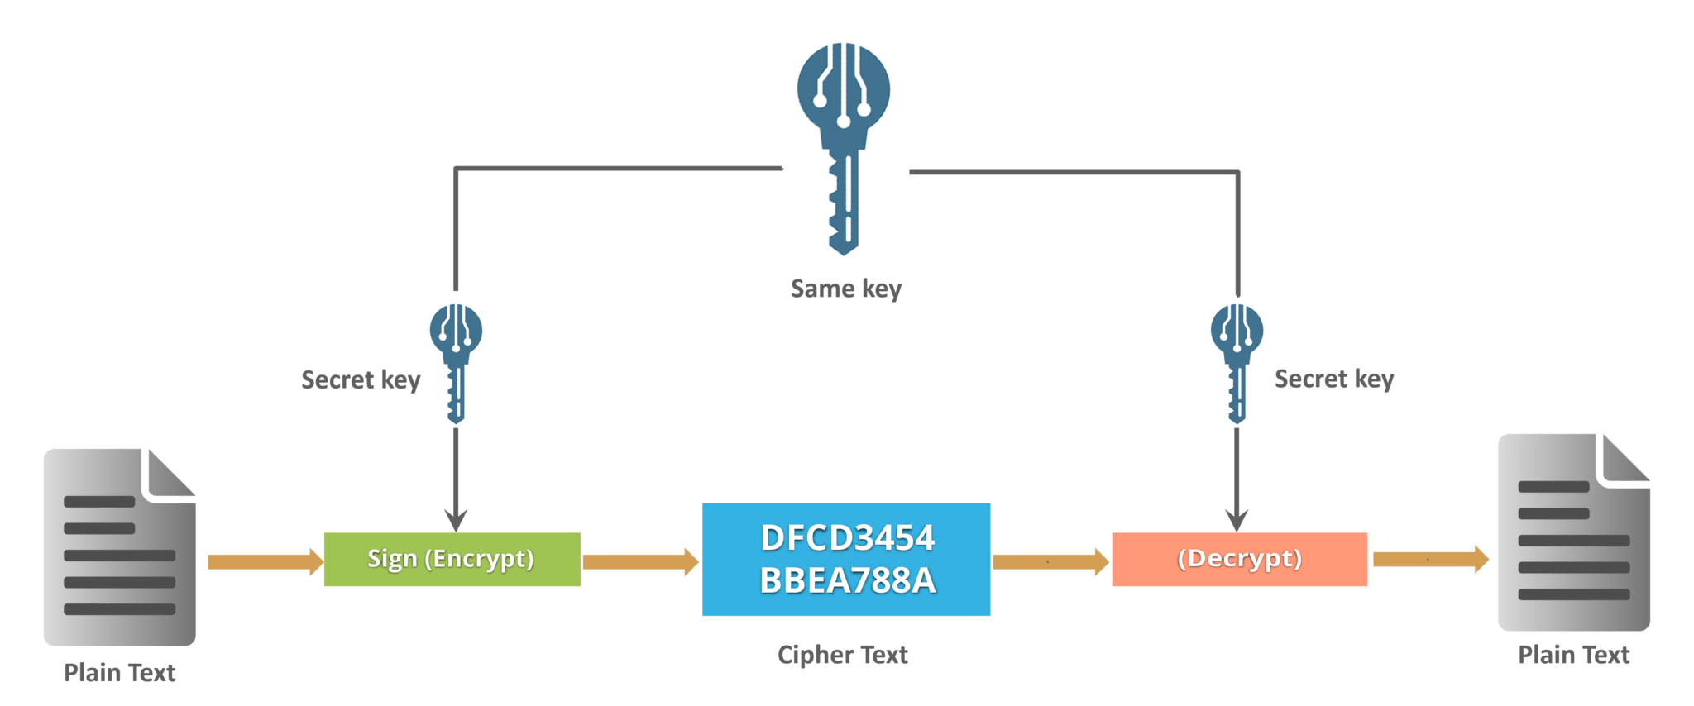
BLOCKCHAIN
Symmetric Key Cryptography

Slide 6
BLOCKCHAIN
Symmetric Key Ciphers
Transposition Cipher
Substitution Cipher
Stream Ciphers
Block Cipher

Slide 7






BLOCKCHAIN
Transposition Cipher
Plain Text: MEET ME AFTER PARTY
Key: 421635
1 | 2 | 3 | 4 | 5 | 6
M | E | E | T | M | E
A | F | T | E | R | P
A | R | T | Y
Cipher Text= TEMEEMEFAPTRYRAT

Slide 8
BLOCKCHAIN
Substitution Cipher
Plain Text : Data Encryption
Key word : 4
1 | 2 | 3 | 4 | 5 | 6 | 7 | 8 | 9 | 10 | 11 | 12 | 13 | 14 | 15 | 16 | 17 | 18 | 19 | 20 | 21 | 22 | 23 | 24 | 25 | 26
A | B | C | D | E | F | G | H | I | J | K | L | M | N | O | P | Q | R | S | T | U | V | W | X | Y | Z
“D” will be replaced with the next 4th alphabet “H” in cipher text
Cipher Text : Hexe Irgvctxmsr

Slide 9
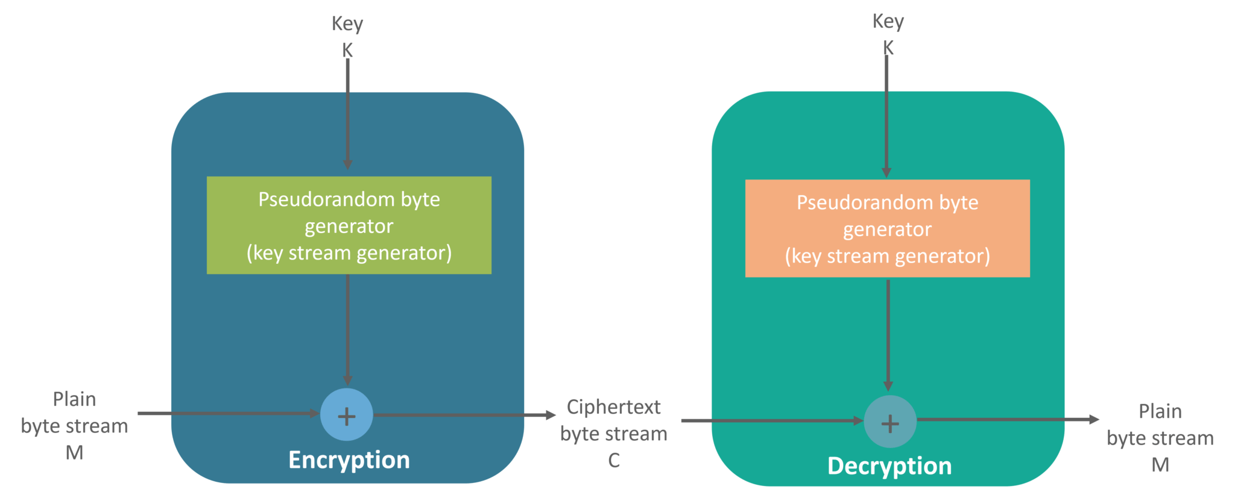
BLOCKCHAIN
Stream Cipher
Ex: Vernam Cipher

Slide 10
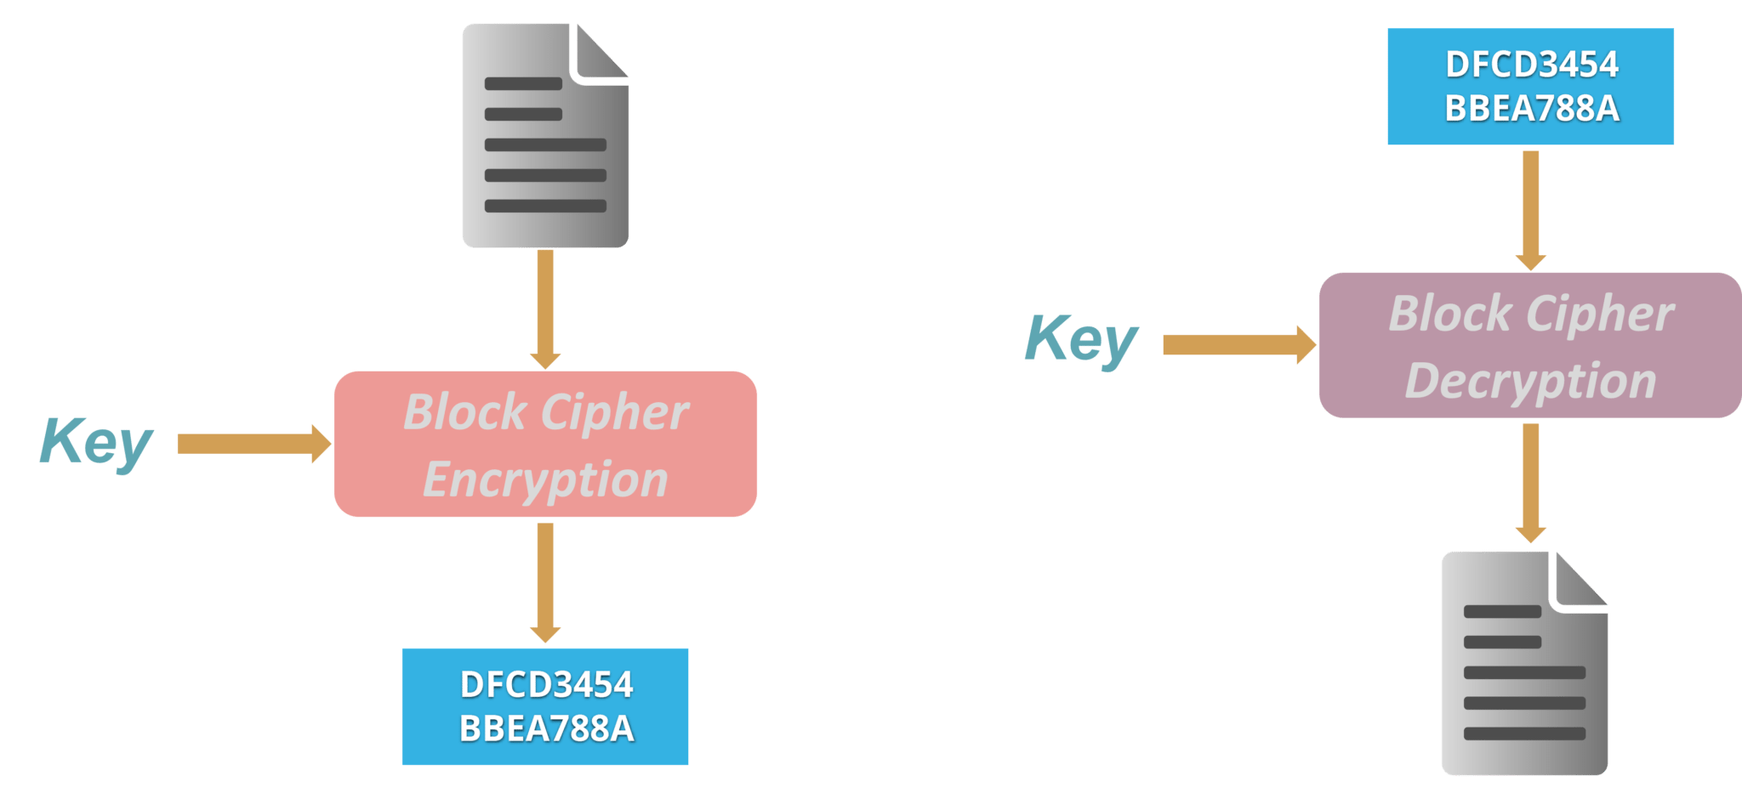
BLOCKCHAIN
Block Cipher
Ex. Feistel Cipher

Slide 11
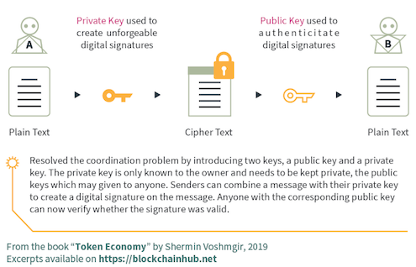
BLOCKCHAIN
Asymmetric Key Cryptography

Slide 12
BLOCKCHAIN
Asymmetric Key Ciphers
RSA
Diffie Helman

Slide 13
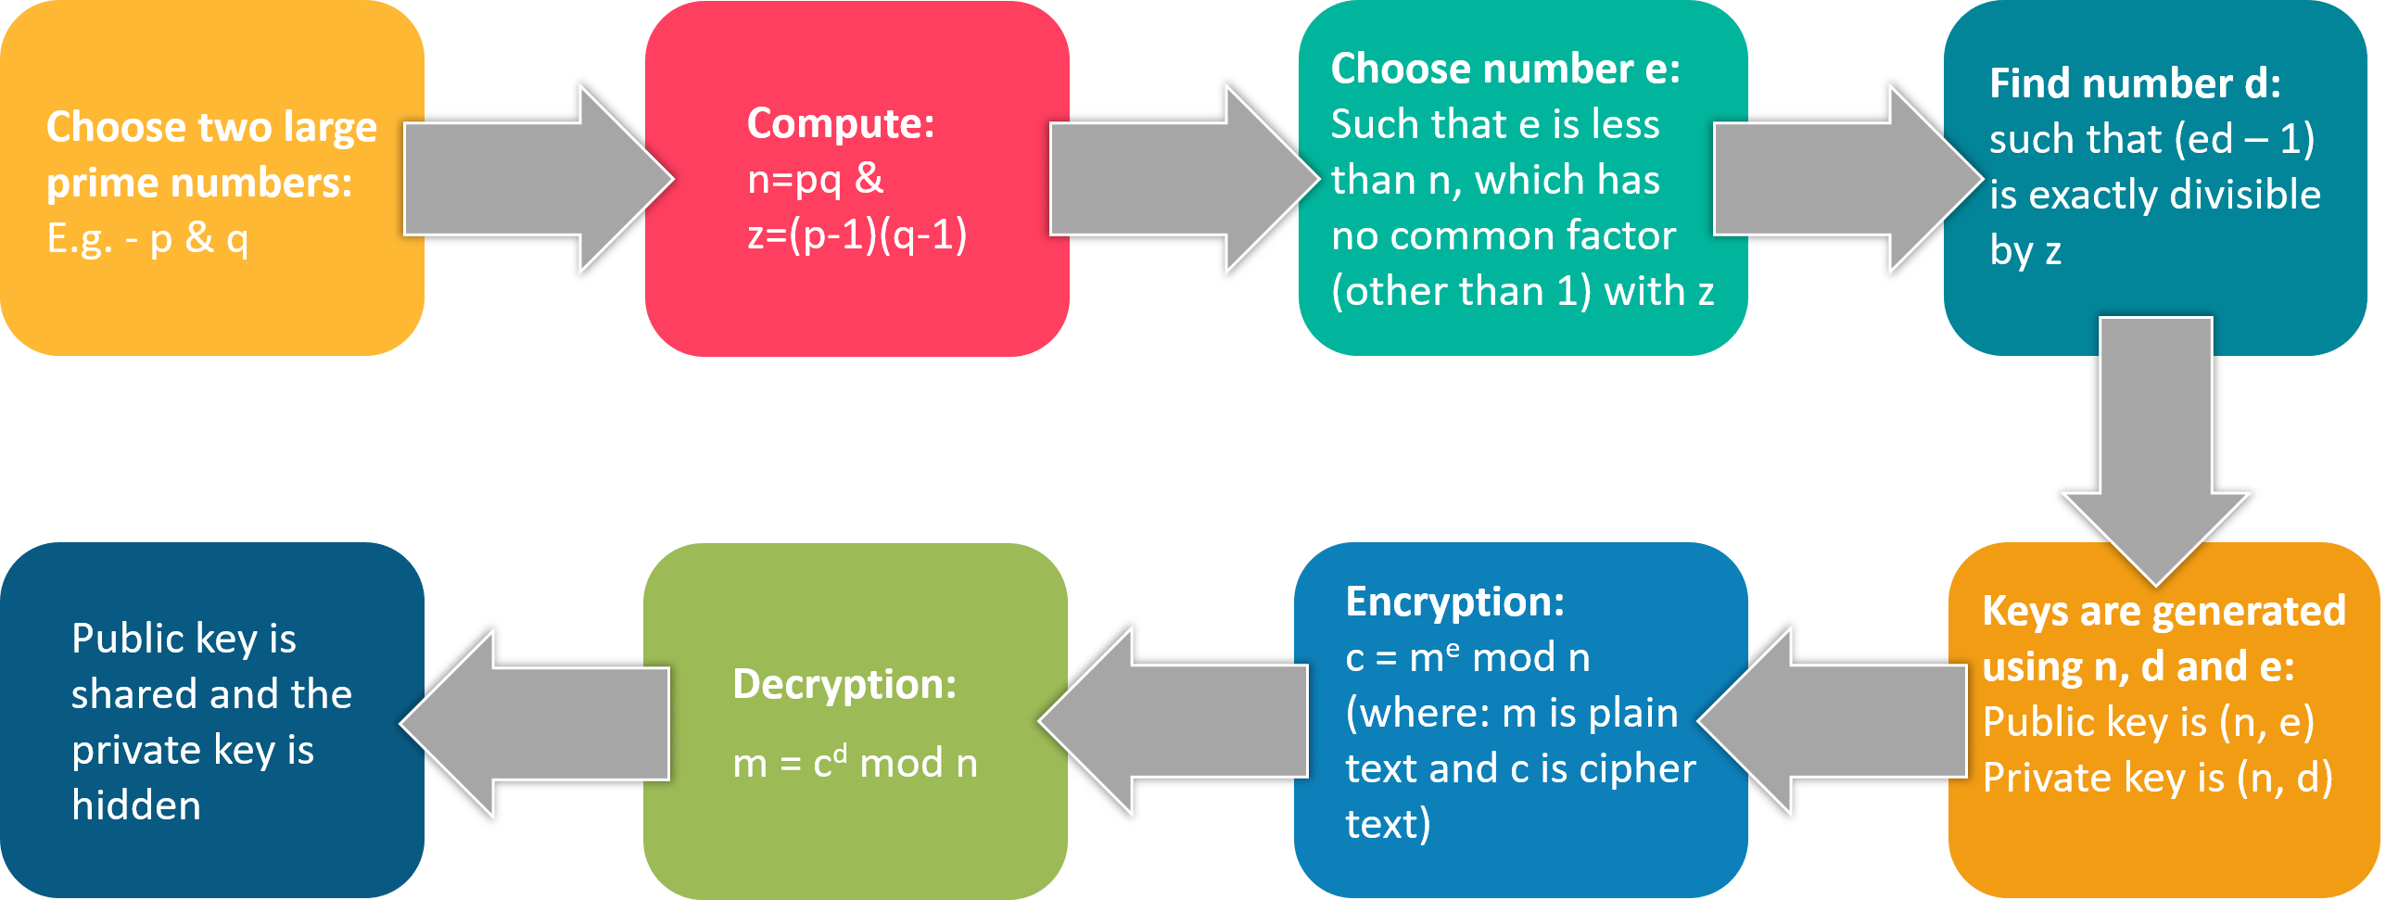
BLOCKCHAIN
RSA

Slide 14


BLOCKCHAIN
Example
Suppose Alice wants her friends to encrypt email messages before sending them to her. Computers represent text as long numbers (01 for “A”, 02 for “B” and so on), so an email message is just a very big number. The RSA Encryption Scheme is often used to encrypt and then decrypt electronic communications.
Alice (n,d)
Bob (n,e)

Slide 15
BLOCKCHAIN
Example
Alice’s Setup:
Choose two prime number p and q
Lets take p=11 and q=3
n = pq = 11 × 3 = 33
z = (p − 1)(q − 1) = 10 × 2 = 20.
If e = 3 and d = 7, then ed = 21 has a remainder of 1 when divided by m = 20.
Publish (n, e) = (33, 3).
Alice (n,d)

Slide 16
BLOCKCHAIN
Example
Bob encrypts message M = 14 :
• (n, e) = (33, 3).
• When 14³ = 2744 is divided by 33, the remainder is C = 5.
• Sends ciphertext C = 5 to Alice.
Bob (n,e)
Alice decrypts ciphertext C = 5:
• (n, d) = (33, 7).
• When 5⁷ = 78125 is divided by 33, the remainder is M = 14.
• M = 14 , the original message from Bob!
Alice (n,d)

Slide 17
BLOCKCHAIN
Supplementary readings
https://ieeexplore.ieee.org/document/8643934
https://ieeexplore.ieee.org/document/8890452
https://ieeexplore.ieee.org/document/8918895

Slide 18
THANK YOU
Sunitha R
Department of Computer Science Engineering
sunithar@pes.edu
+91 80 6666 3333 Extn 721

