Slide 1

BLOCKCHAIN
Sunitha R
Department of Computer Science Engineering

Slide 2

BLOCKCHAIN
Digital Signature
Sunitha R
Department of Computer Science Engineering

Slide 3
BLOCKCHAIN
Learning Content
Get the basic idea of digital signature.
Learn about the implementation and usage of digital signature in blockchain.

Slide 4
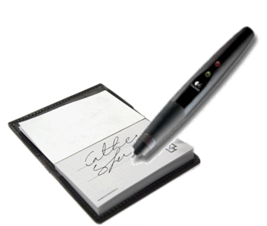
BLOCKCHAIN
Digital Signature
Digital signatures are like electronic “fingerprints”.
In the coded message, the digital signature securely associates a signer with a document in a recorded transaction.
Digital signatures use a standard, accepted format, called Public Key Infrastructure (PKI)

Slide 5
BLOCKCHAIN
History
Use of signatures is recorded in the Talmud (fourth century).
Affixing handwritten signatures began to be used within the Roman Empire in the year AD 439, during the rule of Valentinian III.
It is from this Roman usage of signatures that the practice obtained its significance in Western legal tradition.

Slide 6
BLOCKCHAIN
Why Digital Signature?
To provide Authenticity, Integrity and Non-repudiation to electronic documents
To use the Internet as the safe and secure medium for Banking, e-Commerce and e-Governance with Security of Servers

Slide 7
BLOCKCHAIN
Key Components
Hash function
Public key cryptography
Public key infrastructure (PKI)
Certificate authority (CA)
Digital certificates
Pretty Good Privacy (PGP)/OpenPGP

Slide 8
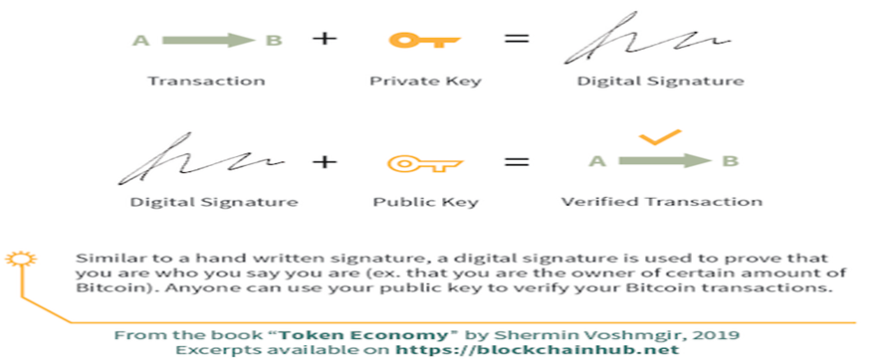
BLOCKCHAIN
Digital Signature for Blockchain

Slide 9
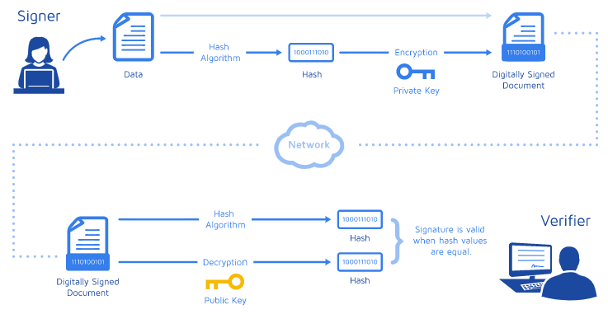
BLOCKCHAIN
Digital Signature for Blockchain
Notes:
How do digital signatures work?
Digital signatures, like handwritten signatures, are unique to each signer. Digital signature solution providers, such as DocuSign, follow a specific protocol, called PKI. PKI requires the provider to use a mathematical algorithm to generate two long numbers, called keys. One key is public, and one key is private.
When a signer electronically signs a document, the signature is created using the signer’s private key, which is always securely kept by the signer. The mathematical algorithm acts like a cipher, creating data matching the signed document, called a hash, and encrypting that data. The resulting encrypted data is the digital signature. The signature is also marked with the time that the document was signed. If the document changes after signing, the digital signature is invalidated.
As an example, Jane signs an agreement to sell a timeshare using her private key. The buyer receives the document. The buyer who receives the document also receives a copy of Jane’s public key. If the public key can’t decrypt the signature (via the cipher from which the keys were created), it means the signature isn’t Jane’s, or has been changed since it was signed. The signature is then considered invalid.
To protect the integrity of the signature, PKI requires that the keys be created, conducted, and saved in a secure manner, and often requires the services of a reliable Certificate Authority (CA). Digital signature providers, like DocuSign, meet PKI requirements for safe digital signing.

Slide 10
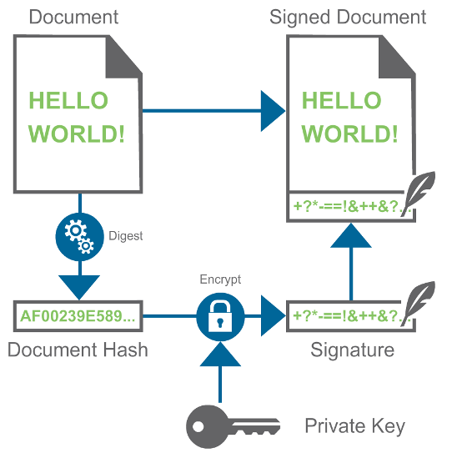
BLOCKCHAIN
Digital Signature Creation
Notes:
A digital signature is a widely used security technique for assuring the integrity of data and authentication of its signer.
The first step in creating a digital signature is to use asymmetric cryptography (also known as public-key cryptography) to generate a pair of keys:
Public key: available to anyone. It is used during the authentication process.
Private key: only known by the signer. It is used in the signing process.
These keys are complementary: if data is encrypted with the private key, then the public key is required to decrypt the data. In a similar way, if the public key is used to encrypt the data, the private key should be used in the decryption.
To generate the signature of a document, encrypt it with the private key, which only the signer has. Note that this does not provide any confidentiality: the public key is known to anyone, so anyone can decrypt the document. However, decrypting the signature with the public signer key and obtaining the same document guarantees that:
The signature was generated by the private key. (Otherwise, the decryption procedure would fail.) And since only the signer has access to the private key, the signature was generated by the signer.
The document has not been modified. (Otherwise, the document would not match the document obtained with the signature.)
Since the signature is the same size as the document, the signed document ends up to be twice the document size. To solve this problem, a cryptographic hash is introduced.
A cryptographic hash (also know as digest) is a function that maps data of any size to data of a fixed size and which is designed to be a one-way function. A cryptographic hash is impossible to invert. Several properties of the hash allows the function to be used in this context without introducing weakness in the scheme:
Changes in the data produce changes in the hash of the data in an untraceable way.
Given the hash of some data, it is infeasible to generate other data that has the same hash.
Instead of encrypting the entire document to generate the signature, the signature is generated from just the hash of the document. This keeps the size of the signature relatively small. The image below shows the complete process:

Slide 11
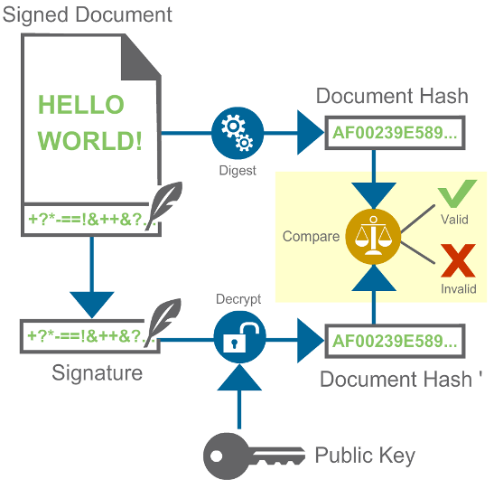
BLOCKCHAIN
Digital Signature Verification
Notes:
Authenticating a signed document
To authenticate a signed document, follow this procedure:
Decrypt the signature to obtain the hash of the original document.
Compute the hash of the document.
Compare the hashes. For them to match, the following conditions must be met:
The document has not been modified. This provides the integrity guarantee.
The key that was used to generate the signature is the private key associated to the public key that you used. This provides the authentication guarantee.
If the hashes match, the signature is correct and the document is valid. The following diagram illustrates the authentication process:

Slide 12
BLOCKCHAIN
Digital Signature in Blockchain
Bitcoin uses Elliptic Curve Digital Signature Algorithm (ECDSA) Based on elliptic curve cryptography Supports good randomness in key generation
Notes:
Authenticating a signed document
To authenticate a signed document, follow this procedure:
Decrypt the signature to obtain the hash of the original document.
Compute the hash of the document.
Compare the hashes. For them to match, the following conditions must be met:
The document has not been modified. This provides the integrity guarantee.
The key that was used to generate the signature is the private key associated to the public key that you used. This provides the authentication guarantee.
If the hashes match, the signature is correct and the document is valid. The following diagram illustrates the authentication process:

Slide 13
BLOCKCHAIN
Digital Signature in Blockchain
A:10, Sig(A)
Alice generates 10 coins
Sign the transaction A:10 using Alice’s private key and put that in the blockchain
Notes:
Authenticating a signed document
To authenticate a signed document, follow this procedure:
Decrypt the signature to obtain the hash of the original document.
Compute the hash of the document.
Compare the hashes. For them to match, the following conditions must be met:
The document has not been modified. This provides the integrity guarantee.
The key that was used to generate the signature is the private key associated to the public key that you used. This provides the authentication guarantee.
If the hashes match, the signature is correct and the document is valid. The following diagram illustrates the authentication process:

Slide 14
BLOCKCHAIN
Digital Signature in Blockchain
H(0)
H(1)
A->B:5
A:10, Sig(A)
A->B:5, Sig(A)
Alice transfers 5 coins to Bob
Sign the transaction A-B:5 using Alice’s private key and put that in the blockchain
Notes:
Authenticating a signed document
To authenticate a signed document, follow this procedure:
Decrypt the signature to obtain the hash of the original document.
Compute the hash of the document.
Compare the hashes. For them to match, the following conditions must be met:
The document has not been modified. This provides the integrity guarantee.
The key that was used to generate the signature is the private key associated to the public key that you used. This provides the authentication guarantee.
If the hashes match, the signature is correct and the document is valid. The following diagram illustrates the authentication process:

Slide 15
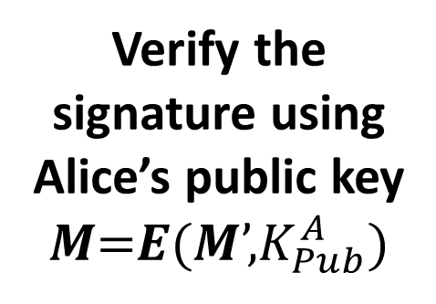
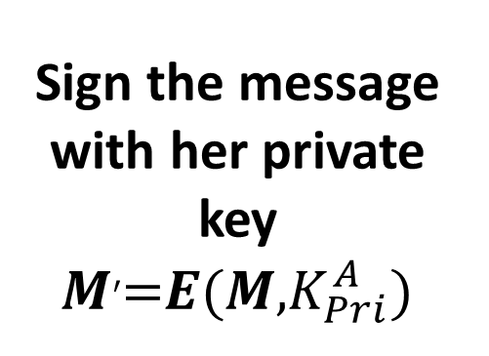
BLOCKCHAIN
Digital Signature using Public Key Cryptography
M, M’
Sign the message with her private key 𝑴′=𝑬(𝑴,$K_{Pri}^{A}$)
Verify the signature using Alice’s public key 𝑴=𝑬(𝑴’,$K_{Pub}^{A}$)
Notes:
Authenticating a signed document
To authenticate a signed document, follow this procedure:
Decrypt the signature to obtain the hash of the original document.
Compute the hash of the document.
Compare the hashes. For them to match, the following conditions must be met:
The document has not been modified. This provides the integrity guarantee.
The key that was used to generate the signature is the private key associated to the public key that you used. This provides the authentication guarantee.
If the hashes match, the signature is correct and the document is valid. The following diagram illustrates the authentication process:

Slide 16
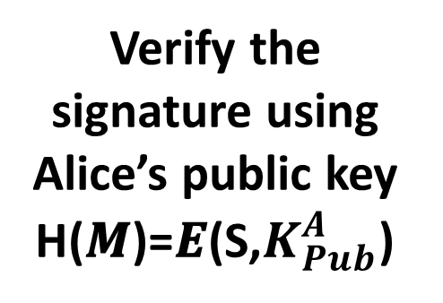
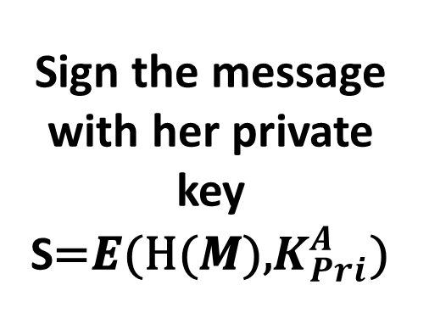
BLOCKCHAIN
Reduce the Signature Size
Use the message digest to sign, instead of the original message
M, S
Sign the message with her private key S=𝑬(H(𝑴),$K_{Pri}^{A}$)
Verify the signature using Alice’s public key H(𝑴)=𝑬(S,$K_{Pub}^{A}$)
Notes:
Authenticating a signed document
To authenticate a signed document, follow this procedure:
Decrypt the signature to obtain the hash of the original document.
Compute the hash of the document.
Compare the hashes. For them to match, the following conditions must be met:
The document has not been modified. This provides the integrity guarantee.
The key that was used to generate the signature is the private key associated to the public key that you used. This provides the authentication guarantee.
If the hashes match, the signature is correct and the document is valid. The following diagram illustrates the authentication process:

Slide 17
BLOCKCHAIN
Digital Signature Ensures
Confidentiality
Authentication
Integrity
Non-repudiation
Notes:
Confidentiality – The ability to keep data hidden from unauthorized parties.
Authentication – This property involves being able to verify that the other party is really who they say they are, and not some impostor or spy.
Integrity – If data retains its integrity, it means that it hasn’t been altered or tampered with by anyone else.
Non-repudiation – This property essentially means that the individual or entity who was responsible for an action cannot claim that they weren’t involved.

Slide 18

BLOCKCHAIN
Applications
Electronic Mail
Data storage
Electronic funds transfer
Software Distribution
eGovernance Applications

Slide 19
BLOCKCHAIN
Additional links to read
http://www.mca.gov.in/MinistryV2/digitalsignaturecertificate.html
https://www.emudhradigital.com/
Notes:
Authenticating a signed document
To authenticate a signed document, follow this procedure:
Decrypt the signature to obtain the hash of the original document.
Compute the hash of the document.
Compare the hashes. For them to match, the following conditions must be met:
The document has not been modified. This provides the integrity guarantee.
The key that was used to generate the signature is the private key associated to the public key that you used. This provides the authentication guarantee.
If the hashes match, the signature is correct and the document is valid. The following diagram illustrates the authentication process:

Slide 20
THANK YOU
Sunitha R
Department of Computer Science Engineering
sunithar@pes.edu
+91 80 6666 3333 Extn 721

