Slide 1

BLOCKCHAIN
Sunitha R
Department of Computer Science Engineering

Slide 2

BLOCKCHAIN
Hash Functions
Sunitha R
Department of Computer Science Engineering

Slide 3
BLOCKCHAIN
Course Content
Learn about the hash code generation and how it can be used in blockchain.

Slide 4
BLOCKCHAIN
Hash
How Blockchain network provide the data security?
How it secures the records of transfer of cryptocurrency from one address to another address?
Hans Peter Luhn, an engineer at IBM coined Hashes in 1950’s as a way to organize numbers and text.

Slide 5
BLOCKCHAIN
Hash Functions
A cryptographic hash function takes data and essentially translates it into a string of letters and numbers.
Data goes into a hash function, the function runs, and a string of letters and numbers is produced, that string is called a hash.
In the Bitcoin blockchain hashes are 256 bits, or 64 characters.
Input can be extremely short or almost infinitely long and you will still get a unique output string of uniform length.

Slide 6
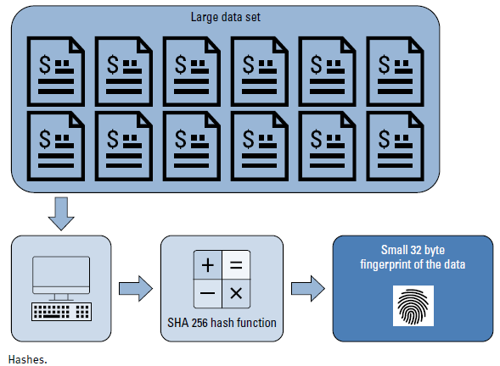
BLOCKCHAIN
Hash

Slide 7
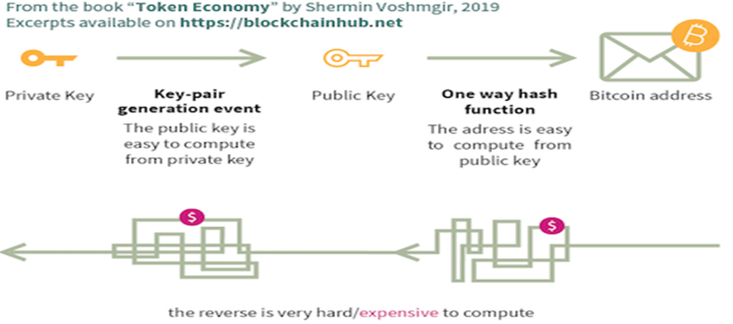
BLOCKCHAIN
Hash Function

Slide 8
BLOCKCHAIN
Example - 1
The hash of:
“It was the best of times, it was the worst of times, it was the age of wisdom, it was the age of foolishness, it was the epoch of belief, it was the epoch of incredulity, it was the season of Light, it was the season of Darkness, it was the spring of hope, it was the winter of despair, we had everything before us, we had nothing before us, we were all going direct to Heaven, we were all going direct the other way — in short, the period was so far like the present period, that some of its noisiest authorities insisted on its being received, for good or for evil, in the superlative degree of comparison only.” is:
df0a199c7fef0a53d9a4144bc9122441b94510c13faf424ca26b65aa5035048f

Slide 9
BLOCKCHAIN
Example - 2
The hash of
“Dog” is:
cd6357efdd966de8c0cb2f876cc89ec74ce35f0968e11743987084bd42fb8944

Slide 10
BLOCKCHAIN
Popular Hash Functions
MD (Message Digest)
SHA (Secure Hash Function)
RIPEMD (RACE Integrity Primitives Evaluation Message Digest)
Whirlpool

Slide 11
BLOCKCHAIN
Examples of cryptographic hash functions
MD 5: It produces a 128-bit hash. Collision resistance was broken after ~2^21 hashes.
SHA 1: Produces a 160-bit hash. Collision resistance broke after ~2^61 hashes.
SHA 256: Produces a 256-bit hash. This is currently being used by bitcoin.
Keccak-256: Produces a 256-bit hash and is currently used by ethereum.

Slide 12
BLOCKCHAIN
Hash Function – SHA256
SHA256 is used in Bitcoin mining – to construct the Bitcoin blockchain.
Secure Hash Algorithm (SHA) that generates 256 bit message digest.
A part of SHA-2, a set of cryptographic hash functions designed by United States National Security Agency (NSA).

Slide 13
BLOCKCHAIN
Hash Function – SHA256
The corresponding SHA-256 of the sentence “How to buy Bitcoin?”
156aedcfab1d49f73abddd89faf78d9930e4b523ab804026310c973bfa707d37
Extra Space added
The SHA-256 of the sentence “How to buy Bitcoin?”
B62889C92F95AB94AD7DB55C81B45E8367C51BFFA0A2A54A4424DA7E00AB7C04
Hash Value Changed, Can you guess why?

Slide 14
BLOCKCHAIN
Hash Function – SHA256
The SHA-256 of the sentence “WE CHOOSE BLOCKCHAIN.”
2AFE58C6D378A0F145D4226669385C34F07D453EBCE2F1BBF2DAFD8A0481E218
I is replaced with l (L)
The SHA-256 of the sentence “WE CHOOSE BLOCKCHAlN.
4D6EC03E42FE83407F92BAC76FF527652333481CCCA8254AB7D3595234AD2DC2
Hash Value Changed, Can you guess why?

Slide 15
BLOCKCHAIN
Supplementary readings
https://ieeexplore.ieee.org/document/8878769
https://ieeexplore.ieee.org/document/8780097
https://ieeexplore.ieee.org/document/8728524
https://ieeexplore.ieee.org/document/8698069

Slide 16
THANK YOU
Sunitha R
Department of Computer Science Engineering
sunithar@pes.edu
+91 80 6666 3333 Extn 721

