Slide 1

BLOCKCHAIN
Sunitha R
Department of Computer Science Engineering

Slide 2

BLOCKCHAIN
Smart Contract
Sunitha R
Department of Computer Science Engineering

Slide 3
BLOCKCHAIN
Learning Elements
Learn
The Elements of Smart Contracts
Syntax and Semantics of Solidity
Structure of Smart contracts

Slide 4
BLOCKCHAIN
Smart Contract
A smart contract is a self-executing contract with the terms of the agreement between buyer and seller being directly written into lines of code.
Nick Szabo, an American computer scientist who invented a virtual currency called "Bit Gold" in 1998, defined smart contracts as computerized transaction protocols that execute terms of a contract.
Smart contracts render transactions traceable, transparent, and irreversible.

Slide 5
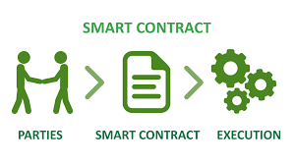
BLOCKCHAIN
Smart Contract

Slide 6
BLOCKCHAIN
Smart Contract Gives you
Autonomy
Trust
Backup
Safety
Speed
Savings
Accuracy

Slide 7
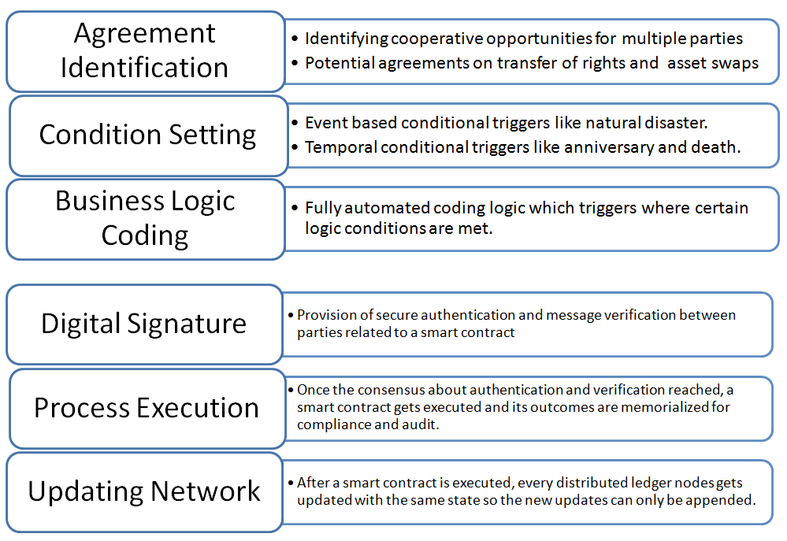
BLOCKCHAIN
Smart Contract Anotomy
Source: Digital Chamber of Commerce, Nov 2016

Slide 8
BLOCKCHAIN
Smart Contract Components
Smart contract code: For instance, Ethereum Solidity code (that is stored, verified and executed on a blockchain).
Smart legal contracts: These are written as a specification for using smart contract code as a complement/substitute for legal contracts executed in traditional usage.

Slide 9
BLOCKCHAIN
A Smart Contract Example
A solidity smart contract includes the following:
Data - This maintains the current state of the contract.
Function - This applies the logic for transitioning the state of the contract.
Pragma Directive
The ‘pragma’ keyword is used to enable some compiler features or checks.
Pragma solidity >=0.4.0 <=0.6.0

Slide 10
BLOCKCHAIN
Solidity
It is an object-oriented high-level programming language used to implement smart contracts.
Solidity helps create contracts for crowdfunding, blind auctions, voting, and multi-signature wallets.
Solidity is influenced by languages such as Python, JavaScript, and C++.

Slide 11
BLOCKCHAIN
Developing Smart Contract
There are two types of variables one needs to be familiar with in smart contracts.
Value Type :These variables are passed by value.
Reference Type: These variables are of complex types and are passed by reference.

Slide 12
BLOCKCHAIN
Contract Structure
Contract Declaration
This is declared through the keyword ‘contract.’
This will declare an empty contract identified by the name of “PurchaseOrder.”
This is depicted as follows:
contract PurchaseOrder{
}

Slide 13
BLOCKCHAIN
Adding Data Variables to the Smart Contract
INT -refers to an integer.
U -means unsigned, which means that this type can represent only positive integers and not both positive and negative integers.
25 -This refers to the 256 bits in size.
The minimum value of uint 256 can be assigned to- 0.
The maximum value that can be assigned for uint 256 is- 2^256-1.

Slide 14
BLOCKCHAIN
Defining Constructor
A constructor is one that is called at the time of deployment of a contract.
The constructor uses some values to initialize the contract.
It is also possible to create a parameterized constructor which can be created by passing a variable and initializing the function using the passed in value.
The access modifier “public” associated with the constructor is the key point to note here.
The keyword “public” denotes that anyone can access the function. Hence, this is not a restricted function.

Slide 15
BLOCKCHAIN
Adding Functions
Functions refer to controlled capabilities that can be added to a program.
Any function will always be preceded by the keyword function.
A function declaration looks like this:
“function <function name> <access modified> <state mutator> <return value>”

Slide 16
BLOCKCHAIN
Get Functions
The most common requirement is to read the stored value.
For example, let us consider the product_quantity value.
To provide this capability, a read or get function is added.
In this function, we will not manipulate the stored value, but will just retrieve the stored value.
The get function can be broken down as follows:
Keyword-Function name; Value- get_quantity()
Keyword- Access modifier; Value- Public (The function can be accessed by anyone)
Keyword- state-mutator; Value- View (The function only reads the state of the contract and does not change it)
Keyword- Returns; Value- Defines a variable of type uint256.

Slide 17
BLOCKCHAIN
Setter Functions
It is necessary to read the data, but it is also necessary to have the capability to write/update data.
This capability is added through a setter function.
This function will take a value from the user in the form of an input parameter.
Keyword- Function name; Value- update_quantity
Keyword- Access modifier; Value- Public
Keyword- state-mutator; Value- This is not needed as the state is updated by the functions.
Keyword- Returns; Value- Returns a variable of type uint256.

Slide 18
BLOCKCHAIN
Deploy the Smart Contract
It is now time to deploy the smart contract.
For example: Remix Online IDE to test the smart contract.
Remix is an online playground that is used for Ethereum smart contracts.
It is completely based on a browser.
It provides an integrated development environment where you can write your smart contracts.
Remix provides an online solidity compiler capability.
Remix IDE helps compile a smart contract seamlessly using a specific compiler version.
It helps in the quick testing of a smart contract.

Slide 19
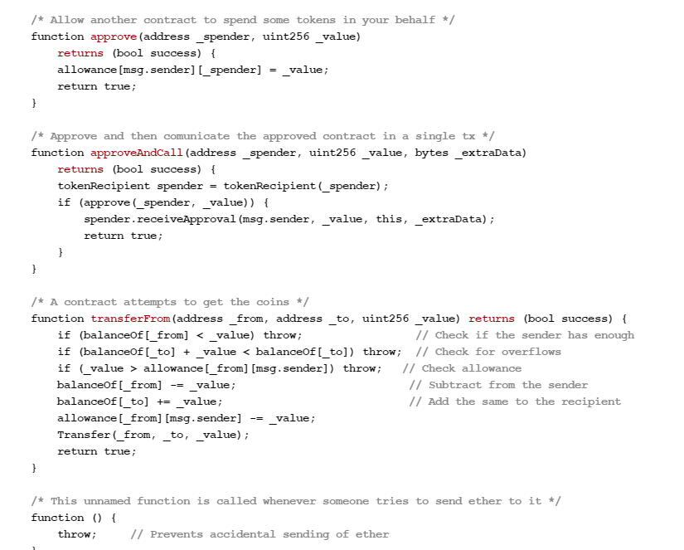
BLOCKCHAIN
A Smart Contract Example

Slide 20
BLOCKCHAIN
Supplementary readings
https://www.entrepreneur.com/article/332657
https://ieeexplore.ieee.org/document/8730359
https://learning.oreilly.com/library/view/ethereum-smart-contract/9781788473040/1ac253c6-24c1-4250-8713-f04c276f8a34.xhtml

Slide 21
THANK YOU
Sunitha R
Department of Computer Science Engineering
sunithar@pes.edu
+91 80 6666 3333 Extn 721

