Slide 1

DATABASE
TECHNOLOGIES
Relational model, Storage formats
and Indexing
Suresh Jamadagni
Department of Computer Science
and Engineering

Slide 2

DATABASE TECHNOLOGIES
Relational model, Storage formats and Indexing
Suresh Jamadagni
Department of Computer Science and Engineering

Slide 3
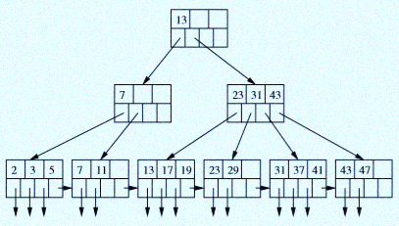
DATABASE TECHNOLOGIES
Index Structure – B Trees
A B-tree organizes its blocks into a tree that is balanced, meaning that all paths from the root to a leaf have the same length
Typically, there are three layers in a B-tree: the root, an intermediate layer and leaves
B-trees automatically maintain as many levels of index as is appropriate for the size of the ﬁle being indexed.
Any number of layers is possible

Slide 4
DATABASE TECHNOLOGIES
Index Structure – B Trees
The keys in leaf nodes are copies of keys from the data ﬁle.
These keys are distributed among the leaves in sorted order from left to right.
There is a parameter n associated with each B-tree index, and this parameter determines the layout of all blocks of the B-tree.
Each block will have space for n search-key values and n +1 pointers.
At the root, there are at least two used pointers.

Slide 5
DATABASE TECHNOLOGIES
Index Structure – B Trees
All pointers point to B-tree blocks at the level below.
At a leaf, the last pointer points to the next leaf block to the right, i.e., to the block with the next higher keys.
Among the other n pointers in a leaf block, at least (n +1)/2 of these pointers are used and point to data records
Unused pointers are null and do not point anywhere.
The i^{th} pointer, if it is used, points to a record with the i^{th} key.

Slide 6
DATABASE TECHNOLOGIES
Index Structure – B Trees
At an interior node, all n + 1 pointers can be used to point to B-tree blocks at the next lower level
All used pointers and their keys appear at the beginning of the block, with the exception of the (n +1)^{st} pointer in a leaf, which points to the next leaf.

Slide 7
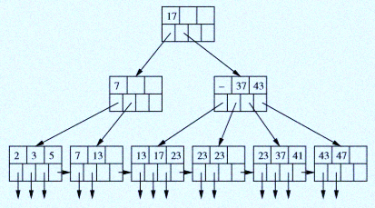
DATABASE TECHNOLOGIES
Index Structure – B Trees with Duplicate Keys
In the second child of the root, the ﬁrst key is now null. The reason is that the second child (fourth leaf) has no new keys at all

Slide 8
DATABASE TECHNOLOGIES
Index Structure – Lookup in B Trees
SELECT * FROM R WHERE R.k > 40;
SELECT * FROM R WHERE R.k >= 10 AND R.k <= 25;

Slide 9
DATABASE TECHNOLOGIES
Index Structure – Insertion into B Trees
Find a place for the new key in the appropriate leaf and insert the key if there is room.
If there is no room in the proper leaf, split the leaf into two and divide the keys between the two new nodes, so each is half full or just over half full.
The splitting of nodes at one level appears to the level above as if a new key-pointer pair needs to be inserted at that higher level. Recursively apply this strategy to insert at the next level: if there is room, insert the key; if not, split the parent node and continue up the tree.
While trying to insert into the root and there is no room, split the root into two nodes and create a new root at the next higher level; the new root has the two nodes resulting from the split as its children.

Slide 10
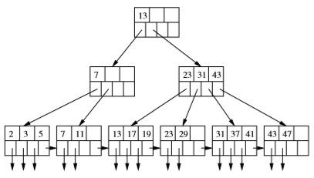
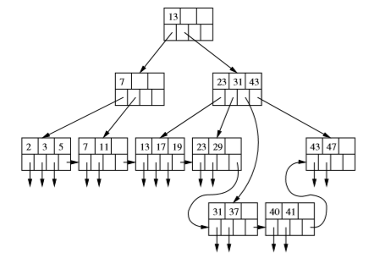
DATABASE TECHNOLOGIES
Index Structure – Insertion into B Tree Example
Insertion of key = 40

Slide 11
DATABASE TECHNOLOGIES
Index Structure – Deletion From B Trees
Locate that record and its key-pointer pair in a leaf of the B-tree.
Delete the record itself from the data ﬁle and delete the key-pointer pair from the B-tree.
If the B-tree node from which a deletion occurred still has at least the minimum number of keys and pointers, then there is nothing more to be done
After deletion, if the constraint on the number of keys is violated, then if one of the adjacent siblings of node N has more than the minimum number of keys and pointers, then one key-pointer pair can be moved to N, keeping the order of keys intact. Adjust the keys at the parent of N to reﬂect the new situation
If neither adjacent sibling can be used to provide an extra key for N, and if there are two adjacent nodes, N and a sibling M; the latter has the minimum number of keys and the former has fewer than the minimum, merge these two nodes, eﬀectively deleting one of them. Adjust the keys at the parent of N to reﬂect the new situation

Slide 12
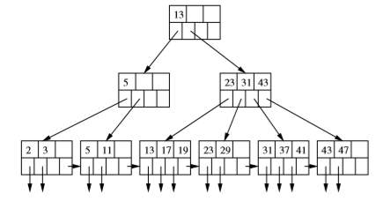
DATABASE TECHNOLOGIES
Index Structure – Deletion from B Tree Example
Deletion of key = 7

Slide 13
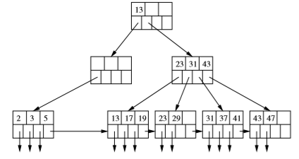
DATABASE TECHNOLOGIES
Index Structure – Deletion from B Tree Example
Deletion of key = 11

Slide 14
DATABASE TECHNOLOGIES
Index Structure – Inserrtion and Deletion from B Tree Example
https://www.youtube.com/watch?v=coRJrcIYbF4

Slide 15
DATABASE TECHNOLOGIES
Index Structure – Efficiency of B Trees
B-trees allow lookup, insertion, and deletion of records using very few disk I/O’s per ﬁle operation.
Observe that if n, the number of keys per block, is reasonably large, then splitting and merging of blocks will be rare events.
Further, when such an operation is needed, it almost always is limited to the leaves, so only two leaves and their parent are aﬀected. Thus, we can essentially neglect the disk-I/O cost of B-tree reorganizations.
Example: A typical block has 255 pointers. With a root, 255 children and 2552 = 65025 leaves, we shall have among those leaves 2553, or about 16.6 million pointers to records. That is, ﬁles with up to 16.6 million records can be accommodated by a 3-level B-tree.

Slide 16
THANK YOU
Suresh Jamadagni
Department of Computer Science and Engineering
sureshjamadagni@pes.edu

