Slide 1

DATABASE
TECHNOLOGIES
Relational model, Storage formats
and Indexing
Suresh Jamadagni
Department of Computer Science
and Engineering

Slide 2

DATABASE TECHNOLOGIES
Relational model, Storage formats and Indexing
Suresh Jamadagni
Department of Computer Science and Engineering

Slide 3
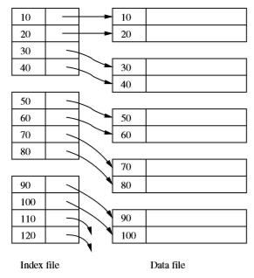
DATABASE TECHNOLOGIES
Index Structure
An auxiliary structure used for faster retrieval of records based on search criteria
A data ﬁle is used to store records of a relation.
The data ﬁle may have one or more index ﬁles.
Each index ﬁle associates values of the search key with pointers to data-ﬁle records that have that value for the attribute(s) of the search key.
It is common to create a primary index on the primary key of a relation and to create secondary indexes on some of the other attributes.

Slide 4
DATABASE TECHNOLOGIES
Index Example
Number of records = 30,000
Record length = 100 bytes
Block size = 1024 bytes
Blocking factor for data record= 1024/100 = 10
Number of blocks required to store 30,000 records = 30000/10 = 3000
A binary search of 3000 blocks will require log₂ 3000 = 12 block access
Length of the ordering key = 9 bytes
Length of the block address field = 6 bytes
Record length of the index file = 9+6 = 15 bytes
Blocking factor for the index file = 1024/15 = 68
Number of entries in the index file = Number of blocks = 3000
Number of blocks required for storing index information = 3000/68 = 45
A binary search on the index file will require log₂ 45 = 6 block access
To retrieve data from the data file will require 1 additional block access for a total of 6 + 1 = 7 block accesses

Slide 5
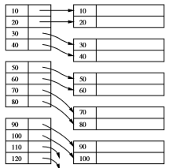
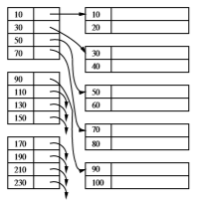
DATABASE TECHNOLOGIES
Index Structure
A dense index is a sequence of blocks holding only the keys of the records and pointers to the records themselves. The index blocks of the dense index maintain these keys in the same sorted order as in the data ﬁle
A sparse index typically has only one key-pointer pair per block of the data ﬁle. It thus uses less space than a dense index, at the expense of somewhat more time to ﬁnd a record given its key

Slide 6
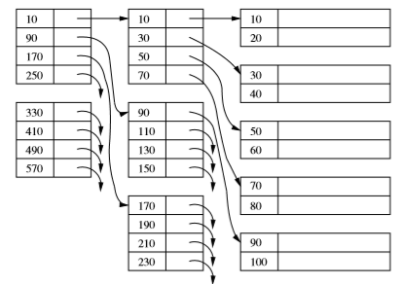
DATABASE TECHNOLOGIES
Multiple Levels of Index
Putting an index on the index, we can make the use of the ﬁrst level of index more eﬃcient
B-tree structure is preferred over building many levels of index.

Slide 7
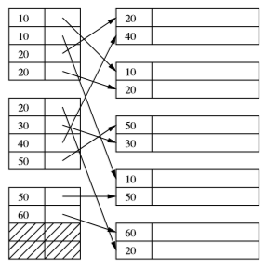
DATABASE TECHNOLOGIES
Secondary Indexes
A secondary index is a data structure that facilitates ﬁnding records given a value for one or more ﬁelds.
The secondary index is distinguished from the primary index in that a secondary index does not determine the placement of records in the data ﬁle.
The secondary index tells us the current locations of records that have been decided by a primary index on some other ﬁeld
Secondary indexes are always dense

Slide 8
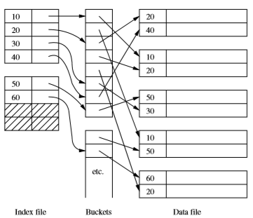
DATABASE TECHNOLOGIES
Indirection in Secondary Indexes
A signiﬁcant amount of storage is wasted, if a search-key value appears n times in the data ﬁle, then the value is written n times in the index ﬁle.
A convenient way to avoid repeating values is to use a level of indirection, called buckets, between the secondary index ﬁle and the data ﬁle

Slide 9
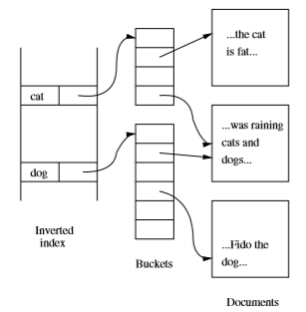
DATABASE TECHNOLOGIES
Document Retrieval and Inverted Indexes
A document may be thought of as a tuple in a relation Doc.
This relation has very many attributes, one corresponding to each possible word in a document.
Each attribute is boolean — either the word is present in the document, or it is not.
The relation schema may be thought of as
Doc(hasCat, hasDog, ... ) where hasCat is true if and only if the document has the
word “cat” at least once.
There is a secondary index on each of the attributes of Doc
Instead of creating a separate index for each attribute, the indexes are combined into one, called an inverted index.
This index uses indirect buckets for space eﬃciency

Slide 10
THANK YOU
Suresh Jamadagni
Department of Computer Science and Engineering
sureshjamadagni@pes.edu

