Slide 1

DATABASE
TECHNOLOGIES
Relational model, Storage formats
and Indexing
Suresh Jamadagni
Department of Computer Science
and Engineering

Slide 2

DATABASE TECHNOLOGIES
Relational model, Storage formats and Indexing
Suresh Jamadagni
Department of Computer Science and Engineering

Slide 3
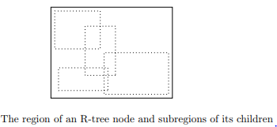
DATABASE TECHNOLOGIES
Index Structure – R Trees
An R-tree (region tree) is a data structure that represents multidimensional data
Each dimension is represented by a data region.
An interior node of an R-tree corresponds to some interior data region
The region can be of any shape, although in practice it is usually a rectangle or other simple shape.
The R-tree node has, in place of keys, sub-regions that represent the contents of its children.
The sub-regions are allowed to overlap, although it is desirable to keep the overlap small

Slide 4
DATABASE TECHNOLOGIES
Index Structure – R Trees
Operations on R-Trees – Search
A typical query is a “where-am-I” query, which specifies a point P and asks for the data region or regions in which the point lies
Start at the root with which the entire region is associated. Examine the sub-regions at the root and determine which children of the root correspond to interior regions that contain point P
If there are zero regions, then P is not in any data region
If there is at least one interior region that contains P, then recursively search for P at the child corresponding to each such region
The leaf node will have the complete record or a pointer to that record

Slide 5
DATABASE TECHNOLOGIES
Index Structure – R Trees
Operations on R-Trees – Insert
Start at the root and find a sub-region into which R fits
If there is more than one region, pick one, go to its corresponding child and repeat the process
If there is no sub-region that contains R, then expand one of the sub-regions. Identify the sub-region where the expansion is as little as possible
Insert R at the corresponding leaf
If there is no room for R at that leaf, then split the leaf.

Slide 6
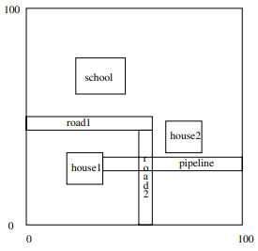
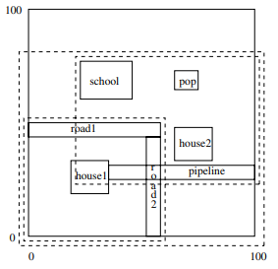
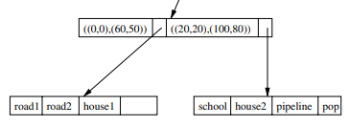
DATABASE TECHNOLOGIES
Index Structure – R Trees
Operations on R-Trees – Example of Insert
Consider adding POP region
Since the seven data regions do not fit on one leaf, split the leaf, with four in one leaf and three in the other.
There are many options to choose.
Choose the division (indicated by the inner, dashed rectangles) that minimizes the overlap, while splitting the leaves as evenly as possible.

Slide 7
DATABASE TECHNOLOGIES
Index Structure – Bitmap Indexes
A bitmap index for a field F is a collection of bit-vectors of length n, one for each possible value that may appear in the field F. The vector for value v has 1 in position i if the i^{th} record has v in field F and 0 if not.
Suppose a file consists of records with two fields, F and G, of type integer and string, respectively. The current file has 6 records, numbered 1 through 6, with the following values in order: (30, foo), (30, bar), (40, baz), (50, foo), (40, bar), (30, baz).
A bitmap index for the first field, F, would have three bit-vectors, each of length 6. The first, for value 30, is 110001, because the first, second, and sixth records have F = 30. The other two, for 40 and 50, respectively, are 001010 and 000100.
A bitmap index for G would also have three bit-vectors, because there are three different strings appearing there. Foo – 100100, bar – 010010, baz - 001001

Slide 8
DATABASE TECHNOLOGIES
Index Structure – Bitmap Indexes
SELECT Title FROM Movie WHERE studioName = ’Disney’ AND year = 2005;
Suppose there are bitmap indexes on both attributes studioName and year.
Then we can intersect the vectors for year = 2005 and studioName = ’Disney’;
That is, take the bitwise AND of these vectors, which will give us a vector with a 1 in position i if and only if the i^{th} Movie tuple is for a movie made by Disney in 2005
To intersect the bit vectors, we must read them into memory, which requires a disk I/O for each block occupied by one of the two vectors.

Slide 9
DATABASE TECHNOLOGIES
Index Structure – Bitmap Indexes
Range queries
Consider a file with twelve records numbered from 1 to 12 as follows:
1: (25, 60) 2: (45, 60) 3: (50, 75) 4: (50, 100) 5: (50, 120) 6: (70, 110) 7: (85, 140) 8: (30, 260) 9: (25, 400)
10: (45, 350) 11: (50, 275) 12: (60, 260)
For the first component age, there are seven different values, so the bitmap index for age consists of the following seven vectors:
25: 100000001000 30: 000000010000 45: 010000000100 50: 001110000010
60: 000000000001 70: 000001000000 85: 000000100000
For the salary component, there are ten different values, so the salary bitmap index has the following ten bit-vectors:
60: 110000000000 75: 001000000000 100: 000100000000 110: 000001000000
120: 000010000000 140: 000000100000 260: 000000010001 275: 000000000010
350: 000000000100 400: 000000001000

Slide 10
DATABASE TECHNOLOGIES
Index Structure – Bitmap Indexes
Range queries
Consider the query SELECT * FROM Employee WHERE Age between 45 and 55 AND Salary between 100 and 200
First find the bit-vectors for the age values in this range. There are only two: 010000000100 and 001110000010 for 45 and 50 respectively.
Take their bitwise OR. This bit-vector is 011110000110
Find the bit-vectors for the salaries between 100 and 200. There are four corresponding to salaries 100, 110, 120, and 140.
Take their bitwise OR. This bit-vector is 000111100000.
Take the bitwise AND of the two bit-vectors calculated by bitwise OR
011110000110 AND 000111100000 = 000110000000
Only the fourth and fifth records satisfy the search criteria

Slide 11
DATABASE TECHNOLOGIES
Index Structure – Bitmap Indexes
Compressed Bitmaps
Suppose we have a bitmap index on field F of a file with n records and there are m different values for field F in the file. Then the number of bits in all the bit-vectors for this index is m * n
If the block size is 4096 bytes, then the number of blocks needed is m * n / (4096 * 8 )
If m is large, then 1’s in a bit-vector will be very rare. The probability that any bit is 1 is 1/m
We can encode bit-vectors so that they take much less than n bits on the average
A common approach is called run-length encoding, where we represent a sequence of i 0’s followed by a 1, by some suitable binary encoding of the integer i. We concatenate the codes for each sequence together and that sequence of bits is the encoding of the entire bit-vector.

Slide 12
DATABASE TECHNOLOGIES
Index Structure – Bitmap Indexes
Compressed Bitmaps Example
If i = 13, then j = Γ log₂ 13 ꓶ = 4. We need 4 bits in the binary representation of i.
Thus, encoding for i begins with 1110.
Follow with i in binary or 1101. Thus, the encoding for 13 is 11101101.

Slide 13
DATABASE TECHNOLOGIES
Index Structure – Managing Bitmap Indexes
Finding Bit-Vectors
Consider each bit-vector as a record whose key is the value corresponding to this bit-vector
Use any secondary index technique to efficiently retrieve their bit-vectors.
Treat bit-vectors as variable-length records for storing.
Finding Records
Consider k^{th} record as having search-key value k
Create a secondary index on the data file whose search key is the number of the record.
Handling Modifications to the Data File
Consider modifying record i of the data file that changes the value of a field that has a bitmap index, from value v to w.
Find the bit-vector for v and change the 1 in position i to 0. If there is a bit-vector for value w, then change its 0 in position i to 1. If there is no bit-vector for w, insert a new value.

Slide 14
THANK YOU
Suresh Jamadagni
Department of Computer Science and Engineering
sureshjamadagni@pes.edu

