Slide 1

DATABASE
TECHNOLOGIES
Relational model, Storage formats
and Indexing
Suresh Jamadagni
Department of Computer Science
and Engineering

Slide 2

DATABASE TECHNOLOGIES
Relational model, Storage formats and Indexing
Suresh Jamadagni
Department of Computer Science and Engineering

Slide 3
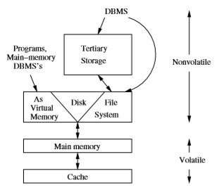
DATABASE TECHNOLOGIES
Secondary Storage Management
Memory hierarchy
Cache – Memory available on the microprocessor itself.
Main memory - Memory available on another chip.
Secondary Storage - Typically magnetic disk or Solid state disks
Tertiary Storage – Optical disks, tapes etc.

Slide 4
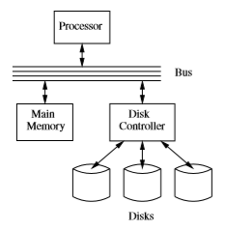
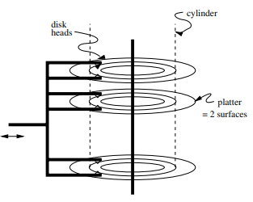
DATABASE TECHNOLOGIES
Secondary Storage Management
Reading or writing a block involves three steps
The disk controller positions the head assembly at the cylinder containing the track on which the block is located. The time to do so is the seek time
The disk controller waits while the first sector of the block moves under the head. This time is called the rotational latency.
All the sectors and the gaps between them pass under the head, while the disk controller reads or writes data in these sectors. This delay is called the transfer time
Disk Latency = Seek time + Rotational latency + Transfer time

Slide 5
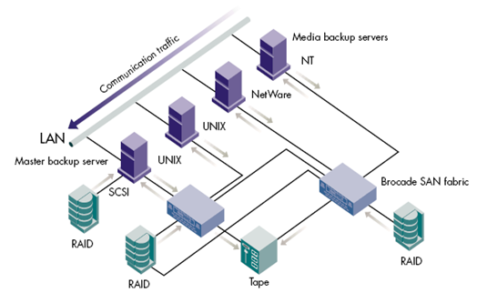
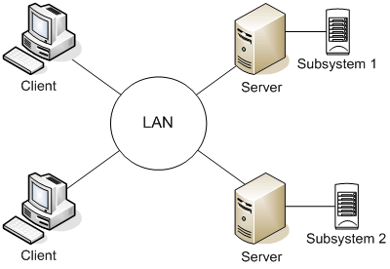
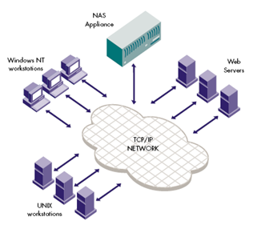
DATABASE TECHNOLOGIES
Secondary Storage Architecture
Directly Attached Storage (DAS)
Network Attached Storage (NAS)
Storage Area Network (SAN)

Slide 6
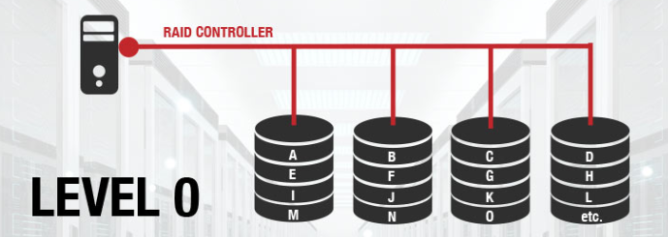
DATABASE TECHNOLOGIES
RAID – Redundant Array of Independent Disks
RAID is a data storage virtualization technology that combines multiple physical disk drive components into one or more logical units for the purposes of data redundancy and performance improvement.
Data is distributed across the drives in one of several ways, referred to as RAID levels, depending on the required level of redundancy and performance

Slide 7
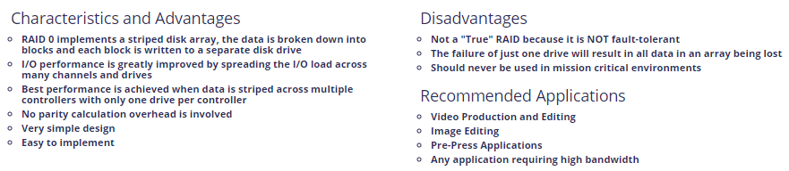
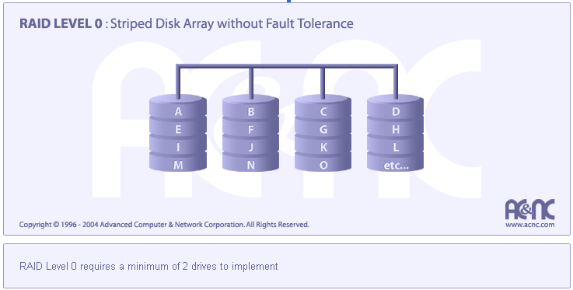
DATABASE TECHNOLOGIES
RAID – Redundant Array of Independent Disks

Slide 8
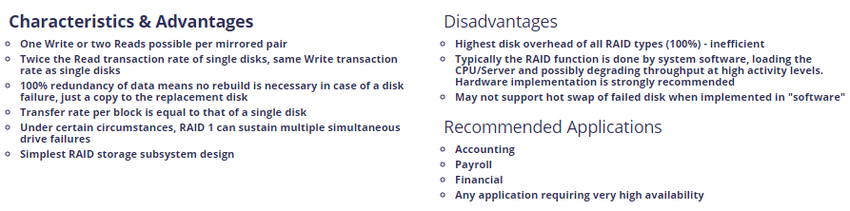
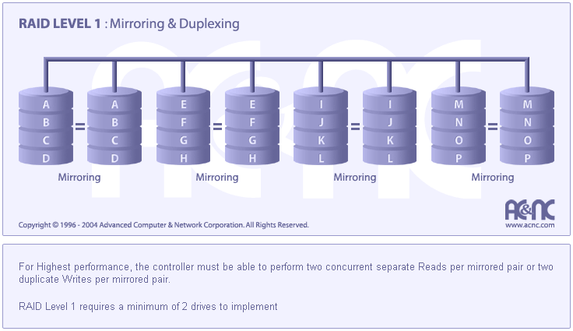
DATABASE TECHNOLOGIES
RAID – Redundant Array of Independent Disks

Slide 9
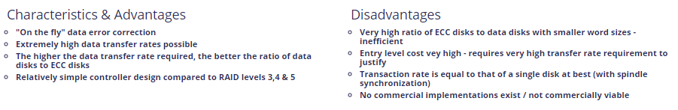

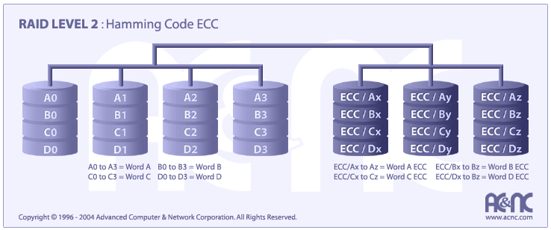
DATABASE TECHNOLOGIES
RAID – Redundant Array of Independent Disks

Slide 10
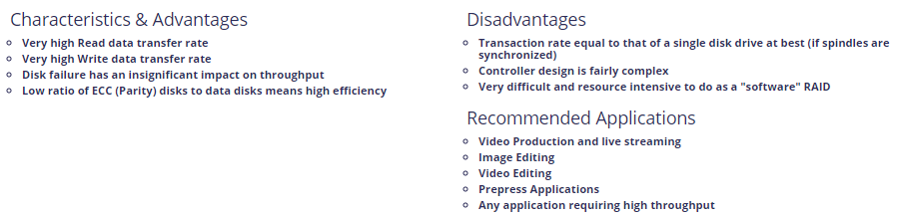
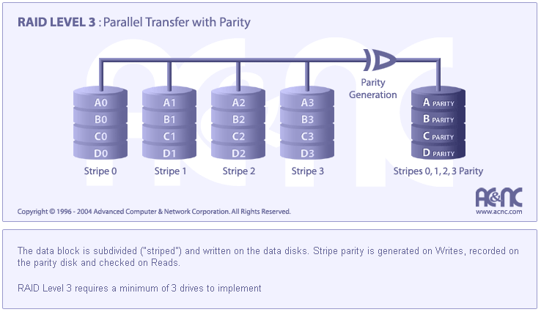
DATABASE TECHNOLOGIES
RAID – Redundant Array of Independent Disks

Slide 11
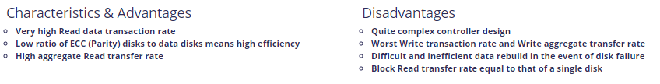
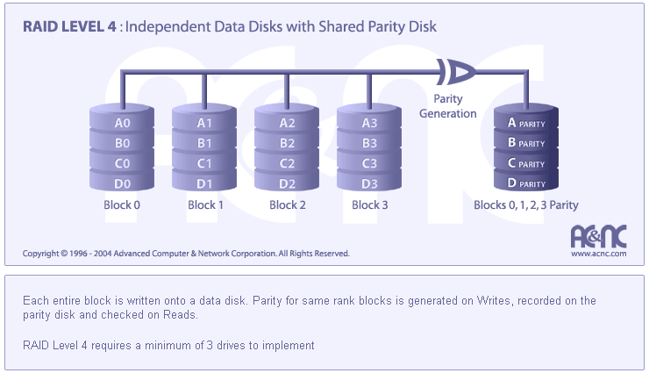
DATABASE TECHNOLOGIES
RAID – Redundant Array of Independent Disks

Slide 12
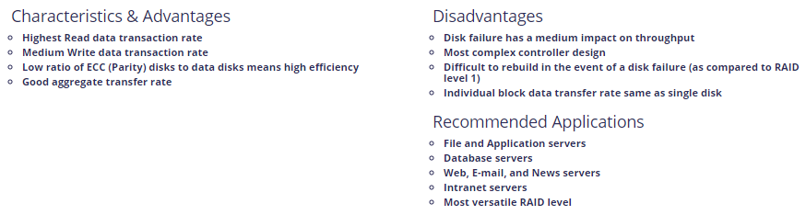
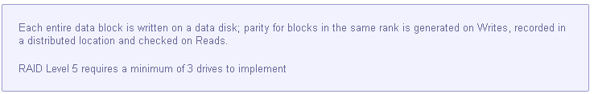
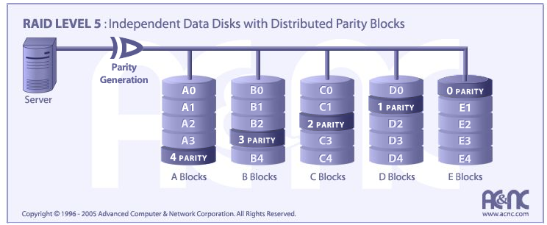
DATABASE TECHNOLOGIES
RAID – Redundant Array of Independent Disks

Slide 13
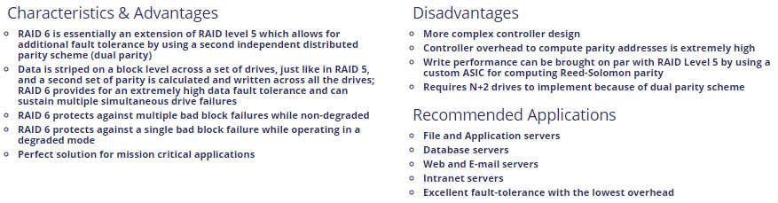
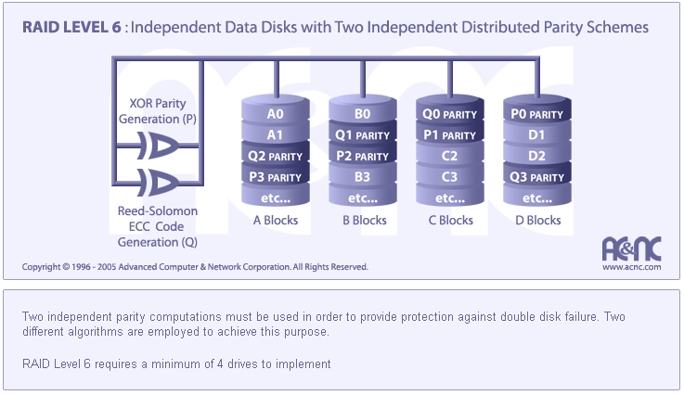
DATABASE TECHNOLOGIES
RAID – Redundant Array of Independent Disks

Slide 14
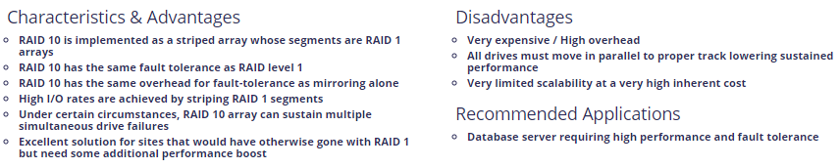
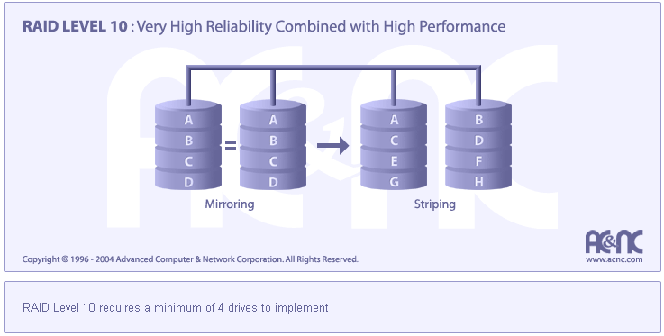
DATABASE TECHNOLOGIES
RAID – Redundant Array of Independent Disks

Slide 15
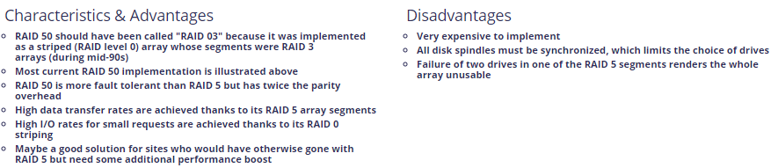
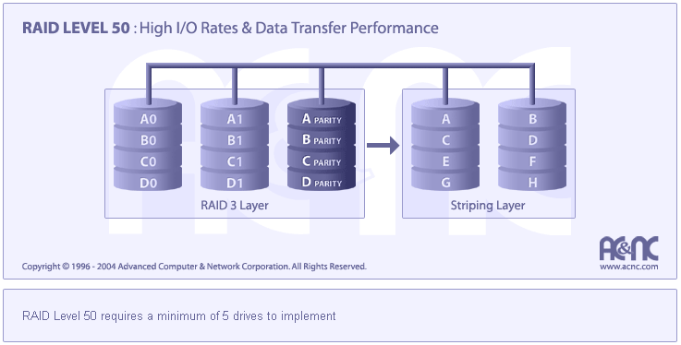
DATABASE TECHNOLOGIES
RAID – Redundant Array of Independent Disks

Slide 16
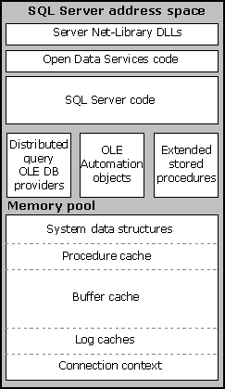
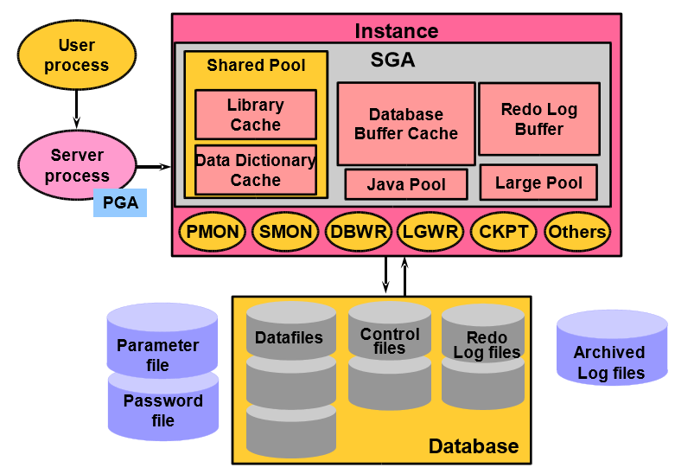
DATABASE TECHNOLOGIES
Secondary Storage Management
MS SQL Server
Oracle

Slide 17
THANK YOU
Suresh Jamadagni
Department of Computer Science and Engineering
sureshjamadagni@pes.edu

