Slide 1
Project Title: Sustainability Benchmarking & Predictive Forecasting

Slide 2
Introduction
Brief overview of the project:
Introduction to sustainability reporting and its significance in modern business practices
Explanation of the Sustainability Data Extraction System
Importance of sustainability reporting and data analysis:
Impact on stakeholder decision-making
Regulatory compliance and corporate responsibility
Objectives of the Sustainability Data Extraction System:
Efficient extraction and analysis of sustainability data
Automation of data collection processes
Facilitation of informed decision-making

Slide 3
Project Objectives
Develop an AI based system to extract and analyze sustainability data from various sources
Modularize components for flexibility and scalability
Ensure seamless integration with user interfaces and APIs
PDF parsing, web scraping, natural language processing (NLP), machine
System Architecture
Diagram illustrating the components and workflow of the system:
PDF Parser: Extracts text content from PDF documents
Web Scraper: Retrieves data from specified websites
NLP Module: Processes text and identifies key entities
ML Model: Analyzes text data and makes predictions
Flask Web App: Provides user interface and APIs learning (ML), and user interface (UI)

Slide 4
Component Details
Detailed explanation of each component:
PDF Parser: Utilizes PyMuPDF library to extract text from PDF documents
Web Scraper: Utilizes BeautifulSoup and requests libraries to retrieve data from specified websites
NLP Module: Utilizes spaCy library to process text and identify key entities
ML Model: Utilizes Transformers library to analyze text data and make predictions
Flask Web App: Utilizes Flask framework to provide user interface and APIs for seamless interaction
Workflow
Step-by-step explanation of how the system works:
1. User input (PDF URL or text data)
2. PDF parsing and text extraction
3. Text processing and entity recognition
4. Web scraping (if necessary)
5. Machine learning analysis
6. Presentation of extracted information to the user

Slide 5
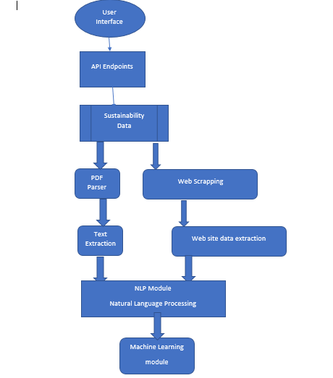
System Architecture

Slide 6
Technology Stack
List of technologies and libraries used in the project:
PyMuPDF, BeautifulSoup, spaCy, Transformers, Flask
Deployment
Overview of deployment options:
Cloud platforms (Azure, GCP)
Containerization (Docker)
Benefits of cloud deployment and scalability:
Flexibility, scalability, and reliability
Cost-effectiveness and resource optimization

Slide 7
API End points
https://hacksustain.azurewebsites.net/api/esg/benchmark/upload/esgdoc/
https://hacksustain.azurewebsites.net/api/esg/benchmark/upload/esgdoc/ESG/ESGScore
https://hacksustain.azurewebsites.net/api/esg/benchmark/pdf-report/esg
https://hacksustain.azurewebsites.net/api/esg/benchmark/keepalive
Application URL:
https://hacksustain.azurewebsites.net
Github URL:
Hackathon2024-March/techraiders (github.com)

Slide 8
Thank You…!

