Slide 1

Secure and Scalable Healthcare Appointment Scheduling Through Distributed Backend Development
REVIEW
MONISHA RAGHINI CHELLE | 2520030537
BHUPATHIRAJU DEVI CHARITHA | 2520030462
PRASHANTHI DABBUGUNTA | 2520030301
Under the Guidance
of
Dr.Y Subbarayudu
Assistant Professor
Department of Computer Science and Engineering
KONERU LAKSHMAIAH EDUCATION FOUNDATION

Slide 2
GROUP NUMBER:8
Name of Candidate | Role
MONISHA RAGHINI CHELLE | Database & SQL
BHUPATHIRAJU DEVI CHARITHA | Frontend & Integration
PRASHANTHI DABBUGUNTA | Backend & API

Slide 3
ABSTRACT
CarePlus is a web-based healthcare appointment scheduling system designed to simplify the process of finding doctors and booking appointments. The system allows patients to register, log in, view doctors based on specialization, check availability, select appointment slots, and manage appointments. An administrator manages doctors, availability, appointments, holidays, and payments. The system uses React for the frontend, FastAPI for the backend, and MySQL for data storage.

Slide 4
INTRODUCTION
Healthcare appointments can be difficult to manage manually.
Patients need an easy way to find suitable doctors and available time slots.
CarePlus provides an online platform for appointment scheduling.
Patients can manage their appointments and notifications.
Administrators can manage doctors, patients, appointments, holidays, and payments.
The system follows a separate frontend, backend, and database architecture.

Slide 5
EXISTING SYSTEM
Traditional appointment booking often depends on manual communication.
Patients may need to contact hospitals to check doctor availability.
Appointment information may not be centrally organized.
Managing cancellations and rescheduling can be difficult.
Manual management increases the possibility of scheduling conflicts.

Slide 6
PROBLEM
Difficulty in finding available doctors.
Manual appointment scheduling is time-consuming.
Patients may not have real-time visibility of available slots.
Appointment conflicts can occur.
Managing patient appointments and records manually is difficult.
Secure access is required for patient and administrator functions.

Slide 7
SOLUTION(Contribution)
CarePlus Healthcare Appointment System
Online patient registration and login.
Doctor search based on specialization.
Doctor profile and availability viewing.
Calendar-based appointment selection.
Time-slot booking with backend validation.
Appointment cancellation and rescheduling.
Notifications and appointment history.
Demo payment and receipt generation.
Administrator dashboard for system management.

Slide 8
Objectives
Develop an easy-to-use healthcare appointment platform.
Provide secure patient and administrator authentication.
Allow patients to search and view doctors.
Display doctor availability and appointment slots.
Prevent invalid or conflicting bookings.
Manage appointments and notifications.
Provide demo payment and receipt functionality.
Provide administrative management facilities.

Slide 9
Modules
PATIENT MODULE
ADMIN MODULE
BACKEND & DATABASE
👤 PATIENT MODULE | 🛠️ ADMIN MODULE | ⚙️ BACKEND & DATABASE
• Registration & Login | • Admin Login & Dashboard | • REST API Development
• Doctor & Specialization Search | • Patient Management | • Authentication & Authorization
• Doctor Profile & Availability | • Doctor Management | • Appointment Validation
• Calendar & Time-Slot Selection | • Doctor Availability | • Notification Management
• Appointment Booking | • Appointment Management | • Payment & Receipt Processing
• Rescheduling & Cancellation | • Holiday Management | • MySQL Database Management
• Notifications & History | • Payment Management | • Database Operations
• Demo Payment & Receipt
• Registration & Login
• Doctor & Specialization Search
• Doctor Profile & Availability
• Calendar & Time-Slot Selection
• Appointment Booking
• Rescheduling & Cancellation
• Notifications & History
• Demo Payment & Receipt
• Admin Login & Dashboard
• Patient Management
• Doctor Management
• Doctor Availability
• Appointment Management
• Holiday Management
• Payment Management
• REST API Development
• JWT Authentication & Authorization
• Appointment Validation
• Notification Management
• Payment & Receipt Processing
• MySQL Database Management
• Database Operations

Slide 10

AUTHENTICATION & SECURITY
• Patient and administrator authentication are implemented separately.
• Passwords are hashed using Passlib with bcrypt.
• JWT access tokens are generated after successful authentication.
• Protected APIs use HTTP Bearer authentication.
• Backend dependencies enforce patient or administrator role access.
• Protected admin API access without a token returns HTTP 401.
Component | Technology
Frontend | React, HTML5, CSS3, JavaScript
Backend | Python, FastAPI
Database | MySQL
ORM | SQLAlchemy
Database Driver | PyMySQL
Authentication | JWT
Password Security | bcrypt / Passlib
Server | Uvicorn
Development | VS Code / PyCharm

Slide 11
SOFTWARE REQUIREMENTS
Frontend: React, Vite, HTML, CSS, JavaScript, React Router
Backend: Python, FastAPI, Uvicorn
Database: MySQL
ORM / Driver: SQLAlchemy, PyMySQL
Authentication: JWT, HTTP Bearer
Password Security: Passlib / bcrypt
Development: Visual Studio Code (VS Code)
API Documentation: FastAPI Swagger / OpenAPI
Component | Technology
Frontend | React, HTML5, CSS3, JavaScript
Backend | Python, FastAPI
Database | MySQL
ORM | SQLAlchemy
Database Driver | PyMySQL
Authentication | JWT
Password Security | bcrypt / Passlib
Server | Uvicorn
Development | VS Code / PyCharm

Slide 12
SYSTEM ARCHITECTURE
Patient / Admin
Browser
React + Vite
Frontend
FastAPI
REST Backend
MySQL
Database
• Separate frontend, backend and database layers.
• FastAPI handles requests, validation, business logic and MySQL communication.
• JWT-based authentication protects patient and administrator functions.

Slide 13
DATABASE DESIGN
admins
admin_id • email • password
specializations
specialization_id • name
patients
patient_id • email • password
admins
admin_id
email
password
patients
patient_id
email
password
doctors
doctor_id
specialization_id
name
doctor_availability
availability_id
doctor_id
day
doctors
doctor_id • specialization_id • name
doctor_availability
availability_id • doctor_id • day
holidays
holiday_id • holiday_date
appointments
appointment_id
patient_id
doctor_id
notifications
notification_id
patient_id
appointment_id
payments
payment_id
appointment_id
receipt_number
holidays
holiday_id
holiday_date
appointments
appointment_id • patient_id • doctor_id
notifications
notification_id • patient_id • appointment_id
payments
payment_id • appointment_id • receipt_number
• SQL schema implemented in healthcare-appointment.sql
• Backend uses SQL queries with a MySQL connection layer.

Slide 14
APPOINTMENT BOOKING WORKFLOW
Login
Select Specialization
Choose Doctor
Select Date
Select Time Slot
Enter Reason
Book Appointment
Demo Payment / Receipt
• Backend validates doctor availability, date, holidays, slot conflicts and patient booking conditions.

Slide 15
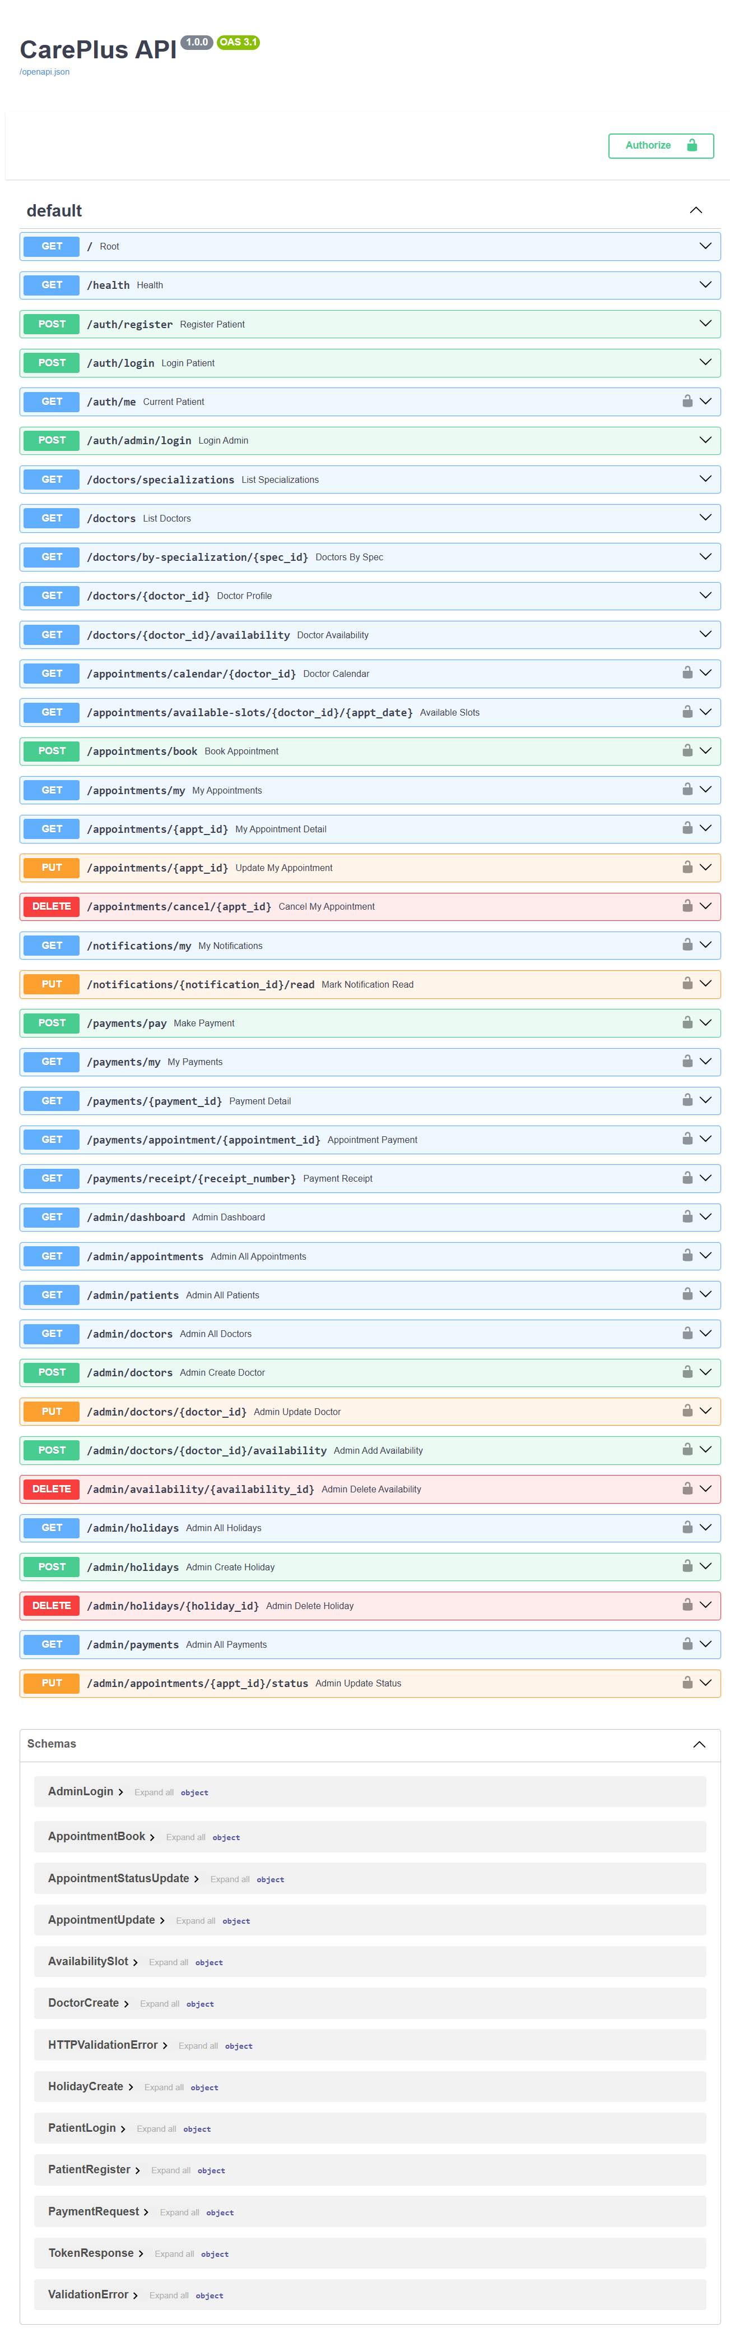
BACKEND & REST API
• FastAPI provides REST endpoints for authentication, doctors, appointments, notifications, payments and administration.
• Uvicorn runs the FastAPI application.
• SQLAlchemy and PyMySQL connect the backend to MySQL.
• FastAPI automatically exposes Swagger/OpenAPI documentation.

Slide 16
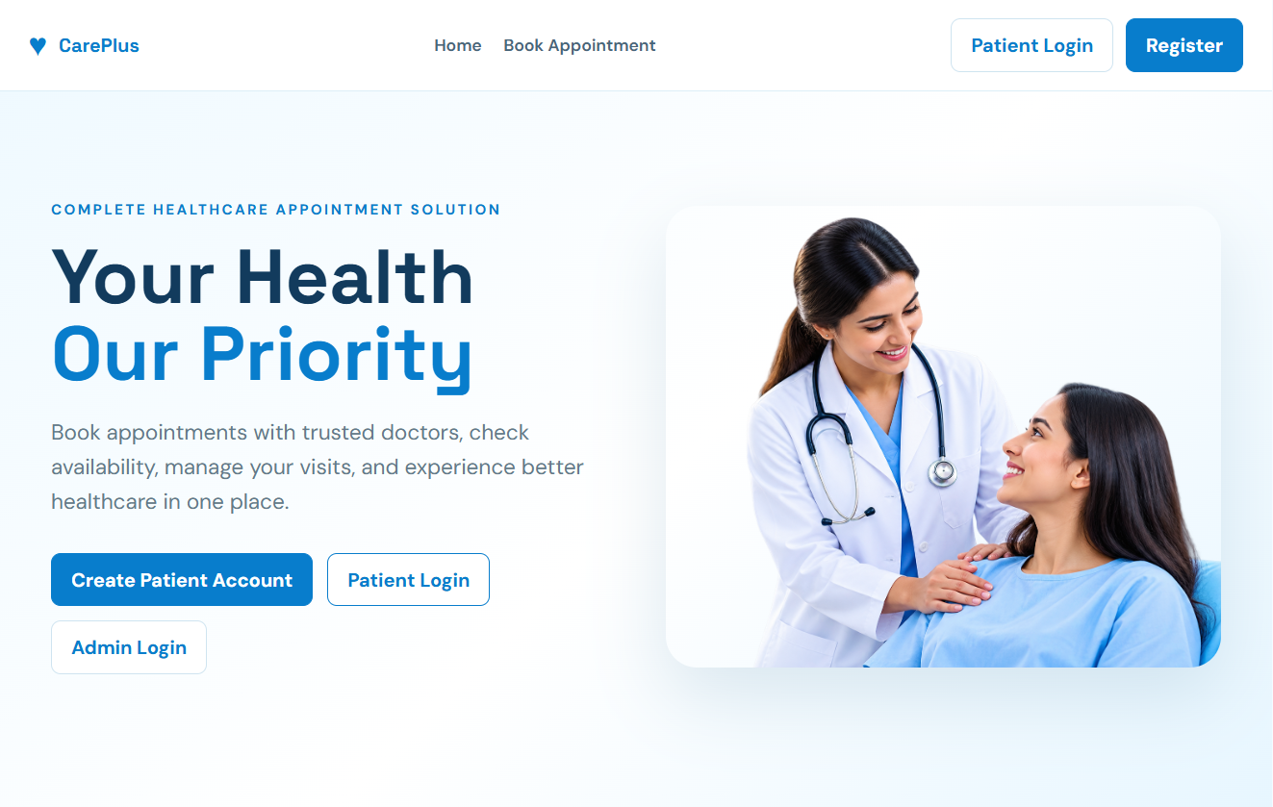
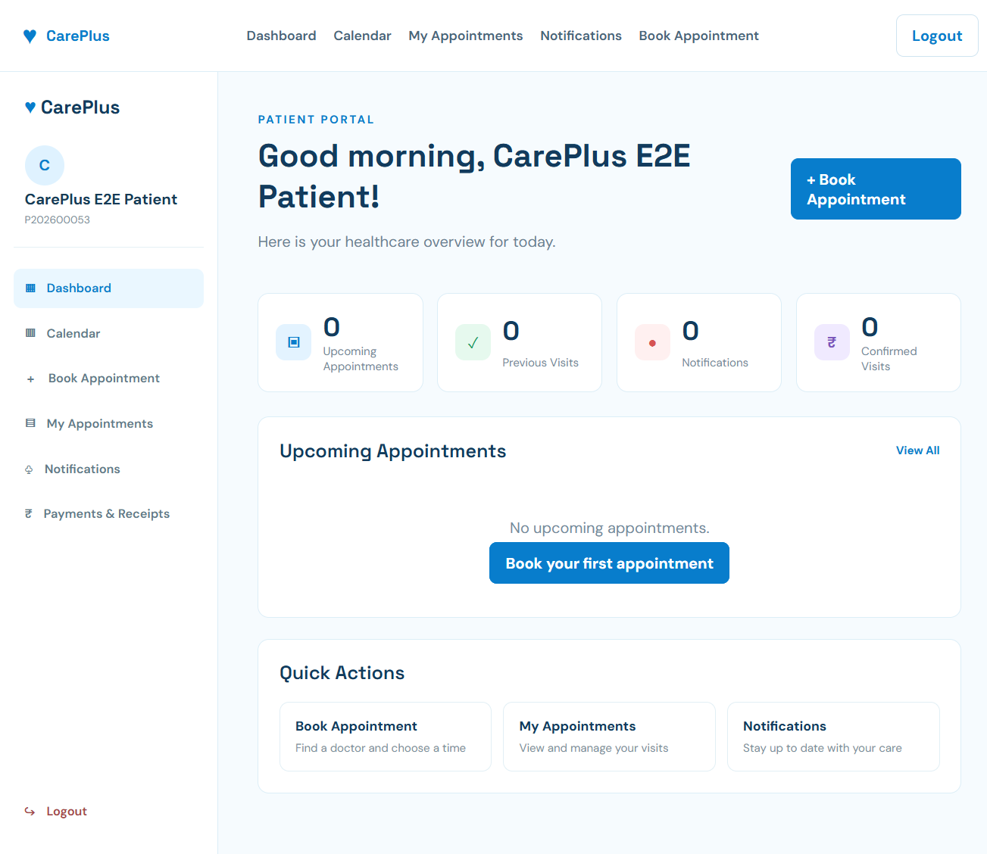
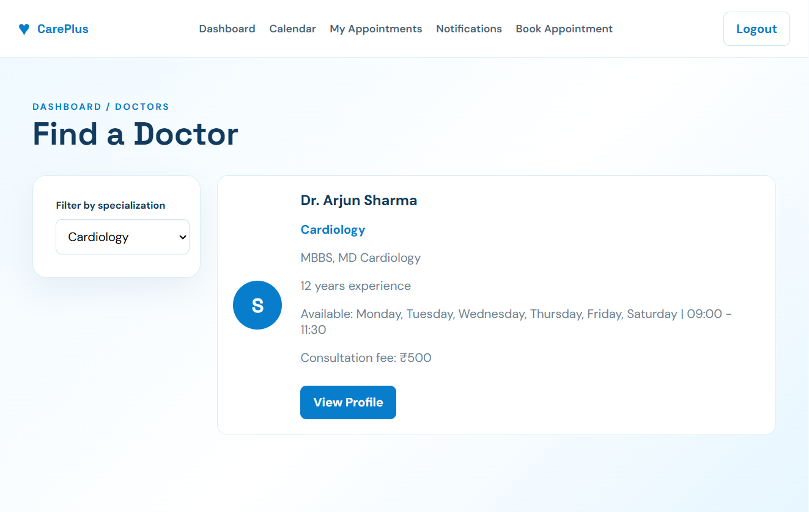
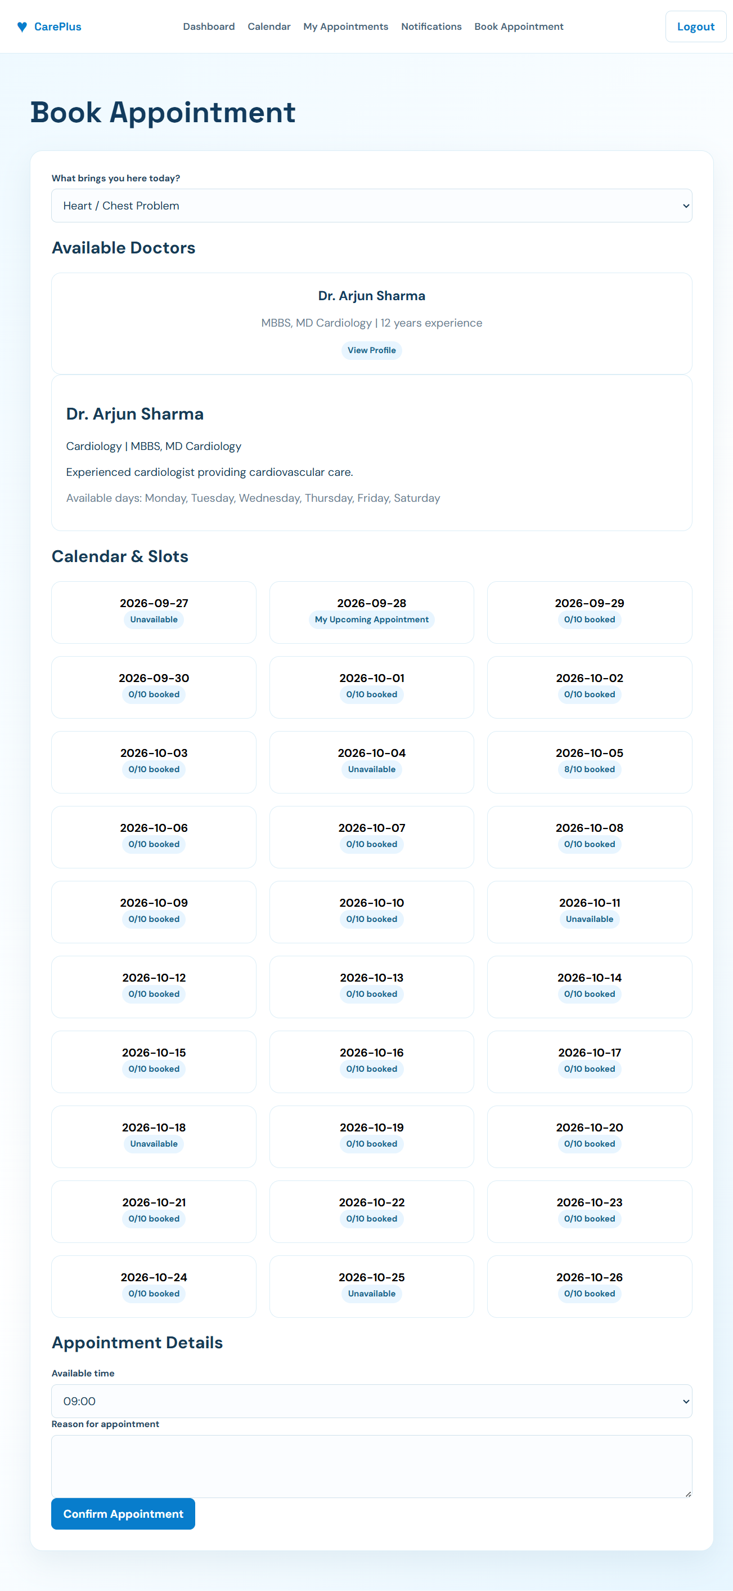
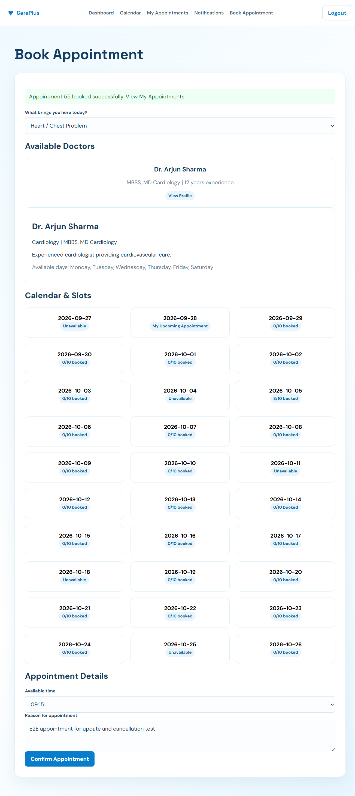
PATIENT INTERFACE — ACTUAL PROJECT SCREENSHOTS

Slide 17
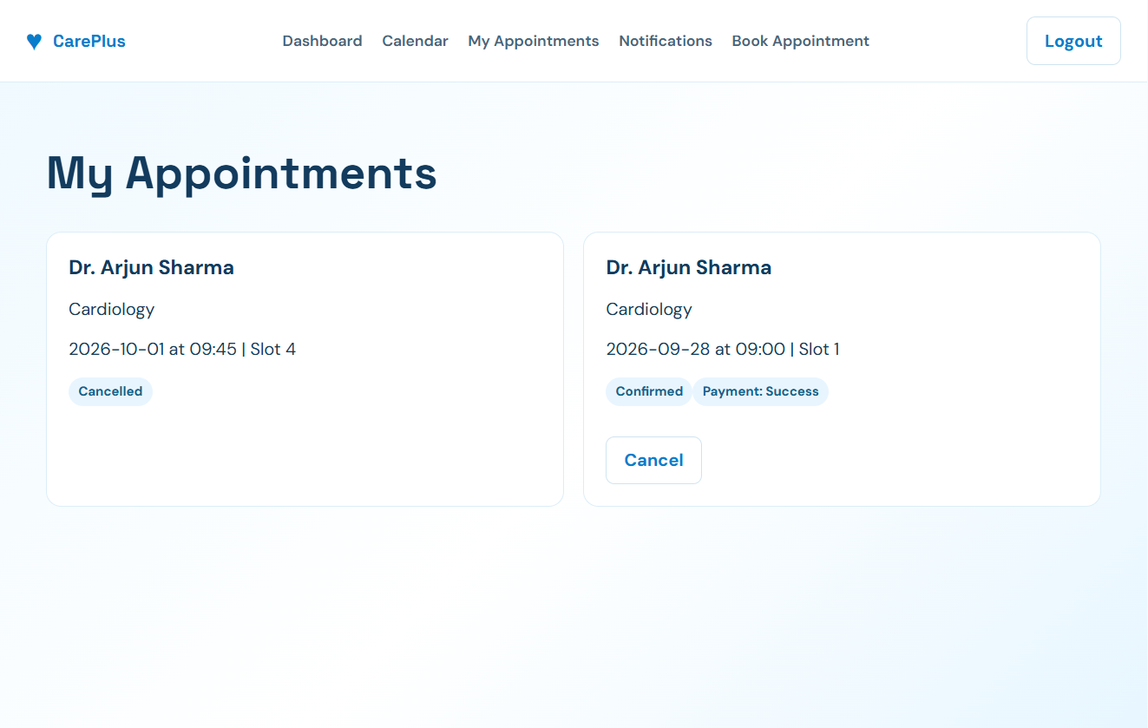
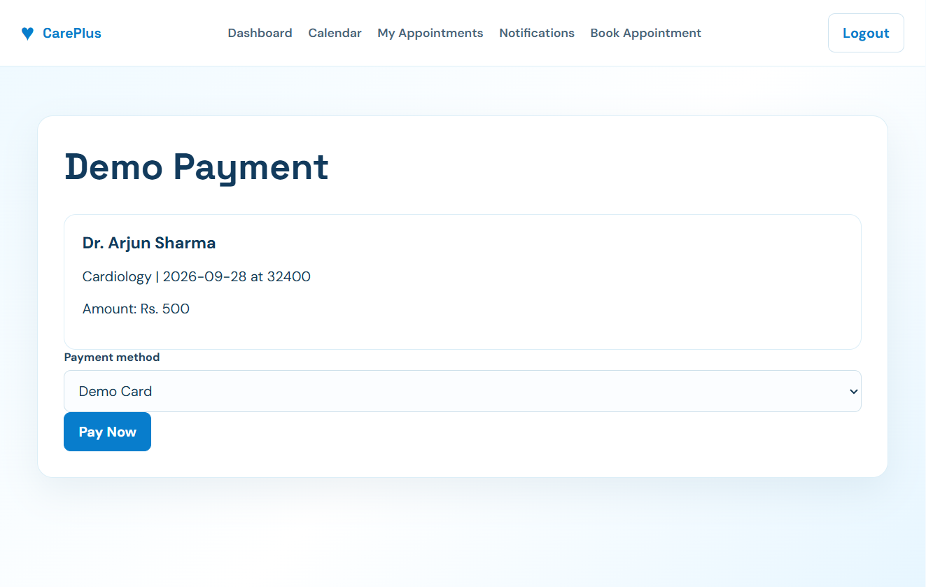
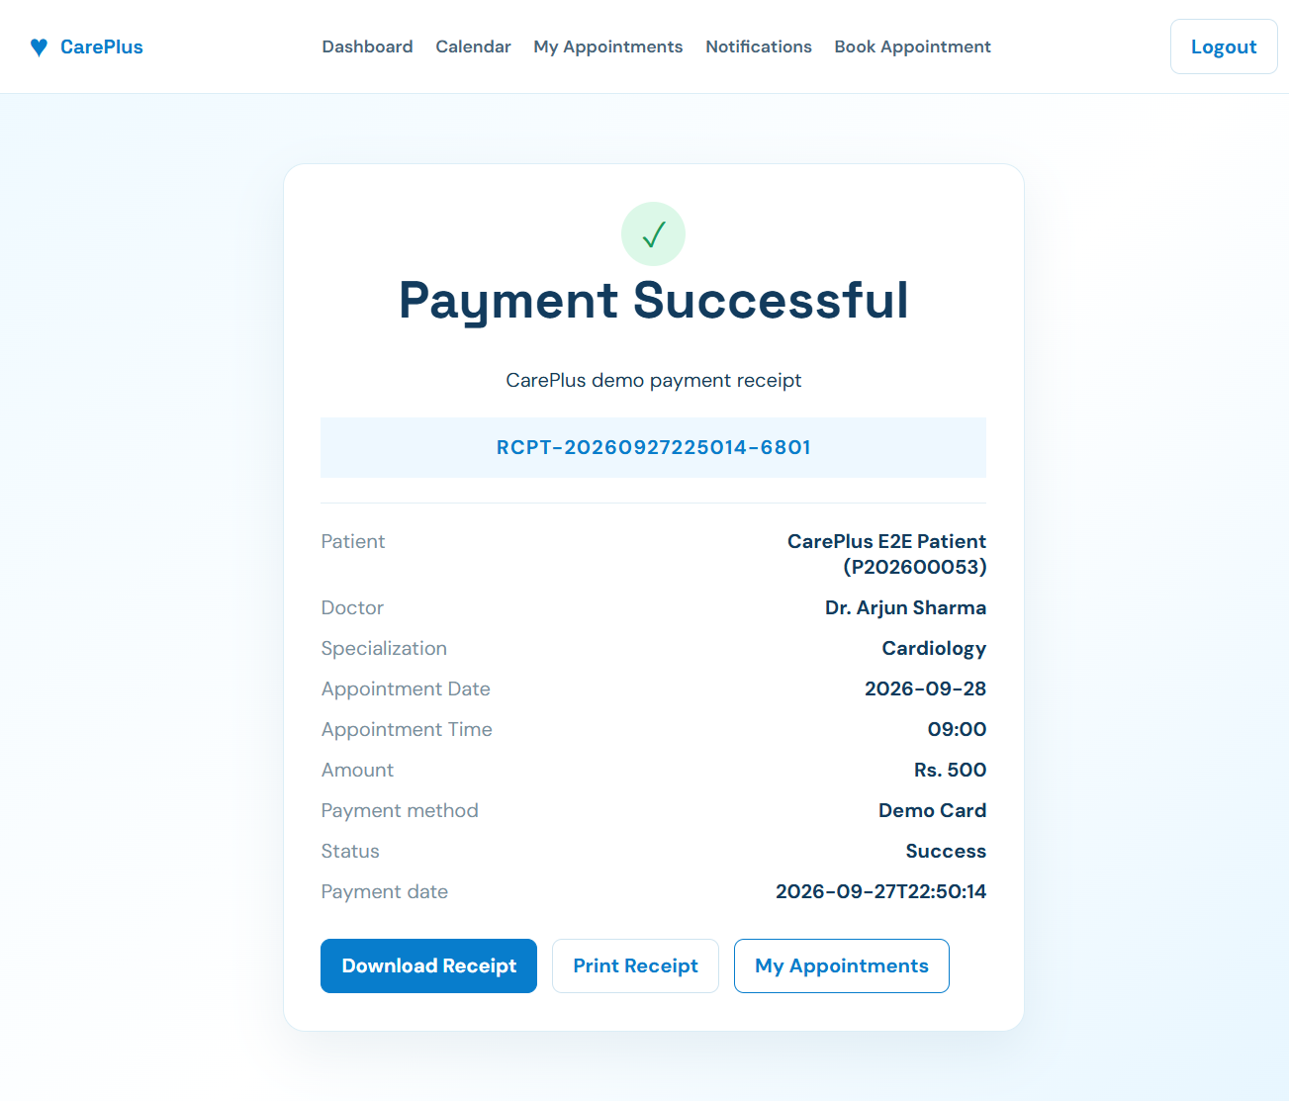
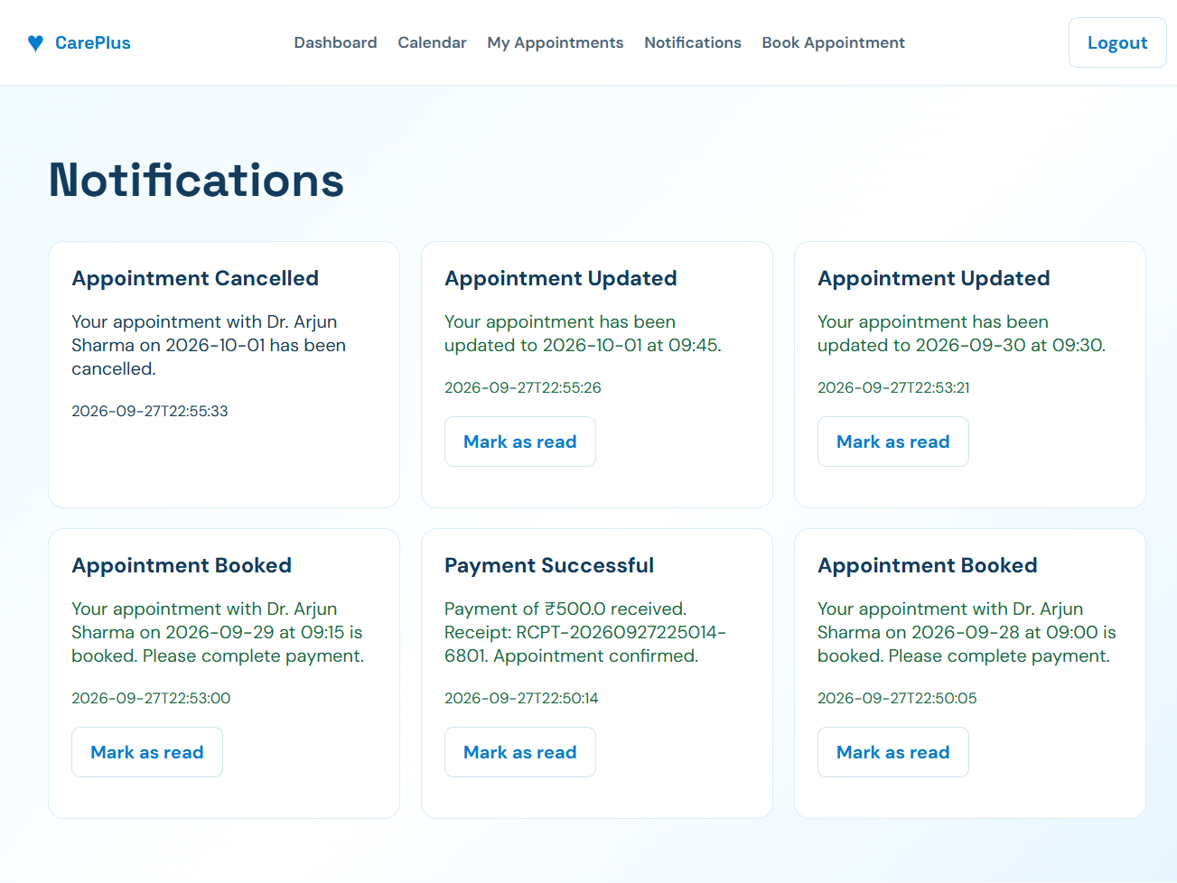
APPOINTMENT, PAYMENT & NOTIFICATIONS
• Payment is a demo workflow; the backend records a successful payment and generates a receipt number.

Slide 18
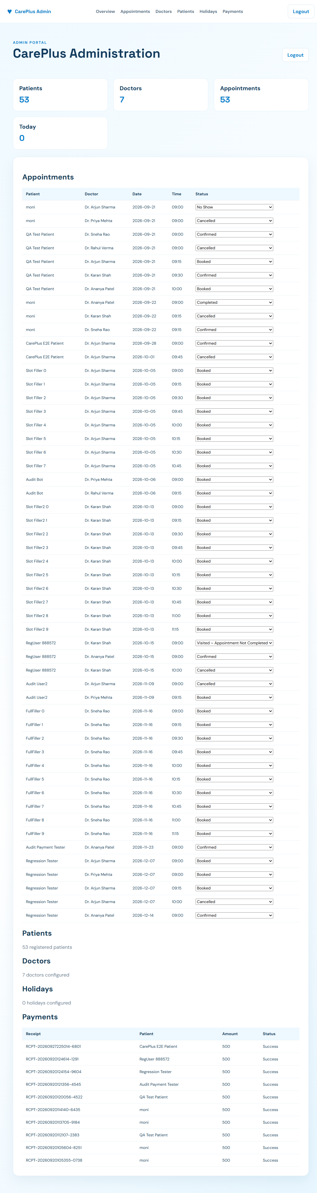
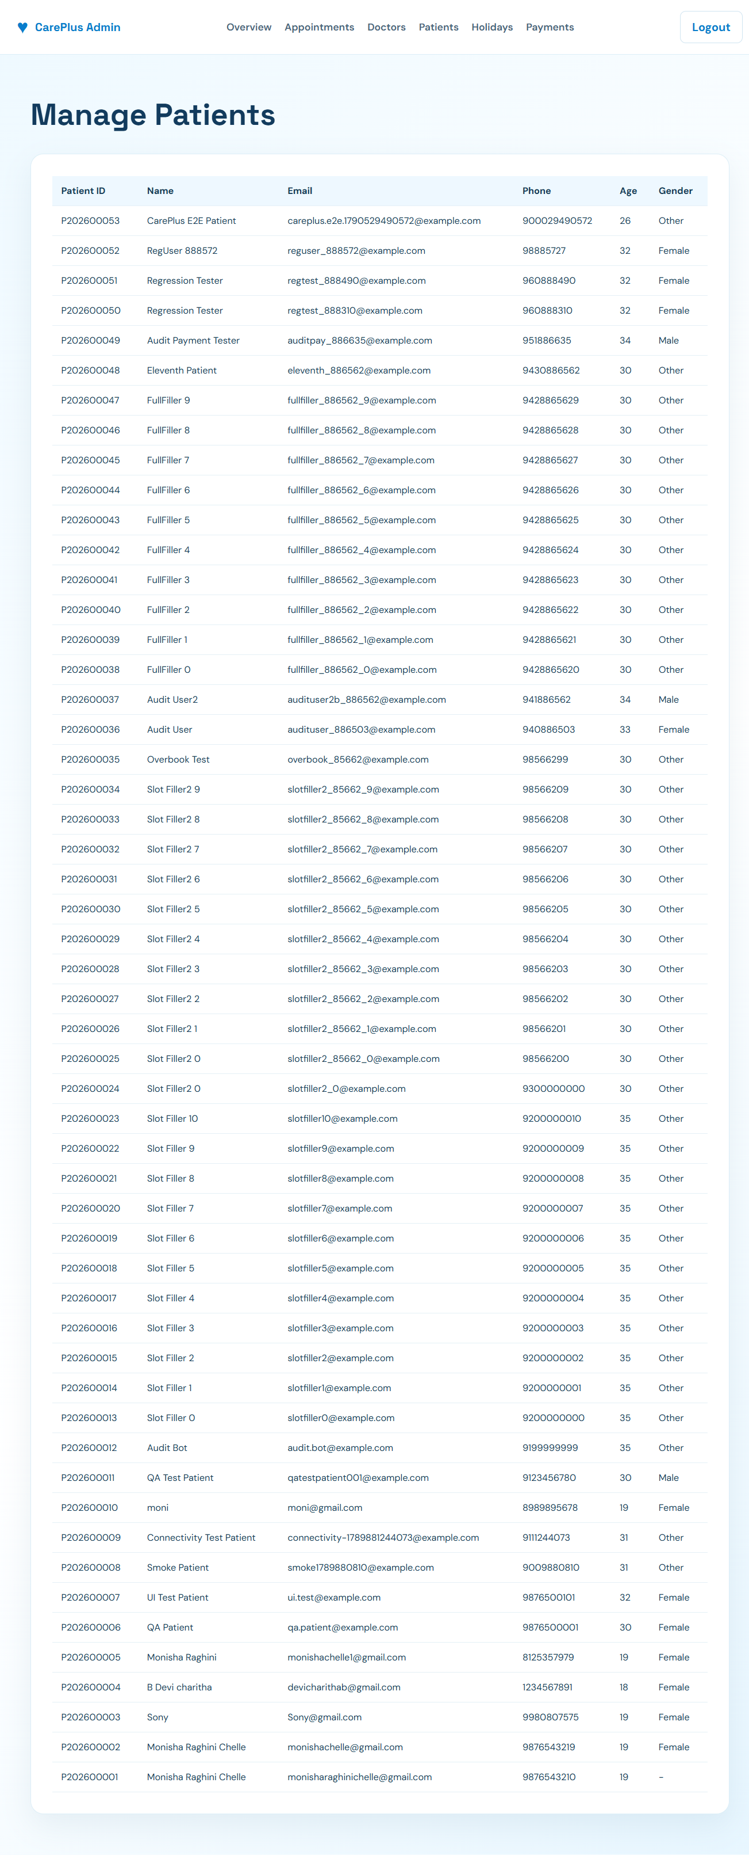
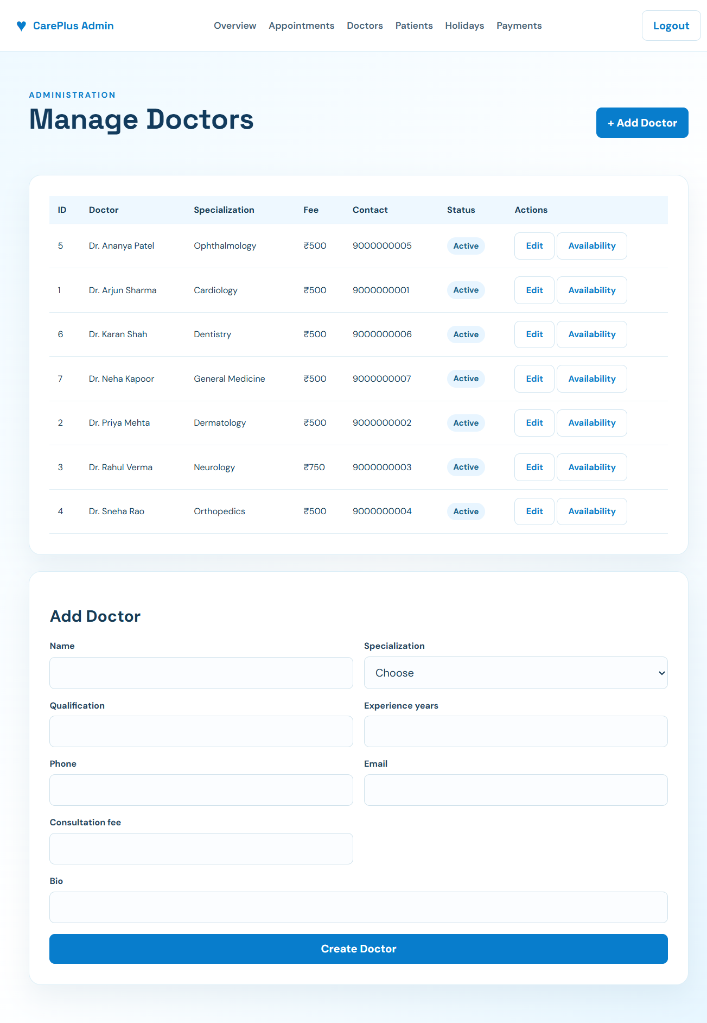
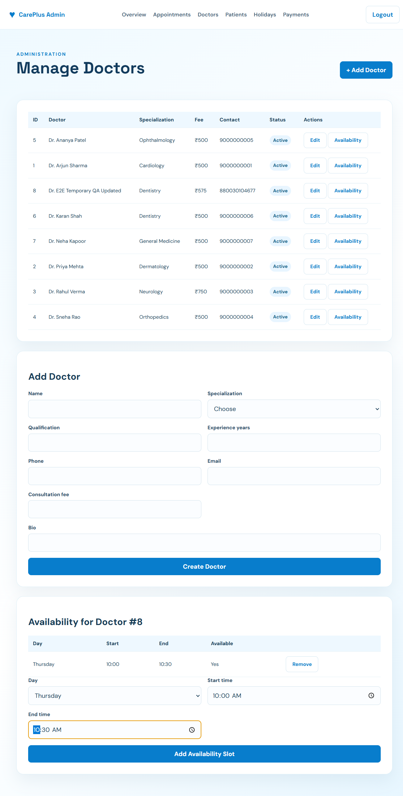
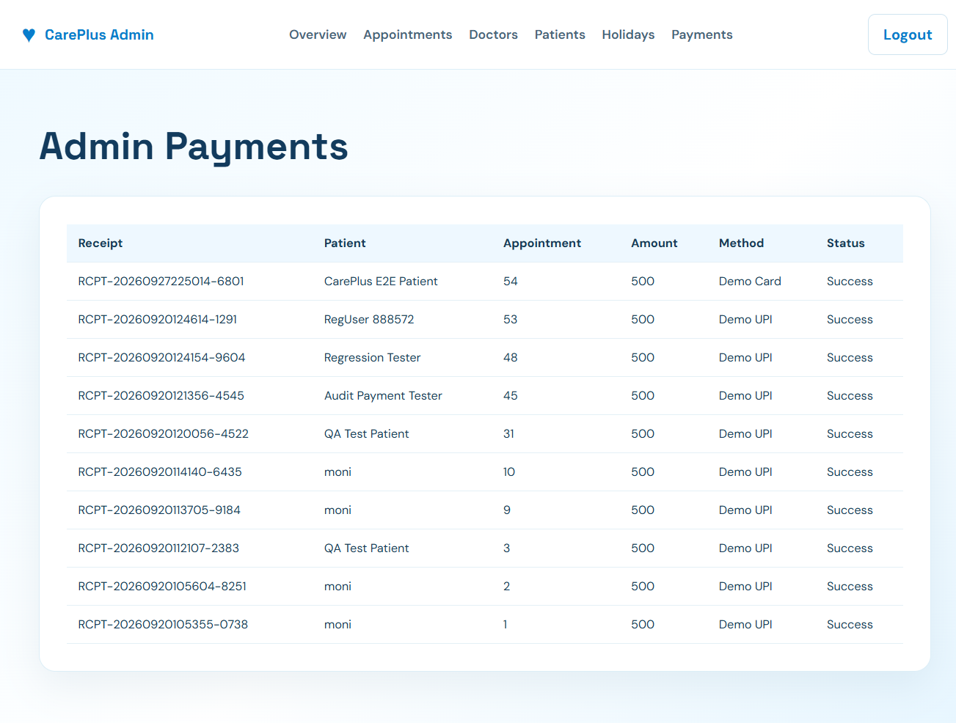
ADMINISTRATION — ACTUAL PROJECT SCREENSHOTS

Slide 19

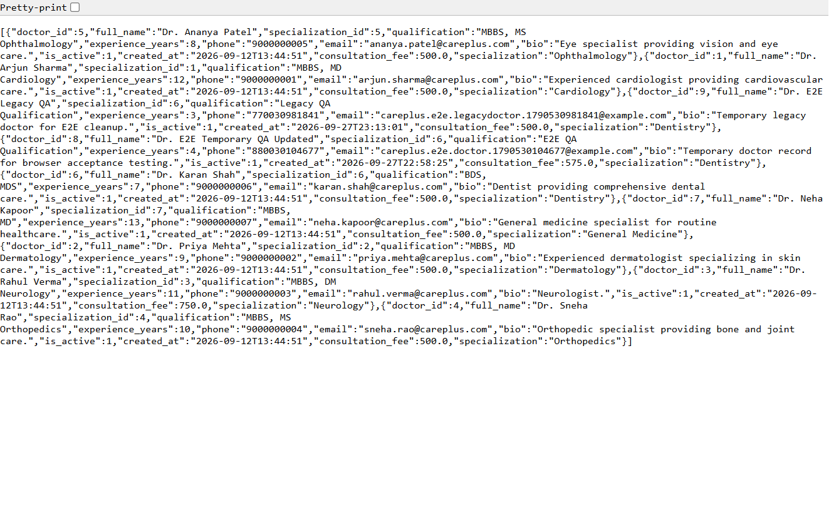
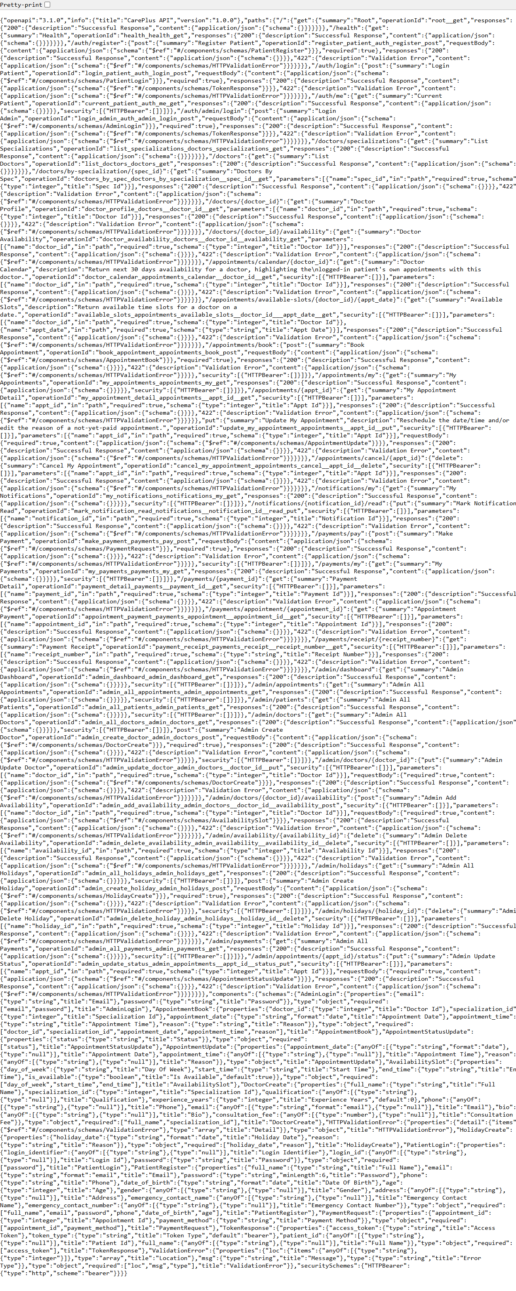
API TESTING & EVIDENCE
• The project includes genuine browser/API captures.
• Testing report records HTTP smoke checks, API checks, database persistence checks and UI workflow validation.

Slide 20
CONCLUSION AND FUTURE SCOPE
Conclusion
CarePlus provides an integrated online appointment scheduling system.
Patients can find doctors, check availability, book appointments, and manage appointments and notifications.
Administrators can manage doctors, appointments, holidays, and payments.
React, FastAPI, and MySQL provide the main application architecture.
Future Scope
Integration with a real payment gateway.
Separate doctor portal and authentication.
Cloud deployment and scalability improvements.
Additional healthcare services and integrations

Slide 21
THANK YOU
QUESTIONS & DISCUSSION

