Slide 1
COVID-19 ICU Admission Prediction
Machine Learning Mini-Project
Logistic Regression using baseline clinical, sex and CT scanner features
81
Patients
17
Test cases
88.24%
Accuracy
0.993
ROC-AUC
UE24CS352A • Machine Learning Mini-Project • 1

Slide 2
1. Problem Statement & Objective
• Goal: predict whether a COVID-19 patient is likely to require ICU admission.
• Binary target: Non-ICU = 0, ICU = 1.
• Use baseline information available before the outcome as model inputs.
• Demonstrate a complete supervised-learning workflow from data preparation to evaluation.
Why ICU prediction?
• Early risk identification
• Patient triage support
• Resource planning
UE24CS352A • Machine Learning Mini-Project • 2

Slide 3
2. Dataset
Rows
81 patient records
Columns
7 original fields
Target
Intensive care unit
Class distribution
48 Non-ICU • 33 ICU
Model inputs
Baseline clinical score • Sex • Baseline scanner
Note: The notebook explores follow-up fields, but the final model uses only the three baseline predictors above.
UE24CS352A • Machine Learning Mini-Project • 3

Slide 4
3. Methodology / Workflow
1
2
3
4
5
6
Load & inspect
Encode target
Prepare X
Split data
Train
Evaluate
81 × 7 dataset
NO → 0, YES → 1
One-hot encode Sex & scanner
80% train / 20% test
Logistic Regression
Accuracy + CM + ROC-AUC
UE24CS352A • Machine Learning Mini-Project • 4

Slide 5
4. Model Implementation
X = pd.get_dummies(
df[["Baseline clinical score",
"Sex", "Baseline scanner"]],
drop_first=True)
X_train, X_test, y_train, y_test =
train_test_split(..., test_size=0.2,
stratify=y, random_state=42)
model = LogisticRegression(random_state=42)
model.fit(X_train, y_train)
• 64 training samples and 17 testing samples
• Stratification preserves the ICU/non-ICU class ratio
• Logistic Regression outputs both class labels and ICU probabilities
• ROC curve uses predicted ICU probability
UE24CS352A • Machine Learning Mini-Project • 5

Slide 6
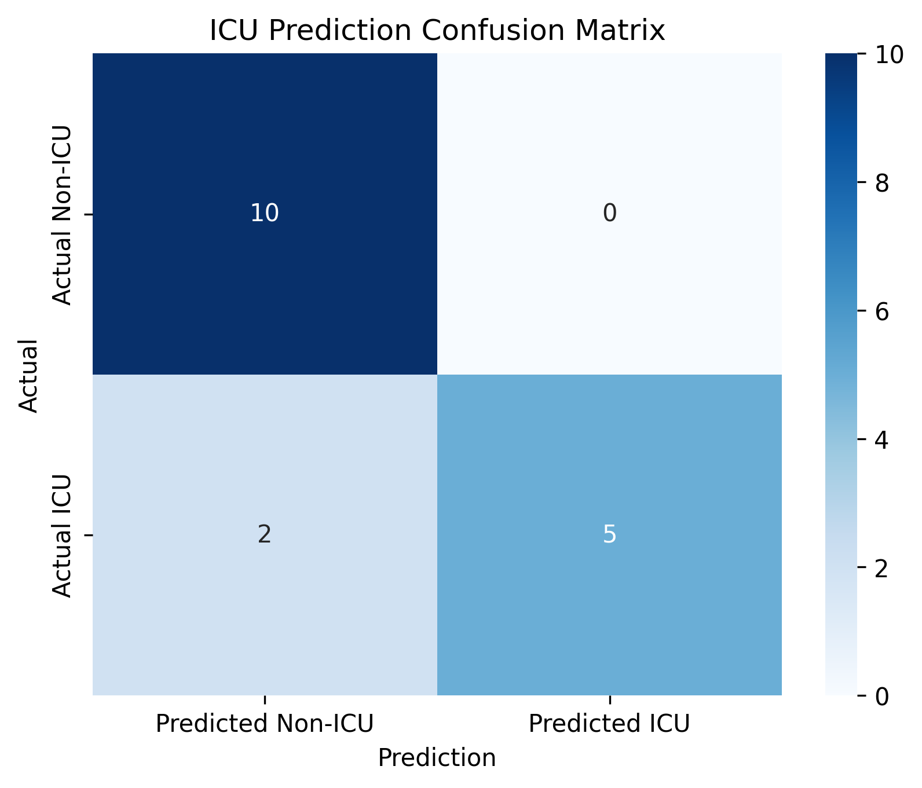
5. Confusion Matrix Results
10
True Negative
0
False Positive
2
False Negative
5
True Positive
0.71
ICU Recall
0.83
ICU F1
Key point: no false positives, but 2 ICU cases were missed.
UE24CS352A • Machine Learning Mini-Project • 6

Slide 7
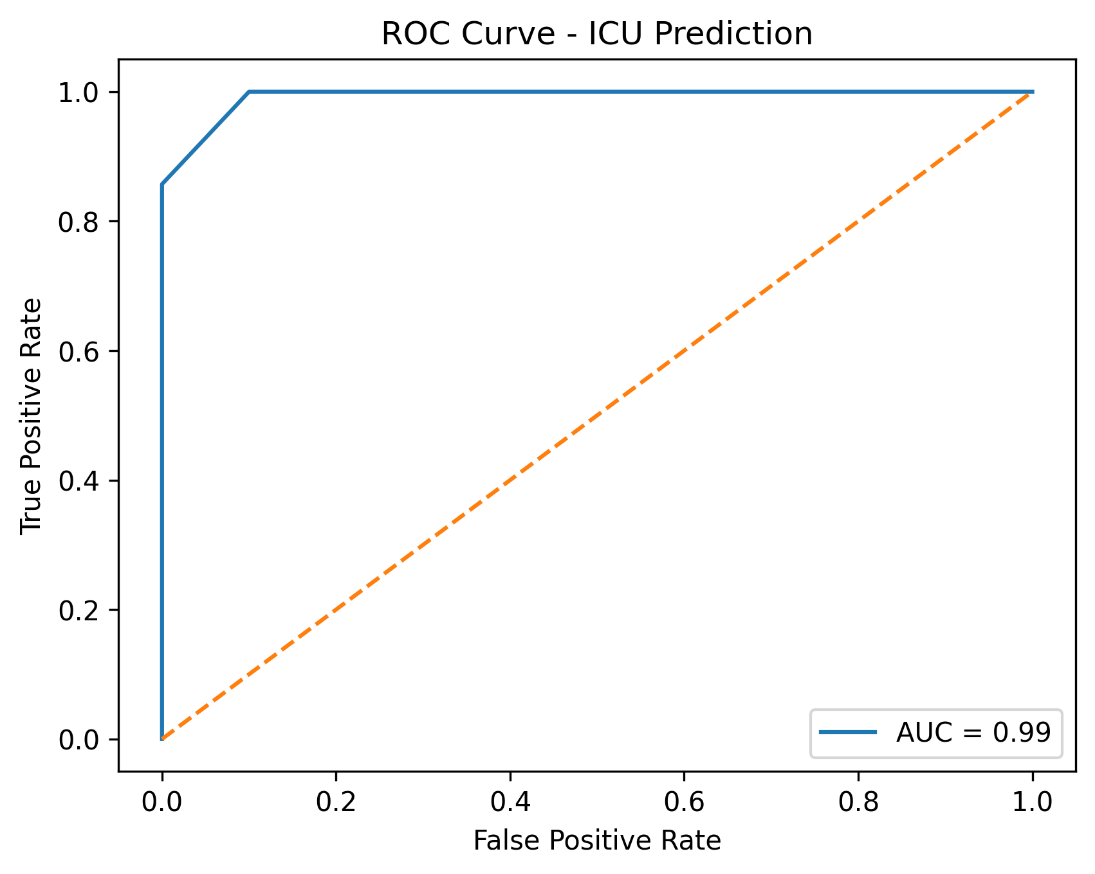
6. ROC Curve & Performance
88.24%
Accuracy
0.9929
ROC-AUC
1.00
ICU Precision
0.71
ICU Recall
UE24CS352A • Machine Learning Mini-Project • 7

Slide 8
7. Conclusion, Limitations & Future Scope
• The end-to-end ICU prediction pipeline works successfully on the supplied 81-record dataset.
• The model achieved 88.24% test accuracy and 0.9929 ROC-AUC.
• The strongest fitted coefficient is for Baseline clinical score (+1.2306).
• Because the dataset and test split are small, the results should not be treated as clinical evidence.
• The current implementation does not directly use extracted radiomics features.
Future scope
• Add radiomics and laboratory features
• Compare Logistic Regression, RF, SVM and boosting models
• Use cross-validation and independent validation
• Study class imbalance and threshold selection
• Improve ICU recall for safer triage
UE24CS352A • Machine Learning Mini-Project • 8

Slide 9
8. Live Demonstration Plan
• Load the dataset → show shape and columns
• Map ICU labels → show 48 Non-ICU / 33 ICU
• Create encoded feature matrix
• Run 80:20 stratified train/test split
• Train Logistic Regression
• Show accuracy + classification report
• Display confusion matrix and ROC curve
• Explain AUC = 0.9929 and the two missed ICU cases
UE24CS352A • Machine Learning Mini-Project • 9

