Slide 1

SAM(Surveyor Agency Management) WORK FLOW
Admin

Slide 2
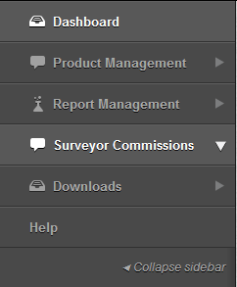
Content
Dashboard
Product Management
Report Management
Surveyor Commissions
Downloads

Slide 3
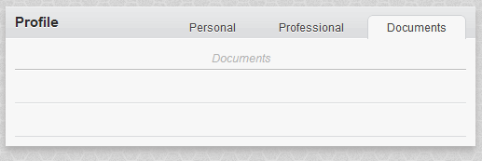
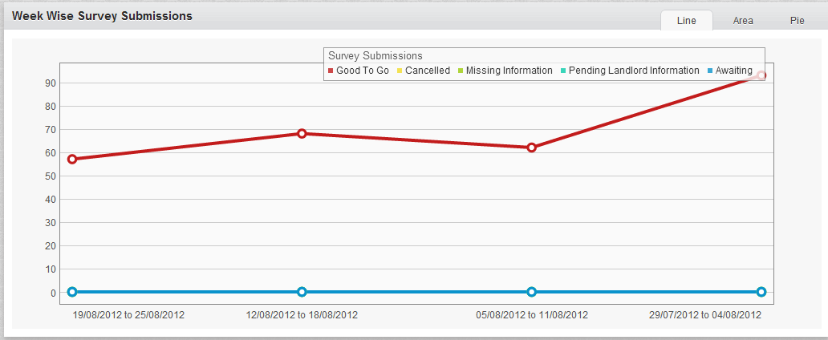
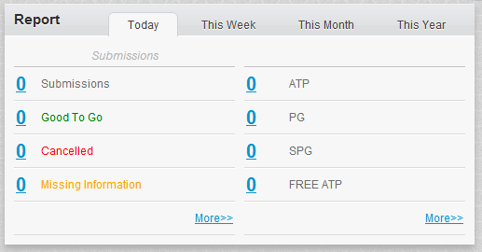
Dashboard
Profile
Week Wise Survey
Submissions
Over All Survey
Report
Check Personal Profile
Graphical Representation of GTG
Total Submissions GTG Pending etc

Slide 4
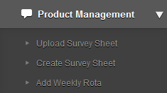
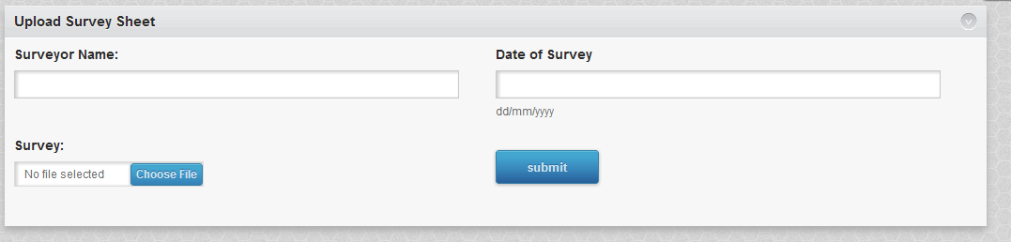
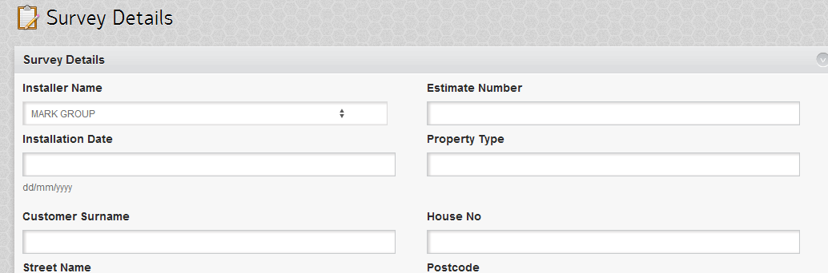
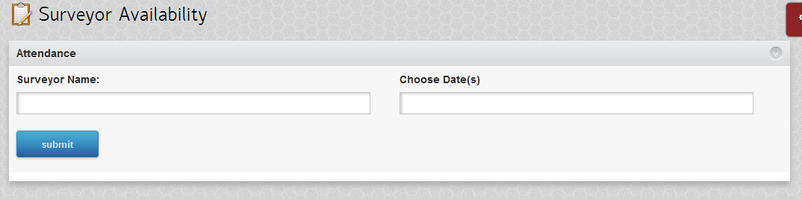
Product Management
Upload Survey Sheet
Create Survey Sheet
Update Weekly Rota

Slide 5
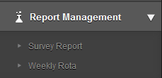
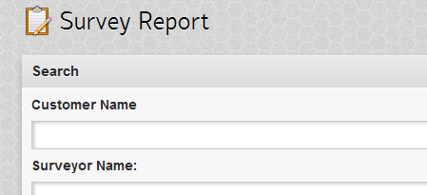
Report Management
Search Submissions
Update weekly Rota

Slide 6
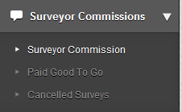
Surveyor Commissions
Pay Structure
Surveyor Commissions
Cancellations

Slide 7
Downloads
Agency Presentation PDF
SAM PPT
Admin Email ID

