Slide 1
Customer Churn Prediction

Slide 2
CONTENTS
Problem statement
Exploratory Data Analysis
Learning Curves for Logistic Regression
Learning Curves for Naïve Bayes
Learning Curves for voting classifier
Compare all Model
Recommendations
conclusion

Slide 3
Problem Statement
.
Today’s Most of the Telecom companies are trying to give best customer services to their subscribers, so customers do not inactive from their services. Acquiring a new customer is always more expensive than retaining an existing one. Hence, not letting them churn is the key to a sustained revenue stream. To solve this Business problem a predictive model is to developed by analyzing and training the given historic data of the telecommunication customers using Machine Learning Algorithm. The developed predictive model should predict the customer behaviour in advance whether churn or not. So the companies can provide better services to customers who are going to churn.

Slide 4
Exploratory Data Analysis
Dataset is Imbalanced as 85.50% of records shows customer stay with the service (churn = 1 )and 14.50% of records shows customer are leave the services (churn = 0).
Contract renewal is one of import feature for churn prediction, As from analysis 80% of customers are not churn because contract renewal is done ,10% of customers are churned although contract is renewed and 4% people churn because contract is not renewed.
The few independent features in dataset suffers from multicollinearity. Data Usage is a independent feature consist of mostly zeros and it is highly correlated with Data plan independent feature and Day mins is highly correlated with Monthly charge.
If the customer not taken data plan there is high chance of leave the service and if customers took the data plan there is less chance of leaving the service
If the customer services calls more than 3 times there is high chance of churn.

Slide 5
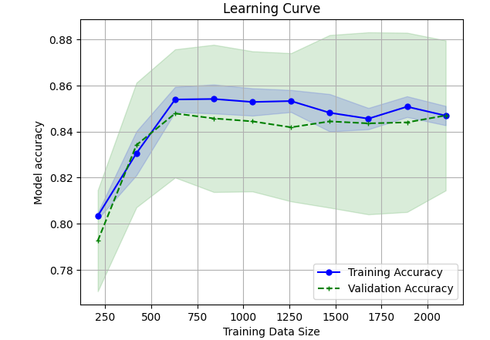
Learning Curves for Logistic Regression
The Learning curve shows the Logistic regression model performing well on Training set and Test set. At sample size between 500 to 700 training accuracy is at peak. There is slight increase and decrease of Train accuracy 750 to 2000 sample.

Slide 6
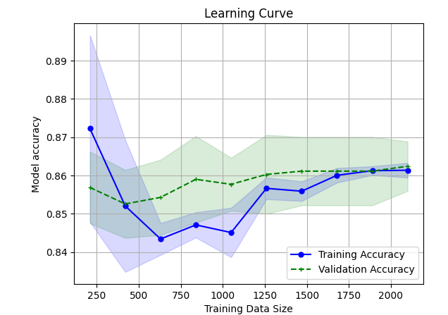
Naïve Bayes Algorithm
From the learning curves train accuracy and test accuracy are low compared to desired performance.
Model is sufferings from Under fitting problem.
The given independent feature doesn’t fit properly to solve the business problem.
Train accuracy is flat at end points of the graph, so adding extra data cannot solve under fitting problem

Slide 7
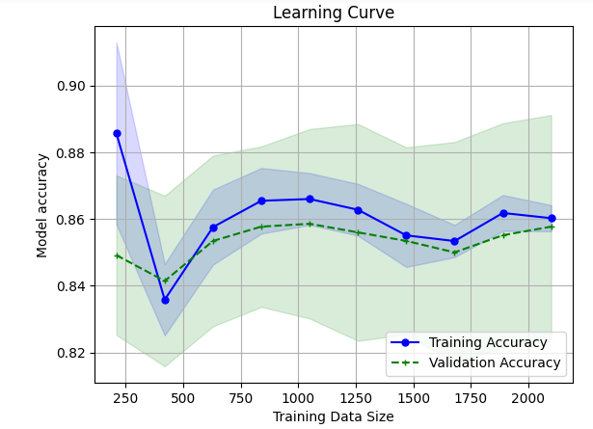
Logistic regression optimization
Logistic regression is optimized by doing hyper parameter tuning and grid serach cv.
Tuned different hyper parameter for logistic regression. But no improvement in model performance compare to original model

Slide 8
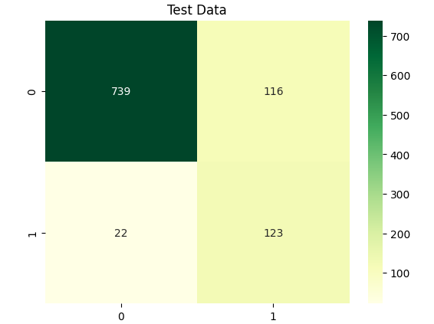
Confusion Matrix
In the given Dataset customer is churn considered as Negative class and not churn considered as positive class.
Customer is not churn is class denoted by 0. True positive 739 records correctly classified by the model and 116 records not correctly classified considered as False positive.
Customer is churn is class denoted by 1. True Negative 123 records correctly classified as churn and 22 records miss classified as not churn (False Negative)

Slide 9
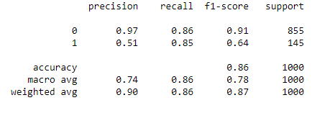
Classification Report
Precision is low for Negative class as customer is churn .
Good recall score for both classes.
Need to improve precision score for minority class.
The class is well detected but the model also include points of other classes in it.

Slide 10
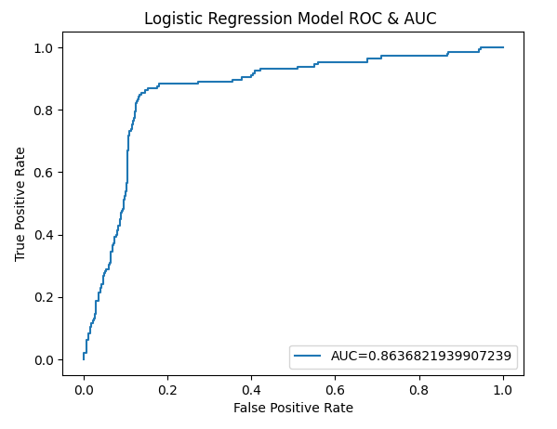
ROC AUC metrics for Logistic Regression
AUC stands for Area under curve it’s a metric used for validating classification problem. Generally AUC scores lies between 0 to 1, the value more closes to 1 has better performance.
From the ROC AUC metric the AUC is 0.86 which is close to 1, so we conclude model is performing good with accuracy of 86% on unseen data.

Slide 11
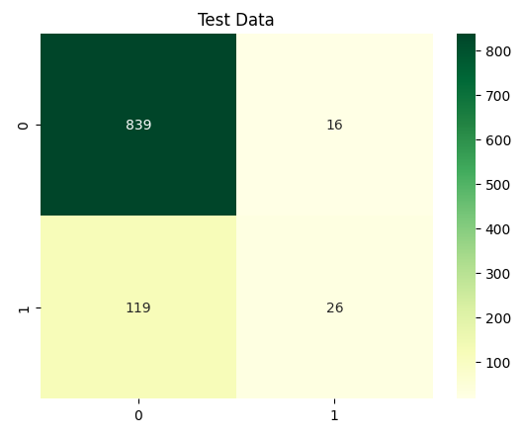
Naïve Bayes Confusion Matrix
In the given Dataset customer is churn considered as Negative class and not churn considered as positive class.
Customer is not churn is class denoted by 0. True positive 839 records correctly classified by the model and 16 records not correctly classified considered as False positive.
Customer is churn is class denoted by 1. True Negative 26 records correctly classified as churn and 119 records miss classified as not churn (False Negative)
Most of the customer churn is misclassified as customer is not churn. Need to decrease misclassification rate of Negative class(churn=1)

Slide 12
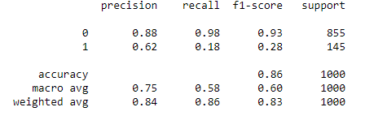
Naïve bayes model classification report
Recall is low for Negative class as customer is churn .
Good recall score for Positive class.
Need to improve precision and recall score for minority class. The class is poorly handled by the model.

Slide 13
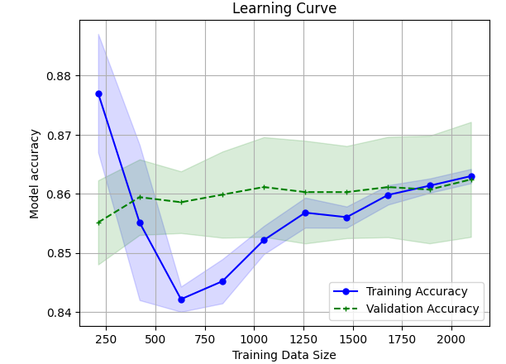
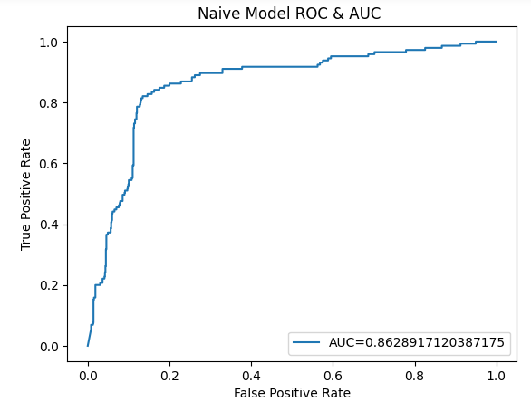
Naïve Bayes model optimization
Learning curve shows Model is suffering from under fitting even though model is optimized.
Learning Curve shows Train accuracy increasing at 2000nth record.
From Learning Curve to avoid under fitting problem adding more amount of data can solve.
ROC/AUC shows curve shows the value of 0.86 its better but this is imbalanced dataset auc is not right metric to validate the model.

Slide 14
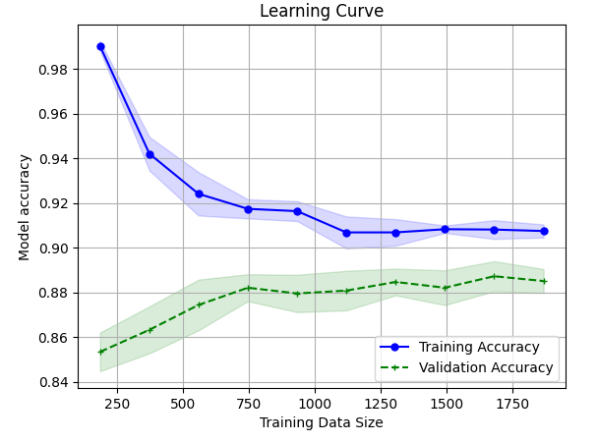
Ada boost algorithm Learning curve
The Learning curve shows the adaboost classifier model performing well on Training set and not on Test set.
Learning curve shows that model is overfitting.
Test accuracy slightly increasing at every step and become slight decrease at final record.

Slide 15
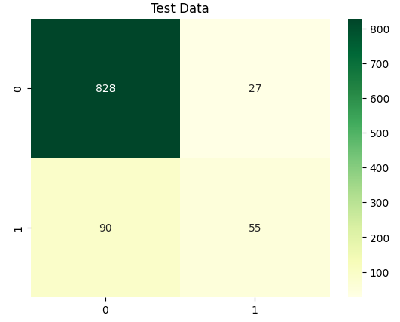
Confusion Matrix
In the given Dataset customer is churn considered as Negative class and not churn considered as positive class.
Customer is not churn is class denoted by 0. True positive 828 records correctly classified by the model and 27 records not correctly classified considered as False positive.
Customer is churn is class denoted by 1. True Negative 55 records correctly classified as churn and 90 records miss classified as not churn (False Negative)
Most of the customer churn is misclassified as customer is not churn. Need to decrease misclassification rate of Negative class(churn=1)

Slide 16
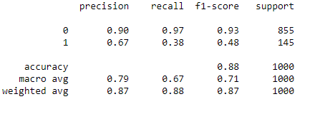
Classification Report
From the classification Report Precision and recall scores are well for Positive class(churn = 0).
Recall is low for Negative class (churn = 0). As misclassification rate is high.

Slide 17
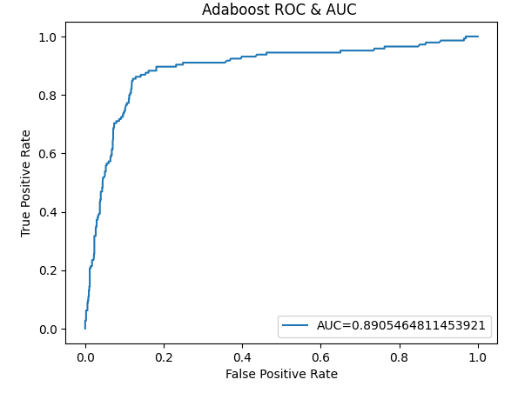
ROC/AUC curves
Model is performing well on test data.
AUC score is 0.89 which near to 1. shows model is performing well.

Slide 18
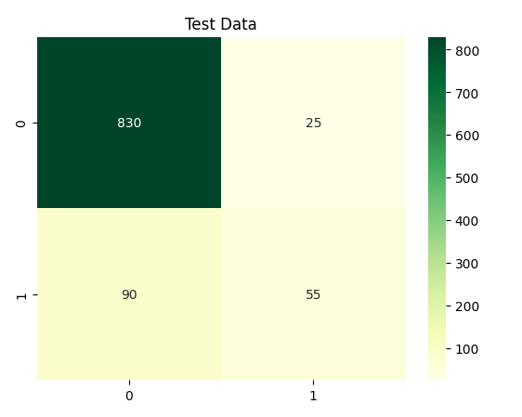
Ensemble Voting Model
Based on performance considered stacking Logistic regression and Adaboost I had created Ensemble voting model.
Customer is not churn is class denoted by 0. True positive 830 records correctly classified by the model and 25 records not correctly classified considered as False positive.
Customer is churn is class denoted by 1. True Negative 55 records correctly classified as churn and 90 records miss classified as not churn (False Negative)
Most of the customer churn is misclassified as customer is not churn. Need to decrease misclassification rate of Negative class(churn=1)

Slide 19
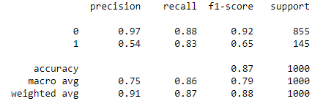
Classification Report
Report shows good recall score.
But low precision score in negative class(churn = 1).
The class is well detected but the model also include points of other classes in it.

Slide 20
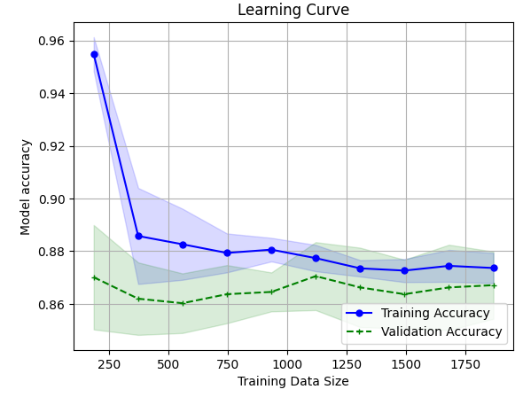
Learning Curve
Learning curve shows model is overfitting slighty

Slide 21
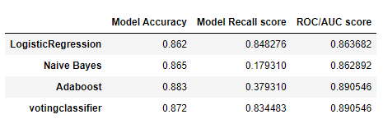
Comparing models based On Recall score
Comparing all given models w.r.t Recall score. Logistic regression recall score high 84% compare to Naïve bayes , Adaboost and Ensemble voting model.

Slide 22
Recommendation
Logistic regression is simple model well fit for the imbalanced dataset.
Adding Training samples and adding minority class samples can help logistic regression perform even better.
Adding Extra features can help to increase model performance.
Should Increase precision and recall rate of the model .

Slide 23
Conclusion
Data is provided is imbalance dataset.
Out of all algorithms Logistic regression had better Recall score and it can handle imbalance dataset with out data pre-processing.
Logistic regression out perform Voting classifier in combination of Logistic regression and Adaboost.
Increasing Training samples and increasing minority class samples can helps to perform Logistic regression even better.

