Slide 1


Logistics optimization through Salesforce
COMPANY PROFILE
How DriverDo overcame its operational limitations with salesforce
LOCATION | Kansas, USA
EMPLOYEES | 12 Employees
INDUSTRY | Internet
COMPETITOR | Arkus, Pracedo
SOLUTION(S) | Sales Cloud, Community Cloud, Chatter, Android and IOS Applications
GO LIVE DATE: | 01/01/2015
COMPANY OVERVIEW
DriverDo is the real-time driver accountability and support service. DriverDo streamlines management by connecting automotive businesses to transport services and independent contract drivers, simplifying employment with quick and direct access to jobs and drivers, GPS routing and tracking, as well as providing digital documentation and payment options. An all-in-one Solution that provides you with the tools to better address the ever-present logistic need.
CHALLENGE
SOLUTION
RESULTS
DriverDo has to maintain a dynamic database of drivers complete with information on location, availability, miles driven, rating. This is usually done with personnel supervision using multiple spreadsheets New drivers require easy vetting and on-boarding, which requires communication with MVD and the local PD. Concern for privacy of the applicant is paramount. Job creation, assignment and tracking needs to be done real time to provide clarity and seamlessness demanded of a facilitating platform Dealerships and drivers have the additional task of raising and clearing invoices for the trip | Database maintenance is automated. Data is sourced from multiple channels and maintained with salesforce enabling seamless operation Driver on-boarding and vetting process is automated which looks up their motor vehicles record and criminal record maintaining the strictest standards of privacy A platform was created on the dealership end to facilitate trip itinerary creation, efficient routing, issue reporting and tracking for real time driver accountability. Drivers use IOS and android based applications to receive and update information including real time location, incurred extra-charges and payments Drivers can raise the invoice through the mobile application and dealerships can clear payments using Online Payment Gateways | Automation drastically reduced operational costs, increased reliability, reduced cycle time. Driver on-boarding time was drastically reduced because the traditional institution visits were replaced by API callouts made to government databases Data collection enabled dealerships to have a 360 degree view of their entire process. Custom reports keep track of imiles driven, fuel consumption, etc. and their relationship with the driver on job. Invoice settling is faster and documenting simplifies tax calculation Digitalization and documentation enabled dealerships to engage n cost management and forecasting
Salesforce Confidential
Notes:
‹#›

Slide 2
More Detailed Info and Quantitative Results
Color Commentary and Notes About Details of Deal or Implementation
NOTES
Paypal integration to facilitate secure, reliable online payments Vetting while on-boarding using VicTig integration Unique algorithm for driver assignment according to availability, experience and score Efficient route calculation factoring distance and toll payments Multiple driver assignment for fleet reclamation Live GPS tracking for accuracy Gate pass transfer through mobile app to facilitate easy movement and inventory tracking within facility Portal to upload photographs to accurately gauge car condition and odometer reading pre and post drive Digital transfer of required documents related to the car prior pick up Automated reassignment of cancellations Versatile dashboards for comprehension
QUANTITATIVE RESULTS IF AVAILABLE
Operational optimization went up by 500%, due to automation and interlinking Vendor on-boarding is 6 times faster at full set limit
Notes:
‹#›

Slide 3
Solution Detail
MORE DETAILS
Competitors of Salesforce engaged in sales cycle: | Pegasys
Previous technology replaced by Salesforce: | MS Excel
Salesforce products deployed: | Sales Cloud, Service cloud, Community Cloud, Chatter, Salesforce Mobile SDK
Customer Business Model (B2B, B2C, or Both) | B2B
Salesforce Product features: | Mobile, Force.com Sites, Knowledge, Case Management, etc
If using Service Cloud, list use case (e.g. customer support, call center, field service, telesales, etc) | Case Management, TeleSales
Integrations: | Android, IOS apps, PayPal, VicTig
AppExchange Apps/Partners | SMS magic
Solution ‘Go Live’ date: | 03/01/2015
Notes:
‹#›

Slide 4
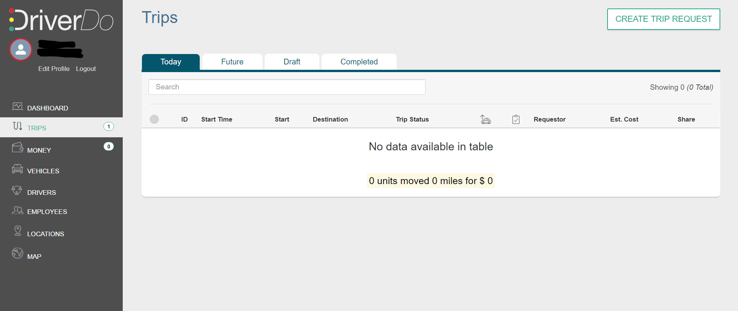
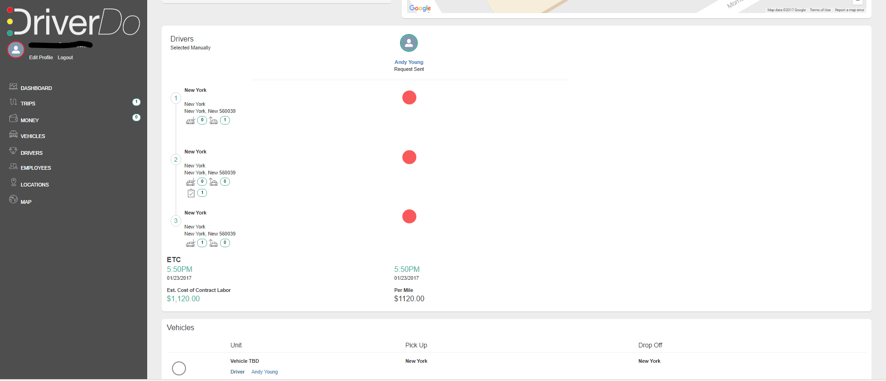
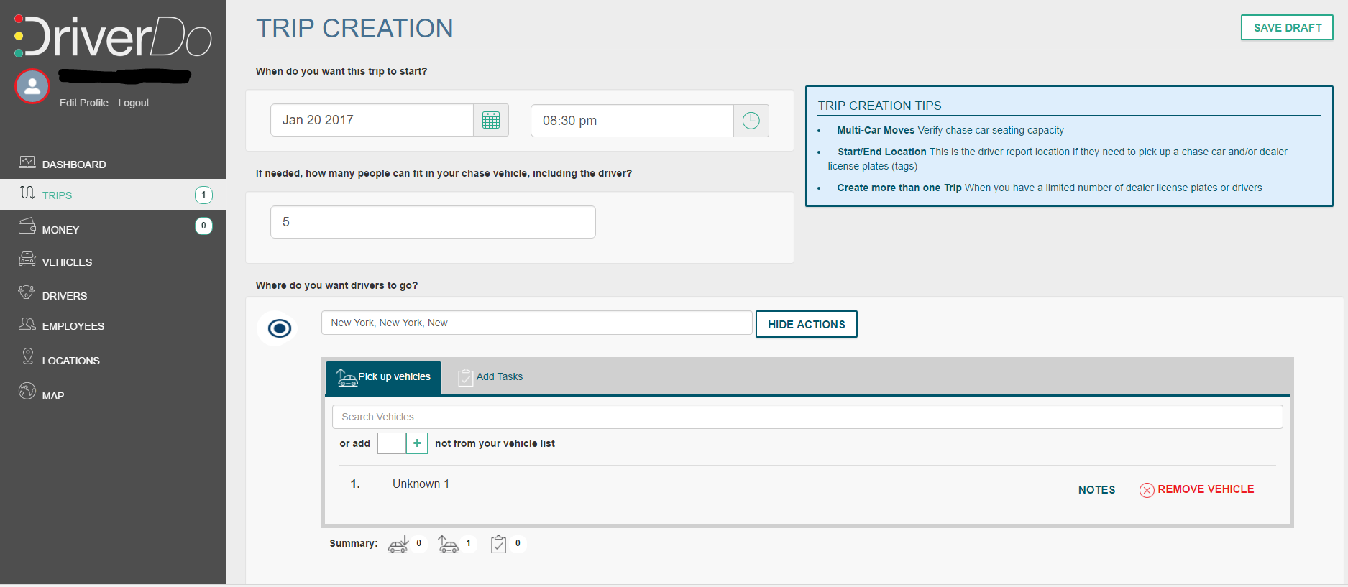
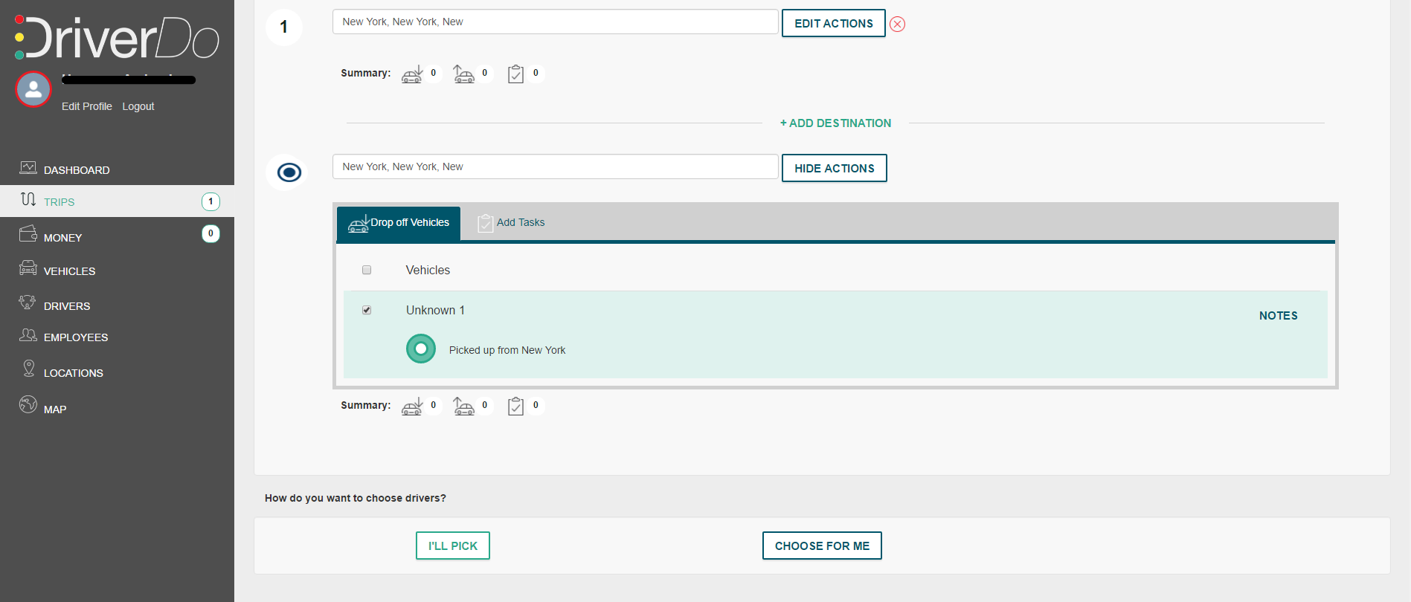
Screenshots of app

Slide 5
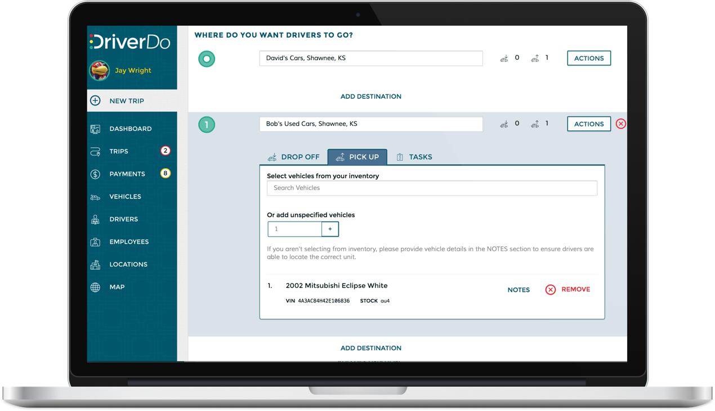
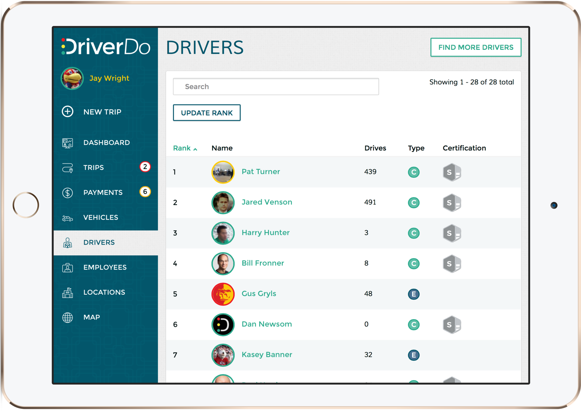
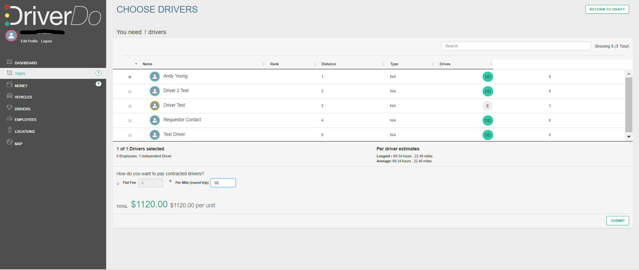
Screenshots of app (if available)

Slide 6
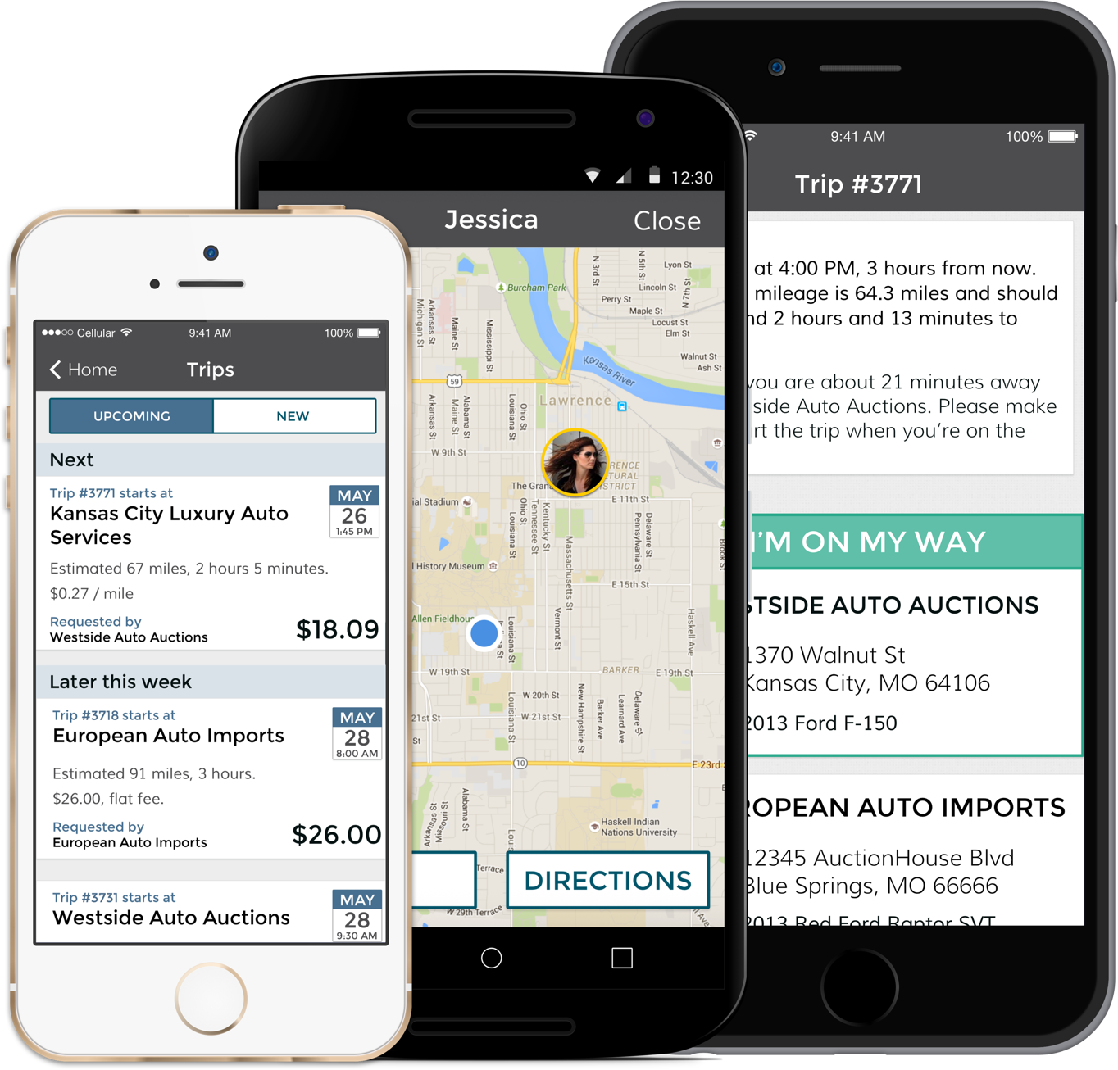
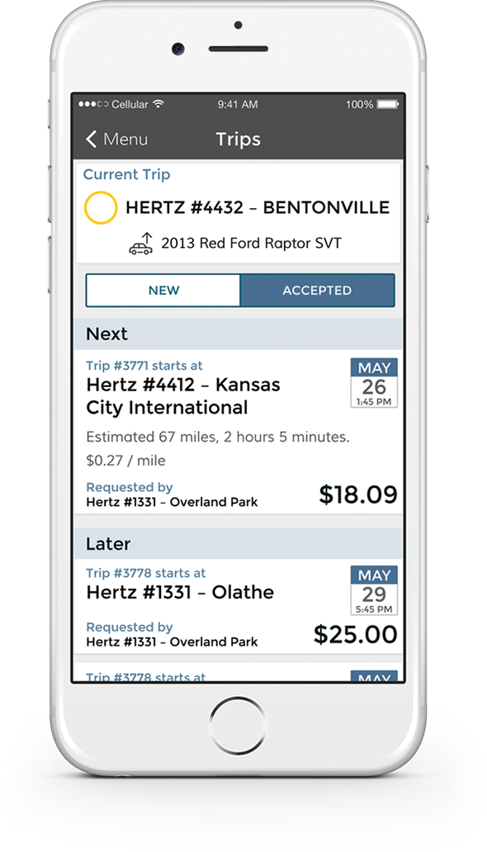
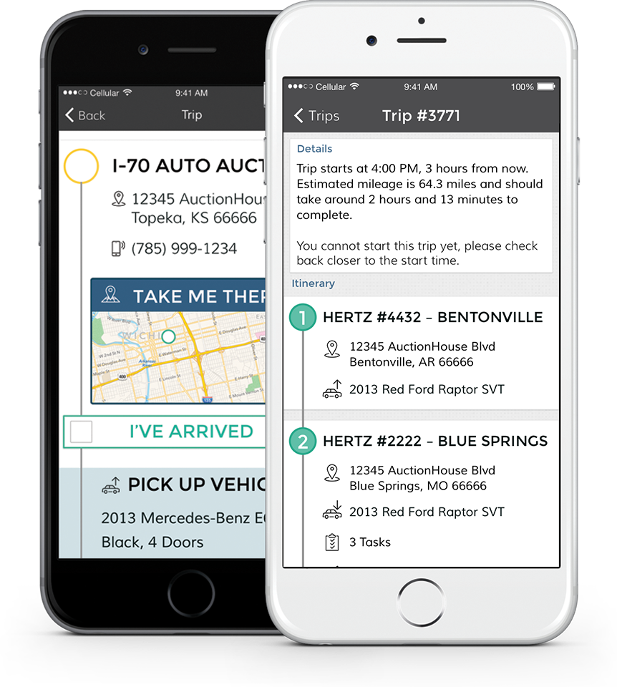
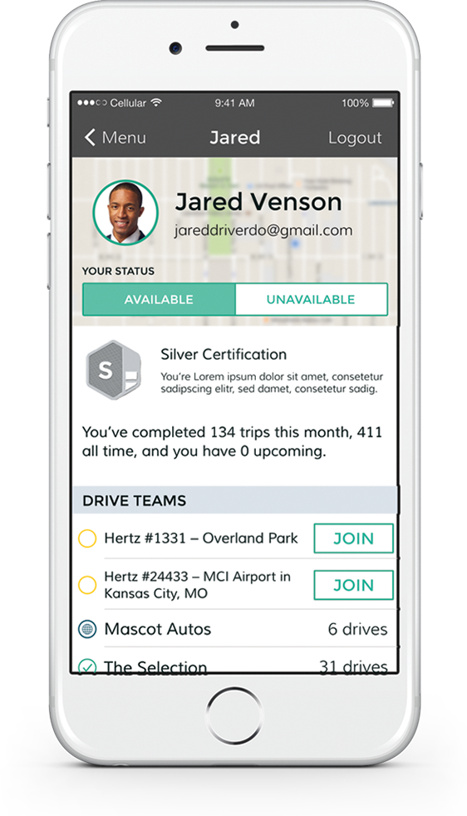
Screenshots of app (if available)

Slide 7
Sharing Guidelines
SHARING USE CASE/SCENARIO:
Can salesforce.com AEs share this story and overview slide in sales settings? | Y
Can salesforce.com AEs mention the customer name in sales settings? | Y
Is this customer willing to act as a reference customer for prospects? | N
Would the customer be willing to speak at Dreamforce or other events? | N
PARTNER INFORMATION
Name of reference approver: | Zarif Harque
Title of reference approver: | CEO
Email of reference approver: | zarif@driverdo.com
Notes:
‹#›

