Slide 1
MECHANICAL GEAR
Presented By-
PRAGYA KUMARI [3BR15CS116]
PRASHANTH RS [3BR15CS119]
Under the Guidance of
Prof.Sudhakar A

Slide 2
Objectives
Abstract
Introduction
Requirements & Specifications
Design
Implementation
Snapshots
Bibliography
Conclusion

Slide 3
Abstract
The project Mechanical Gear is created to demonstrate OpenGL’s concepts
It encompasses some of the skills learnt in our OpenGL classes such as pushmatrix(),translate() , popmatrix(),timer function
This project is developed to give a view of an gear and allows the user to briefly analyze the motion and view of a gear

Slide 4
Introduction
Computers have become a powerful medium for the rapid and economical production of pictures.
Graphics provide a so natural means of communicating with the computer that they have become widespread.
Interactive graphics is the most important means of producing pictures since the invention of photography and television .
There are five major elements in system: input devices, processor, memory, frame buffer, output devices.

Slide 5
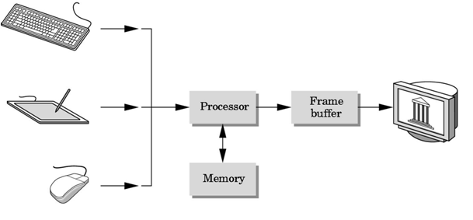

Slide 6
OpenGL Technology
OpenGL is the premier environment for developing portable, interactive 2D and 3D graphics applications. Since its introduction in 1992, OpenGL has become the industry's most widely used and supported 2D and 3D graphics application programming interface (API), bringing thousands of applications to a wide variety of computer platforms.
OpenGL Available Everywhere: Supported on all UNIX® workstations, and shipped standard with every Windows 95/98/2000/NT and MacOS PC, no other graphics API operates on a wider range of hardware platforms and software environments.
OpenGL runs on every major operating system including Mac OS, OS/2, UNIX, Windows 95/98, Windows 2000, Windows NT, Linux, Open Step, and BeOS; it also works with every major windowing system, including Win32, MacOS, Presentation Manager, and X-Window System. OpenGL is callable from Ada, C, C++, Fortran, Python, Perl and Java and offers complete independence from network protocols and topologies.

Slide 7
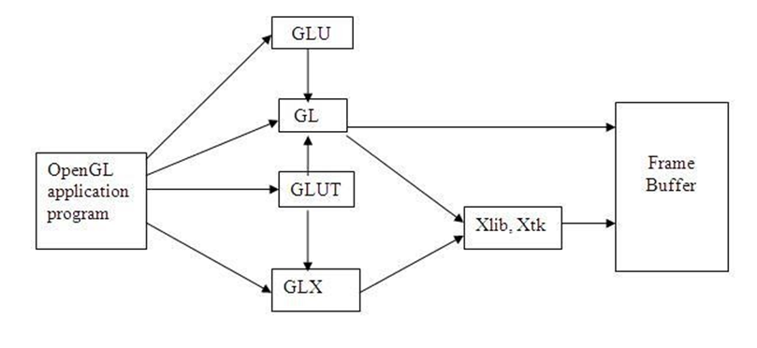

Slide 8
Requirements and specifications
Scope of the project
To design and create a view model of a mechanical gear using GL/glut.h library
Definition
A Mechanical gear is a rotating part machine having cut like teeth or cogs which mesh with another toothed part in order to transmit torque

Slide 9
Specific Requirements
User Requirement:
Software Requirements:
Hardware Requirements:

Slide 10
Design
myinit():
This function initializes light source for ambient, diffuse and specular types.
display():
This function creates and translates all the objects in a specified location in a particular order and also rotates the objects in different axes.
glClear(GL_COLOR_BUFFER_BIT);
glFlush();
timerfunc():
This function starts a timer in the event loop that delays the event loop for delay miiliseconds.
MainLoop():
This function whose execution will cause the program to begin an event processing loop.

Slide 11
PushMatrix():
Save the present values of attributes and matrices placing ,or pushing on the top of the stack.
PopMatrix():
We can recover them by removing them from stack;
Translated();
In translate func the variables are components of the displacement vector.
main():
The execution of the program starts from this function. It initializes the graphics system and includes many callback functions.
PostRedisplay():
It ensures that the display will be drawn only once each time the program goes through the event loop.

Slide 12
Implementation
Basic Functions
glPushMatrix, glPopMatrix Function
The glPushMatrix and glPopMatrix functions push and pop the current matrix stack.
SYNTAX: void glPushMatrix();
void glPopMatrix(void);
PARAMETERS:
mode - The primitive or primitives that will be created from vertices presented between glBegin and the subsequent glEnd. The following are accepted symbolic constants and their meanings

Slide 13
Transformation Functions
glTranslate Function
The glTranslated and glTranslatef functions multiply the current matrix by a translation matrix.
SYNTAX:
Void glTranslate( x, y, z);
glMatrixMode Function
The glMatrixMode function specifies which matrix is the current matrix. SYNTAX:
void glMatrixMode(GLenum mode);

Slide 14
CALL BACK FUNCTIONS
glOrtho
This function defines orthographic viewing volume with all parameters measured from the centre of projection.
multiply the current matrix by a perspective matrix.
SYNTAX:
void glOrtho( GLdouble left, GLdouble right, GLdouble bottom, GLdouble top, GLdouble near, GLdouble far)
Functions Used to Set the Viewing Volume
glutDisplayFunc Function
glutDisplayFunc sets the display callback for the current window.
SYNTAX:
void glutDisplayFunc(void (*func)(void));

Slide 15
Main Function
glutInit Function
glutInit is used to initialize the GLUT library.
SYNTAX:
glutInit(int *argcp, char **argv);
glutInitDisplayMode Function
glutInitDisplayMode sets the initial display mode.
SYNTAX:
void glutInitDisplayMode(unsigned int mode);
glutMainLoop Function
glutMainLoop enters the GLUT event processing loop.
SYNTAX:
void glutMainLoop(void);

Slide 16
Screen shots

Slide 19
Bibliography
1) OpenGL Programming Guide (Addison-Wesley Publishing Company)
2) The OpenGL Utility Toolkit (GLUT)Programming Interface
-API Version 3 BY MARK J. KILGARD
3) Interactive computer graphics
-A top down approach by using Open GL by EDWARD ANGEL

Slide 20
Conclusion
We have attempted to design and implement the MECHANICAL GEAR using Turbo C Devcpp 4.9.9.2 , Glut 3.7.6+
The main aim of the project is to create a mechanical gear model on the platform using GL/glut.h library
By the end of this project we have implemented basic transformation operations of OpenGL that is Translation and Scaling

Slide 21
Thank you
-Plant a tree save planet

