Slide 1
PRODUCT PROFITABILITY
What drives modeled gross profit?
Which products generate the most modeled gross profit, and is the result driven by sales volume, unit margin, or both?
Modeled gross profit = product price - component supply costs
Labour, rent, discounts, and overhead are not available in the source data.
997
$6,818
$5,412
items sold
item revenue
modeled gross profit
UoB dbt workshop | 01

Slide 2
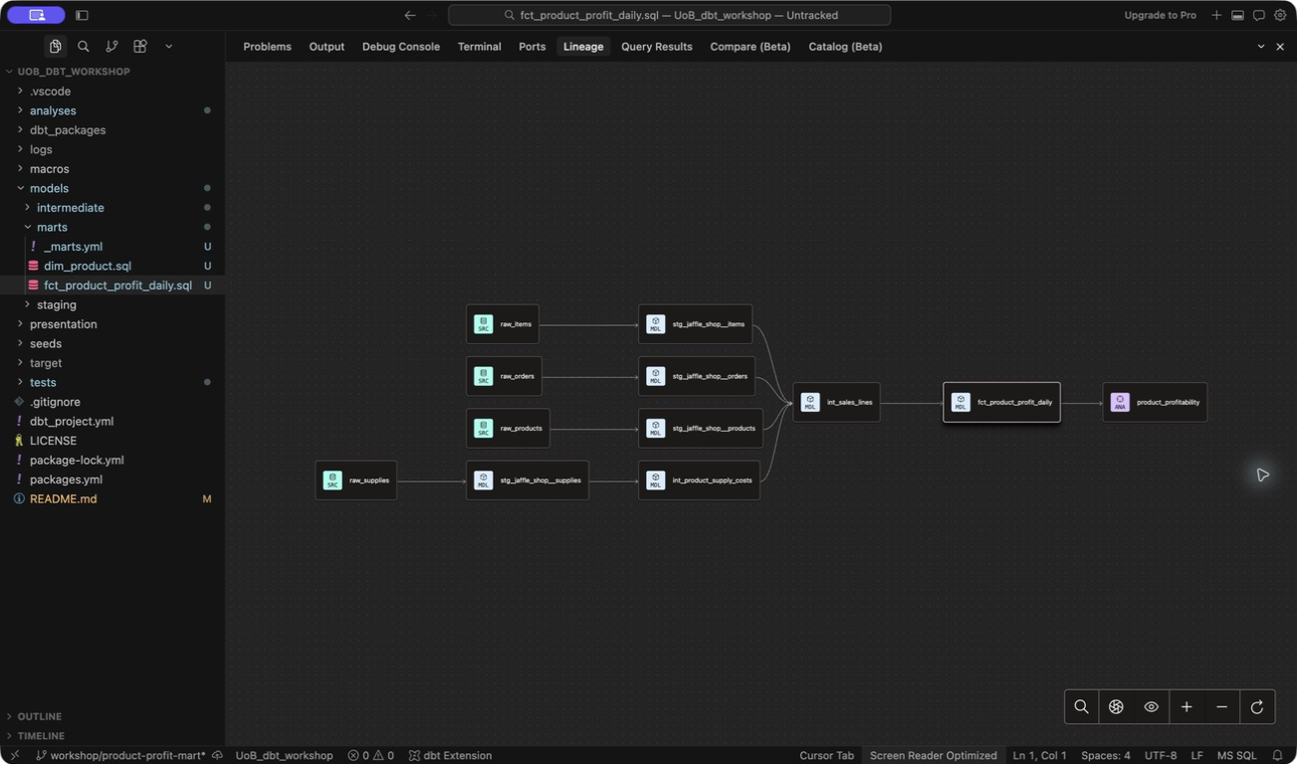
Every metric traces back to four raw sources
The DAG makes the calculation path visible and testable.
UoB dbt workshop | 02

Slide 3
BEV-004 wins on volume and margin
Bubble size shows total modeled gross profit.
BEV-004
168 units
88.3% margin
$1,038 gross profit
JAF-001
Highest margin: 89.0%
Only 37 units sold
1-16 September 2016
UoB dbt workshop | 03

Slide 4
Protect the winner, test the margin opportunity
1
Protect BEV-004 availability
dbt tests used
It contributes $1,038.24, or 19.2% of modeled gross profit.
Keys: unique + not_null
Grain: date + SKU unique
2
Run a controlled JAF-001 promotion
Logic: subtotals, profit + margin
Test whether an 89.0% unit margin can support more volume without displacing stronger products.
38 / 38 build nodes passed
686 / 686 subtotals reconciled
Limits: one store, 16 days, no operating costs.
UoB dbt workshop | 04

