Slide 1
Mobile Phone Price Prediction
Problem Statement:-
Predicting the price of a mobile phone based on features of mobile.
Build a system that can predict pricing for a mobile phone using data on available phones in the market. Predict if the mobile can be priced low/med/high/very high. Explore the data to understand the features and figure out an approach.

Slide 2
Dataset :
Description of columns:
● battery_power: Battery Capacity in mAh
● blue: Has Bluetooth or not
● clock_speed: Processor speed
● dual_sim: Has dual sim support or not
● fc: Front camera megapixels
● four_g: Has 4G or not
● int_memory: Internal Memory in GB
● m_deep: Mobile depth in cm.
● mobile_wt: Weight in gm
● n_cores: Processor Core Count
● pc: Primary Camera megapixels
● px_height: Pixel Resolution height
● px_width: Pixel Resolution width
● ram: Ram in MB
● sc_h: Mobile Screen height in cm
● sc_w: Mobile Screen width in cm
● talk_time: Time a single battery charge will last. In hours.
● three_g: Has 3G or not
● touch_screen: Has touch screen or not
● wifi: Has WiFi or not
● Price_range: This is the target ○ 0 = low cost ○ 1 = medium cost ○ 2 = high cost ○ 3 = very high cost

Slide 3
Data Preprocessing:
Step 1:- Load the dataset
=>Use the pandas to read the CSV file
Ex:-
import pandas as pd
df=pd.read_csv(‘dataset.csv’)
Step 2:=>use df.info() to check data types and missing values
battery_power | blue | clock_speed | dual_sim | fc | four_g | int_memory | m_dep | mobile_wt | n_cores | ... | px_height | px_width | ram | sc_h | sc_w | talk_time | three_g | touch_screen | wifi | price_range
0 | 842 | 0 | 2.2 | 0 | 1 | 0 | 7 | 0.6 | 188 | 2 | ... | 20 | 756 | 2549 | 9 | 7 | 19 | 0 | 0 | 1 | 1
1 | 1021 | 1 | 0.5 | 1 | 0 | 1 | 53 | 0.7 | 136 | 3 | ... | 905 | 1988 | 2631 | 17 | 3 | 7 | 1 | 1 | 0 | 2
2 | 563 | 1 | 0.5 | 1 | 2 | 1 | 41 | 0.9 | 145 | 5 | ... | 1263 | 1716 | 2603 | 11 | 2 | 9 | 1 | 1 | 0 | 2
3 | 615 | 1 | 2.5 | 0 | 0 | 0 | 10 | 0.8 | 131 | 6 | ... | 1216 | 1786 | 2769 | 16 | 8 | 11 | 1 | 0 | 0 | 2

Slide 4
Use df.head() to preview the data
Use df.describe() gives the min , max , count , std , 25% , 50% , 75% of all features data
Step3:- Check for missing values
use df.isnull().sum() to check the null values present in the dataset.
Handling missing values :
Drop rows (df.dropna())
Imputing values (df.fillna())
Step4:- Built the correlation matriex to understand the data more
Ex:
correlation_matrix = df.corr()
plt.figure(figsize=(10, 8))
sns.heatmap(correlation_matrix, annot=True, cmap="coolwarm")
plt.title('Correlation Matrix’)
plt.show()

Slide 5
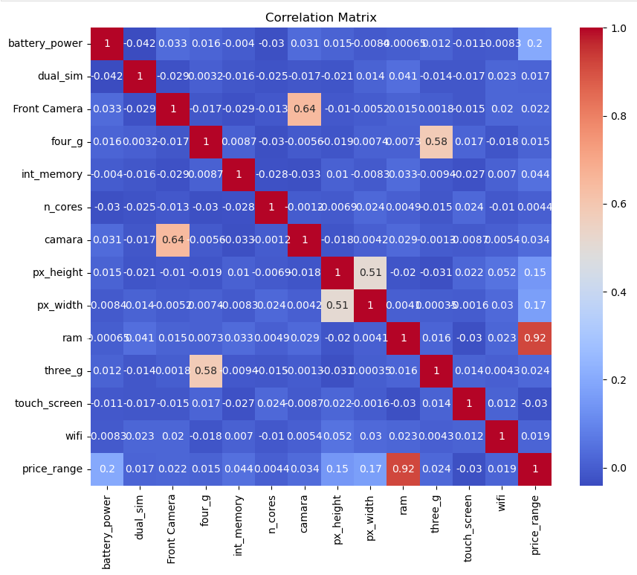

Slide 6
Finding the correlation between the variables
Ex:
correlation = df['battery_power'].corr(df['price_range’])
print("Correlation between battery_power and price_range:", correlation)
Output:- Correlation between battery_power and price_range: 0.200
Has the strong positive correlation
correlation = df['price_range'].corr(df['n_cores’])
print("Correlation between battery_power and ram:", correlation)
Output:- Correlation between battery_power and ram: 0.004399274799457284
After finding this correlation between them creating some features and and merging them into the new feature like
Ex:
df['screen_size'] = df['px_height'] / df['px_width’]
df['total_memory'] = df['int_memory'] + df['ram’]
df['camera_index'] = df['camara’]
df['cores_battery'] = df['n_cores'] * df['battery_power']

Slide 7
Drop some unwanted features like
px_height
px_width
ram
n_cores
battery_power
int_memory
camara or pc
Ex:
df.drop(['px_height','px_width','ram','n_cores','battery_power','int_memory','camara'],axis=1,inplace = True)
-------------------------------------------------------------Data preprocessing is done-------------------------------------------

Slide 8
Model Development:
Step 1: load the preprocess datasat
df = pd.read_csv(‘dataset_preprocess.csv’)
Step 2:Feature selection
Select the feature to be selected
Based on the features
Ex:
X = df[['dual_sim', 'four_g', 'three_g', 'wifi', 'screen_size', 'total_memory', 'camera_index', 'cores_battery’]]
y = df['price_range’]
Step 3: scale the features to perform in prediction
Ex:
scaler = StandardScaler()
X_scaled = scaler.fit_transform(X)
Step 4: divide the data into two half for train and test
Ex: X_train, X_test, y_train, y_test = train_test_split(X_scaled, y, test_size=0.2, random_state=42)

Slide 9
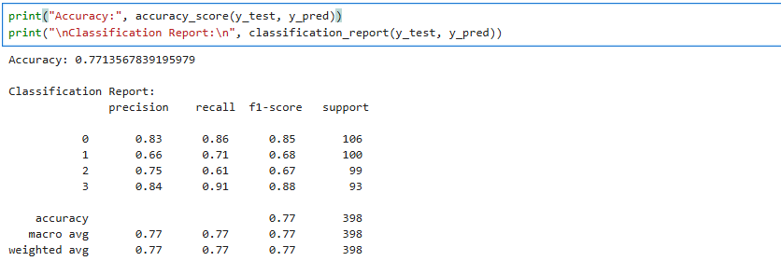
Step 5: Selecting the sutable model for prediction
->RandomForest
Ex:
model = RandomForestClassifier(n_estimators=100, max_depth=10, random_state=42)
model.fit(X_train, y_train)
Step 5: Now after training the model start testing the model from the second half of the data
Ex: y_pred = model.predict(X_test)
Step 6: Testing the accuracy of the model using Z_score Test
Ex:
print("Accuracy:", accuracy_score(y_test, y_pred))
print("\nClassification Report:\n", classification_report(y_test, y_pred))

