Slide 1

DOCKER BASICS
Version: 1.0
Date: 11-01-2019
Notes:
1
1

Slide 2
INTRODUCTION
Docker
Docker is a set of platform as a service products that use OS-level virtualization to deliver software in packages called containers. Containers are isolated from one another and bundle their own software, libraries and configuration files; they can communicate with each other through well-defined channels.
Monolithic Systems
Distributed Systems
All the layers are tightly coupled.
Even if there is a small change in any one of the layer, it will conclude to redeployement of all the layers.
Each layer depends on the other layers.
1. Layers are divided individually without depending on each other.
2. Every microservice/layer has a REST-API for interfacing purpose.
3. Docker is used as a solution, dependencies and binary are coupled together.
Docker
=
Binary application + dependencies
Notes:
2
2

Slide 3

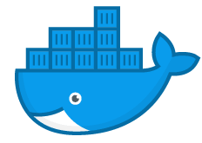
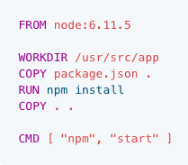
LOAD A DOCKER IMAGE
Load image to container
Docker file
Create a Docker Image
Load the image to the container
docker build –t <name> .
Docker run –it <name> bash
Docker run –d <name> bash
Docker run –d –p 80:8080<name> bash
Tag
All files
Interactive
Deteched
Port
Host’s port
Docker port
Notes:
3
3

Slide 4
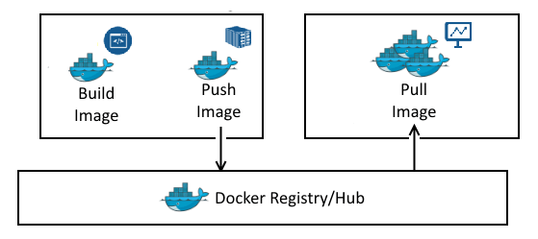
DOCKER HUB
1. Open source docker images can be fund at docker-hub.
2. Docker images can be pushed and pulled using simple commands:
“$ docker push <image_name>”
“$ docker pull <image_name>”
ex: “$ docker pull nginx”
Pulls the image from the docker hub

Slide 5
DOCKER COMMANDS
“$ docker ps”
“$ docker info”
“$ docker version”
“$ docker pull <image_name>”
“$ docker push <image_name>”
“$ docker images”
“$ docker ps -a”
“$ docker build –t <image_name> .”
“$ docker run –it <image_name> bash”
“# docker run –it –p 80:8080 <image_name>”
“$ docker run –d <image_name>”
“$ docker run –d –p 80:8080<image_name>”
Docker stop <container_id>

Slide 6
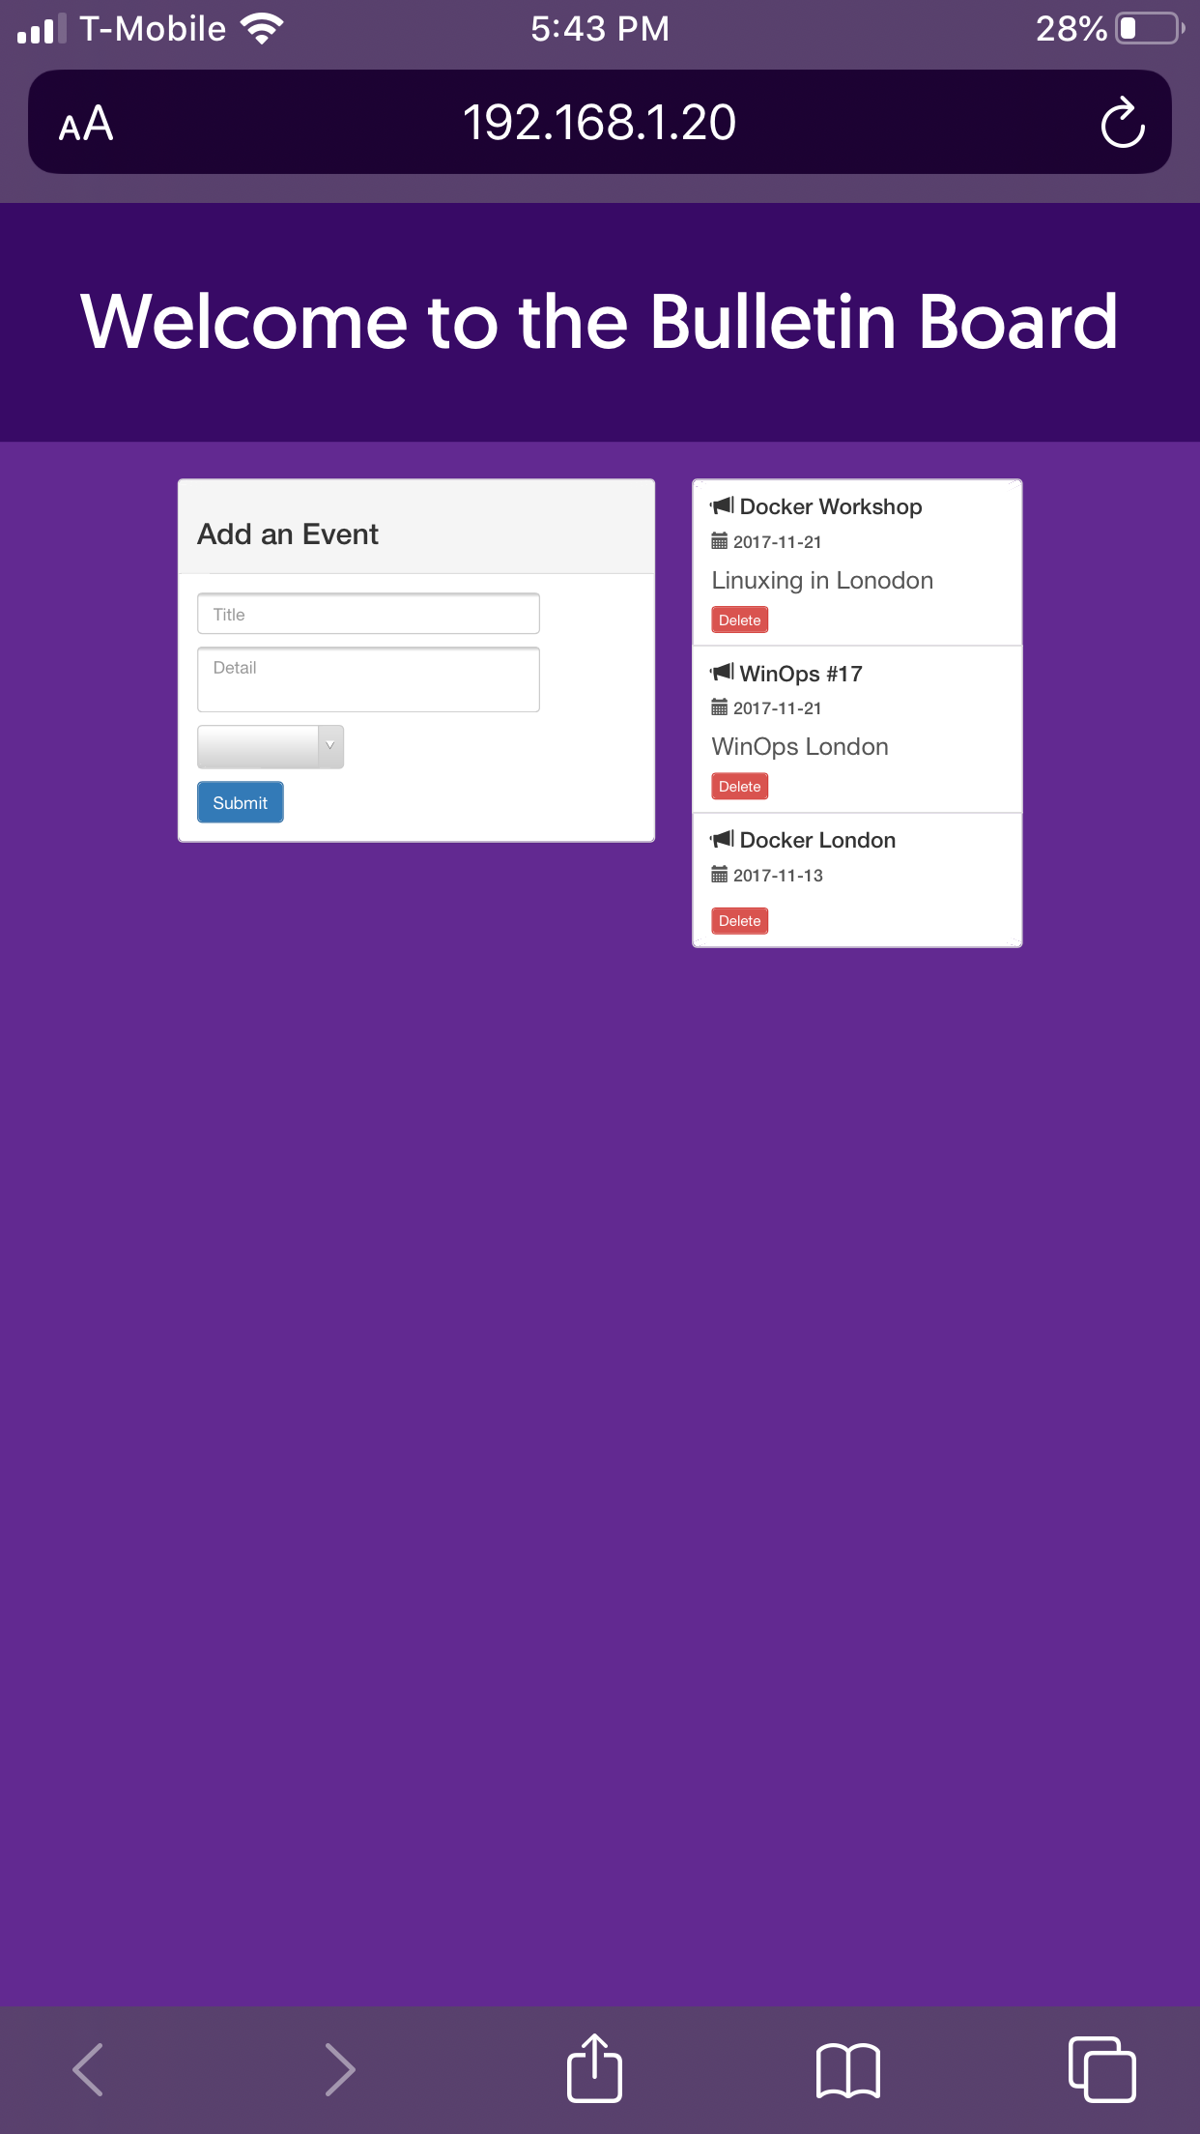
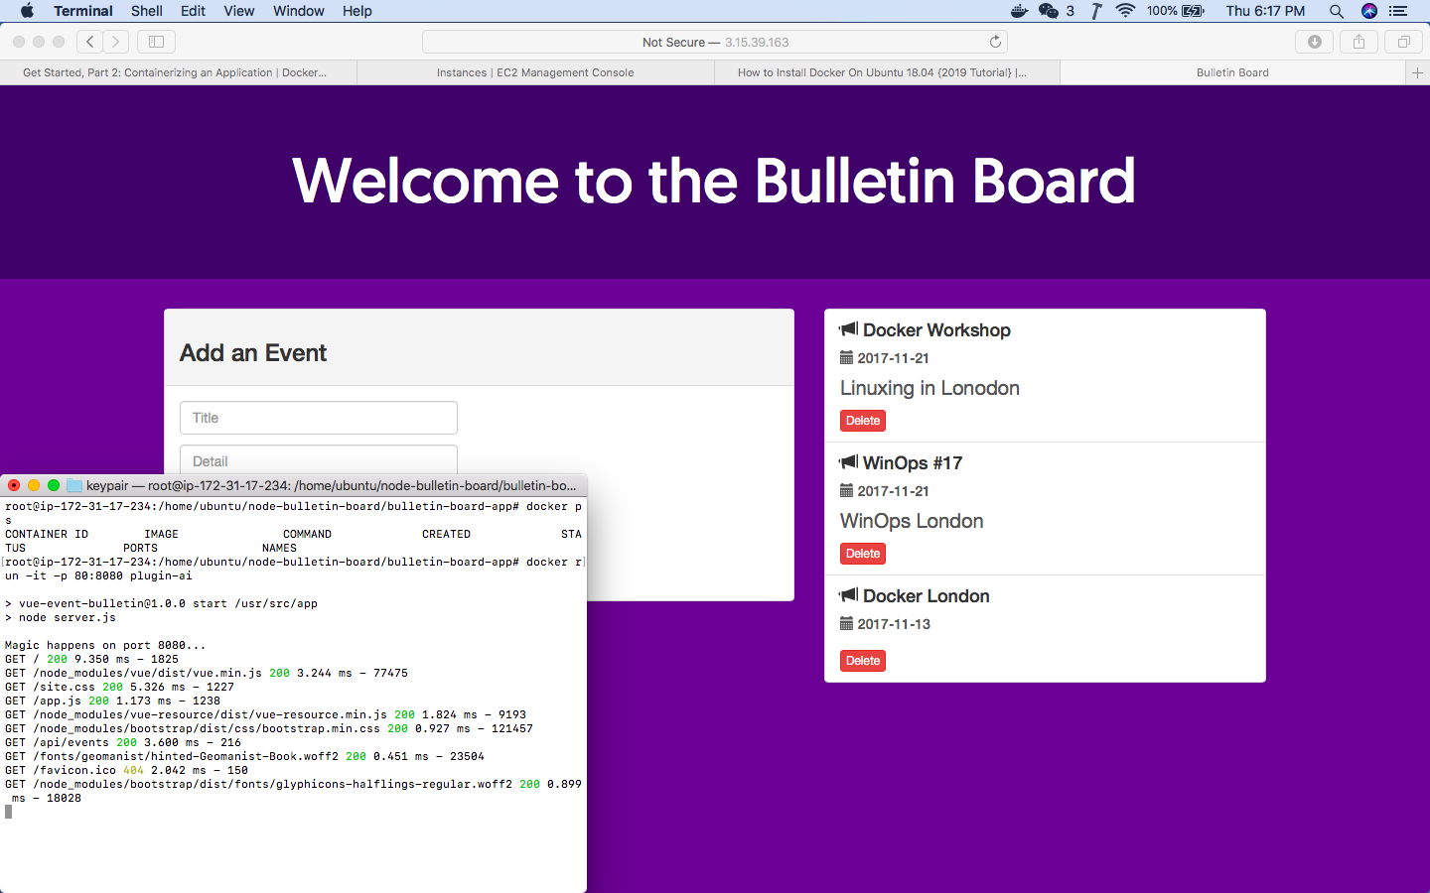
HANDSON IMPLEMETATION
PLUGIN-AI
Cloning and running the sample docker program provided in the repo mentioned below.
git clone -b v1 https://github.com/docker-training/node-bulletin-board
1. Running docker program on macbook air and browsing the application using the mobilephone connected to the same local network.
2. Running the docker rgram in the amazon EC2 instance and browsing the application using macbook air’s browser. (add security rule to allow incoming at port 80 on the ec2 instance.)

Slide 7
THE END

