Slide 1


JENKINS
Version: 1.0
Date: 11-02-2019
Notes:
1
1

Slide 2
TOPICS TO BE COVERED
Before Jenkins.
What is Jenkins?
What is continuous Integration?
Continuous Integration tools.
Features of Jenkins.
Jenkins Architecture.
Master Slave Architecture.

Slide 3

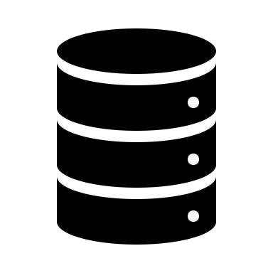



BEFORE JENKINS
Developer-1
Irregular commits
Developer-2
Code
repository
Issues in
Integration
Delay in
Testing
Delay in
Software Release
Developer-3

Slide 4
WHAT IS JENKINS ?
Jenkins is a continuous Integration tool that allows continuous development, test and development of newly created codes.
Before Jenkins
After Jenkins
Code is pulled whenever there is a commit
All changes made to the code are build together
All changes made to the code are build continuously
Code
repository
Code
repository
Developer
Developer
Nightly build and Integration
Continuous build and Integration
Developer do not have to wait for a particular code to be build and test.
Realtime commit and testing result can be achieved using Jenkins.

Slide 5
CONTINUOUS INTEGRATION
CI
SERVER
If PASS
TESTER
Code
repository
Test cases
If FAIL
IF ERRORS
Developer-1
Release and Deploy
1. When developer commits the changes to repo, the code is passed to Continuous Integration server.
2. If the testcases pass, the code is then forwarded to the tester else given back to the developer for improvement.
3. During the testing phase, if the code still has any errors, the development team will be notified, else the code is released for deployment.

Slide 6




CONTINUOUS INTEGRATION TOOLS
Bamboo
CI
TOOLS
Jenkins/Hudson
Build-bot
Travis CI
Apache Gump
Bamboo: It is a CI tool that can run multiple builds in parallel for faster compilation. It has a built in functionality to connect with repositories and has build tasks for Ant, maven, etc.
Build-bot: it is an opensource framework for automating build, testand release processes. It is written in python and supports distributed, parallel execution of jobs across multiple platforms.
Apache Gump: It is aimed to build and test the opensource Java projectseverynight. It makes sure that all projects are compatible at the API level and functionality level.
Travis CI: It is a distributed CI tool used to build and test software projects hosted at github. It is build for projects and teams for all sizes and supports 20 different languages.
Jenkins: CI tool written in JAVA. It is used to automate software development proves via continuous Integration and continuous delivery.

Slide 7
FEATURES OF JENKINS
Easy Installation
Easy configuration
Plugins
Extensible
Distributed
Jenkins Pipeline
Commit
code
Build
Test
Release
Deploy
Continuous Integration and Continuous Delivery Pipeline
Development
Production

Slide 8
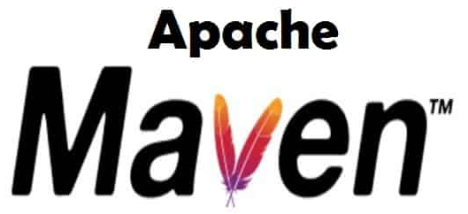

JENKINS ARCHITECTURE
Jenkins
Maven
Selenium
Developer-1
CI
Server
Build
Server
Test
Server
Code
repository
Developer-2
Release
If no errors, the tested application is then deployed to production server
Production
Server

Slide 9



MASTER / SLAVE ARCHITECTURE
Jenkins Server(Master)
Jenkins master pulls the code every time there is a commit
Code
repository
TCP/IP
TCP/IP
TCP/IP
Jenkins Slave - 1
Jenkins Slave - 2
Jenkins Slave - 3
Jenkins master distributes the workload to all the servers.
On request from Jenkins master , the slave carry out builds and produce test results.

Slide 10
HOW TO INSTALL JENKINS
Link1:
https://www.techrepublic.com/article/how-to-install-jenkins-on-ubuntu-server-18-04/
Link2:
https://www.hostinger.com/tutorials/how-to-install-jenkins-on-ubuntu/
Notes:
10
10

Slide 11
THE END
Notes:
11
11

