Slide 1


Version: 1.0
Date: 11-30-2019
Notes:
1
1

Slide 2
TOPICS TO BE COVERED
What is Ansible?
2. Configuration management.
3. Push Based vs Pull Based Architecture.
4. How to install Ansible.
Host Inventory.
Ansible Modules.
Ansible Playbooks
Hands-on Implementation.
Notes:
2
2

Slide 3
INTRODUCTION
Ansible - It is an opensource IT engine which automates application deployment, intra service orchestration, cloud provisioning and many other IT tools.
Playbooks – Lists the automation jobs written in YAML(Yet Another Markup Language).
Ansible connects to the host vis ssh connection and sends programs called modules. Ansible runs the modules on the nodes and removes them when finished.
Notes:
3
3

Slide 4
CONFIGURATION MANAGEMENT
Establishes and maintains consistency of a product performance.
Maintains physical attributes with its requirements and design.
Preserves operational information throughout its life.
Features
Host1
Host2
HostN
Deployment Agent Less
ssh
ssh
ssh
ssh
Ansible Management Node
Python
PUSH
No agents have to be deployed on the nodes unlike puppet or cheff.
Establishes connection to nodes using SSH.
Written in python
Push based architecture.
Playbooks
Host Inventory
Notes:
4
4

Slide 5



PUSH BASED vs PULL BASED ARCHITECTURE
PUSH
Configuration changes from management node is pushed to the client node. No agents have to be deployed to the client side. Ex – Ansible, CFEngine.
ssh
Node-1
Poll for changes
1
ssh
Version Control System
ssh
Node-2
2
Send specification
Server
ssh
Node-3
Node-n
PULL
Agents from client side pull changes from the management node. Ex – Cheff Puppet.
3
Nodes with Agents
Poll for changes
Poll for changes
1
4
Client-1
Version Control System
Send specification
2
checkout
Poll for changes
3
Server
Send specification
Nodes with Agents
4
Client-n
Notes:
5
5

Slide 6
HOW TO INSTALL ANSIBLE
Please type in the commands one by one to install ansible successfully.
$ sudo apt-get update
$ sudo apt-get install software-properties-common
$ sudo apt-add-repository ppa:ansible/ansible
$ sudo apt-get update
$ sudo apt-get install ansible
Notes:
6
6

Slide 7
HOST INVENTORY
Contains the host to which ansible pushed the configurations to.
[ webserver ]
Server1
[ application ]
Server1
Server2
hosts
File location: /etc/ansible/hosts
[ webservers ]
Server1 ansible_port=4242
ansible_user=adimania
[ application ]
Server1
Server2
[ master ]
Localhost ansible_connection=local
Notes:
7
7

Slide 8
ANSIBLE MODULES
To use ansible modules from command line, type:
$ ansible all –m ping
If we want to use the ping module to ping all the hosts efined in the inventory, then type:
$ ansible webservers -m command –a “ls”
If you want to flush iptable rules on all the hosts in the inventory, then type:
$ ansible –i inventory all –m command –a “iptables -F” –become –ask-become-pass
To gather facts about the hosts, then type:
$ ansible all –m setup
If we want to extract particular facts in the documentation of the setup module, then type:
$ ansible-doc setup
Notes:
8
8

Slide 9
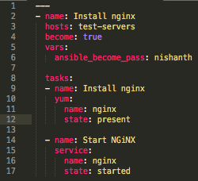
SAMPLE ANSIBLE PLAYBOOK
Group name inside host file
Password for remote host
Install nginx
Start nginx
Notes:
9
9

Slide 10
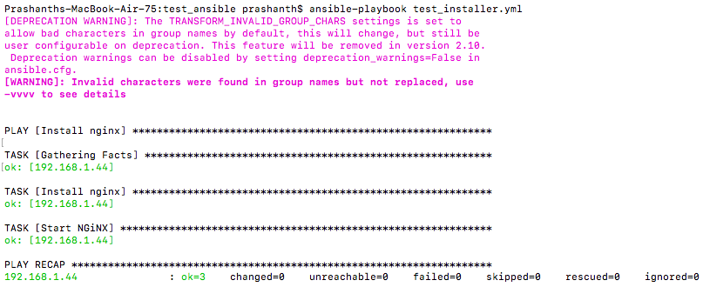
HANDSON IMPLEMENTATION
Ansible pushed the modules to the node for the execution.
Notes:
10
10

Slide 11
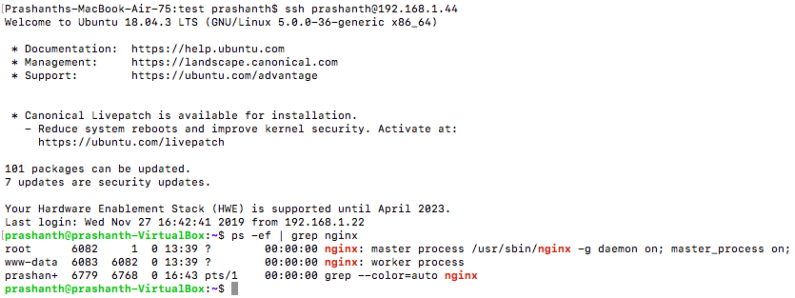
HANDSON IMPLEMENTATION
As per the verification we can see that nginx has been installed by ansible and is up and running.
Notes:
11
11

Slide 12
THE END
Notes:
12
12

