Slide 1
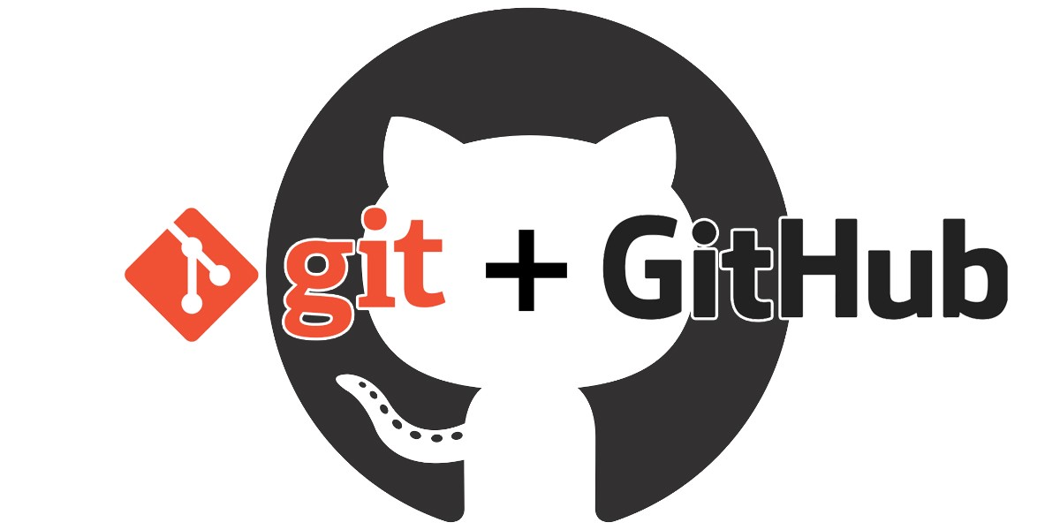
PR
PLUGIN-AI
Version: 1.0
Date: 11-02-2019
Note: A Very Deep Dive
Notes:
1
1

Slide 2
PR
TOPICS
PLUGIN-AI
Part-1
Setting up Git
Understanding and using Git
Remotes and Branches
Part-2
Adding a collaborator
Forking workflows of collaboration
Git Flow workflows of collaboration
Notes:
2
2

Slide 3
PR
SETTING UP GIT
PLUGIN-AI
Part-1
What can git do for you?
Install Git
Configure Git
GIT Source : https://git-scm.com
Subime Source: https://www.sublimetext.com/3
Git is a version control system which can not only track individual files, but can track folders also.
Collaborator can simultaneously edit the same file.
Because of the version control, we can switch back and forth to the previous and next states.
Multiple people participating in code changes can work independently and can track their work using the revision history.
Notes:
3
3

Slide 4
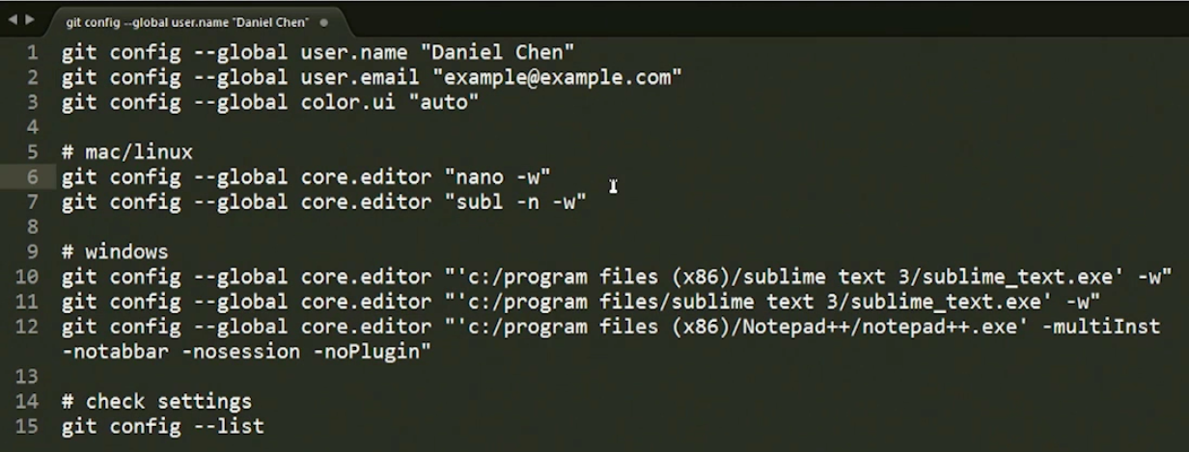
PR
SETTING UP GIT
PLUGIN-AI
Open the terminal and apply the following configurations.
sublime –n -w
Notes:
4
4

Slide 5
PR
CREATE A REPOSITORY
PLUGIN-AI
Create a repository
Track changes
Look at differences
Look around
Undoing changes
Ignore things in Git
Create a folder named “git” in your “Desktop”.
Create a subfolder named “git_lessons”.
Initialize git inside the “git_lessons” folder using the command “$ git init”.
Do not type “git init” in any other folder later.
An new folder “.git” will be created, that contains all the version control information.
Commonly used command “$ git status” – It tell the status of the directory that we are currently in.
Notes:
5
5

Slide 6
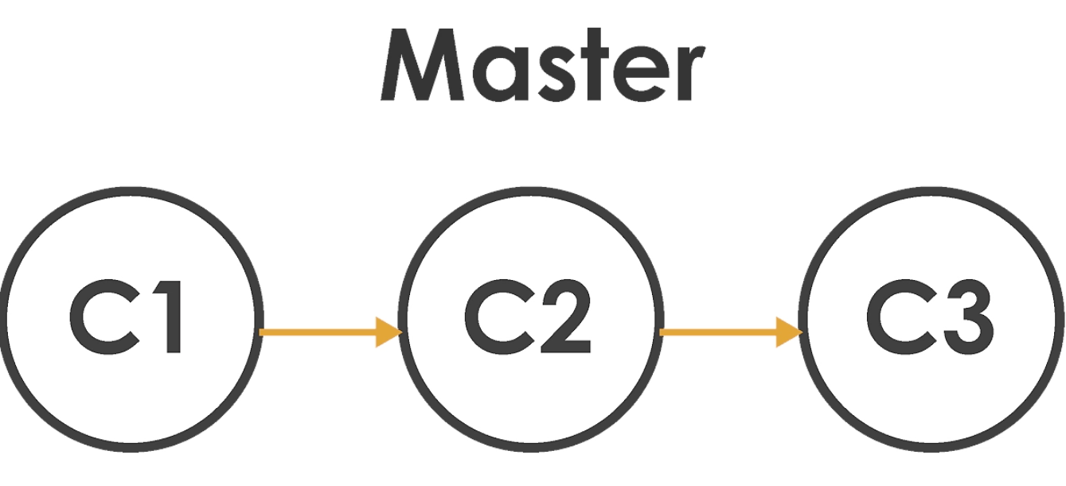
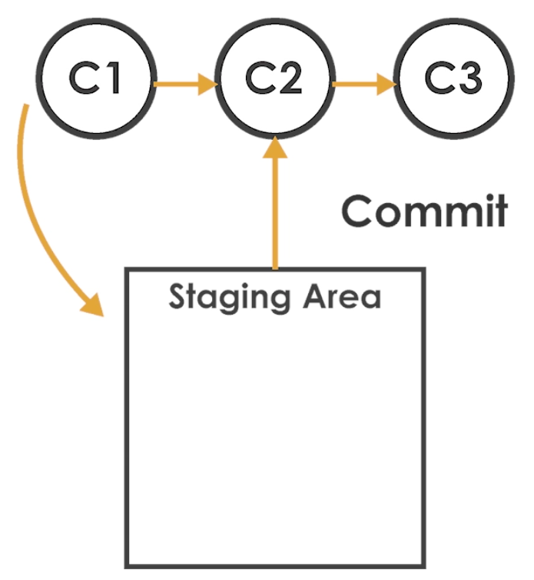
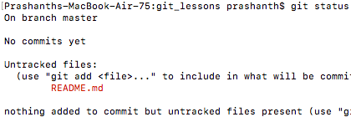
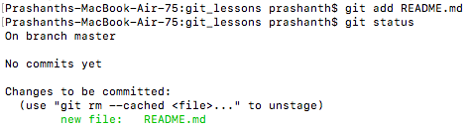
PR
TRACK CHANGES
PLUGIN-AI
Create a repository
Track changes
Look at differences
Look around
Undoing changes
Ignore things in Git
Master is a graph that has all the information of the saved state of commits.
Create a file “README.md”.
Insert some text into the file.
Type “$ git status” – we can see the file to which the changes has been made.
For committing the changes made in the readme file. We need to place the file to the staging area and then commit it.
Type “$ git add README.md” to stage the file.
Notes:
6
6

Slide 7



PR
TRACK CHANGES - Cont…
PLUGIN-AI
6. Then we commit the file by typing “$ git commit”, with “-m” we can add some message to track the commits.
7. This commit information has been saved in the “.git” folder.
8. Type ”$ git status” – the output should be clean.
Use the ”$ git log” or “$ git log --oneline” command to check for the committed commits.
10. Try playing with the command and edit the README.md file.
Notes:
7
7

Slide 8
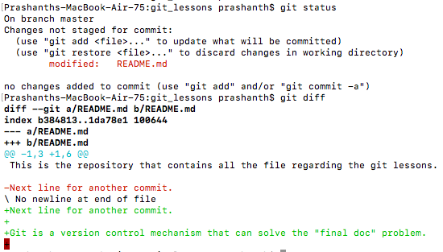
PR
LOOK AT DIFFERENCES
PLUGIN-AI
1. The command “$ git diff” can be useful to see what’s the difference between the previous commit and the latest modification.
2. We can also use “$ git add .” to add all the files to the stage for committing.
3. We can even see the differences between the previous commit and the file that is in the staging area using the command “$ git diff –staged”.
Create a repository
Track changes
Look at differences
Look around
Undoing changes
Ignore things in Git

Slide 9
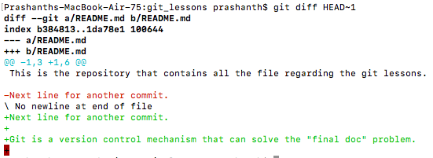

PR
LOOK AROUND
PLUGIN-AI
Create a repository
Track changes
Look at differences
Look around
Undoing changes
Ignore things in Git
1. We can also look for the differences among the committed files also using the command “$ git diff HEAD~1”.
“1” refers to the total number of states to look behind.
2. We can also find the difference between a particular previous commit and the current commit using the commit hash number. Like “$ git diff <commit hash>”

Slide 10
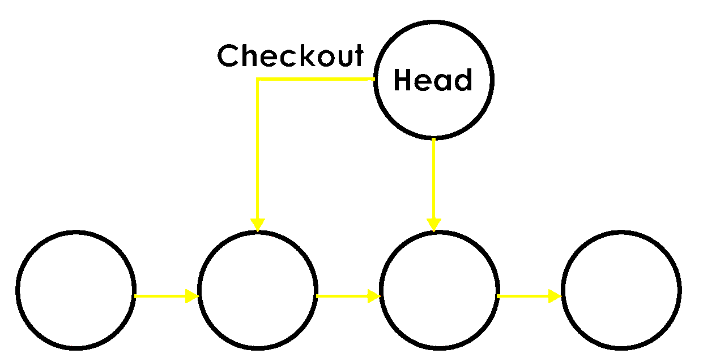
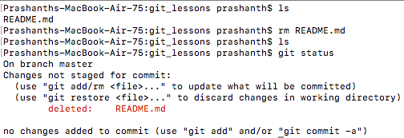

PR
LOOK AROUND - Cont…
PLUGIN-AI
3. We can move to the previous state using the checkout command like “$ git checkout HEAD~1 README.md”.
4. What is actually happening is, we are picking the head pointer and placing it to the one of the previous state.
5. It is done using “DAG” i.e., Directed Acyclic Graph.
6. Git actually takes the previous state and commits to the current state.
7. Lets say the file got accidently deleted.
8. We can still get the lost file using the command “$ git checkout master README.md”
9. We can remove the file from the staging area using the command “$ git reset HEAD README.md”.

Slide 11
PR
UNDOING CHANGES
PLUGIN-AI
Create a repository
Track changes
Look at differences
Look around
Undoing changes
Ignore things in Git
Lets say we accidently made some changes to the file. And after the modification we decide to move backward.
To do that we have a panic option “$ git reset --hard”.
This deletes the current state and moves back to the previous state by deleting the added line in the file.
We can remove the file from the staging area using the command “$ git reset HEAD README.md”.

Slide 12
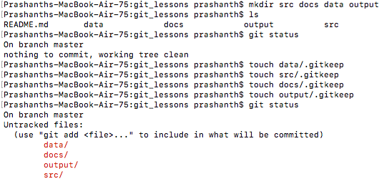
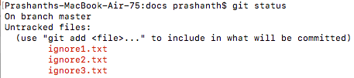

PR
IGNORING THINGS IN GIT
PLUGIN-AI
Create a repository
Track changes
Look at differences
Look around
Undoing changes
Ignore things in Git
We create a hidden .gitkeep file to help git to keep a track of the folders.
Unrequired files can be ignored by putting the filename to be ignored into the ”.gitignore” file.
By doing this, we can find the “git status” command to be clean.
“.gitignore” file has to be created at the root directory.
We can also mention something like “*.log, *.txt” to ignore file that contains these text pattern in it.

Slide 13
PR
REMOTES AND BRANCHES
PLUGIN-AI
Understanding what GitHub is and how its used.
Use remotes with Https.
Use remotes with SSH.
Utilize self collaboration.
Use git for project management.
Use branches on your own.
Understanding git flows and workflows.
Incorporating changes after you branch.
Use Git GUIs.

Slide 14
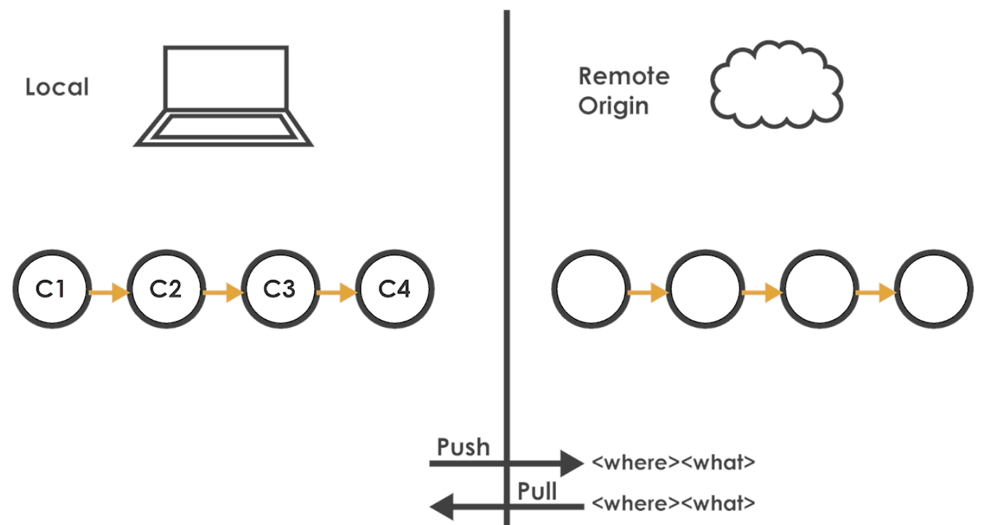
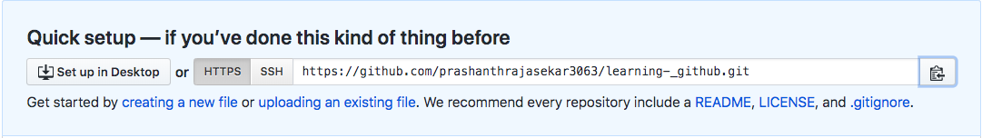

PR
REMOTES AND BRANCHES
PLUGIN-AI
Understanding what GitHub is and how its used.
2. Use remotes with Https.
2.1 We can store the pull the file from one place and push the file to a different place also. Most of the time fetch and push will be same.

Slide 15
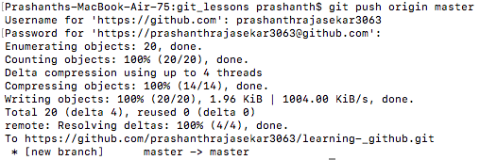
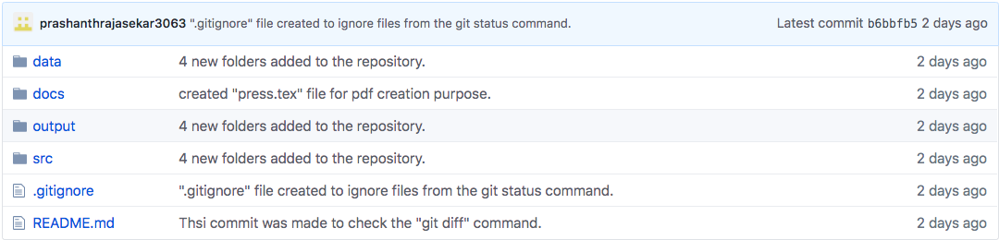

PR
REMOTES AND BRANCHES
PLUGIN-AI
Command to push the file:
“$ git push <where> <what>”
“$ git push origin master”
The file gets uploaded to the github repository.
3. USE REMOTES WITH SSH.
3.1 Go through all the process, and finally we reach here, 2 files gets generated “id_rsa”, “id_rsa.pub”.

Slide 16
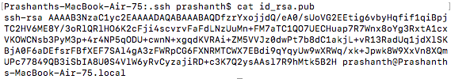
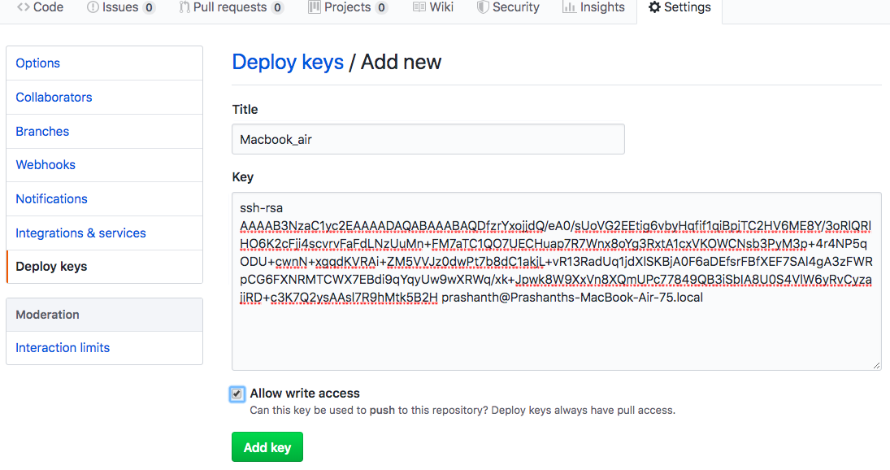
PR
REMOTES AND BRANCHES
PLUGIN-AI
3.2 Copy the contents from inside the id_rsa.pub file to the github addkey section. The pages are shown below.
1
2
3
3.3 Follow the steps shown in slide14 by adding ssh link to the “$ git remote add origin <ssh link>” cmd.

Slide 17

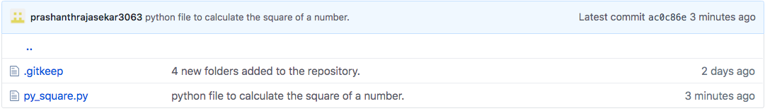
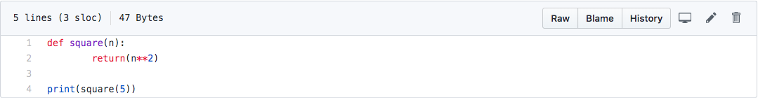
PR
UTILIZE SELF COLLABORATION
PLUGIN-AI
4.1 Create a simple python file inside the “src” folder.
4.2 Stage the file and commit it.
4.3 Type “$ git push origin master” to add the file to github.
4.4 Once done, we can see the file in the github.
We can see the source in raw text format.
Shows which programmer wrote what line of code.
Similar to git log.
4.5 We can modify the code using the online interface, and pull the code back to the machine.
“$ git pull origin master” – The newly modified file will replace the old file from your machine.

Slide 18
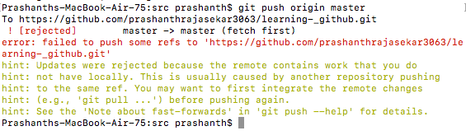
PR
REMOTES AND BRANCHES
PLUGIN-AI
4.6 If the code is being edited in the local machine as well as via github.
4.7 If we try to commit the file, it will return “commit rejected”.
4.8 We need to pull the edited file from github to the local machine. Once the file is downloaded we can see that file both the edited part in it.
4.9 Then again we can push the file to the github via the push command.
4.10 Merge conflict occurs when the changes have been made at the same location.
- a small demo, lets edit the same character in the same location in local machine as well as github and try the command as shown below.
“$ git push origin master”
- It will return an error saying there was a conflict.
- so do “$ git pull origin master” and visualize the file, it will look similar to what is shown in the nextslide.

Slide 19
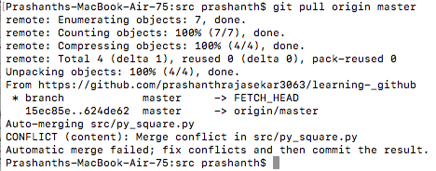
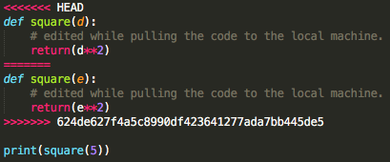
PR
REMOTES AND BRANCHES
PLUGIN-AI
- Lets visualize the python script file.
We need to manually edit the file to get rid of the comments.
Once edited, push the code to the github.
All the conflicts will be fixed and the code will be successfully pushed to github.

Slide 20
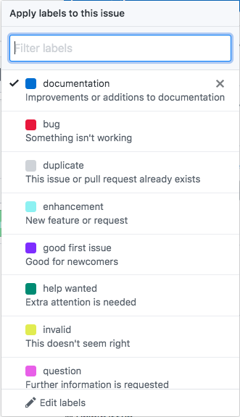
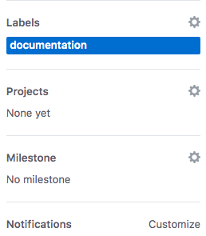
PR
USE GIT FOR PROJECT MANAGEMENT
PLUGIN-AI
5.1 We can write issues mentioning the improvements needed to the project or file.
5.2 We can provide labels mentioning the sensitivity of the issue.
5.3 We can write a brief description using the WIKI tab. A well described documentation can be generated here.
5.4 We can add milestones that provides the information of the stages of your project and we can link the issue with it.

Slide 21
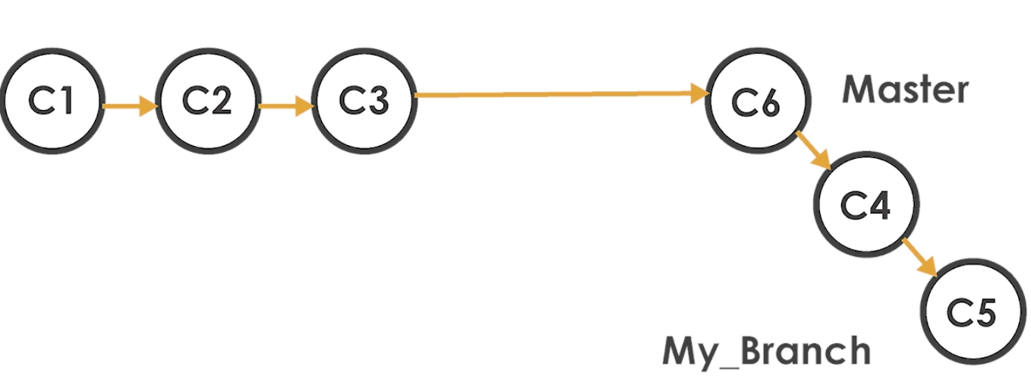

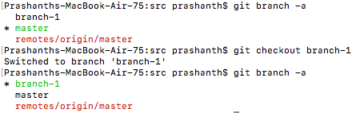
PR
USE BRANCHES ON YOUR OWN
PLUGIN-AI
6.1 We can create the branch using the command:
“$ git branch <branch_name>”
6.2 To see all the branches, we can type:
“$ git branch -a”
6.3 We can see that the same branch gets added to github also.
6.4 We can switch between branches using the command:
“$ git checkout branch-1”
“$ git checkout –b branch-1” this creates the branch as well as moves to that branch.

Slide 22
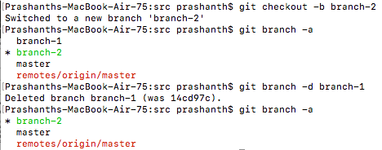
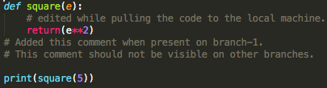

PR
USE BRANCHES ON YOUR OWN
PLUGIN-AI
6.5 We can also delete the branch using the following command:
“$ git branch –d <branch_name>”
6.6 We cannot delete the branch by hopping on the branch that we want to delete. It will throw out an error.
6.7 In order to delete the branch, we need to move to the other branch and then perform the delete activity.
6.8 We can now switch to branch-1 and try to make some changes, the changes made will not be visible in other branches.
The output has been visualized in the next slide.
branch-2
master

Slide 23
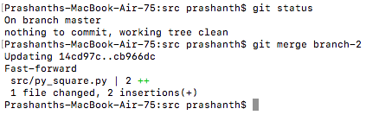
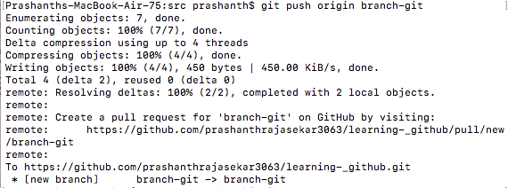
PR
USE BRANCHES ON YOUR OWN
PLUGIN-AI
6.9 As we have 2 branches, we can merge one branch to another using the command:
”$ git merge <branch name>“
Say we are currently in master branch and we want to incorporate the changes from branch-2 to the master branch then we need to use.
Ex- “$ git merge branch-2”
Now we incorporated branch-2 changes into master branch.
W can now push the changes made to github also. And the changes mae will will replicated in github.
We can also push the changed to github on a different branch also.
“$ git push origin <new-branch>”
“$ git fetch --prune” -> updates the branch changes made in github to the localmachine.
We can delete the branch by”
“$ git branch –d <branch>”
“$ git branch –D <branch>”
Force delete

Slide 24
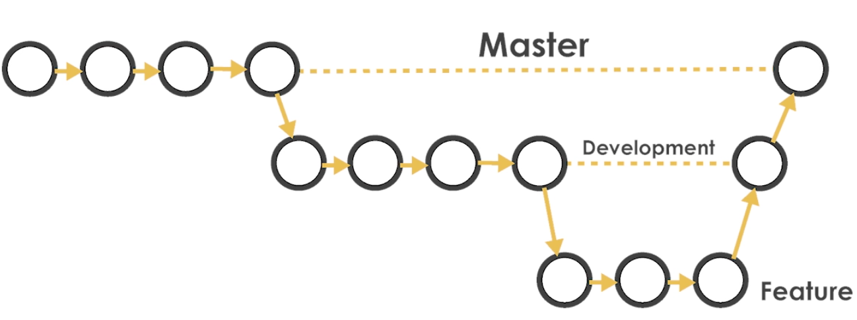
PR
UNDERSTANDING GIT WORKFLOWS
PLUGIN-AI
1. We can crate new branched and incorporate the changes to any of the branch – it is like a side job and integration.
“$ git checkout –b feature/document_docs”
“$ cd docs”
“$ sublime README.md” – insert some comments to the readme.
- push the feature/document_docs branch to github.
- click on compare and pull request.
- select the branch where the feature/document_docs branch needs to merge and create the pull request.
- Once created, merge the pull request – this incorporated the changes into the current branch.
- We can also delete the branch if needed.
- We created the README.md file in the feature/docment_docs branch and merged into some other branch. We can see the that the README.md file is visible in the other branch , but not in the master branch.

Slide 25
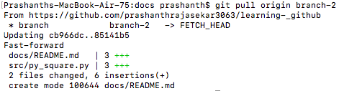
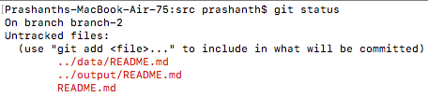
PR
UNDERSTANDING GIT WORKFLOWS
PLUGIN-AI
We can update the branch that was updated in github in our current system also.
“$ git pull origin <merged_branch>”
So the changes gets updated to the branch in our local system also.
2. Now lets add README.md files in all the directories with some details in it.
“$ git status”
- Now we are inside the “src” directory, so we can stage only the “README.md” file inside the “src” directory.
- To stage all the files, get to the previous directory and type “$ git add -all”.
- Once done, merge the current branch to the master branch after switchin gto the master branch “$ git merge branch-2”. “$ git rebase master” can bring all the brances to the same state.

Slide 26
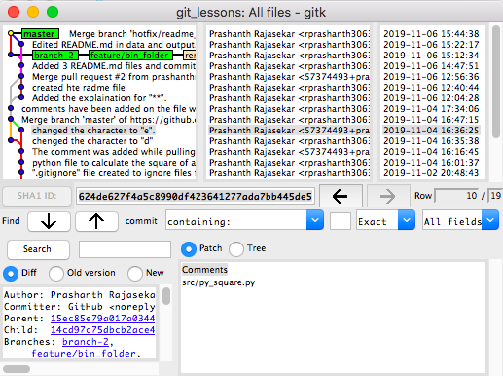
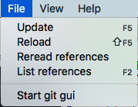
PR
USE GIT GUI
PLUGIN-AI
1. “$ gitk”
2. Start the GUI as shown below.

Slide 27
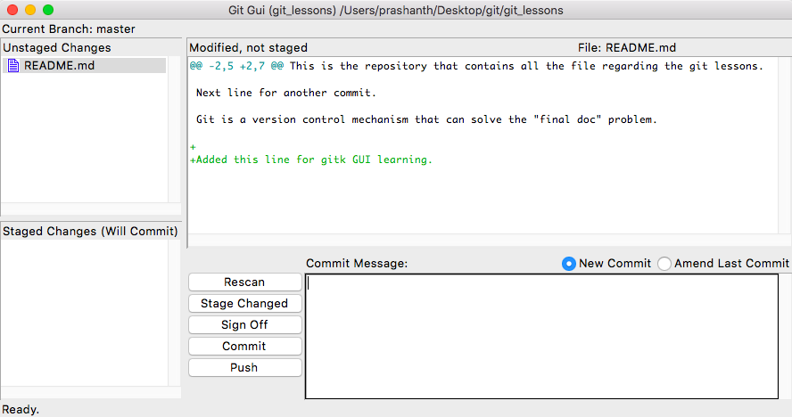
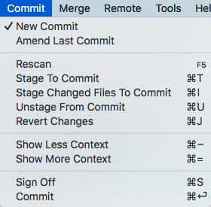
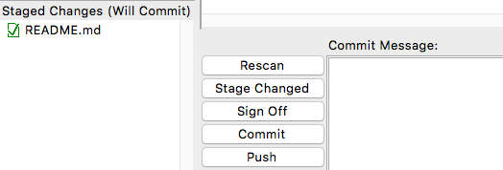
PR
USE GIT GUI
PLUGIN-AI
3. Lets make some changes to the README.md file in the root directory and open git gui again.
1. Unstaged area
2. Staging area
3. Commit message
4. File diffs
Click the “Commit” tab located on the task bar.
Click “Stage to Commit” – the file get pushed to the staging area.

Slide 28
PR
ADDING A COLLABORATOR
PLUGIN-AI
Adding a collaborator, push and pull down changes.
Push/Pull with branches and request a pull.
Incorporate changes in existing branches.

Slide 29
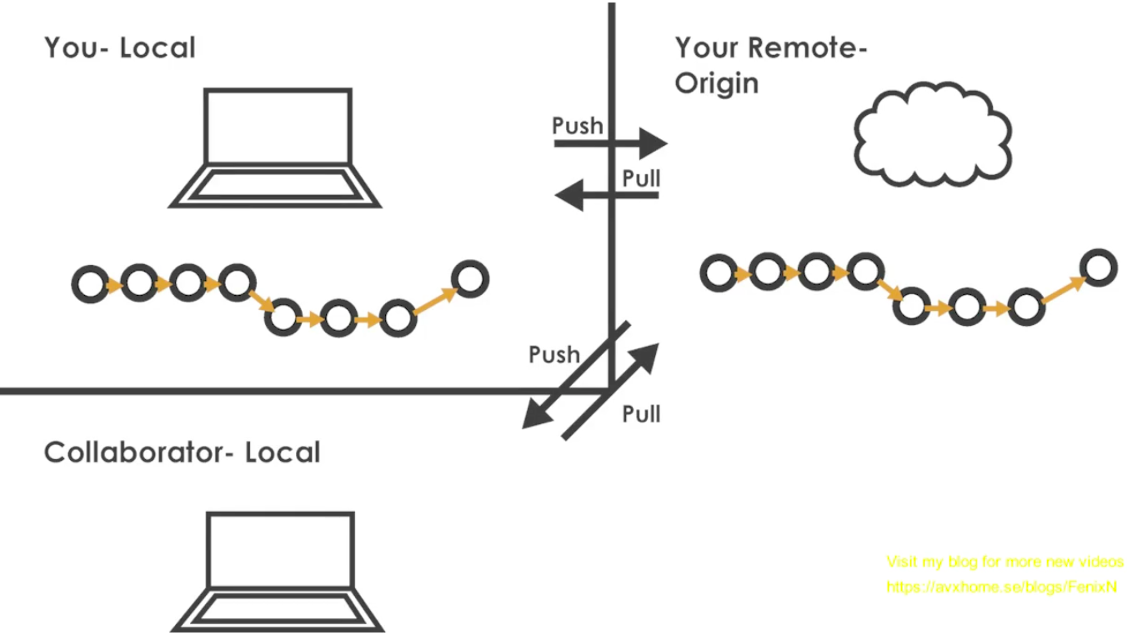
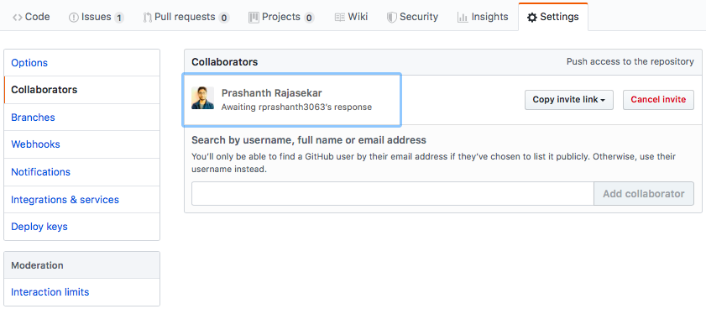
PR
ADDING A COLLABORATOR, PUSH AND PULL
DOWN CHANGES
PLUGIN-AI
1. Go to ”settings” then “Collaborators”, then enter the email address and send the invitation.

Slide 30
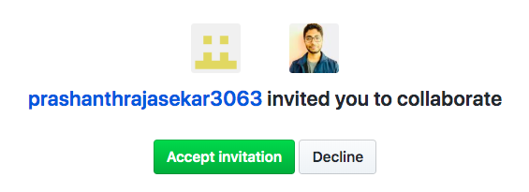
PR
ADDING A COLLABORATOR, PUSH AND PULL
DOWN CHANGES
PLUGIN-AI
2. Accept the invitation
3. Now the collaborator has the access to all the files.
4. Now as a collaborator, clone the complete files.
5. Modify the changes on the downloaded and commit the changes and then push the changes to the github repo.
6. Now the blame section get updated with 2 collaborators.
7. Now when the main collaborator pulls the branch from the github, the repo has all the updates carried out by the new collaborator.
8. The collaborator from his point of view will perform the same commands as we did till now.
9. When the new collaborator clones the repository, the origin URL gets automatically updated.
10.But if we download the repository as a zip file, then we have to manually add the URL link as the origin.

Slide 31
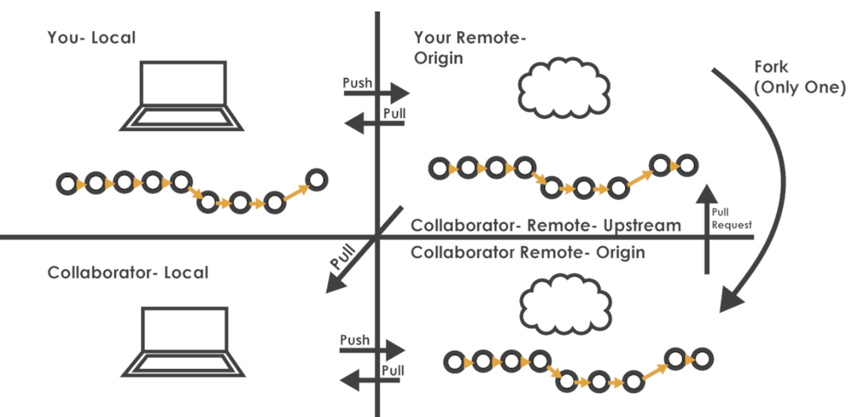
PR
FORKING A REPOSITORY AND MAKING A
CHANGE AS A COLLABORATOR.
PLUGIN-AI
1. The entire repo gets added to the collaborators page.

Slide 32
PR
PLUGIN-AI
THE END

