Slide 1
Tableau
Changing the way you think about data

Slide 2
Tableau Meaning
A group of Models or Motionless figures representing a scene from a story or from history.
Business Intelligence Platform
Analytical Platform
Visualization tool

Slide 3
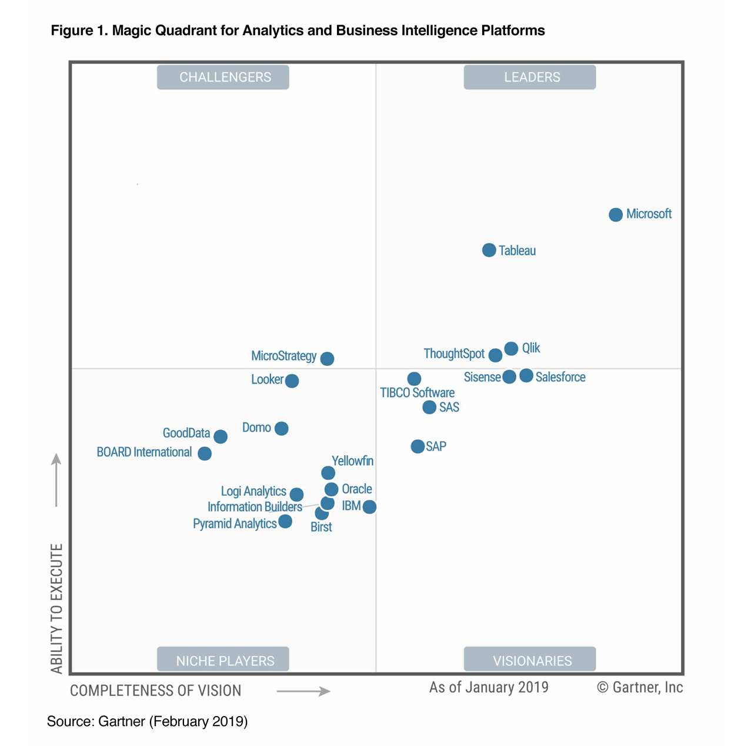
Gartner Magic Quadrant for Business Intelligence and Analytics Platforms (2019).

Slide 4
What is Business Intelligence?
A set of processes, architectures, and technologies that convert raw data into meaningful information that drives profitable business actions.
BI has a direct impact on organization's strategic, tactical and operational business decisions.
BI supports fact-based decision making using historical data rather than assumptions and gut feeling.
BI tools perform data analysis and create reports, summaries, dashboards, maps, graphs, and charts to provide users with detailed intelligence about the nature of the business.

Slide 5
Why is BI important?
Measurement: creating KPI (Key Performance Indicators) based on historic data
With BI systems organizations can identify market trends and spot business problems that need to be addressed.
BI helps on data visualization that enhances the data quality and thereby the quality of decision making.
BI systems can be used not just by enterprises but SME (Small and Medium Enterprises)

Slide 6
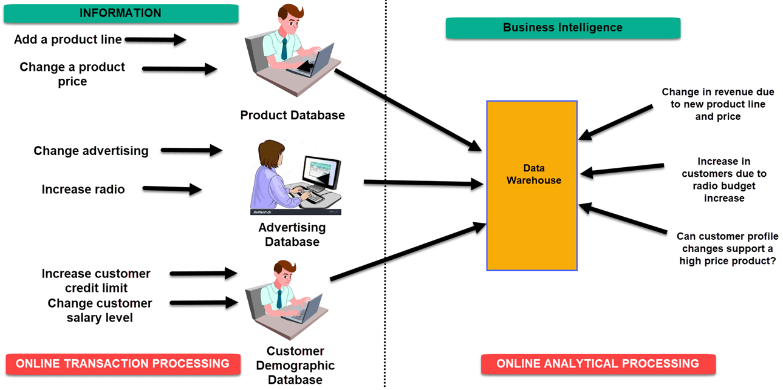
How Business Intelligence systems are implemented?
Raw Data from corporate databases is extracted.
The data is cleaned and transformed into the data warehouse.
Using BI system the user can ask quires, request ad-hoc reports or conduct any other analysis.

Slide 7
Types of BI users
The Professional Data Analyst:
The data analyst is a statistician who always needs to drill deep down into data. BI system helps them to get fresh insights to develop unique business strategies.
The IT users:
The IT user also plays a dominant role in maintaining the BI infrastructure.
The head of the company:
CEO or CFO can increase the profit of their business by improving operational efficiency in their business.
The Business Users:
Casual business intelligence user
The power user

Slide 8
Advantages of Business Intelligence
Boost productivity
To improve visibility
Fix Accountability
It gives a bird's eye view
It streamlines business processes
It allows for easy analytics
Disadvantages of Business Intelligence
Cost
Complexity
Limited use
Time Consuming Implementation

Slide 9
Tableau and Competitors
SAP BO Objects
Qlik View
IBM Cognos
Oracle BI
Sisence
Dundas BI
Microsoft Power BI
Micro Strategy
Domo
Birst
Tibco Spotfire
Sas
Pentaho
Datapine

Slide 10
Tableau and Qlik
Basis of Difference | Tableau | QlikView
Performance | When it comes to performance, Tableau uses the cubing technique which gives out results slower than QlikView. | Comparatively, QlikView is faster in this case. QlikView can effortlessly combine all sizes of datasets.
Interface | Tableau comes with a simple drag-and-drop interface which is easy, clean, and interactive. | The interface of QlikView has too many tools on its menu which are rarely used, but they certainly provide a wide range of ways in which the data can be showcased.
Capabilities | Real-time visualization | Strong visualizations with BI reporting
Suitable for | Dash boarding and rapid visualizations | Departmental and enterprise-wide BI solution
Product range | Diverse products for varied use | Single product for the entire BI solution
Gauge charts and 3D graphs | Tableau does not support gauge charts and 3D graphs | In QlikView, gauge charts are available and it also has 3D graphs to showcase data.
Geographical maps | In Tableau, it is easy to build map visualization. It has an inbuilt extension to perform map visualization. | In QlikView, building map visualization takes longer, than in Tableau, since it needs scripting and external extension for this.
Tables | Weaker in tables | Very good for tables
Speed | Speed depends on RAM and the source database | Speed depends on RAM
Graphical inputs and changes | With easy drag and drop, graphical inputs become easy too. | In QlikView, it is needed to write the logic for the areas where graphical changes are required.

Slide 11
Tableau Products
Tableau Server
Tableau Online
Tableau Desktop
Tableau Public Desktop
Tableau Reader
Tableau Mobile
Tableau Prep Builder

Slide 12
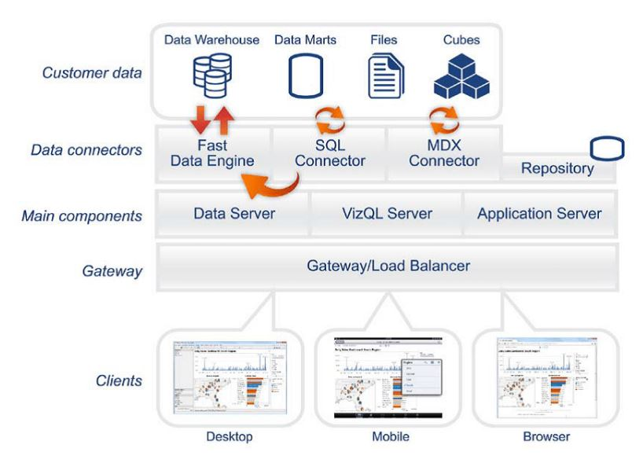
Tableau Architecture

Slide 13
Licensing Overview
User-Based
Viewer licenses - view and interact with workbooks in Tableau Server
Explorer licenses - Create and Publish new workbook from existing published data source
Creator licenses - Server administration and Advanced Server Deployment Monitoring
Core-Based
you can run Tableau Server on a specific number of CPU cores. For core-based licensing, you can install Tableau Server on a single-node or multi-node cluster, as long as the total number of cores for all of the nodes does not exceed the number of cores that you have licensed.

Slide 14
Authentication
Authentication verifies a user's identity.
Everyone who needs to access Tableau Server—whether to manage the server, or to publish, browse, or administer content, must be represented as a user in the Tableau Server repository.
Authentication Types
Local authentication
LDAP (light weight authentication process) –Active Directory

Slide 15
Tableau Hardware Specifications
Tableau Desktop
Windows
Microsoft Windows 7 or newer (64-bit)
Microsoft Server 2008 R2 or newer
2 GB memory
1.5 GB minimum free disk space
Mac
iMac/MacBook computers 2009 or newer
Mac OS High Sierra 10.13, mac OS Mojave 10.14 and mac OS Catalina 10.15
1.5 GB minimum free disk space

Slide 16
Tableau Hardware Specifications
Tableau Prep
OS Requirements
Windows
Mac
Microsoft Windows 7 or newer (64-bit)
Microsoft Windows Server 12R2 or newer
Mac OS High Sierra 10.13, mac OS Mojave 10.14 and mac OS Catalina 10.15
Minimum System
Requirements
Windows
Mac
Intel Core i3 or AMD Ryzen 3 (Dual Core)
4GB or larger
2GB HDD free or larger*
Intel Core i3 (Dual Core)
4GB or larger
2GB HDD free or larger*

Slide 17
Tableau Hardware Specifications
Tableau Prep
Recommended
Requirements
Windows
Mac
Intel Core i7 or AMD Ryzen 7 (Quad Core)
16GB or larger
2GB SSD free or larger*
Intel Core i7 (Quad Core)
16GB or larger
2GB SSD free or larger*
High Performance
Requirements
Windows
Intel Core i7 or AMD Ryzen 7 (16 Core)
32GB or larger
2GB SSD free or larger*

Slide 18
Tableau Hardware Specifications
Tableau Server
System
Requirements
Microsoft Windows Server 2016, 2012, 2012 R2, 2008 R2, 2019
Amazon Linux 2, Red Hat Enterprise Linux (RHEL) 7.3+, CentOS 7.3+, Debian 9.0+, Oracle Linux 7.3+, Ubuntu 16.04 LTS and 18.04 LTS on x64 chipsets
Proof of Concept
Requirements
Tableau will not proceed on computers with less than these hardware minimums
4 cores / 8v-CPU (ex.AWS)
16 GB system memory
15 GB minimum free disk space

Slide 19
Tableau Hardware Specifications
Tableau Server
Minimum Production
Requirements
Tableau will not proceed on computers with less than these hardware minimums
8 physical cores, 16V-CPU (ex. AWS)
32 GB system memory
50 GB minimum free disk space

Slide 20
Download and Install Software
https://www.tableau.com/support/releases
Tableau provides a 14-days trial version of tableau desktop.
You can use the same and practice it on your own
https://www.tableau.com/academic/students
If you are a Student (Holding valid Student ID),
then you can download the Tableau for Students, and license valid for one year.

Slide 21
Tableau Versions
2019.4 is current standard version as of November 2019.
Released on November 6, 2019
2019.3
2019.3.1 Released On October 24, 2019
2019.3 Released on September 17, 2019
2019.2
2019.2.5 Released on October 24, 2019
2019.2.4 Released on September 17, 2019
2019.2.3 Released on August 22, 2019
2019.2.2 Released on July 23, 2019
2019.2.1 Released on June 25, 2019
2019.2 Released on May 21, 2019

Slide 22






Tableau File Extensions
.TWB (Tableau Workbook)
.TWBX (Tableau Packaged Workbook)
.TDE or .HYPER (Tableau Data Extract)
.TDS (Tableau Data Source)
.TDSX (Tableau Packaged Data Source)
.TBM (Tableau Bookmark)

