Slide 1
2048 in GPU
Prashanth Soundarapandian
Rakshith Reddy

Slide 2
Implementation
The following versions were implemented.
Serial Version
Parallelized using GPU threads
Our 2048 solver uses ExpectiMax search with 3 heuristics that were applied on the terminal states.

Slide 3
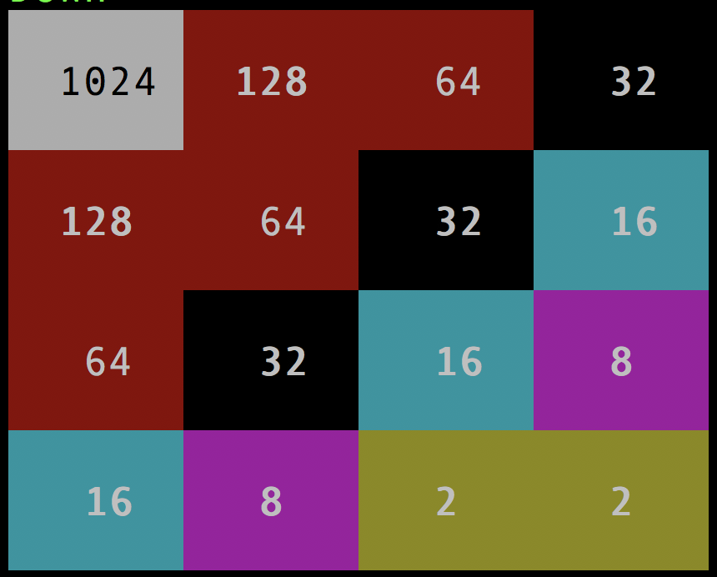
Heuristics 1
Monotonicity
Across every row/column the value must be increasing/decreasing

Slide 4
Heuristics 2
Smoothness
Neighbouring tiles must be closer powers of 2.
Penalize if that is not the case.

Slide 5
Heuristics 2
Smoothness
Neighboring tiles must be closer powers of 2.
Penalize if that is not the case.

Slide 6
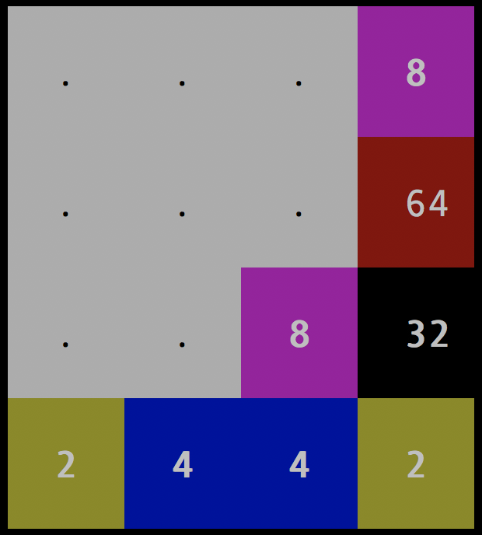
Heuristics 3
Free Tiles
Incentivize if free tiles are present

Slide 7
GPU Parallelization
L
R
Max
U
D
ExpectiNodes
Max
L
L
R
L
L
R
U
R
R
U
D
D
U
U
D
D

Slide 8
GPU Memory Model
Disk
CPU
Main Memory
SLOW
GPU Video Memory
CPU Caches
GPU Cache
CPU Registers
CPU Constant Registers
CPU Temporary Register

Slide 9
Expectimax Search
expectimax (matrix_stack,level,type):
if(level ==max_level ):
calculate(heuristic)
else if type == 1:
create 4 children ( left , right, up ,down )
expectimax (4 childs,level+1,2)
calculate max of four directions
return
else
Fill all vacant spots with 2 to create N matrices
expectimax (M matrices,level+1,1)
take average weighted sum of all probabilities.
return

Slide 10
GPU Parallelization
Right
Left
Down
Up

Slide 11
Stats
Max Score Achieved – 4192
Max Depth Explored – 7

