Slide 1

PREDICTIVE ANALYSIS OF TRAFFIC SEVERITY
Presented by:
Prashanth Vijayaraja
Under the Supervision of:
Dr. Tamer Abdou, PhD

Slide 2
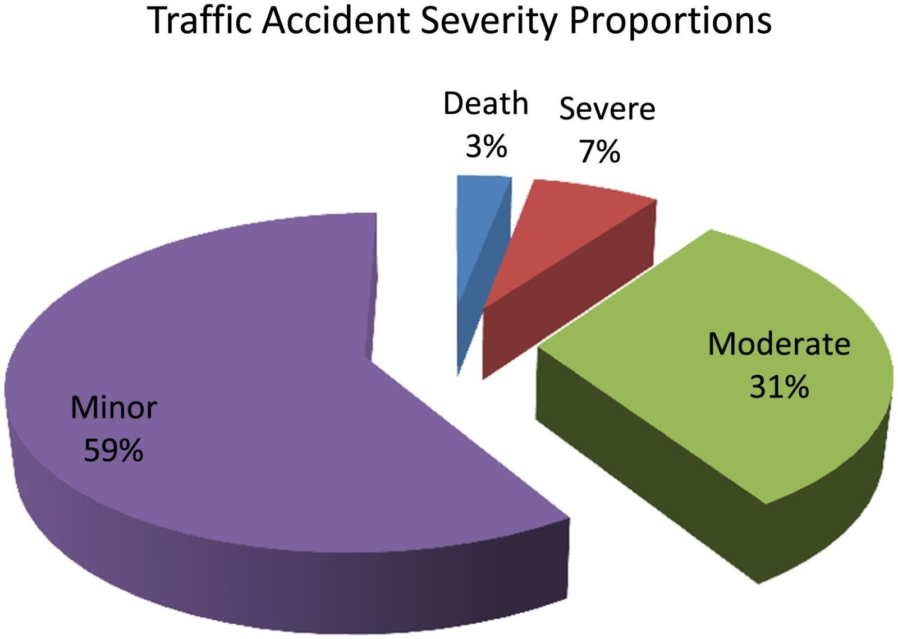
Motivation
Trafﬁc Severity signiﬁcantly impacts society
through economic expenses, physical and mental health disorders, a loss of productivity and most importantly, the loss of many valuable lives.
Take the example of the USA, where the National Highway Trafﬁc Safety Administration released its latest report estimating that there had been about
42,795 fatalities in 2022 due to motor vehicle
crashes.
(Source : ResearchGate)

Slide 3
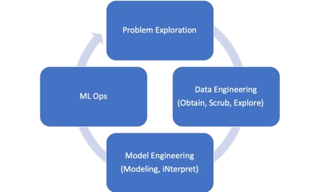
Motivation
In order to come up with effective
approaches to prevent such accidents, it is critical that we perform Trafﬁc Severity Analysis to identify frequent patterns and trends.
This involves carefully examining the dataset
and identifying the key factors/variables that inﬂuence trafﬁc severity, and then using these factors to create a model which can accurately predict the severity of any future trafﬁc situations.
(Source : DataScience.org)

Slide 4

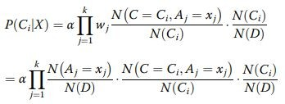

Literature Survey
Improved naive Bayes classiﬁcation algorithm for trafﬁc risk management by
Hong Chen , Songhua Hu , Rui Hua and Xiuju Zhao
Paper highlights Naive Bayes' advantages of minimal parameter estimation from limited training data.
However, simple Naive Bayes faces some obvious shortcomings. So, it introduces an "Improved Naive Bayes Classiﬁer" with feature weighting for enhanced feature importance.
Further addresses accuracy issues in small sample, large attribute scenarios using Laplace calibration.
Offers promising potential for more accurate trafﬁc risk prediction.

Slide 5
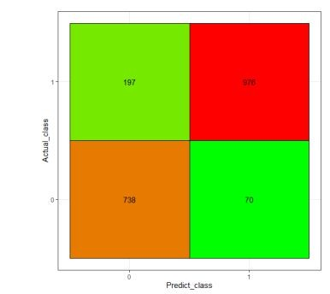
Literature Survey
2. Trafﬁc Accidents Severity Prediction using Support Vector Machine Models by
Zeinab Farhat, Ali Karouni, Bassam Daya, Pierre Chauvet, Nizar Hmadeh
Paper explores SVM models for predicting accident fatality rates, comparing radial basis function (RBF) and linear kernels.
Dataset from Lebanon in 2016-2017 underwent preprocessing with normalization and outlier removal.
SVM seeks to maximize hyperplane margin for optimal class separation. This model employs a binary SVM.
Paper employs SVM kernels (linear, RBF) for data prediction model.
Model achieved 91% accuracy on the testing set with RBF kernel and 84.6% with the linear kernel.

Slide 6
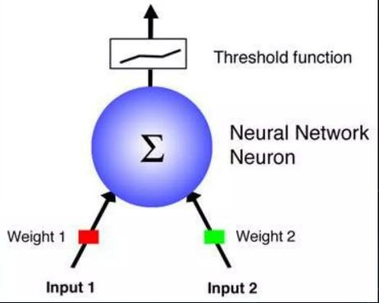
Literature Survey
Traﬃc Accident Analysis Using Decision Trees and Neural Networks
by VicĞor Akinbola OluĞayo and Adekunle Eludire
The paper employs Decision Trees and Neural Net- work techniques to perform trafﬁc accident analysis which is used to identify variables that are correlated to the severity level, standard errors, varying importance of different features, and their effects on the target variable
The data set used Nigeria Road Safety Corps, covering a 24-month period from January 2002 to December 2003 as their dataset
The results observed were Decision Tree better than RBF neural network which was better than MLP

Slide 7
DATASET DESCRIPTION
The dataset includes trafﬁc severity
information covering 49 states of the US from the years 2016 - 2018. There are a total of 314285 rows and 18 features in the dataset to begin with. On the basis of these attributes, an accident is classiﬁed as having a severity between 1 - 4 (inclusive).
Trafﬁc
Attributes
Severity, Distance, Trafﬁc
Signal, Time Difference
Location
Attributes
Start Latitude, Start
Longitude, Street, City, County, State, Airport Code
Temperature, Wind Chill,
Visibility, Wind Direction, Weather Condition
Weather
Attributes
The features have been divided into 4 types
of attributes depending upon the kind of information that they provide.
Time
Attributes
Year, Sunrise_Sunset

Slide 8
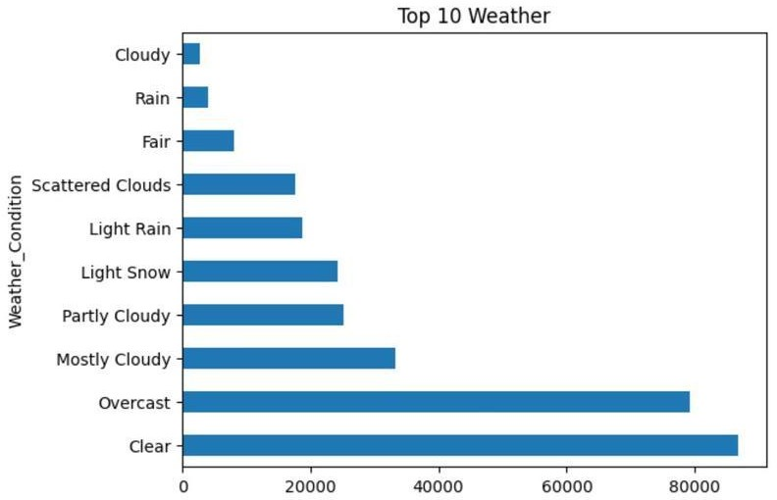
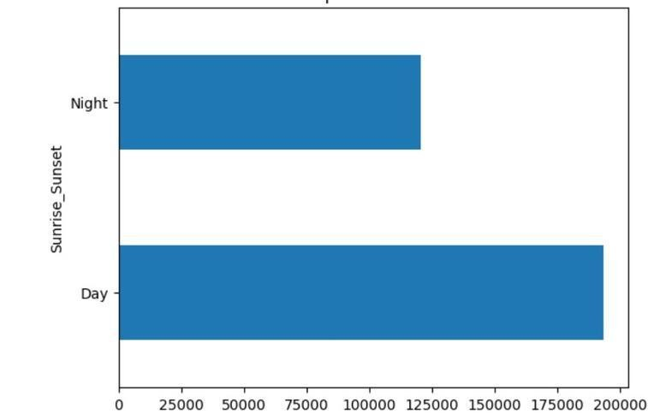
DATA INFERENCES
The bar graph representing weather
conditions reveals that the majority of accidents occur during clear or overcast weather conditions.
The bar graph depicting sunrise
and sunset times indicates that the majority of accidents occur during daylight hours.

Slide 9
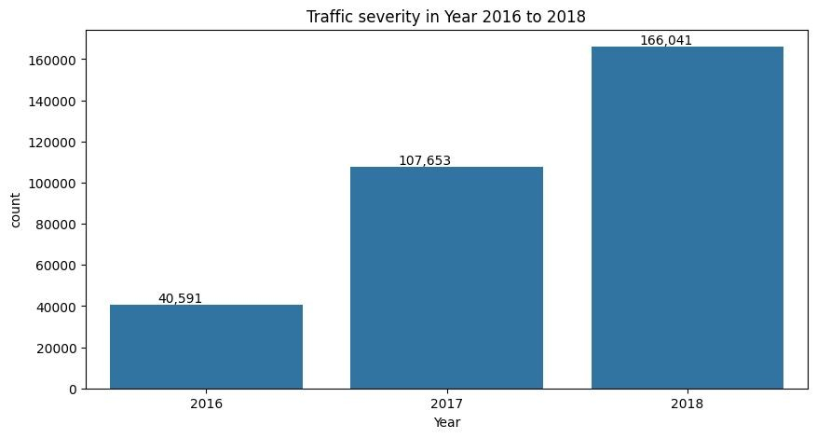
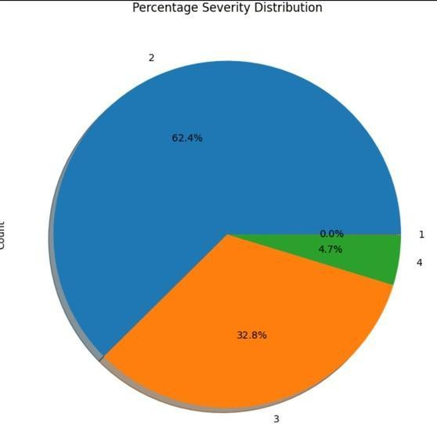
DATA INFERENCES
The bar graph of the year wise trafﬁc distribution
shows that the trafﬁc severity has kept on increasing over the years, with the 2018 count being about 4 times the 2016 count.
The pie-chart of the percentage severity
distribution tells us that most of the trafﬁc observed on the roads is of severity level 2 (62.4%) and severity level 3 (32.8%). Trafﬁc severity levels of 1 and 4 are rarely observed.

Slide 10
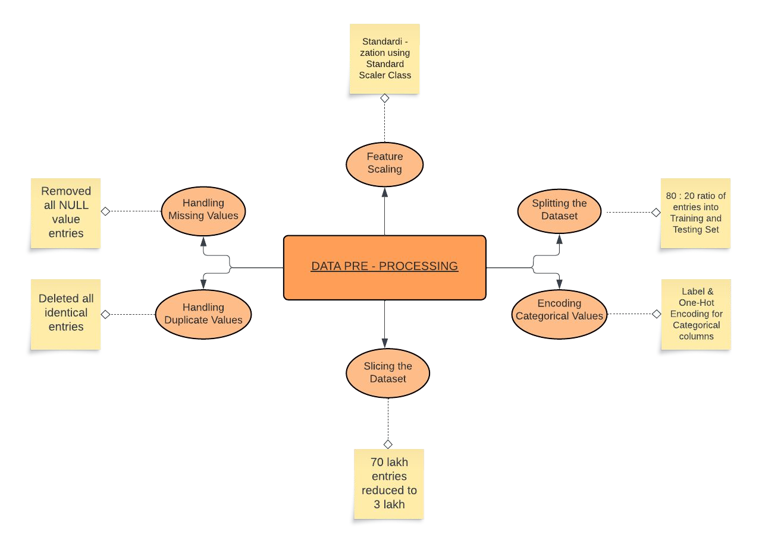
DATA PRE-PROCESSING

Slide 11
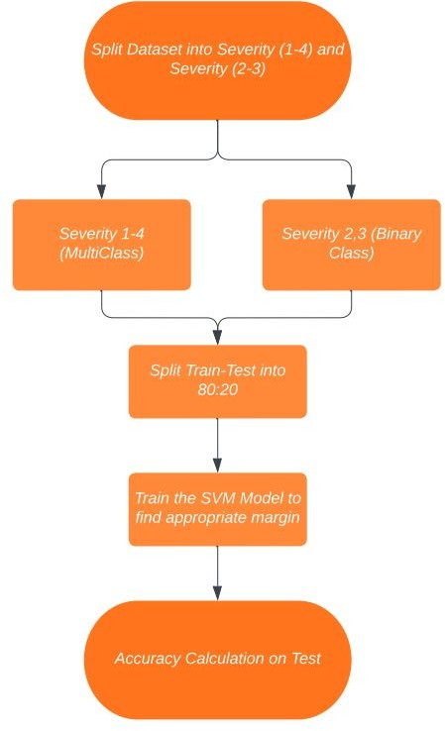
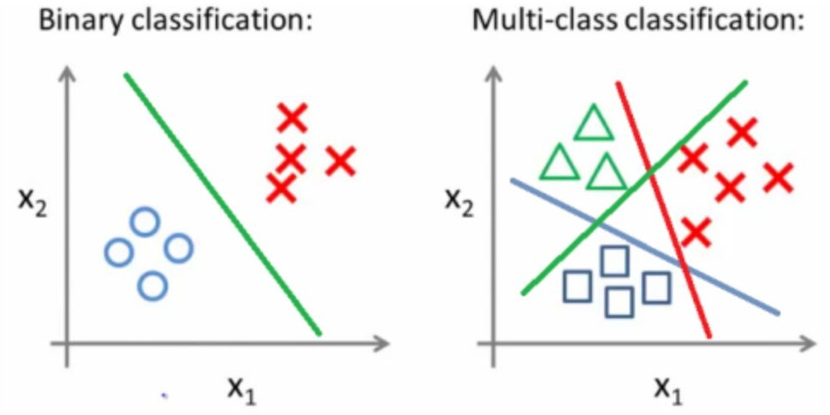
Methodology-Support Vector Machine
Fig : Multiclass breaks into many binary classes problems (Source: Medium)
 | TrainSet | TestSet | SVM type
Severity(1-4)Outliers | 0.6775 | 0.681 | linear
Severity(1-4) w/o Outliers | 0.689 | 0.657 | linear
Severity (2,3) | 71.43 | 0.669 | linear

Slide 12
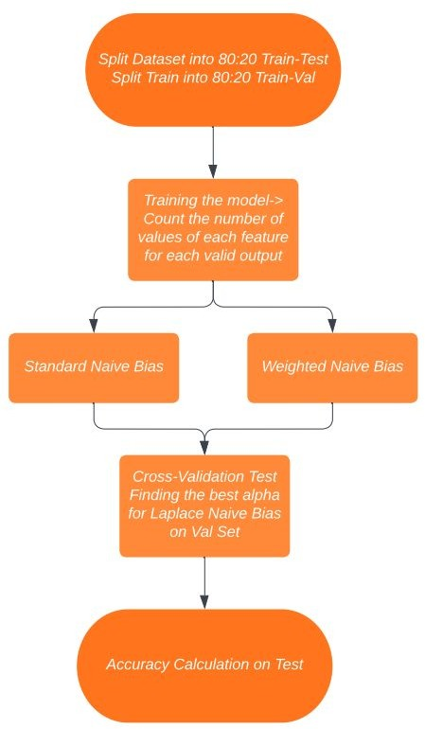


Methodology-Mixed Naive Bayes
 | TestTrain | ValTrain | TestSet | Alpha
With Outliers | 0.67 | 0.645 | 0.623 | 1.5
Without Outlier | 0.687 | 0.676 | 0.679 | 1
Improved NBC | 0.728 | 0.683 | 0.672 | 1

Slide 13
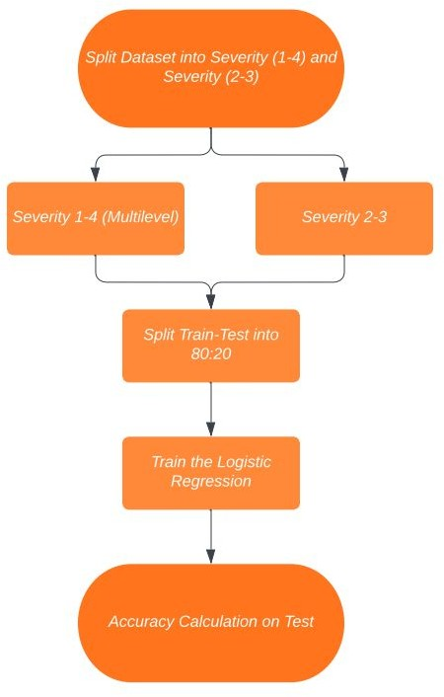
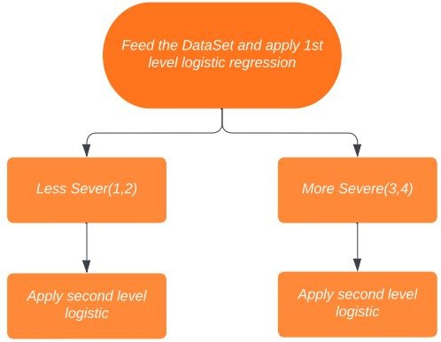
Methodology-Logistic Regression
Multilevel Logistic Regression procedure
 | TrainSet | TestSet
Basic With Outliers | 0.65 | 0.603
Basic Without Outliers | 0.67 | 0.62
Multilevel | 0.57 | 0.53

Slide 14
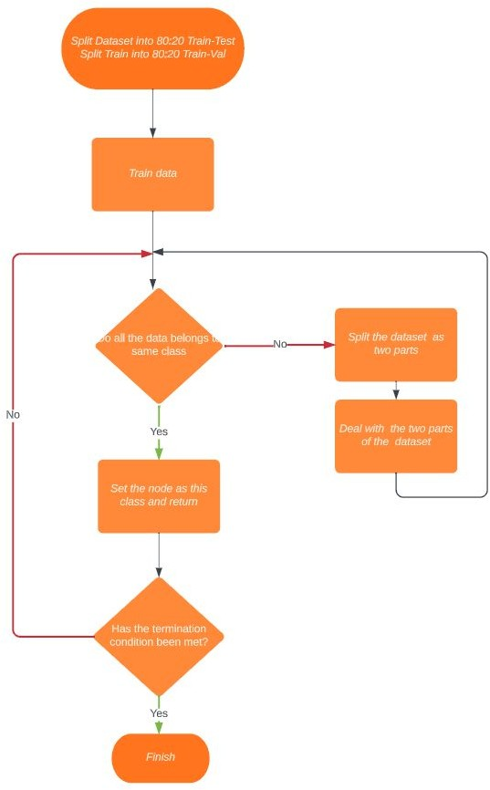
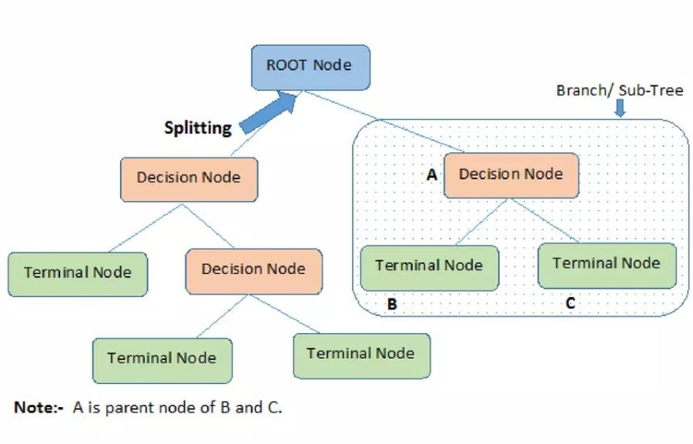
Methodology-Decision Tree
 | TrainSet | TestSet
Entropy | 0.999 | 0.82032
Gini | 0.999 | 0.82244
Grid Search CV | 0.999 | 0.83
Decision Tree Procedure
Accuracy Score

Slide 15
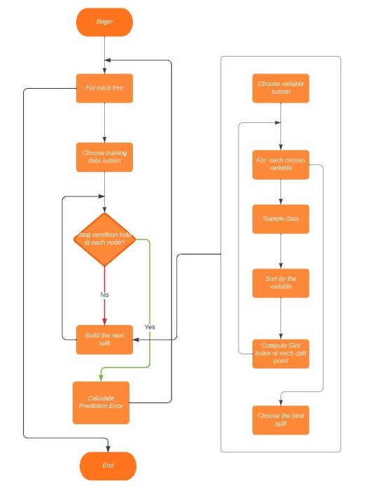
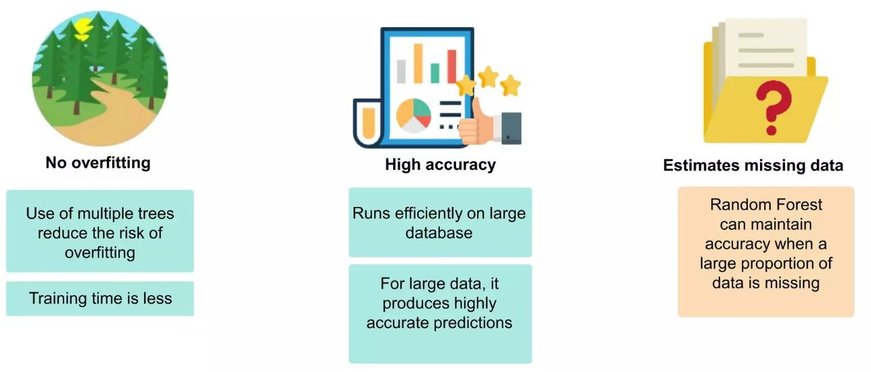
Methodology-Random Forest
Accuracy Score
 | TrainSet | TestSet
Entropy | 0.99 | 0.885
Gini | 0.99 | 0.884
Grid Search CV | 0.999 | 0.893

Slide 16
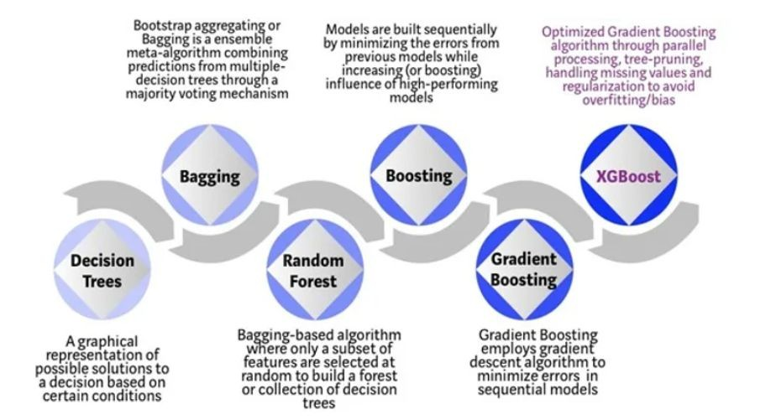
Methodology-Boosting Algorithm
Accuracy Score
 | TrainSet | TestSet
XG Boosting | 0.999 | 0.913
Gradient Boosting | 0.944 | 0.858
Ada Boosting | 0.6533 | 0.6538

Slide 17
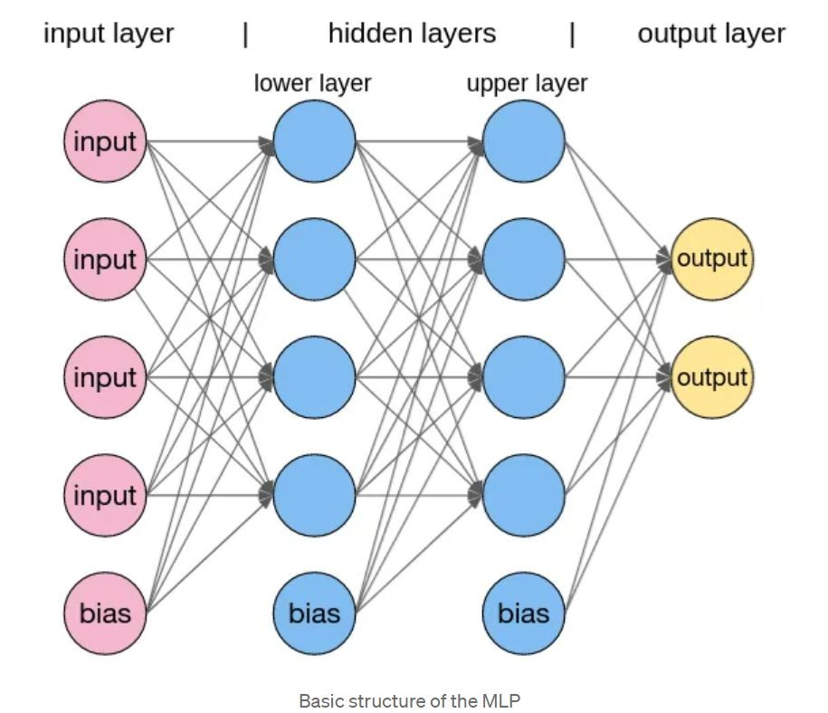
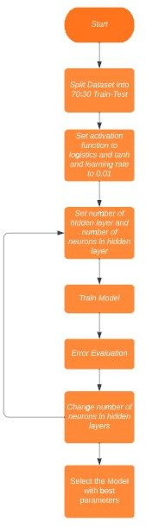
Methodology-MultiLayer Perceptron
Source:Medium
 | TrainSet | TestSet
Multi Layer Precepton | 0.707 | 0.709
Accuracy Score

Slide 18
Results & Analysis
Data Preprocessing is crucial since a signiﬁcant improvement in accuracy is observed before and after removal of outliers.
We here deal with a classiﬁcation problem with discrete outputs so linear regression can’t be used and hence is avoided.
We have employed the models of SVM, Naive Bayes and Logistic Regression till now.
It is observed that upon the use of weighted Naive Bayes and Laplace calibration, bias decreases by about 5%.
For all SVM models, linear kernel is the best ﬁt out of linear, polynomial and rbf kernels.
Multilevel logistic regression is not an idealistic method for multiclass classiﬁcation

Slide 19
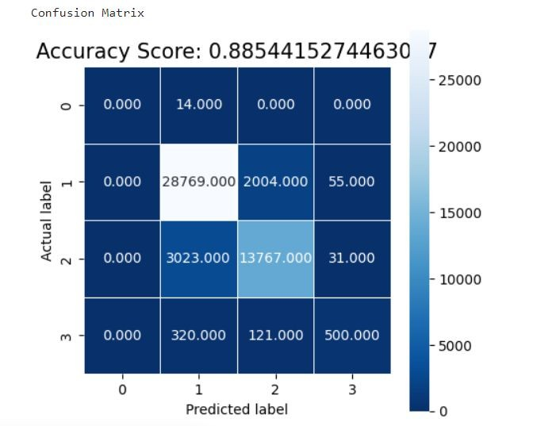
Results & Analysis
Our best model is XGBoost trained upon Dataset without outliers, while Random Forest and Gradient Boosting also gave high accuracy.
KNN and K - Means didn’t work on our data set since the data is not clusterable
MLP performs quite well and doesn’t really differ on adding more layers/neurons
Boosting algorithms performed quite well and reduces variance as expected.

Slide 20
Results & Analysis
Technique | Train Score | Test Score
Random Forest | 0.999 | 0.885
Gradient Boosting | 0.944 | 0.858
Decision Tree | 0.999 | 0.830
Multilayer Perceptron | 0.707 | 0.709
Mixed Naive Bayes | 0.665 | 0.660
Support Vector Machine | 0.643 | 0.681
Adaptive Boosting | 0.6533 | 0.6538
Logistic Regression | 0.645 | 0.646

Slide 21
Thank you

