Slide 1



MyFX High-level Discovery
4th-5th of July 2016

Slide 2
Table of Contents
Background & Scope
Solution Overview
Discovery – Requirements Gathering and Definition
Phase 1 – Money Changer functionality implementation
Phase 2 – Money Changer functionality implementation
Money Changer functionality implementation – Mobile App
Phase 1 – Customer functionality Implementation
Phase 2 – Customer functionality Implementation
Phase 1 – Administrative functionality Implementation
MyFX system features
Timelines and Deliverables
Technology Specifications
Thank You

Slide 3
Background
Fischer’s core focus is in the business segment for fixing systems.
Fischer’s strength is in their capability to provide the right product in a technically-perfect design for a wide range of customers, from DIY fans through to skilled trade workers.
Fischer has identified the need to catalog it’s products along with example implementation of its products to be made available for the companies sales associates.
A product catalog along with sample implementations will amplify the companies sales by providing associates the opportunity to demonstrate its product line while on the field.

Slide 4
Scope
Fischer has contacted Verbat to develop an application with the following features
Approval Copies
A mobile device (Phone or Tablet) application that can take pictures of products.
Ability to associate the product with a project, contractors, consultants, clients etc.
Approval Form
Create an approval form (option for draft and final) that can be send to approval managers for approval.
Approval copies once approved can be further enhanced with additional information
Product Catalog
Create a product catalog with various product details
Be able to attach documents from emails, scanned images or from the device storage.

Slide 5
Scope (Continued)
Submittal Forms
Create product or company submittal forms
Create cover page
Be able to add additional attachments via email, pics or device storage
Ability to combine all documents & attachments to be collated as a single PDF document.
Application Platforms
System will be deployed on desktop as well as mobile devices
Administrative features will be implemented on the desktop version
All other features will be available on the mobile devices
System will be available on both IOS and Android devices.

Slide 6
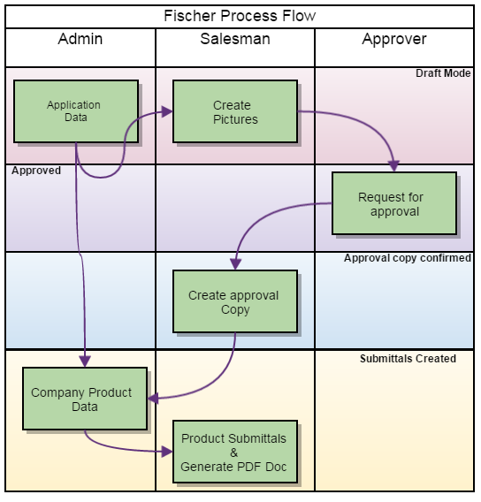
Solution Overview
System provides an Optional web service layer to integrate the application with mobile devices.
The main components of the application are
Authentication, authorization to distinguish the logged in user, auditing to track the progress of the workflow and logging for security purposes.
The case management system consist of two distinct workflows
Dispute resolution to arbitrate cases between clients
An arbitration management system for SOE to allocate and deallocate cases to arbitrators and for managing the arbitration process.
Arbitration certification for candidates and a test management and administration system.
The above workflows are build on a common framework that manages the workflow.
The system will also have a build in file management, email management system and scheduling services to sent reminder emails to concerned parties
The application is also integrated with an online payment system manage fee collection.

Slide 7
Discovery Phase – Requirements Gathering and Definition
A dedicated phase for Verbat to discuss the detailed business and technical requirements, define the solution approach and deliverables, document these and obtain mutual sign-off
Verbat proposes to deploy a senior Technical Architect and a senior Business Analyst for this phase
The phase will be completed over 10 working days
Deliverables:
Detailed requirement specifications
Wireframes for the key screens for the proposed web and mobile apps
High level technical design
Dependencies:
Availability of key stakeholders for meetings to discuss requirements and validate findings and deliverables
Written sign-off for completion, prior to commencement of the next phase

Slide 8
SOE functionality implementation
SOE Functionality for candidates
User authentication and entitlement
Create Candidate profiles and upload relevant documentation
Schedule The candidate for test and lesson plans
Fee collection from Candidates for tests and lesson plans
SOE Functionality For managing test
Create and manage objective type test questions
Create and manage Descriptive questions
Record the test results with comments
Ability to pass or fail Descriptive tests and interviews.
Test taking and test grading functionality
Manage Arbitrations
Manage arbitration cases
Ability to view arbitration cases
Assignment of cases to chief arbitrator
Ability to view case status
Ability to view the cases assigned to an arbitrator
Fee collection from clients for arbitrating cases
Authorization logic for workflow progression
Specify the commission for SOE for facilitating arbitration.
SOE will facilitate the meetings between arbitrators and clients for dispute resolution.

Slide 9
Candidate functionality implementation
Functionality for taking objective type test
Functionality to take descriptive test
Functionality to make payment for Objective type test
Functionality to receive reminder mails and status of the interview process

Slide 10

Client functionality implementation
Clients can create profile and upload documents relevant to their case
Clients will receive emails and updates on their case.
Client can make payments for case arbitration.
Clients can escalate the case to the chief arbitrator if they are not satisfied with the results of the judgement.

Slide 11
Arbitrator functionality Implementation
Chief Arbitrator Functionality
Cases will be assigned to the chief arbitrator by the SOE.
Chief arbitrator will reassign the cases to other arbitrators who are specialized in handling the case
The chief arbitrator will receive feedbacks from the arbitrators.
Chief arbitrator will assign the case to a single arbitrator pending review and feed back from other arbitrators
Once the case is resolved the chief arbitrator will relieve the assigned arbitrator from the case
The chief arbitrator may receive an escalation if the clients are not satisfied with the verdict
Assigned arbitrator functionality
Assigned arbitrators will receive an initial receipt of a case assigned to them.
The arbitrator can ignore or reject the case
Alternatively the arbitrator can accept the case for a price.
The chief arbitrator will assign the case to one arbitrator among the ones solicited for service based on the their cost as well as other parameters
The arbitrator will help the clients resolve disputes.
The results of the judgement along with meeting minutes will be recorded in the system

Slide 12
System Administration functionality
Web Portal Administration Functionalities : Support (Phase 1):
Functions around user management including authentication and entitlement for entire platform
Money changer profile management
View transaction history including quotations which are ignored, expired, missed or cancelled and successful transactions
View best buy, last buy and sell for entire platform
Online money changer on-boarding / registration
Audit/transaction logs of changes in board rates, cancelled/completed transactions, threshold settings, changes in Hard/Soft Limit
Upgrade moneychanger tiers (Gold, silver, bronze).
Manage Money changer tiers based on functionality offered (e.g. online banking, delivery service, buy back, duration – order forward)
Web Portal Super Admin (Phase 1):
View invoices by money changer
View Commissions earned by money changer
View debtors
Manage content for messages, alerts and terms
Set the default radius for customer searches

Slide 13
MyFX system features
MyFX System Features
Phase 1
Secure and encrypted communication
QR code encryption
Calculate distance between Money Changers
Phase 2
Provision for payment gateway integration
Provision for leveraging and using Market rate (FX)
Provision for myKad integration

Slide 14
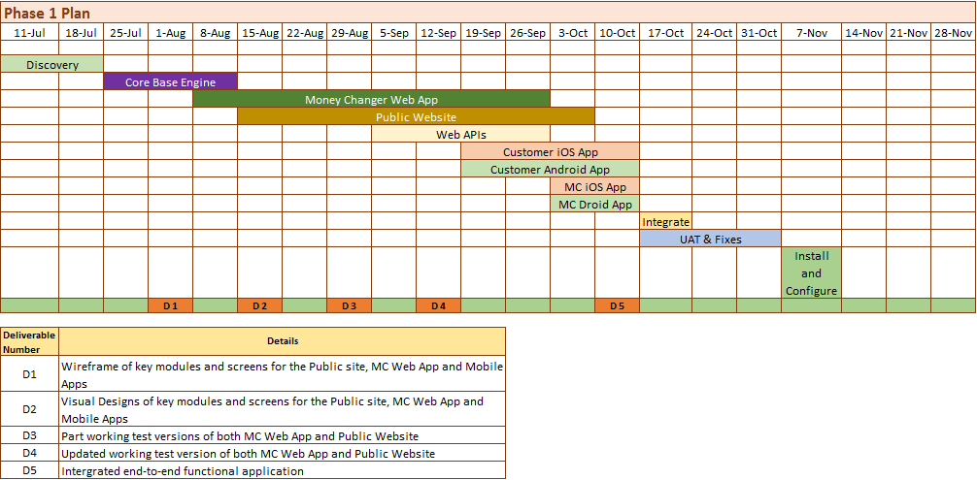
Timelines and Deliverables (July – November 2016)

Slide 15
Technology Specifications
Technology Stack:
Language - PHP
Database - MySQL
Server - Apache 2.4.9
Operating System – Linux
Native Mobile apps – iOS and Android
Server and Hosting Recommendation
Memory – 8 GB
Processors: 4 Cores
HDD Quota – 1 TB
Monthly Transfer (Bandwidth) – As required/ month

Slide 16




Thank You
3rd Floor 207 Regent Street London W1B 3HH
+44 20 8090 1461
sales.uk@eduworks.com
USA
2033 Gateway Place
Suite 500
San Jose
CA 95110
UAE
217, Sheikh Rashid Bldg.,
P.O Box 56272 Dubai
India
Level 3, PTC Tower
Nanthancode
Trivandrum – 695003
Kerala

