Slide 1
Genset Booking
Mobile, Web Application
Middle East Container Repair Co, LLC

Slide 2
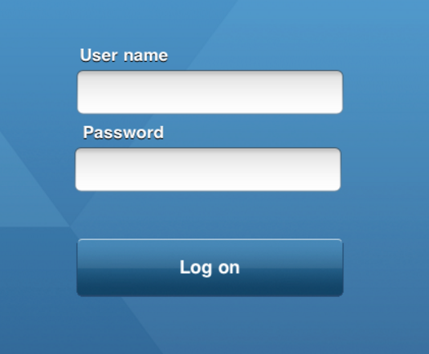
Web Application Login
Customer Login
Forget Password

Slide 3
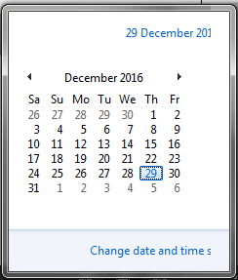
Client Web Login
Genset Booking
Genset Haring
Tracking
Reports
Exit
Teams & Condition, I agree to hire this Genset from , Teams & Condition, I agree to hire this Genset
Genset Release Form Online Filled By Clients
Job Order No : MECRC01
Vehicle No,_______
EIR No,_______
From date__/__/___
Shipping Line: ____________________________
To Date__/__/____
Cancel
Save

Slide 4
Client Web Login
Genset Booking
Genset Haring
Reports
Exit
Genset Hiring Slip Date 00/00/0000
Job Order: MECRC01 No
Vehicle No,_______
From date
__/__/___
Cash [ ]
Credit [ ]
Con No, ABCD1234567
To Date
__/__/____
Shipping Line: ____________________________
Customer : ____________________________
Details of Security Cheque__________________
Address
Cancel
Save

Slide 6
Middle East Container Repair Co, LLC
Admin Login

Slide 7
Administrator MECRC
Control Panel
Genset Booking
Genset Hiring
Genset Out
Genset IN
Reports
Exit
Genset Issuance Date 00/00/0000
Job Order: MECRC01 No
Vehicle No,_______
Out date__/__/___
Con No, ABCD1234567
Out Time _______HH/MM
Shipping Line: ____________________________
Cancel
Save

Slide 8
Administrator MECRC
Control Panel
Genset Booking
Genset Hearing
Genset Out
Genset IN
Reports
Exit
Genset Return Date 00/00/0000
Job Order: MECRC01 No
Vehicle No,_______
Out date__/__/___
Con No, ABCD1234567
Out Time _______HH/MM
Shipping Line: ____________________________
Cancel
Save

Slide 9
Administrator MECRC
Control Panel
Genset Booking
Genset Hearing
Genset Out
Genset IN
Reports
Exit
No, Book by , Days, Arrive Cont No JobNo Days
1 | IBRAKOM | 12MECRC | 21/12/2016 | CGMU4993990 | JBLSO1 | 10/01/2017 |  | 23045 | Credit
2 | AL FUTTAIM LOGISTICS | 16MECRC | 21/12/2016 | APLU23423232 | JBLSO1 | 10/01/2017 | 3 | 45741 | Credit
3 | GANDHI CARGO | 11MECRC | 21/12/2016 | TTNU2323232 | JBLSO1 | 10/01/2017 | 1 | 43234 | Cash
4 | NAWAH MAQAL LLC | 12MECRC | 21/12/2016 | HHMU322323 | JBLSO1 | 10/01/2017 | 1 | 12322 | Credit

Slide 10

Administrator MECRC
Control Panel
Genset Booking
Genset Hearing
Genset Out
Genset IN
Reports
Exit
Dashboard,
No
Genset No
Book By
Book Date
Arrival
Days
Color
Terms
Code
1 | 12MECRC | IBRAKOM | 21/12/2016 | 21/12/2016 | 2 | JBLSO1 | 10/01/2017 | Credit | 12MECRC
2 | 16MECRC | AL FUTTAIM LOGISTICS | 21/12/2016 | 21/12/2016 | 3 | JBLSO1 | 10/01/2017 | Credit | 16MECRC
3 | 11MECRC | GANDHI CARGO | 21/12/2016 | 21/12/2016 | 4 | JBLSO1 | 12/01/2017 | Cash | 11MECRC
4 | 12MECRC | NAWAH MAQAL LLC | 21/12/2016 | 21/12/2016 | 5 | JBLSO1 | 15/01/2017 | Credit | 12MECRC
Book
Book
Confirmed
Book

Slide 11
Administrator MECRC
Control Panel
Genset Booking
Genset Hearing
Genset Out
Genset IN
Reports
Exit
Dashboard,
No
Genset No
Book By
Book Date
Arrival
Days
Color
Terms
Code
1 | 12MECRC | IBRAKOM | 21/12/2016 | 21/12/2016 | 2 | Red | 10/01/2017 | Credit | 12MECRC
2 | 16MECRC | AL FUTTAIM LOGISTICS | 21/12/2016 | 21/12/2016 | 3 | yellow | 10/01/2017 | Credit | 16MECRC
3 | 11MECRC | GANDHI CARGO | 21/12/2016 | 21/12/2016 | 4 | green | 12/01/2017 | Cash | 11MECRC
4 | 12MECRC | NAWAH MAQAL LLC | 21/12/2016 | 21/12/2016 | 5 | green | 15/01/2017 | Credit | 12MECRC
Book
Book
Confirmed
Book

Slide 12

Administrator MECRC
Control Panel
Genset Booking
Genset Hearing
Genset Out
Genset IN
Reports
Exit
Dashboard,
Create User
Name
Upload Photo
Company
Account No
Contact Person
Address
Account Holder
Email

Slide 14
Middle East Container Repair Co, LLC
Smart Phone Login
Options
Booking
Genset Issue
Payment
Inbox
Tracking

Slide 15
Login
Menu
10.30: am
10.30: am
MECRC: Genset
Menu
Dashboard
User Name
Genset Booking
Password
Payment
Sign In
Inbox
Forget password
Don’t have an account yet?, Sign Up
Tracking
Sign Out

Slide 16
Genset available
Search G.set
10.30: am
10.30: am
Dashboard
Dashboard
Search
Search
Job Order No :
Sr
Genset No
Arrival Date
Days Job No
Code
Vehicle No,
1 | 12MECRC | 21/12/2017 | 2 | JBLSO1 | 12MECRC
2 | 16MECRC | 21/12/2017 | 3 | JBLSO1 | 16MECRC
3 | 11MECRC | 21/12/2017 | 4 | JBLSO1 | 11MECRC
4 | 12MECRC | 21/12/2017 | 5 | JBLSO1 | 12MECRC
5 | 15MECRC | 21/12/2017 | 5 | JBLSO1 | 12MECRC
6 | 18MECRC | 21/12/2017 | 5 | JBLSO1 | 12MECRC
7 | 21MECRC | 21/12/2017 | 5 | JBLSO1 | 12MECRC
6 | 18MECRC | 21/12/2017 | 5 | JBLSO1 | 12MECRC
6 | 18MECRC | 21/12/2017 | 5 | JBLSO1 | 12MECRC
6 | 18MECRC | 21/12/2017 | 5 | JBLSO1 | 12MECRC
6 | 18MECRC | 21/12/2017 | 5 | JBLSO1 | 12MECRC
6 | 18MECRC | 21/12/2017 | 5 | JBLSO1 | 12MECRC
6 | 18MECRC | 21/12/2017 | 5 | JBLSO1 | 12MECRC
6 | 18MECRC | 21/12/2017 | 5 | JBLSO1 | 12MECRC
Cont_No
Shipping Line:
EIR No,
Gate out:
Back
Back

Slide 17
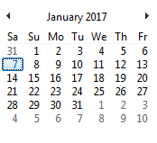
Booking
Hiring Confirmation
10.30: am
10.30: am
Genset Booking
Genset Hiring
Job Order No : MECRC01
Job Order No : MECRC01
Vehicle No,
Vehicle No,
Shipping Line:
Shipping Line:
From date__/__/___
EIR No,_______
To Date__/__/____
From date__/__/___
To Date__/__/____
Cancel
Save
Cancel
Save

Slide 18
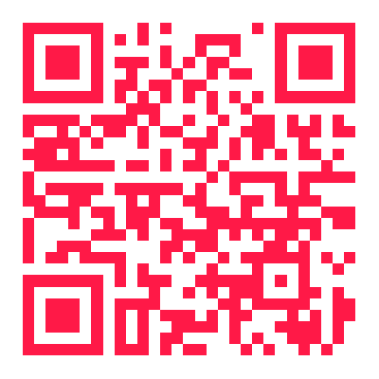
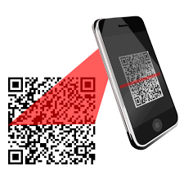
Confirmation
QR Confirmation
10.30: am
10.30: am
Booking Confirmation
Confirmation QR Code
Booking No: MECRC01G926J17
Booking No: MECRC01G926J17
Job Order No : MECRC01
Booked Vehicle No, ABC9898
Shipping Line: SKEIEWEW
From date:
01/01/2017
To Date 02/01/2017
Days:
1
Hours : 24:00
Print
Close
Forward
Print

Slide 19
Inbox , messages
Payment
10.30: am
10.30: am
Inbox Box
Payment
Booking No: MECRC01G926J17
Booking No: MECRC01G926J17
Job Order No : MECRC01
Job Order No : MECRC01
Booked Vehicle No, ABC9898
Booked Vehicle No, ABC9898
Shipping Line: SKEIEWEW
Shipping Line: SKEIEWEW
Print
Close
Pay
Close

Slide 20
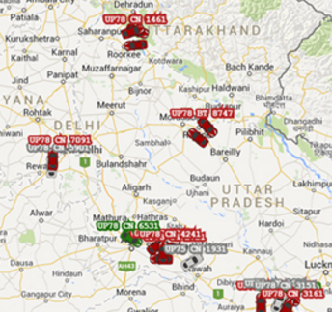
GPS Tracking
Expected Time
Online Tracking
Expected Time
10.30: am
10.30: am
Genset No,
Vehicle No
Expected , Arrival
Vehicle No
Genset No
Current Location
Days:
1
Hours : 24:00

