Slide 1
Maritronics
ARENA
Build Operate & Manage

Slide 2
Proposal Overview
In light of the recent developments, Verbat proposes a win-win collaborative strategy for Maritronics - To take advantage of Verbat‘s Infrastructure and Administrative capabilities, while being able to manage projects independently without having to deal with a third party.
Verbat has 27 years of experience in managing and maintaining IT teams in India and in other parts of the globe. We sustain right sized teams with minimal administrative overheads. Verbat offers a veritable resource with extensive knowledge in a wide range of technologies
We offer the following immediate advantages
Reduced Development Cycle through better communication strategies and our network of technical resources
Reduced costs through optimal resource management and forecasting
Ensure technical advantage through our extended partner resources
On demand resource availability

Slide 3
About Verbat-ODC
Verbat Technologies is a privately held technology corporation that focuses on partnering with its clients for taking e-business ideas from concept to fruition.
Our client base includes Fortune 500 companies, Governments Corporations, as well as dot-coms, located in major world centers like USA, Middle East and India.
Our value proposition is unique. We give our clients the capability-building advantages of in-house development, domain expertise, experience of systems integrators, customer-service oriented knowledge of technical support teams, flexibility of high tech experts and consulting on demand.

Slide 4
The ODC Advantage
Considerable cost savings: As a boutique firm, we have considerable experience in managing right sized teams. Our guiding principle has always been to grow organically with a “Hire and Keep” policy not the mindless “Hire and Fire” strategy employed by multinationals. With Verbat you can be assured of ethical business practices
Our presence in Middle East: Registered in UAE since 1999; we are a legal entity that can handle all contracts and agreements
Location: Our office is just 6 kilometer from Trivandrum International Airport and 4 KMS from the Trivandrum Central Railway Station. Unlike Techno-park, enjoy a traffic free commute to our offices 24/7.
Time difference: We are just 1.5 Hours ahead of the Gulf region and we are available through-out your business hours.
Communications: We provide a state of the art high bandwidth IP based communication infrastructure that can be configured as local extensions to your existing infrastructure
Connectivity: Our facility is equipped with a multi-protocol, high speed network with redundancy over terrestrial and fiber optic lines.
Data Security and Confidentiality: Verbat maintains security in its facilities through restricted physical access, use of firewalls for network security and access control of all sensitive information
IP Rights: We guarantee our clients full ownership of all intellectual property rights and software source code at the completion of the project

Slide 5
Our services & Technical Capability
Application Development
Client / Server Application Development
Distributed Application Development
Enterprise Application Integration
Component based software development
Software Testing
Mobile Application Development
Digital Marketing
Cloud and Dedicated Server Hosting

Slide 6



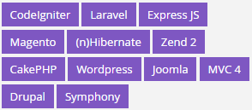
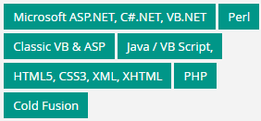




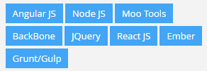
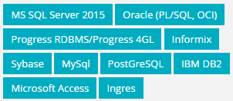

Skill Set
Development Frameworks
Programming Languages
Mobile Skill Set
JavaScript Frameworks
Databases / RDBMS
Reporting Solutions
Angular IO
Page:4 © 2016. All Rights Reserved / www.eduworks-uk.com

Slide 7




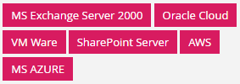




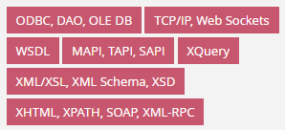



Skill Set
Messaging Middleware
Enterprise software
Application / Web Servers
OWASP, Burp Suite, Zed Attack Proxy, Selenium WireShark, Metasploit F/W
Web Technologies
Robotic Process Automation
Testing & Versioning
Blue Prism, UI Path, Automation Anywhere
Page:5 © 2016. All Rights Reserved / www.eduworks-uk.com

Slide 8
Commercial

