Slide 1



MyFX High-level Discovery
4th-5th of July 2016

Slide 2
Table of Contents
Background & Scope
Solution Overview
Discovery – Requirements Gathering and Definition
Phase 1 – Money Changer functionality implementation
Phase 2 – Money Changer functionality implementation
Money Changer functionality implementation – Mobile App
Phase 1 – Customer functionality Implementation
Phase 2 – Customer functionality Implementation
Phase 1 – Administrative functionality Implementation
MyFX system features
Timelines and Deliverables
Technology Specifications
Thank You

Slide 3
Background & Scope
UAE Society of Engineers participates in solving arbitration cases with the cooperation of UAE courts.
The Arbitration Committee maintained by the UAE Society of Engineers is responsible for resolving claims and disputes between two legally binding parties amicably.
UAE Society of Engineers Cooperate with government in rehabilitating arbitrators.
The Society of Engineers Intends to develop an case management system that facilitate the following
The selection, training and certification of arbitrators for dispute resolution.
Assignment of arbitrators to cases for dispute resolution.
An arbitration management system that tracks the status and stages in the workflow.

Slide 4
Background & Scope
The system will have the following salient features
Provision to manage different stakeholders such as clients, arbitrators, chief arbitrators, SOE admins and users.
Provision to manage tests. I.E add questions, create test, rank test etc.
Ability to track the stages of the application workflow as well as the status of the applications
Ability to conduct online payments and transactions
Email and file management for workflows.
System will be composed of two major workflows
Arbitrator training and certification workflow
Dispute resolution case management system

Slide 5
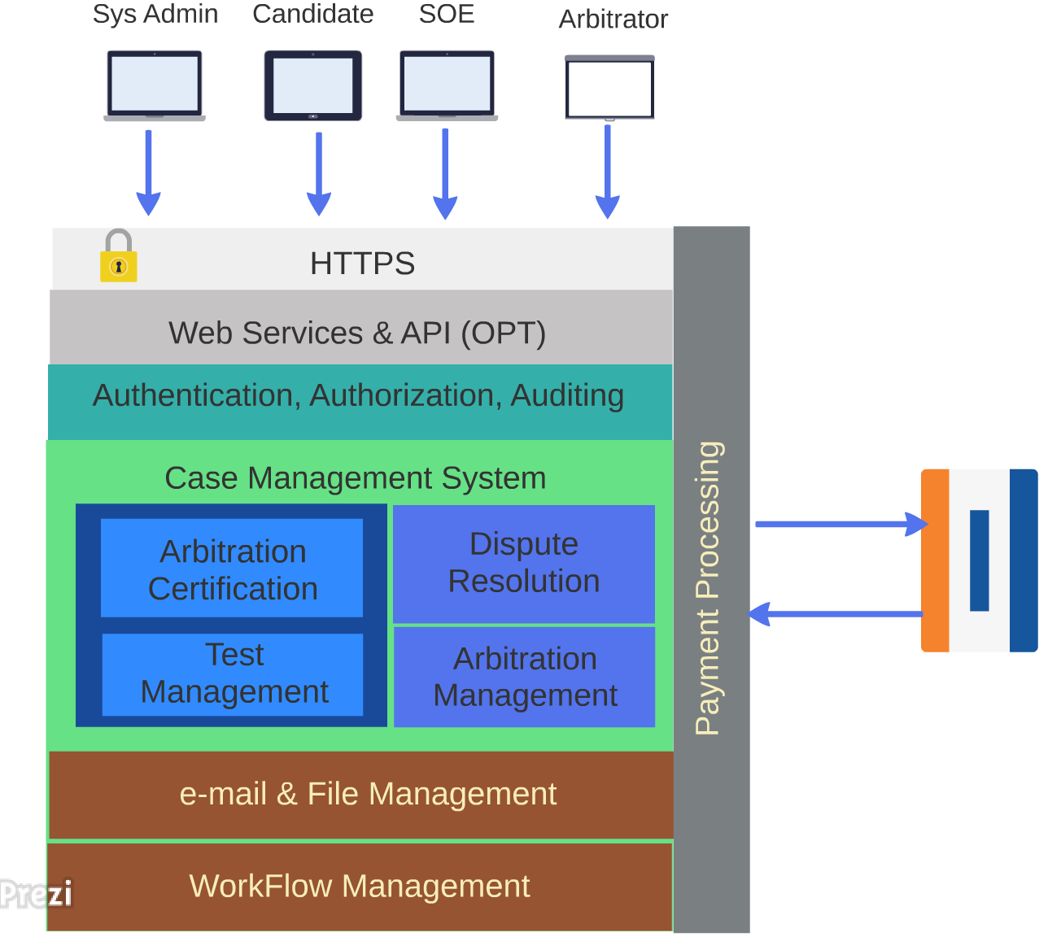
Solution Overview
System provides an Optional web service layer to integrate the application with mobile devices.
The main components of the application are
Authentication, authorization to distinguish the logged in user, auditing to track the progress of the workflow and logging for security purposes.
The case management system consist of two distinct workflows
Dispute resolution to arbitrate cases between clients
An arbitration management system for SOE to allocate and deallocate cases to arbitrators and for managing the arbitration process.
Arbitration certification for candidates and a test management and administration system.
The above workflows are build on a common framework that manages the workflow.
The system will also have a build in file management, email management system and scheduling services to sent reminder emails to concerned parties
The application is also integrated with an online payment system manage fee collection.

Slide 6
Discovery Phase – Requirements Gathering and Definition
A dedicated phase for Verbat to discuss the detailed business and technical requirements, define the solution approach and deliverables, document these and obtain mutual sign-off
Verbat proposes to deploy a senior Technical Architect and a senior Business Analyst for this phase
The phase will be completed over 10 working days
Deliverables:
Detailed requirement specifications
Wireframes for the key screens for the proposed web and mobile apps
High level technical design
Dependencies:
Availability of key stakeholders for meetings to discuss requirements and validate findings and deliverables
Written sign-off for completion, prior to commencement of the next phase

Slide 7
SOE functionality implementation
SOE Functionality for candidates
User authentication and entitlement
Create Candidate profiles and upload relevant documentation
Schedule The candidate for test and lesson plans
Fee collection from Candidates for tests and lesson plans
SOE Functionality For managing test
Create and manage objective type test questions
Create and manage Descriptive questions
Record the test results with comments
Ability to pass or fail Descriptive tests and interviews.
Test taking and test grading functionality
Manage Arbitrations
Manage arbitration cases
Ability to view arbitration cases
Assignment of cases to chief arbitrator
Ability to view case status
Ability to view the cases assigned to an arbitrator
Fee collection from clients for arbitrating cases
Authorization logic for workflow progression
Specify the commission for SOE for facilitating arbitration.
SOE will facilitate the meetings between arbitrators and clients for dispute resolution.

Slide 8
Candidate functionality implementation
Functionality for taking objective type test
Functionality to take descriptive test
Functionality to make payment for Objective type test
Functionality to receive reminder mails and status of the interview process

Slide 9

Client functionality implementation
Clients can create profile and upload documents relevant to their case
Clients will receive emails and updates on their case.
Client can make payments for case arbitration.
Clients can escalate the case to the chief arbitrator if they are not satisfied with the results of the judgement.

Slide 10
Arbitrator functionality Implementation
Chief Arbitrator Functionality
Cases will be assigned to the chief arbitrator by the SOE.
Chief arbitrator will reassign the cases to other arbitrators who are specialized in handling the case
The chief arbitrator will receive feedbacks from the arbitrators.
Chief arbitrator will assign the case to a single arbitrator pending review and feed back from other arbitrators
Once the case is resolved the chief arbitrator will relieve the assigned arbitrator from the case
The chief arbitrator may receive an escalation if the clients are not satisfied with the verdict
Assigned arbitrator functionality
Assigned arbitrators will receive an initial receipt of a case assigned to them.
The arbitrator can ignore or reject the case
Alternatively the arbitrator can accept the case for a price.
The chief arbitrator will assign the case to one arbitrator among the ones solicited for service based on the their cost as well as other parameters
The arbitrator will help the clients resolve disputes.
The results of the judgement along with meeting minutes will be recorded in the system

Slide 11
System Administration functionality
Web Portal Administration Functionalities : Support (Phase 1):
Functions around user management including authentication and entitlement for entire platform
Money changer profile management
View transaction history including quotations which are ignored, expired, missed or cancelled and successful transactions
View best buy, last buy and sell for entire platform
Online money changer on-boarding / registration
Audit/transaction logs of changes in board rates, cancelled/completed transactions, threshold settings, changes in Hard/Soft Limit
Upgrade moneychanger tiers (Gold, silver, bronze).
Manage Money changer tiers based on functionality offered (e.g. online banking, delivery service, buy back, duration – order forward)
Web Portal Super Admin (Phase 1):
View invoices by money changer
View Commissions earned by money changer
View debtors
Manage content for messages, alerts and terms
Set the default radius for customer searches

Slide 12
MyFX system features
MyFX System Features
Phase 1
Secure and encrypted communication
QR code encryption
Calculate distance between Money Changers
Phase 2
Provision for payment gateway integration
Provision for leveraging and using Market rate (FX)
Provision for myKad integration

Slide 13
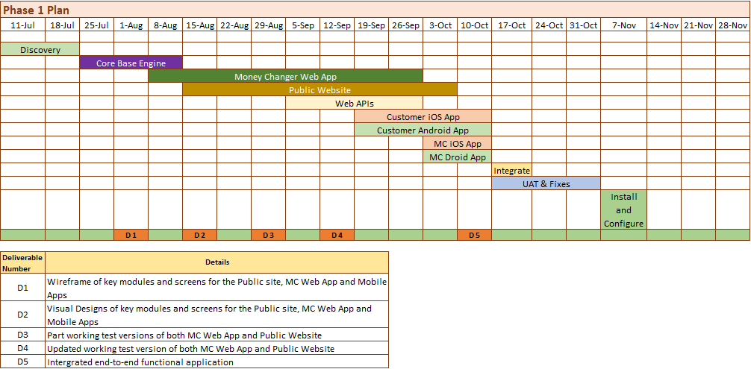
Timelines and Deliverables (July – November 2016)

Slide 14
Technology Specifications
Technology Stack:
Language - PHP
Database - MySQL
Server - Apache 2.4.9
Operating System – Linux
Native Mobile apps – iOS and Android
Server and Hosting Recommendation
Memory – 8 GB
Processors: 4 Cores
HDD Quota – 1 TB
Monthly Transfer (Bandwidth) – As required/ month

Slide 15




Thank You
3rd Floor 207 Regent Street London W1B 3HH
+44 20 8090 1461
sales.uk@eduworks.com
USA
2033 Gateway Place
Suite 500
San Jose
CA 95110
UAE
217, Sheikh Rashid Bldg.,
P.O Box 56272 Dubai
India
Level 3, PTC Tower
Nanthancode
Trivandrum – 695003
Kerala

