Slide 1

We Engineer your Digital Success
Proposal for Development of a CMS based Website for Sharp UAE
Nov 2016
© 2016. All Rights Reserved / www.verbat.com

Slide 2

Contents
1
Background & Scope
2
Technology Specification
3
Project Timeline & Deliverables
4
Commercials
5
Assumptions & Out of scope
6
Terms & Conditions

Slide 3
Background & Scope

Slide 4
Background & Scope
The client has contacted Verbat Technologies to develop a CMS based website for showing information's of their products online.
Verbat shall develop the website using PHP & CodeIgnitor . The design for the website shall be a theme based template. The web site will be developed keeping the following in mind
Content will be sourced from the existing website
Website will be developed in PHP & CodeIgnitor Framework.
Website will be developed in two phases
Phase 1 will be used to develop the content along with a blog
Phase 2 will be used to develop the customer and partners portal

Slide 5
Scope
Verbat shall develop the website with the following features:
Phase 1
Home Page
Products
Home Entertainment ( with Subcategories, product lists and product details)
Home Appliances ( with Subcategories, product lists and product details)
Healthcare ( with Subcategories, product lists and product details)
Multifunction printer ( Product lists and product details)
Professional display ( Product lists and product details)
Calculator (Product lists and product details)
Electronic Cash Register ( Product lists and product details)
Product Search
Blog
News letter subscription
Integration with Social media
Responsive design compatible with iOS, Android, Windows, Mac OSX

Slide 6
Scope
Sitemap
Site policy
Policy on Information security
About Sharp (Sharp History, Philosophy, Environmental & CSR , Corporate Profile, MD Message)
News & Events (updatable with new events and news)
Contact us (Regional Head Office, Service center location, Careers, Feedback)
Page/Content Creation
Phase 2
Customer Portal
Customer Login
Product Registration
Product Search ( specifications and data sheets)
Partners Portal
Partner Login
Training Videos
File sharing

Slide 7
Technology Specification

Slide 8
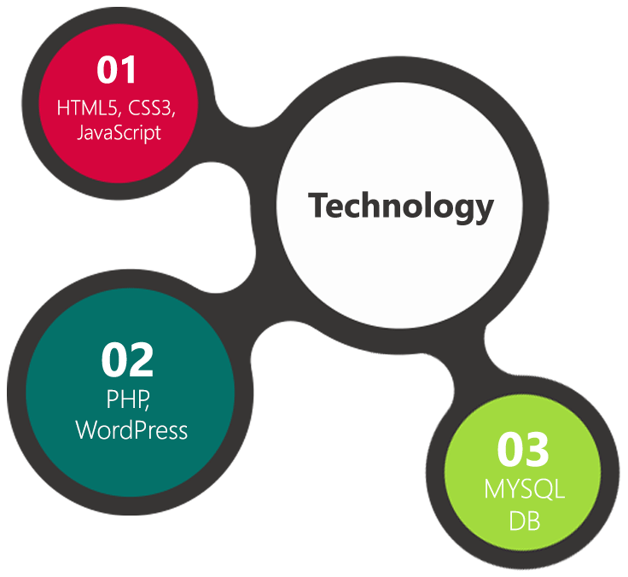
Technology Specifications
Technology Stack
Application Framework – PHP, CodeIgnitor
Database – My SQL
Server – Apache
Operating System – Linux
Server and Hosting
HDD Quota – 50 GB
1 GB Backup Storage
25K Visit per month
128 Bit SSL

Slide 9
Project Timeline & Deliverables

Slide 10
Project Timeline & Deliverables
The time estimated for delivering the application is 30 working man days
Activity | Phase | Effort (Man Days)
Finalizing and purchase of Word press Theme & Images | Phase 1 | 20
Customization of WordPress Theme
Theme Integration & Page Creations
Page/Content Creation
Quality Analysis (QA)
UAT Support & Implementation, Live
Customer Login | Phase 2 | 10
Product Registration
Product Search ( specifications and data sheets)
Partner login
Training Videos
File Sharing
Multi lingual site
Deliverables
Phase 1
Selection & Purchase of WordPress Template
Fully developed and tested Website for deployment
Phase 2
Customer Portal
Partner Portal
Multilingual options

Slide 11
Commercials

Slide 12
Commercials
Website Development
Sl. | Description | Cost
01. | Development of CMS based Website in WordPress (Phase 1) | AED 0,000
02. | Development of CMS based Website in WordPress (Phase 2) | AED 0,000
03. | Annual Maintenance Contract | AED 0,000
04 | Purchase WordPress theme* | AED 0,000
*Price of the WordPress theme will vary depending on the functionality

Slide 13
Assumptions & Out of Scope

Slide 14
Assumptions
Website shall be done using WordPress Theme. Verbat shall purchase the template agreed and signed off by the client
Client will provide the branding guidelines
Client shall purchase the domain name
If client is providing the server for hosting, it shall adhere to the server & hosting specification
Client will purchase plugins for - Customer Portal, Partners Login & multilingual options
Client will furnish Verbat with the relevant content & images in the specified size and resolution as needed for the website
Blog & events will be updated by the client
Any extended or additional features that are over and above the “out of the box functionality” of the selected theme will be considered as additional effort, unless the appropriate plugins are purchased by the client

Slide 15
Out of Scope
Any language other than English (in phase 1)
Backup solution and Disaster recovery for hosting
No Emails with the hosting
Content / News writing

Slide 16
Terms & Conditions

Slide 17
Terms & Conditions
Offer Valid for 30 calendar days from the date of submission of the Proposal
An average of 20 working days are assumed in a month
This proposal and all technical/ functional specifications have been derived or concluded from the data shared via email / information's transferred during the initial requirement analysis meetings and conversations. Verbat reserves the right to amend the terms of this proposal, should the SOW terms, functional features and functionalities change during the course of the project
The website will be built as per the specifications agreed mutually. Any changes will be executed through a deﬁned change management process between both parties
All Source Code and other project artefacts would adhere to the Verbat document templates and internal coding standards
Acceptance criteria will be based on the clauses which were mutually discussed between Verbat and client at the Requirement Analysis phase and the same will be documented and approved by both parties through official emails
Final deployment to Live server pursuant to completion of all payments

Slide 18



Contact Us
217, Sheikh Rashid Bldg
P.O Box 56272, Dubai United Arab Emirates
+971 04 2973236
joyce.daniel@verbat.com
USA 2033 Gateway Place
Suite 500
San Jose , CA- 95110
India
Level 3, PTC Tower
Nanthancode Trivandrum, Kerala

Slide 19

Thank You
© 2016. All Rights Reserved Verbanet Technologies LLC www.verbat.com

