Slide 1

We Engineer your Digital Success
Proposal for Development of a CMS based Website
Nov 2016
© 2016. All Rights Reserved / www.verbat.com

Slide 2

Contents
1
Background & Scope
2
Technology Specification
3
Project Timeline & Deliverables
4
Commercials
5
Assumptions & Out of scope
6
Terms & Conditions

Slide 3
Background & Scope

Slide 4
Background & Scope
The client has contacted Verbat Technologies to develop a CMS based website for showing information's of their products online. The site will have different pages depicting about the company, technologies & products.
Verbat shall develop the website using WordPress CMS. The design for the website shall be a theme based WordPress template. The template shall be chosen by the client and shall be purchased which will be integrated for displaying the informations.

Slide 5
Scope
Verbat shall develop the website with the following features:
Homepage
Simple Search
Advanced Search ( By Category, Venue, Month, Year )
Generic pages
About us ( About Us, Our Clients, Accreditations, In House Seminars, Testimonials, FAQ’s )
Training Tools ( Training seminars by dates, categories & Venues )
Articles ( Multiples Listed from database )
Press Release ( Multiples Listed from database )
Careers ( Opportunities, Instructors )
Contact Us ( Contact us, Course enquiry, Hotel Reservation, mailing List, Feed Back )
Training Categories
Management (7 Subcategories)
Functional ( 4 Subcategories)
Technical ( 6 Subcategories
Others (4 Subcategories)

Slide 6
Scope Continued…
Training Venues
Asia (4 Subcategories )
Europe ( 9 Subcategories )
North America ( 5 Subcategories )
Middle East ( 7 Subcategories )
Africa ( 1 Subcategories )
Training Calendar
Professional Certificates ( 6 Subcategories )
Others
Trusted By ribbon
New Menu Structure
Social Media Integration
Search Engine Optimization
Better visual appeal & easier to find information
Arabic Version of site

Slide 7
Scope Continued…
Course Registration Page
Course Details page ( Title, Course instance list, Introduction, Objectives, Training methodologies, Personal impact, Who should attend, Day Wise Seminar outline , Assessment, Accreditation, In Association, Share Seminar )
Course Details Page ( Send to Colleague, Print, Download )
Related Courses Blurb for detailed description of courses
Course Creation Page
Course / Site testimonials
Payment Gateway integration (TBD)
Tools ( Training Seminars by Date, Category, Venue )

Slide 8
Technology Specification

Slide 9
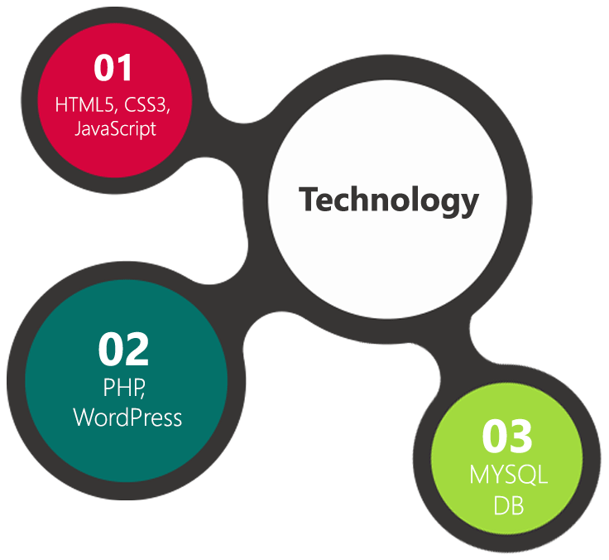
Technology Specifications
Technology Stack
CMS – WordPress
Database – My SQL
Server – Apache
Operating System – Linux
Server and Hosting
WordPress Cloud Hosting
HDD Quota – 50 GB
1 GB Backup Storage
25K Visit per month
128 Bit SSL

Slide 10
Project Timeline & Deliverables

Slide 11
Project Timeline & Deliverables
The time estimated for delivering the application is 08 working man days
Activity | Effort (Man Days)
Finalizing and purchase of Word press Theme & Images | 08
Customization of WordPress Theme
Theme Integration & Page Creations
Content Upload
Quality Analysis (QA)
UAT Support & Implementation, Live
Deliverables
Selection & Purchase of WordPress Template
Content upload
Fully developed and tested Website for deployment

Slide 12
Commercials

Slide 13
Commercials
Website Development
Sl. | Description | Cost
01. | Development of CMS based Website in WordPress | AED 0,000

Slide 14
Commercials
Hosting (Yearly)
Sl. | Description | Cost
01. | Hosting of the Application in WordPress Cloud Server including 50 GB Quota 1 GB Backup Hack Alert 128 Bit SSL | AED 3,000

Slide 15
Assumptions & Out of Scope

Slide 16
Assumptions
Website shall be done using WordPress Template. Verbat shall purchase the template agreed and signed off by the client
Client need to provide licensed images in specified size & format
Client will provide the branding guidelines
Client shall purchase the domain name
If client is providing the server for hosting, it shall adhere to the server & hosting specification

Slide 17
Out of Scope
Any language other than English
Database migration
Physical deployment at client’s site
Backup solution and Disaster recovery for hosting
No Emails with the hosting
Content writing
Annual Maintenance Contract
Theme customization (Layout & Element Placements)

Slide 18
Terms & Conditions

Slide 19
Terms & Conditions
Offer Valid for 30 calendar days from the date of submission of the Proposal
An average of 20 working days are assumed in a month
This proposal and all technical/ functional specifications have been derived or concluded from the data shared via email / information's transferred during the initial requirement analysis meetings and conversations. Verbat reserves the right to amend the terms of this proposal, should the SOW terms, functional features and functionalities change during the course of the project
The website will be built as per the specifications agreed mutually. Any changes will be executed through a deﬁned change management process between both parties
All Source Code and other project artefacts would adhere to the Verbat document templates and internal coding standards
Acceptance criteria will be based on the clauses which were mutually discussed between Verbat and client at the Requirement Analysis phase and the same will be documented and approved by both parties through official emails
Final deployment to Live server pursuant to completion of all payments

Slide 20



Contact Us
217, Sheikh Rashid Bldg
P.O Box 56272, Dubai United Arab Emirates
+971 04 2973236
Lekshmi.krishna@verbat.com
USA 2033 Gateway Place
Suite 500
San Jose , CA- 95110
India
Level 3, PTC Tower
Nanthancode Trivandrum, Kerala

Slide 21

Thank You
© 2016. All Rights Reserved Verbanet Technologies LLC www.verbat.com

