Slide 1

Core Concepts of the Standards 2019 Prof. Emad Abuelrub, Commissioner Commission for Academic Accreditation Ministry of Education, UAE June 2019

Slide 2

Outline
Background
Figures and Numbers
Terms of Reference
New Concepts
CAA Task
The Standards 2019
Risk Based Assessment
Sanctions and Fines
Establishing New Institutions
Closing an Institution

Slide 3
Background
2019 6th Edition of the Standards
2018 Unpublished Edition of the Standards
2011 5th Edition of the Standards
Procedural Guidlines
2009 Standards for VET
2007 4th Edition of the Standards
e-Learning Standards
2005 3rd Edition of the Standards
2003 2nd Edition of the Standards
2001 1st Edition of the standards

Slide 4
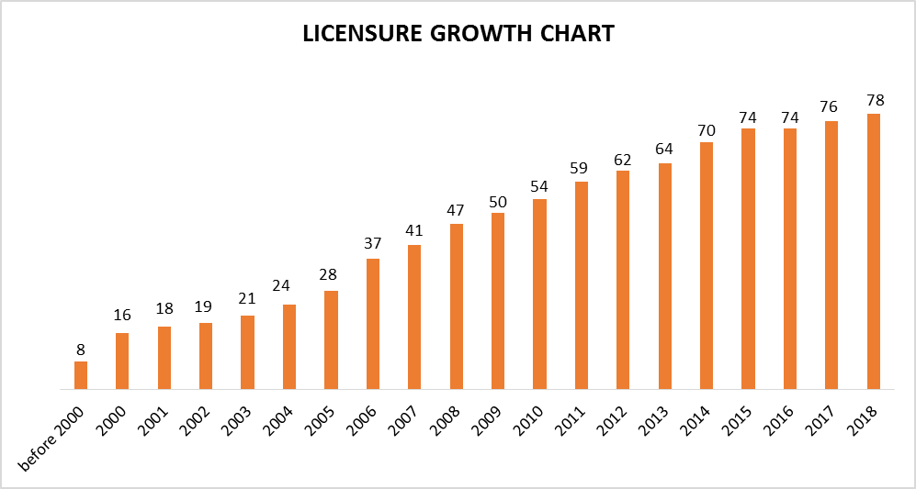
Figures and Numbers

Slide 5
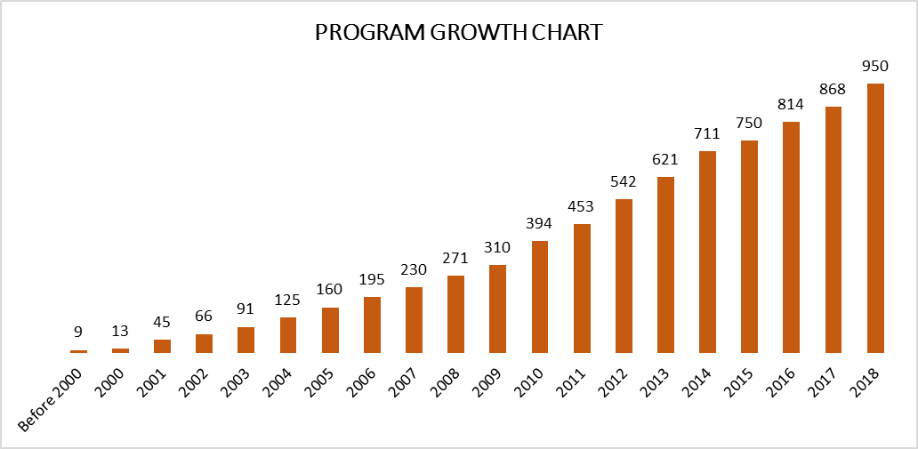
Figures and Numbers

Slide 6
Figures and Numbers

Slide 7
Terms of Reference
Concise statements for the 11 Standards.
Set of Standards (7) to focus on during Institutional Licensure (Standards for Institutional Licensure - SIL).
Set of Standards (6) to focus on during Program Accreditation (Standards for Program Accreditation - SPA).
Move details into Stipulations and Annexes.
Introduce new concepts
Introduce the Supplementary Guidance and related updated Guides: 4 Procedural Manuals, Guide for ERT, Extracts from QFEmirates, and Guide to Writing LOs; as well as the CAA Policies and Procedures Manual.

Slide 8
New Concepts
Risk Assessment
Establishing New Institutions
Closing Institutions and Programs
Sanctions
Concerns
Appeals
Financial Aspects
Fines
Criteria for Teaching Hospitals/Healthcare Units
Program Specifications
Joint Degree Programs
RPL
e-Learning
Continuous Education and Lifelong Learning
International Accreditation

Slide 9
CAA Task
Stage 0: Pre-phase, Feedback, and Consultation (2016-2018)
Stage 1: Producing the Main Standards Documents (2019)
The Standards for Institutional Licensure and Program Accreditation
7 Standards for Institutional Licensure (SIL)
6 Standards for Program Accreditation (SPA)
Supplementary Guidance to the Standards

Slide 10
CAA Task
Stage 2: Producing the Four Procedural Manuals (2019)
Procedural Manual for Initial Institutional Licensure
Procedural Manual for Renewal of Institutional Licensure
Procedural Manual for Initial Program Accreditation
Procedural Manual for Renewal of Program Accreditation

Slide 11
CAA Task
Stage 3: Updating Related Guides (2019)
Guide for External Review Teams
Extracts from QFEmirates: A Guide for External Review Teams
Guide to Writing Learning Outcomes at Program and Course Level that Align with QFEmirates
CAA Policies and Procedures Manual

Slide 12
The Standards 2019
Standards / Stipulations
Governance and Management
Quality Assurance
Educational Programs
Research and Scholarly Activities
Faculty and Professional Staff
Students
Health, Safety and Environment
Learning Resource Center
Fiscal Resources, Financial Management and Budgeting
Legal Compliance and Public Disclosure
Community Engagement

Slide 13
Annexes
Annex 1: Substantive Change at Institutional Level
Annex 2: By-Laws of the Governing Body
Annex 3: Policies and Procedures Manual
Annex 4: Catalog
Annex 5: Faculty Manual
Annex 6: Staff Manual
Annex 7: Student Handbook
Annex 8: Quality Assurance Manual
Annex 9: Feasibility Study, Financial Analysis and Timed Action Plan
Annex 10: Program Specifications
Annex 11: Joint Degree Programs
Annex 12: Guidelines for Good Practice in Internships or Practicums

Slide 14
Annexes … continue
Annex 13: Course Syllabi
Annex 14: Intensive Courses and Block Delivery
Annex 15: Courses Taught Through e-Learning
Annex 16: Course files
Annex 17: Substantive Change at Program Level
Annex 18: Adjunct Clinical Faculty
Annex 19: Equivalent Scores on Approved Tests of English Language Proficiency
Annex 20: Recognition of Prior Learning
Annex 21: Criteria for Teaching Hospitals/Healthcare Units within the UAE
Annex 22: Website Content
Annex 23: Glossary of Terms

Slide 15
Structure of the Standards
No | Standards | 2011 |  | 2019
 |  | Institutional | Program | Institutional | Program
1 | Governance and Management | √ | √ | √
2 | Quality Assurance | √ | √ | √ | √
3 | Educational Programs | √ | √ |  | √
4 | Research and Scholarly Activates | √ | √ | √ | √
5 | Faculty and Professional Staff | √ | √ |  | √
6 | Students | √ | √ |  | √
7 | Health, Safety, and Environment | √ | √ | √
8 | Learning Resource Center | √ | √ |  | √
9 | Fiscal Resources and Financial Management | √ | √ | √
10 | Legal Compliance and Public Disclosure | √ | √ | √
11 | Community Engagement | √ | √ | √

Slide 16
Supplementary Guidance to the Standards
Sections
Introduction
Organization and Regulatory Standards
The National Register (licensed institutions and accredited programs)
CHEDS Data (collection and utilization guidance)
Risk Based Assessment
Opening a New Institution
Institutional Review
Program Review
Concerns about an Institution
Sanctions
Closing an Institution or Terminating a Program
Appeals
Financial Obligations

Slide 17
Supplementary Guidance to the Standards
Annexes
Annex 1: Risk Evaluation Metric
Annex 2: Membership and Orientation of ERTs
Annex 3: Review Schedule
Annex 4: Issues that can be Investigated
Annex 5: Violations, Sanctions, and Penalties
Annex 6: Business Process Models for CAA Activities

Slide 18
Risk Based Assessment
A new addition to the Standards 2019 is the introduction of a ‘risk-based approach’ to institutional licensure and program accreditation that is embedded within the Licensure Review and conducted by the ERT.
Purpose:
To provide a quantitative indicator of the risk of failure within the operational risk areas of strategic, operational, legal and financial, academic, and international dimensions.
To identify the degree to which the institution is actually fulfilling the academic needs of the Emirates in producing knowledgeable, skilled and competent, employable graduates.

Slide 19
Sanctions and Fines
1) Sanctions
Official Warning
Public Warning
First Probation
Second Probation
Revocation of Program Accreditation or Licensure

Slide 20
2) Fines
* Note: Partial activation of financial guarantee.
a. Institutional Level
Sanction | Penalty
Official Warning | AED 50,000
Public Warning | AED 100,000
First Probation | AED 200,000
Second Probation | AED 400,000
Revocation of Licensure * | AED 1,000,000 (minimum depending on number of students)

Slide 21
* Note: Partial activation of financial guarantee.
b. Program Level
Sanction | Penalty per Program
Official Warning | -
Public Warning | AED 10,000
First Probation | AED 20,000
Second Probation | AED 40,000
Revocation of Program Accreditation * | AED 100,000 (minimum depending on number of students)

Slide 22
Establishing New Institutions
Initial Process to establish a new HEI prior to submitting Application for Initial Institutional Licensure to CAA.
Proposal for Pre-Approval Stage will be covered in a later presentation.

Slide 23
Guidelines for Establishing New Institutions
Table 1: Recommended student to faculty ratios per type of program
Program Type | Recommended Student to Faculty Ratio
Doctoral | 5:1
Master’s or Higher Diploma | 10:1
Undergraduate | 10:1 (medical programs) 15:1 (other clinical health science programs) 20:1 (other lab- and studio-based programs) 25:1 (non-lab based)
General Education | 30:1
Table 2: Indicative financial guarantee values – no cash reserve (equivalent to one year of operation at peak)
Number of Students | Amount
< 500 | AED 10 million
500 to 1000 | AED 20 million
1000 to 2000 | AED 40 million
> 2000 | AED 100 million

Slide 24
Closing an Institution
Recommendation from the Director of the CAA to the Minister of Education based on recommendations of the Council of Commissioners and ERT.
Consultation with the Legal Affairs at the MoE.
The Minister of Education issues a Ministerial Decree to close the institution.
The Minister of Education forms a Special Committee to supervise the Closing Process.
The MoE secures student’s records.
Activation of financial guarantee.
Activation of the Teach-out Policy

Slide 25
Thank you!

