Slide 1


PROPOSAL
INTEGRATED HIGHER EDUCATION PLATFORM
FOR
MINISTRY OF EDUCATION
HIGHER EDUCATION AFFAIRS
UNITED ARAB EMIRATES
MINISTRY OF EDUCATION

Slide 2

EXECUTIVE SUMMARY
Design, Development and Implementation of an
Integrated Higher Education Platform
(Systems & Smart Services)
Overall system requirement analysis and assessment of the operating model, to develop seamless integrated platform
“
Integrated Higher Education Platform of new operational systems, eservices portal and smart services to support MOEHEA business operation.
.
“

Slide 3






UNIFIED PLATFORM MODEL
SERVICES
PLAN, BUDGET, MEASURE
STUDENT
TEACHER
UNIVERSITY
INSTITUTE
INTERNAL PROCESSES
INTEGRATION

Slide 4

CUSTOMER SERVICES PLATFORM
A
01
EQUIVALENCY & ATTESTATION
05
SCHOLARSHIPS
B
02
STUDENT REGISTRATION &
COUNSELLING
06
EVALUATION & QUALITY
C
03
GRADUATE AFFAIRS
LICENSING & ACCREDITATION
07
D
04
TEACHER LICENSING
E
08
SCIENTIFIC RESEARCH

Slide 5

APPLICATION FOR A SERVICE
PLAN & BUDGET CONTROL
....................................................................
01
.........................................................
02
INTERNAL COMMITTEE REVIEW
RESPONSIBILIY ASSIGNMENT
.............................................
03
ACTION & NOTIFICATION
...................................
04

Slide 6
...................................
01
KPIs & STATISTICS
SEARCH & RETRIEVE
.............................................
02
VARIANCE ANALYSIS
.........................................................
03
CATALOG & INDEXING
....................................................................
04
INTEGRATED STATISTICS ENGINE

Slide 7

TECHNICAL
RECOMMENDATIONS
A
B
INTEGRATION METHODOLOGIES
TECHNICAL SYSTEM CONSIDERATIONS
ECO SYSTEM
C
D
SUPPORT &
HANDOVER
SCALABILITY
E

Slide 8
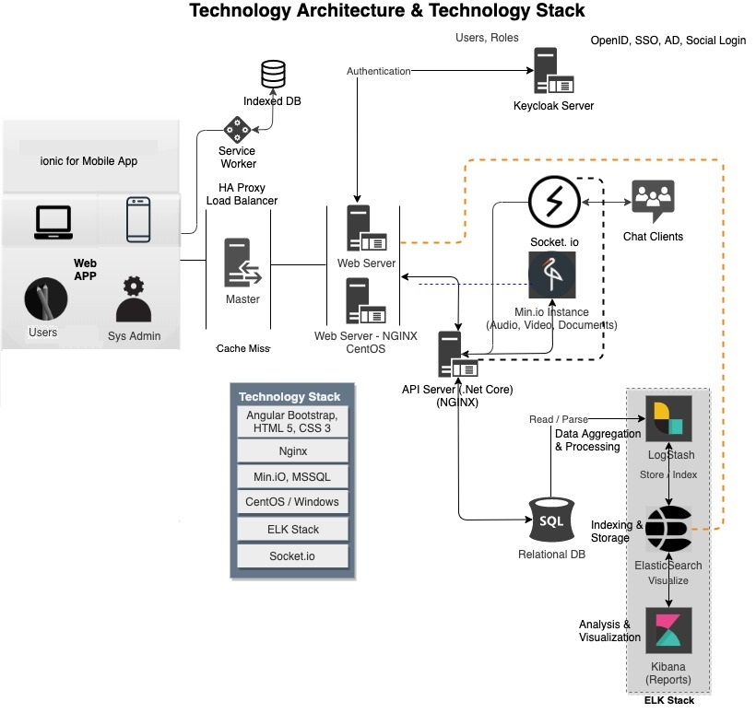
A
C
E

Slide 9

KEY ACTION PLAN
BUSINESS REVIEW &
REQUIREMENT ANALYSIS
DEVELOP IMPLEMENTATION ROADMAP
ROLL OUT & SUPPORT
01
02
03
04
05
DETAILED DESIGN OF INTEGRATED PLATFORM
BUILD, TEST & DELIVER

Slide 10

PROJECT CHARTER
PROJECT MANAGEMENT PLAN
BUSINESS REQUIREMENTS DOCUMENT
DESIGN PROTOTYPE
KEY DELIVERABLES
SPRINT SRS
TESTING & TRAINING
PLATFORM DEPLOYMENT
POST GO LIVE SUPPORT
PROJECT STATUS REPORTS
RISK / ISSUE / ACTION LOG

Slide 11
PROJECT TEAM LEADS
BUSINESS ANALYSIS CONSULTANT
PROJECT MANAGER
IT CONSULTANT
MANAGEMENT CONSULTANT WITH 20+ YEARS OF EXTENSIVE EXPERIENCE
CERTIFICATIONS
CMA CERTIFIED MANAGEMENT ACCOUNTANT, AUSTRALIA
SIX SIGMA GREEN BELT
AREAS OF EXPERTISE
PROCESS IMPROVEMENT – CMM & LEAN STRATEGIES
MANAGEMENT CONSULTANCY
BUDGET PLANNING, MONITORING AND CONTROL
PROJECT MANAGEMENT AND OPERATIONS PROFESSIONAL WITH OVER 21+ YEARS’ OF EXPERIENCE
CERTIFICATIONS
PFMP®, PMI®, PMP®, PMI® , PSMI (SCRUM MASTER), PMOC, CGEIT® , ITIL V3 , COBIT® AREAS OF EXPERTISE
PROJECT & PROGRAMME MANAGEMENT
AUDIT & ASSESSMENTS
PROCESS MAPPING & DESIGN
ENTERPRISE WIDE IMPLEMENTATIONS
REQUIREMENTS & ROI ANALYSIS
TECHNOLOGY PROFESSIONAL WITH OVER 18+ YEARS’ OF EXPERIENCE
CERTIFICATIONS :
BTECH, MBA, PMP AREAS OF EXPERTISE:
ENTERPRISE LEADERSHIP/DIRECTION FOR IT SYSTEMS
FULL STACK APPLICATION DEV
DATA ANALYTICS
BUSINESS INTELLIGENCE (BI)
BUSINESS PROCESS ROLLOUT
PROJECT MANAGEMENT
BUSINESS SYSTEMS INTEGRATION
DATA VISUALIZATIONS

Slide 12





Globally Accredited Software Consultation Partner
IT Strategy, Application Development, Maintenance and Testing Services, Information Management, Digital Marketing
WHY VERBAT
Verbat is a Digital Technology Services company with over 19+ years of experience in delivering Internet and Mobile Solutions to Enterprises, through Agile Development and Application Management Methodologies
Nearly two decades of development experience to Global Corporates and Government
Domain specialists in Finance, Retail, Logistics, Construction, Fashion, Manufacturing, Hospitality, Automotive, Government & Healthcare
Spearheaded by a team of Technology and Management Leaders

Slide 13
[
[
Q A
&

Slide 14



At Verbat, we are committed to make IT services a pleasant experience. As such we always welcome your enquires, feedback and suggestions
Let’s Hear From You
Get in Touch
217, Sheikh Rashid Building PO Box 56272, Dubai
+971 4 2973236
USA 600 Eagle View Blvd, Suite 300
Exton Pa 19341
INDIA Level III, PTC Tower, Nanthancode, Trivandrum, Kerala
Hashim.haleem@verbat.com

Slide 15
A VERBAT
THANK YOU
PRESENTATION

