Slide 1

We Engineer your Digital Success
Proposal for Development of a Loyalty Program for Mentis
Aug 2016
© 2016. All Rights Reserved / www.verbat.com

Slide 2

Contents
1
Background & Scope
2
Solution Overview & Application Workflow
3
Application Functionality
4
Discovery Phase
5
Application Delivery
6
Technology Specification
7
Project Timeline & Deliverables
8
Commercials
9
Assumptions
10
Out of scope
11
Terms & Conditions

Slide 3
Background & Scope
Mentis specializes in world-class assessment, training, coaching and development programs - offering targeted solutions to meet your needs. Our services cover all organizational levels, from designing and delivering graduate development to coaching and advising at CEO and Board level. It’s all about predicting performance and identifying potential. Mentis values long-term client relationships. We believe that with an in-depth understanding of your requirements we can provide meaningful results. Our services are available throughout the UK, Europe and the Middle East and ASEAN regions
Scope
Verbat is proposing to develop a Loyalty Program for Mentis that will facilitate Mentis to provide an incentive based discount program to customers based on their service tiers. The loyalty program will enable customers to have advanced access to make discount purchase off of products as well as avail offers to receive free merchandise.

Slide 4
Scope
The proposed application will consist of the following modules
Administration
Users and user groups
Roles and Entitlements
Raise Invoices
Generate reports
Support
Application Maintenance
Customer & Technical Support
Application configuration
Lead Generation & inbound marketing
Other functions TBD
Customer
View transactions
Redeem vouchers & offers
Choose Loyalty program (Platinum, Gold, Silver)

Slide 5
Solution Overview & Application Workflow

Slide 6
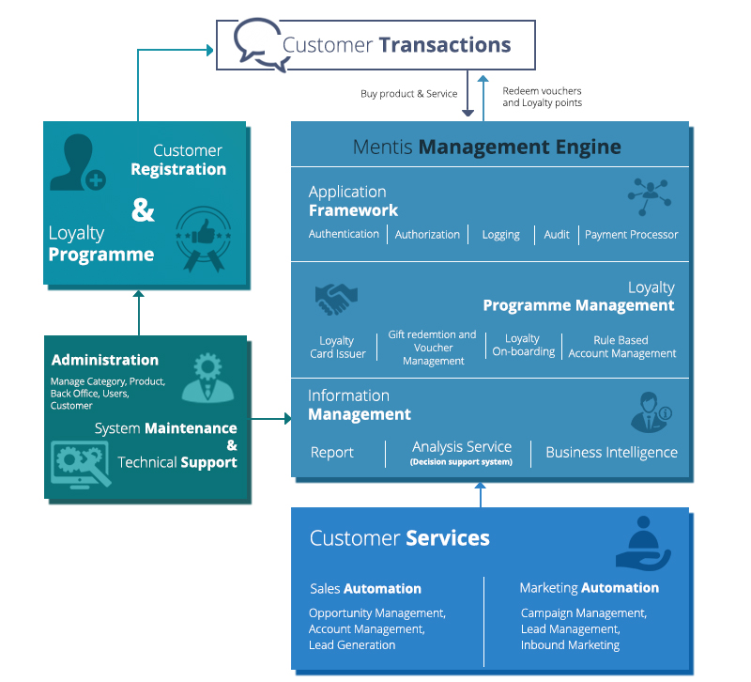
Solution Overview
Customer Registers and opts for loyalty program
Mentis Management engine is comprised of
Application Framework
Loyalty Program Management (LPM)
Information management
Application Framework consist of User authentication, authorization, application auditing & logging with payment processor integration
LPM manages the Loyalty card issuance & tracking, Gift voucher redemption and voucher management, Customer onboarding for the loyalty program and rule based account management of the loyalty program
Information management provides business intelligence, reporting services and the analysis supports through decision support systems
Customer service activities including sales and marketing automation are capabilities that Verbat has a proven track record and can provide value added services (optional)
System administrator manages the general operation of the site. Verbat will provide all the necessary utilities and scripts to ensure business continuity and smooth day to day operations

Slide 7



Application Work Flow
START
START
START
Portal registration and program Selection
Opportunity Management
Application Management
(users, products etc.)
Purchase products and receive coupons and discounts based on Loyalty group
Support
Inbound marketing & lead generation
Technical Support
&
System Maintenance
View Transactions and redeem offers & vouchers
Market analysis & campaign Management
Manage loyalty programs and generate Management reports
Administrator
STOP
STOP
STOP
Customer
Customer Service

Slide 8
Application Functionality

Slide 9
Feature Details
Mentis Core Engine Services
Core services : Authentication, Authorization, Logging, Auditing, Payment Gateway Integration
Loyalty program Engine: Loyalty card Issuer, Loyalty program management, Loyalty Onboarding, Rule based account management
Information Management: Reports, Analytics, Business Intelligence
Customer Service (Optional)
Sales Automation: Lead Generation, Opportunity Management, Account Management, Sales Analytics
Marketing Automation: Campaign Management, Market Analysis, inbound marketing
Administration
Manage: categories, products, customers, back office users, Loyalty programs
System maintenance, Technical support, Reports
Customers
Registration, Loyalty program selection, coupon redemption, Reports,

Slide 10
Discovery Phase

Slide 11
Requirements Gathering
On signing the contract, Verbat will deploy a senior Business Analyst to discuss the business and technical requirements, define the solution approach, deliverables during each phases of execution, documentation and sign-off
Deliverables
Detailed requirement specification document
Wireframes for the key screens for the proposed application
Dependencies
The client to nominate a Point of contact to coordinate with our team
Availability of key stakeholders for meetings to discuss requirements and validate findings and deliverables
Written sign-off on the deliverables prior to commencement of the development phase

Slide 12
Application Delivery

Slide 13
Application Delivery
Application will be delivered in three phases. Development will start post approval and sign-off of the Software Requirements Specification (SRS) by the client. The deliverables for each phase is listed below.
Phase 1 Design
Project plan
SRS & Functional Specification
Wire frames for key screens
Phase 2 Development
Mentis core engine
Administration module
Customer registration and loyalty onboarding
Customer support and services (optional)
General pages
Phase 3 Testing
QA
UAT
Phase 4 Go Live
Application deployment
Application configuration

Slide 14
Technology Specification

Slide 15
Technology Specifications
Recommended System Requirements
Database – MS SQL 2008 and above
Operating System – Windows 7 & above with .Net Framework 3.5 and above

Slide 16
Project Timeline & Deliverables

Slide 17
Project Timeline & Deliverables
The time estimated for delivering the application is 39 working man days
Activity | Phase | Effort (Man Days)
Initiation | Phase 1 | 9
Requirement Gathering Complete and Sign-Off
Software requirement Specification & functional Specification
UI Design
Database Design
Development Start | Phase 2 | 19
Application Framework
Administration
Customer registration and on boarding
General information pages
Mentis Core Engine Services
Code Review
QA & Deployment | Phase 3 | 11
QA
UAT
Deployment & Go Live
Deliverables
Software Requirement Specification (SRS)
Functional Specification
Low level design
Wireframes for the key screens
Fully developed and tested application for deployment

Slide 18
Commercials

Slide 19
Commercials
Sl. | Description | Cost
01. | Development of Mentis Loyalty Program (MLP) | USD 00,000

Slide 20
Assumptions

Slide 21
Assumptions
Web Services for the following will be provided by the client
Web Services/API and the detailed documentation for
User Authentication
Payment Request Initiation
Payment Authentication & Authorization
The client will also provide
Logo
UI Design Guidelines
Testing Cards and the PIN number.
Required working device with SDK

Slide 22
Out of Scope

Slide 23
Out of Scope
Any other language other than English
Manual data entry
Integration with other payment processors
Integration with any other systems other than those specified in the Scope
Physical installation at the client site

Slide 24
Terms & Conditions

Slide 25
Terms & Conditions
Offer Valid for 30 calendar days from the date of submission of the Proposal
An average of 20 working days are assumed in a month
This proposal and all technical/ functional specifications have been derived or concluded from the data shared via email / information's transferred during the initial requirement analysis meetings and conversations. Verbat reserves the right to amend the terms of this proposal, should the SOW terms, functional features and functionalities change during the course of the project
The applications will be built as per the specifications agreed mutually. Any changes will be executed through a deﬁned change management process between both parties
All Source Code and other project artefacts would adhere to the Verbat document templates and internal coding standards
Verbat will provide a bug ﬁx warranty at no additional cost for 30 days from the date of acceptance of the project, for correction of any errors in the developed application that may be attributed to Verbat
Acceptance criteria will be based on the clauses which were mutually discussed between Verbat and client at the Requirement Analysis phase and the same will be documented and approved by both parties through official emails

Slide 26



Contact Us
217, Sheikh Rashid Bldg
P.O Box 56272, Dubai United Arab Emirates
+971 04 2973236
Lekshmi.krishna@verbat.com
USA 2033 Gateway Place
Suite 500
San Jose , CA- 95110
India
Verbat Technologies (India) Pvt. Ltd. Level 3, PTC Tower Trivandrum, Kerala

Slide 27

Thank You
© 2016. All Rights Reserved Verbanet Technologies LLC www.verbat.com

