Slide 1


Prepared by,
Ratheesh V S
PROSUM Technologies LLC
January 2016
Integrated Payments Solution

Slide 2
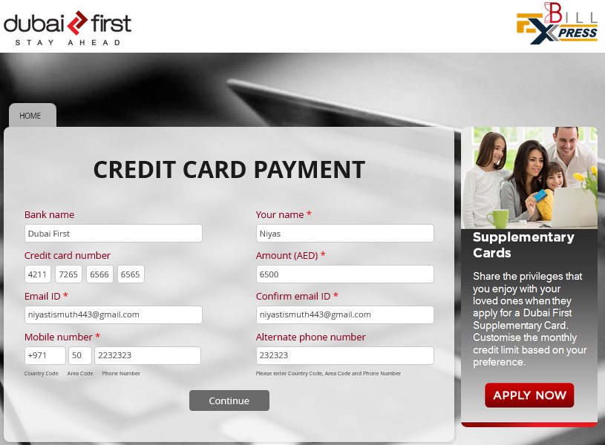
Screenshots – CC Bill Payment

Slide 3
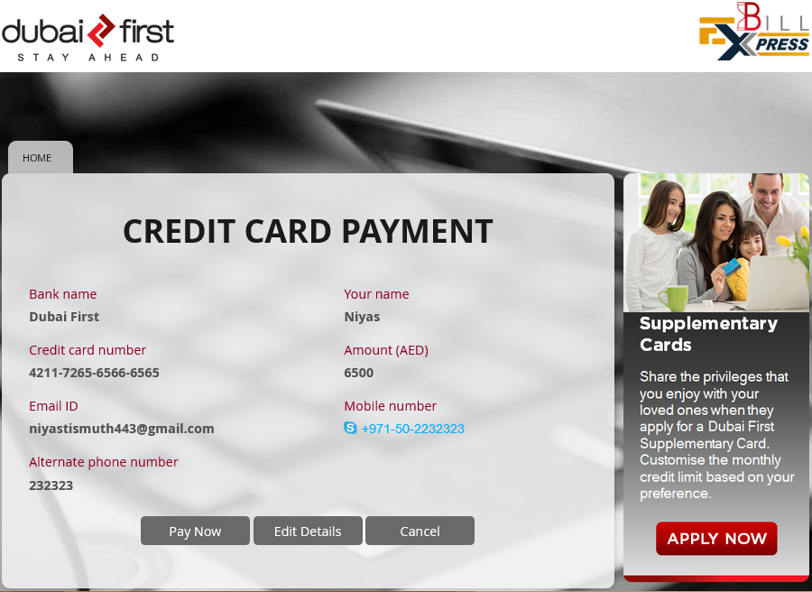
Screenshots – CC Bill Payment
Credit card bill payment transaction

Slide 4
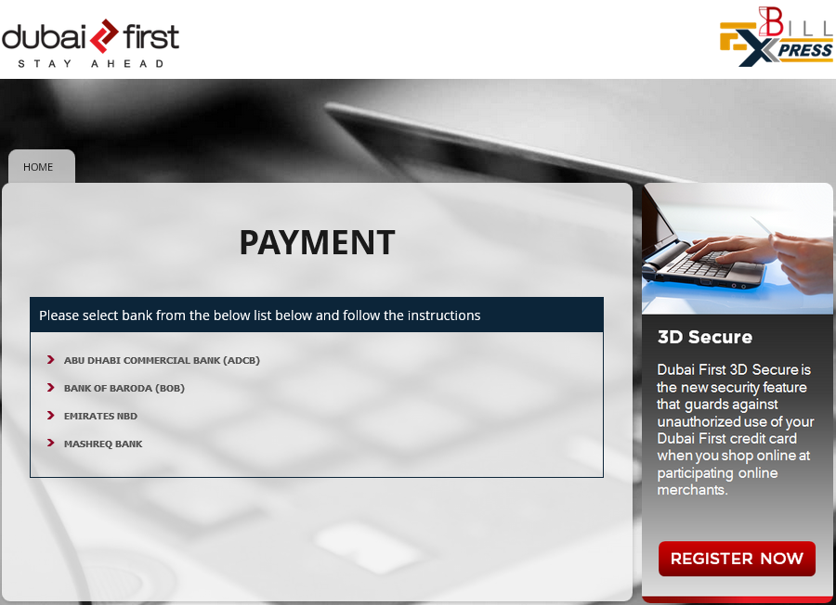
Screenshots – CC Bill Payment
Credit card bill payment transaction

Slide 5
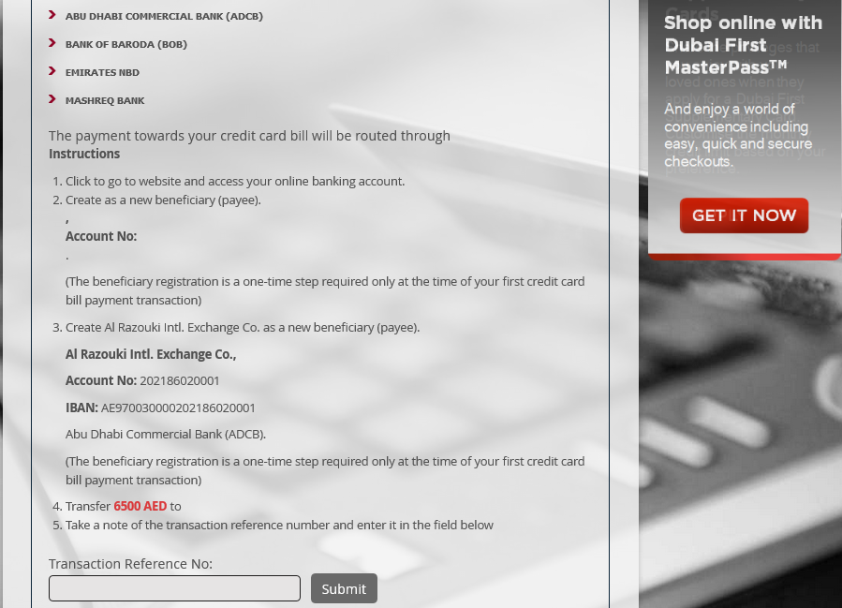
Screenshots – CC Bill Payment

Slide 6
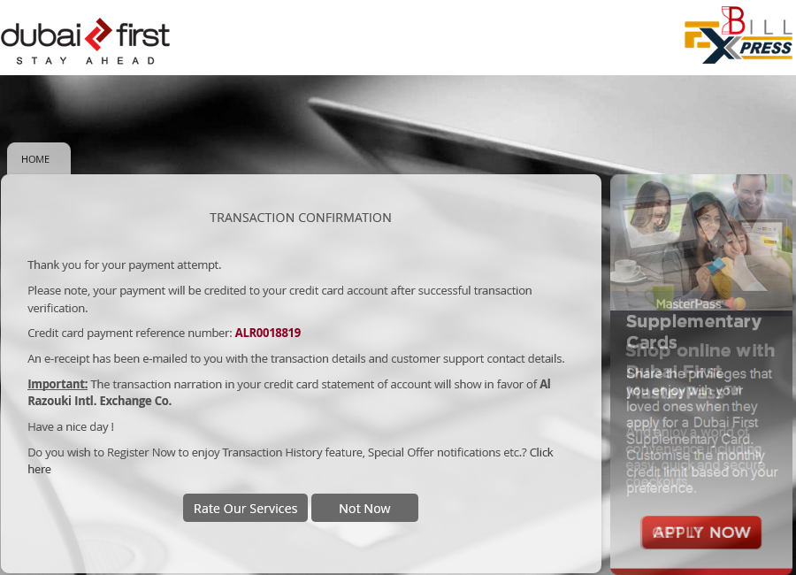
Screenshots – CC Bill Payment

Slide 7
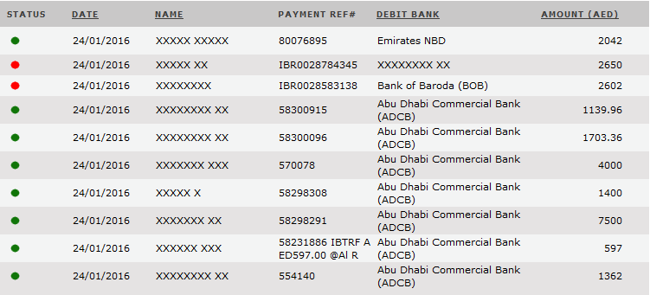
Screenshots – CC Bill Payment
Transaction view – Al Razouki

Slide 8
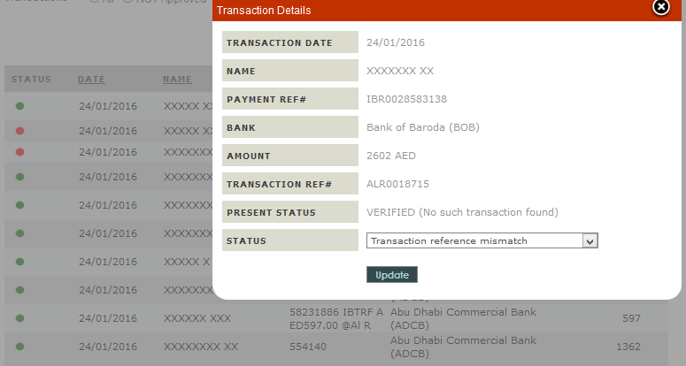
Screenshots – CC Bill Payment
Transaction approval by Al- Razouki

Slide 9
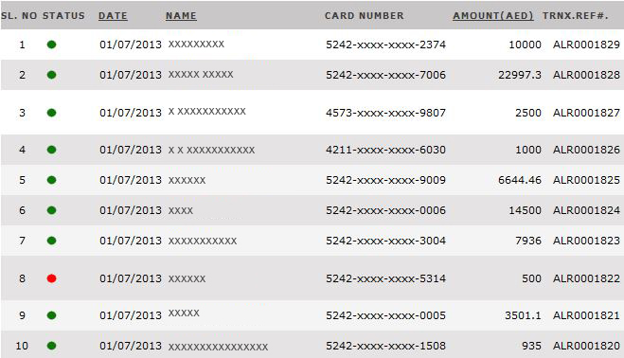
Screenshots – CC Bill Payment
Transaction view – Dubai First

Slide 10
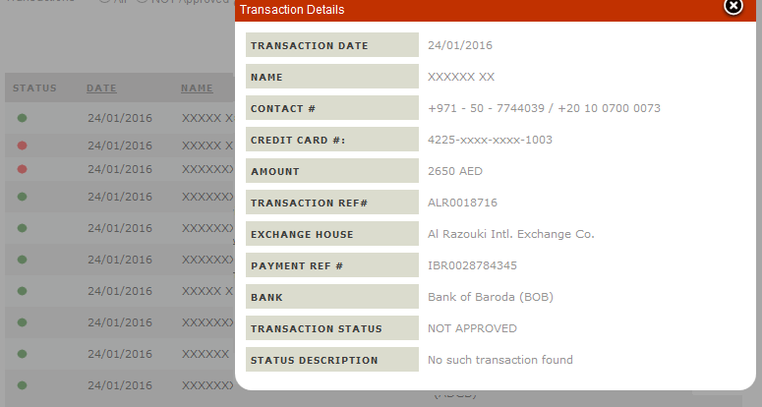
Screenshots – CC Bill Payment
Transaction detailed view – Dubai First

Slide 11

Ratheesh V S
Email: ratheesh.vs@prosumfzc.com
Emerging technologies Integrated business solutions
PROSUM Technologies LLC Suite No:217, Sheikh Rashid Bldg., P O Box 56272, Dubai, UAE Ph.: +971 4 2973236, +971 4 2974007

