Slide 1
General Features
Ebay Magento
Targeted towards small to Medium business (100M)
Only OSS in the magic quadrant
Large Ecosystem of 6000+ free and paid extensions.
Well Suited for backend integration (WS, rest api’s, ERP connectors)
Good for B2C & OK for B2C
Clients- Coca-Cola, Nike, Ford, Vizio
SAP Hybris
Targeted towards Medium to Large business (1B)
Third in the Magic Quadrant
Well suited to partner with the SAP ecosystem
SAP Connectors are expensive
Good for B2B and B2C
Clients – Aldo, Acics, Barbour

Slide 2
COST & TCO
EBAY Magento
Enterprise edition costs $20K per year
Support cost is higher than normal
Resource cost is higher than normal
Documentation is open and free
Typical implementation time:1-5 months
ROI: 176-159% payback in 5.2-5.8 months (Forrester Study)
SAP Hybris
Enterprise edition cost ~60K per year
Support cost is high
Resources are scarce and come at a high cost
Documentation is closed
Typical implementation time:7-9 months
Expensive to Scale

Slide 3
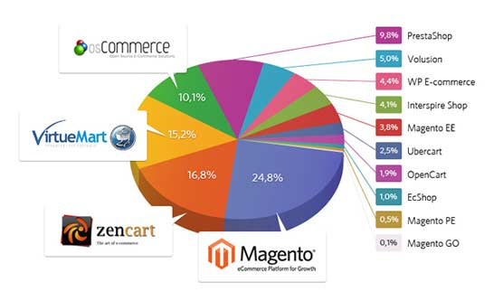
Market Share

Slide 4
In House knowledge of the Carrefour Systems
Product knowledge on C4 Web Store
Cart/Checkout
Data model updates
Delivery Slots
Discounts
Email / SMS / FTP
Facet
Rule based fraud management
Interfaces \w maxoptra, sendgrid, SMA/POS , icecat, Ogloba
GIMA / GICA / GS1 / icecat
Loyalty Cards
Newsletter
Order Management / Payment
Promotions / Voucher
Shopping list / Storefront
User Management
Web Content Management System
Product Information Management
Refunds and Returns
Pick Pack Application
Hybris integration services
Various third party integration services

Slide 5
Proposed Product Features
Implementation time between 5-12 months
Custom Integration
Multiple store management
C4 Product lifecycle & Implementation knowledge
On site product owners
Multi currency and language support
Inbuilt SEO and Marketing tools
Omni channel integration
Product information management, Product lifecycle management, Web content management, User management

Slide 6
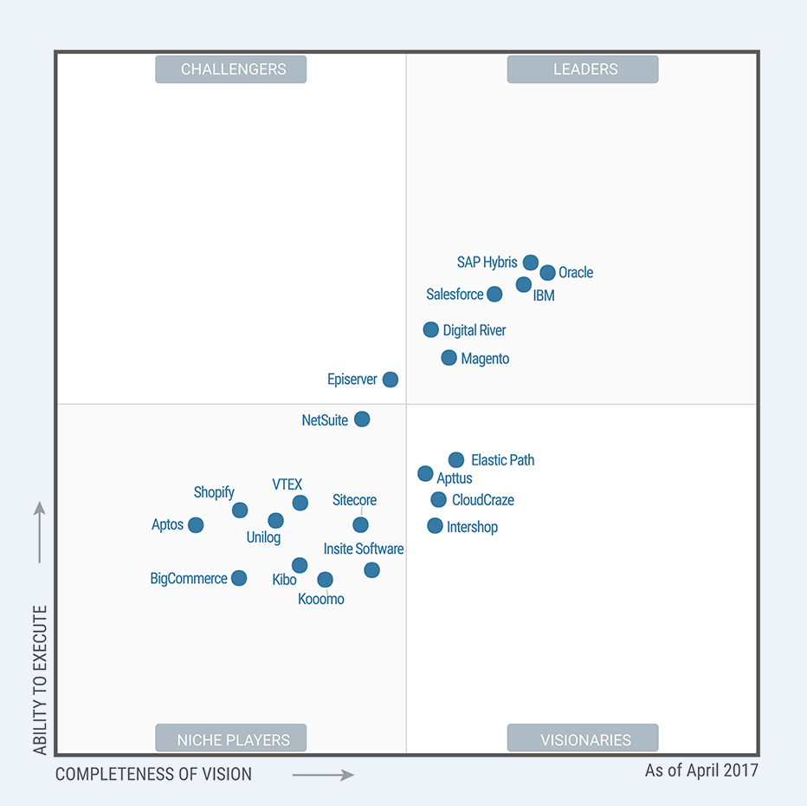
Gartner Magic Quadrant (2017)

Slide 7
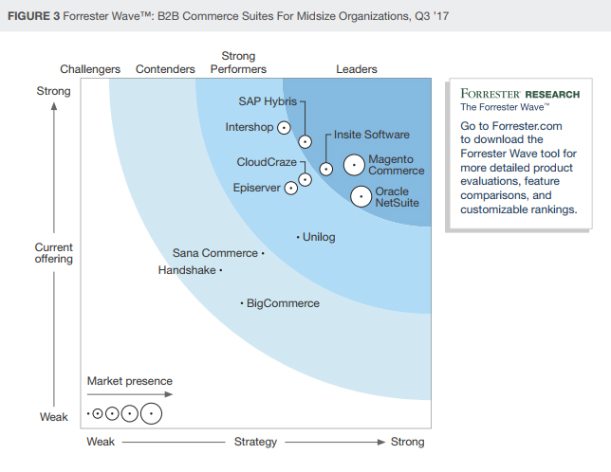
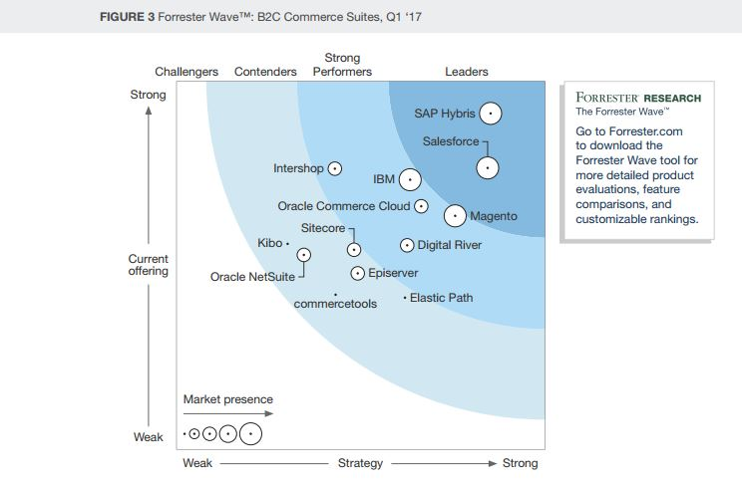
Forrester Research (2017)

